Slide 1
Interactive Code Review for Systematic Changes
Krishna Teja Ayinala

Slide 2
Problem and Motivation
It is hard to review a change in all locations for a thousands of lines of code during peer code review, whenever an update is made in the program.
A tool is needed to find a similar, related changes to multiple contexts, solving the issue of poor scalability and high rate of false positives.
CRITICS, a new approach for interactively inspecting systematic changes during peer code reviews which creates a context-aware , change template, extracting the surrounding control and data flow context.
CRITICS is used to inspect systematic changes and to detect potential missing or inconsistent updates iteratively.

Slide 3
Approach
Two studies were conducted to demonstrate the benefits of CRITICS
Professional software engineers at Salesforce.com were made to use CRITICS
Twelve participants reviewed patches with both CRITICS and eclipse diff
Professional software engineers said that CRITICS’s features to detect missing or inconsistent edits was valuable to their team and its interactive usage was appropriate for novice developers to learn about the codebase
In the second study, with the assistance of CRITICS, human subjects answered questions about systematic changes 47.3% more correctly and 31.9% faster on average in comparison with the baseline use of Eclipse diff.

Slide 4
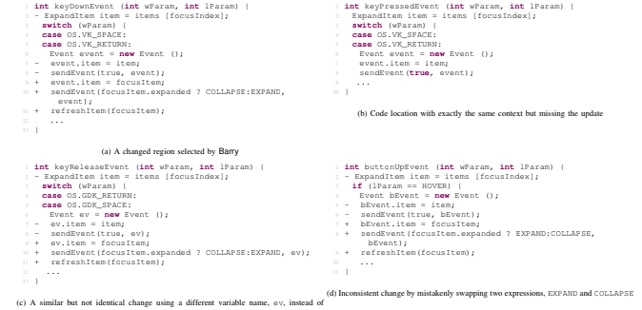
Motivating Example

Slide 5
Example
To update the program to use the new sendEvent API, the reviewer needs to inspect line level differences file by file to find incorrect edits.
In iteration 1, the reviewer inspects changes in keyDownEvent method in the above figure 1(a) and selects the changed code in the diff patch, CRITICS identifies the change context and serves as an anchor to locate missing updates.
In iteration 2, CRITICS allows the reviewer to generalize change template by parameterizing type, variable and method names. The reviewer generalizes the variable name Event and searches again. Ev is used as a variable name to summarize location in Figure 1(c)
In iteration 3, CRITICS includes the changes in control flow contexts, here it locates buttonUpEvent in figure 1(d)

Slide 6
Critics: Interactive Code Review for Systematic Changes
If anything mistakenly swapped during any updates or any hidden modifications which is hard for the reviewer to detect during code inspection, CRITICS finds the location, finds the context, generalizes and locates similar changes in control flow statements.

Slide 7
CONTEXT EXTRACTION
CRITICS parses the selected changed fragments into Abstract Syntax Tree(AST) edits and extracts the change context.
The selected edits are are control and data dependent by performing static intra procedural slicing.
Data dependence
Control dependence

Slide 8
Change Template Customization
Here CRITICS allows reviewer to customize the template by generalizing its content and to iteratively refine template.
Two things were done here
Parameterizing Identifiers
Excluding statements

Slide 9
Matching and anamoly Detection
Here CRITICS searches and summarizes systematic changes of a given customized change template
CRITICS apply an efficient and worst-case optimal tree matching algorithm, Robust Tree Edit Distance(RTED), which combines the strength of Zhag’s algorithm and De-maines’s algorithm
Each template consists of before and after state
If a method matches before state, but not after state it implies that the programmer either made an incorrect edit or forgot to update the code
If a method matches the after state but not the before state, CRITICS reports it as an anamaly

Slide 10
Evaluation: Research Questions
How accurately does a reviewer locate similar changes with CRITICS in comparison to Eclipse Diff and search?
How correctly can a reviewer detect change anomalies with CRITICS in comparison with Eclipse diff and search?
How much time can a reviewer save in a code review task when using CRITICS?
What kind of challenges were faced while conducting code reviews?
In which situation CRITICS will be helpfull while reviewing?
How do they like or dislike CRITICS?
Do they want to have CRITICS as the code review tool integrated to their currently using tool?

Slide 11
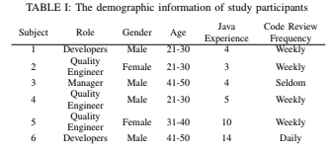
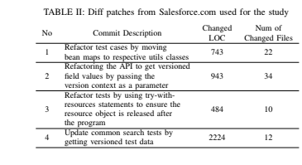
Evaluation Design
Evaluation was done using two methods
User study with professors and developers at Salesforce

Slide 12
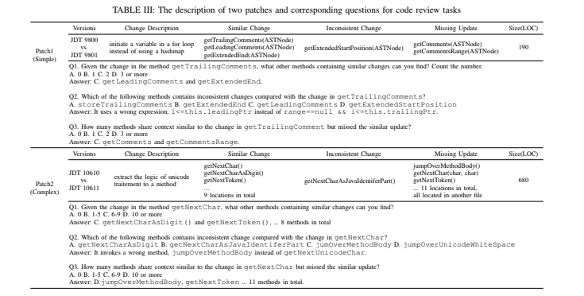


Slide 13
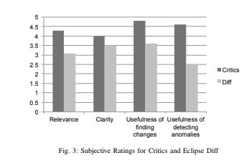
Ratings

Slide 14
Evaluation Result for RQ1
10 out of 12 participants answered question 1 correctly about similarly changed locations with CRITICS and 5 out of 12 did with Eclipse diff.
Patch 2 required more template configuration and search iterations in CRITICS and participants stopped refining after two or three iterations where customized template was still not general enough to find similar changes
Eclipse diff provided unstable results depending on the choice of the keywords

Slide 15
Evaluation Result for RQ2
Detecting inconsistent changes
All 12 participants found inconsistent change locations correctly with CRITICS, only 7 out of 12 with Eclipse diff
Detecting missing updates
11 out of 12 participants pinned all missing updates correctly with critics, while only 4 out of 12 found with Eclipse diff
Task completion time
Participants saved 6 min 13 secs with CRITICS with 31.9% task done, faster than Eclipse diff

Slide 16
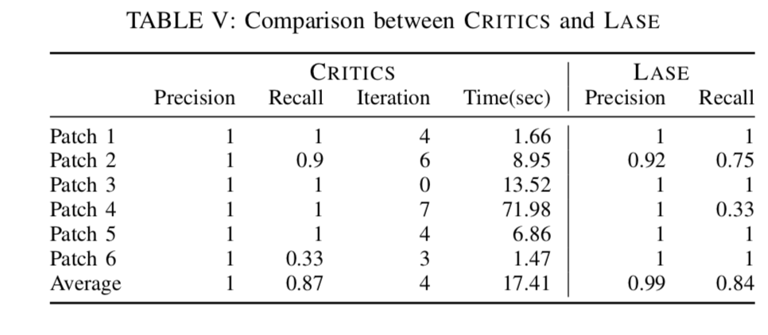
Evaluation Result for RQ3

Slide 17
Limitations
EXTERNAL VALIDITY
The study at Salesforce broughts a limitation of how much productivity gain CRITICS can provide in comparison to their current code review, COLLABORATOR

Slide 18
Conclusion and Future Work
CRITICS is a great approach for searching systematic changes and detecting potential anomalies during peer code review when compared to Eclipse diff.
It help developers to comprehend the underlying latent structure of diff patch and locate missed or inconsistent updates during peer code review

