Slide 1
Creditcore
Automated Academic Progress and Degree Audit Tracking System
Project Team
Academic Details
Department
Batch
K. Tejaswanth - 2300031638
Computer Science & Engineering / AI & Data Science
Y23 B.Tech
Project Guide
K. Pavani - 2300033843
Domain
Dr. K. Sripath Roy
Education
N. Sowjanya - 2300031099
P. Pradeepthi - 2300031006

Slide 2
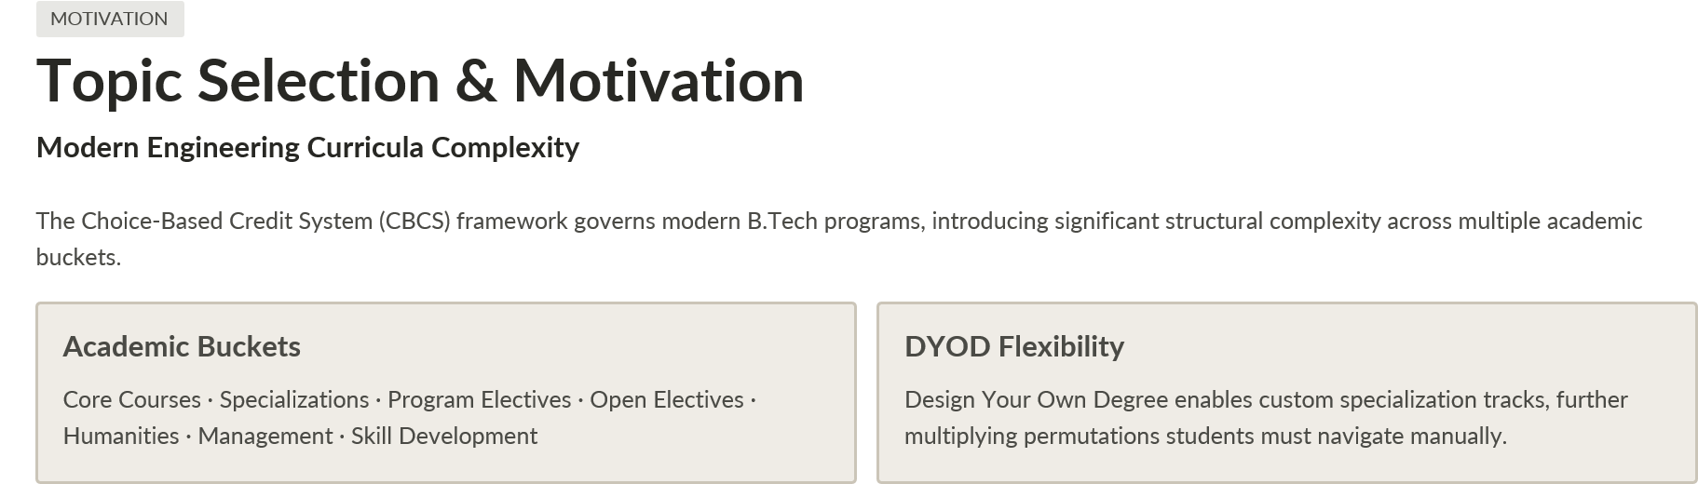
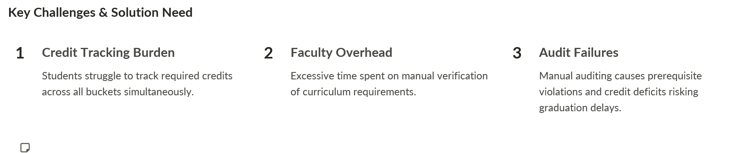
Real-time automated academic progress tracking and degree audit is the imperative solution.

Slide 3

Problem Statement & Existing Limitations
Existing System Limitations
Administrative Challenges
Grade-Only Output
No Cohort Dashboards
Traditional ERP systems surface only semester marks and grades (SGPA/CGPA) — no category-aware degree auditing.
Faculty lack monitoring tools for cohort-level academic progress and at-risk student identification.
No Bucket Visibility
Paperwork-Driven Processes
Students cannot identify remaining bucket credits or determine prerequisite eligibility for upcoming courses.
Manual course additions and substitutions require physical paperwork with high approval latency.
Static Curriculum Tools
No Prerequisite Validation
No simulation or roadmap generation for future semester planning under CBCS or DYOD tracks.
Zero real-time validation of prerequisite chains leads to enrollment errors and curriculum non-compliance.
Impact: Graduation delays, credit deficits, and inefficient academic governance across entire cohorts.

Slide 4
LITERATURE REVIEW & RESEARCH GAP
Literature Review & Research Gap Analysis
Literature Findings
Gap Analysis: Existing ERP vs. Creditcore
1
Degree Audit & DARS Systems
Parameter | Existing ERP Systems | Proposed Creditcore
Audit Engine | Static semester-wise grades only | Real-time multi-bucket credit fulfillment audit
Curriculum | Fixed rigid degree pathways | Dynamic DYOD / Specializations
Advising Workflows | Manual paperwork and email chains | RBAC with instant course approval flow
Bulk Administration | Slow record-by-record data entry | High-speed Excel batch ingestion
Automated degree audit engines reduce completion time and decrease administrative advising bottlenecks by over 40%.
2
Interactive Dashboards in HE
Visual progress tracking via circular meters and category breakdowns improves student self-regulation and on-time course registration.
3
CBCS Optimization Research
Multi-bucket credit mapping complexity in Indian universities demands rule-based validation engines to prevent graduation credit shortfalls.

Slide 5
OBJECTIVES
Research Objectives
Creditcore is designed around five core engineering objectives that directly address the identified gaps in existing academic management systems.
1
Automated Degree Audit Engine
Real-time evaluation of completed course credits against curriculum requirements across all CBCS buckets simultaneously.
2
DYOD & Degree Path Planner
Dynamic roadmap generator for Honors, Minors, and Specialization tracks under the Design Your Own Degree framework.
3
Role-Based Access Control (RBAC)
Secure multi-tier system serving Students, Faculty Advisors, and Department Admins with role-appropriate data and workflows.
4
Bulk Upload Administration
Automated Excel parsers for curriculum schemas, course mappings, and student records — eliminating manual data entry overhead.
5
AI-Assisted CI/CD & Notifications
Zero-downtime deployment pipeline with automated PR reviews via CodeRabbit AI and instant SMTP alerting for academic events.

Slide 6
SCOPE
Research Specification & Scope
Target Curricula
Module Coverage
KL University
🎓 Student Module
👨‍🏫 Faculty Module
⚙️ Admin Module
B.Tech Programs
Profile management & degree roadmap visualization
Bucket progress tracking & course history
Add/swap course requests with real-time validation
Student roster and cohort statistics
Academic audit approval workflow
Department configuration & curriculum creation
Bulk course/mapping uploads
Report generation
Y23 CSE
Computer Science & Engineering
Y23 AI&DS
Artificial Intelligence & Data Science
Non-Functional Requirements
Response time: < 200 ms for all audit calculations
JWT-based stateless authentication
BCrypt password security

Slide 7




METHODOLOGY
Proposed Methodology
Creditcore was engineered through a structured four-phase development methodology, progressing from raw data extraction to a production-grade CI/CD pipeline.
Phase 1
Phase 2
Data Extraction & Modeling
Ingest university curriculum handbooks via Python scripts; create relational database schemas.
Backend Engine Development
Build Spring Boot REST APIs; implement credit aggregation, prerequisite checking, and bucket completion logic.
Phase 3
Phase 4
Frontend Integration
Construct React 19 SPA with glassmorphic cards, responsive UI, and interactive progress bars.
Automated Validation & CI/CD
Maven unit tests, ESLint checks, Vite builds, and CodeRabbit AI-assisted pull request reviews.

Slide 8
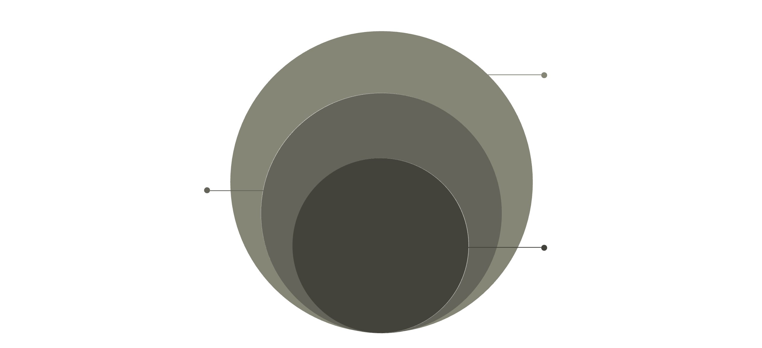
ARCHITECTURE
System Architecture Overview
Creditcore follows a strict three-layer architecture ensuring clean separation of concerns between presentation, business logic, and data persistence.
🖥 Presentation Layer
⚙️ Application Layer
🗄 Data Layer
React 19 + Vite + React Router
Student Dashboard · Faculty Review Portal · Admin Portal
Crimson & Alabaster UI with glassmorphism design system
Spring Boot (Java 21) with Spring Security
JWT stateless authentication & RBAC enforcement
Audit Engine · Degree Path Controller · RBAC Services
PostgreSQL relational database
Supabase or Docker PostgreSQL deployment
HikariCP connection pooling for performance
Data
PostgreSQL with HikariCP connection pool
Application
Spring Boot with JWT RBAC and audit engine
Presentation
React 19 SPA sends HTTP/JSON requests

Slide 9
BACKEND ARCHITECTURE
Backend Architecture
Spring Boot 3.x — Java 21 Core Stack
Key REST API Controllers
Security
StudentController
BucketProgressController
Spring Security + JWT RBAC + BCrypt password hashing for all user tiers
Academic audit, student profile, and course enrollment history endpoints
Credit fulfillment per category: Core, Electives, Humanities, Management, Skill Development
ORM & Persistence
Spring Data JPA / Hibernate with HikariCP connection pooling
DegreePathController
CurriculumAdminController
Authentication
Degree completion roadmaps and path recommendations for DYOD tracks
Course structure and curriculum management for department administrators
Stateless JWT tokens with expiring password reset tokens
CurriculumBulkUploadController
Faculty, SuperAdmin & ReportController
Excel batch uploads for courses and course-curriculum mappings
Role-specific operations, system administration, and academic report generation

Slide 10
PROGRESS
Initial Implementation & Progress
Creditcore's core components are rapidly advancing, with key functionalities already implemented and tested across the backend, database, frontend, and CI/CD pipeline.
Backend
Database
Frontend
CI/CD
100% operational core REST APIs, including secure JWT authentication, robust password recovery mechanisms, and advanced audit calculation services.
Fully normalized relational schema established, with comprehensive baseline data loaded for both Y23 CSE and AI&DS curricula, ensuring system readiness.
Functional student, faculty, and admin interfaces, featuring real-time credit charts for visual progress tracking and efficient batch student registration.
Automated backend build pipeline, meticulous frontend linting checks, and robust Docker verification steps integrated for continuous delivery and quality assurance.

Slide 11
FEATURES
Core System Features
Creditcore streamlines academic management with a suite of powerful, interconnected features designed for efficiency and accuracy.
Automated Degree Audit Engine
Bucket-wise Credit Tracking
Personalized Degree Roadmaps
Real-time validation of all completed credits against program requirements and academic policies.
Monitors credit fulfillment across core, elective, and specialized academic categories for precise progress.
Dynamic visualization of academic progression and future course planning to guide students effectively.
Design Your Own Degree (DYOD)
Prerequisite Validation
Role-Based Access Control (RBAC)
Supports flexible academic planning for Honors, Minors, and specialized tracks under the DYOD framework.
Automatically checks and enforces course prerequisites during enrollment to ensure academic integrity.
Secure access levels tailored for students, faculty advisors, and administrators with appropriate permissions.
Bulk Excel Ingestion
Comprehensive Curriculum Management
Intuitive User Portals
Streamlined import of curriculum data, course mappings, and student records via Excel files.
Tools for creating, editing, and managing all academic program structures and course definitions.
Dedicated dashboards and workflows for students, faculty, and administrative staff for enhanced usability.

Slide 12

User Roles & Workflow
Creditcore is designed with distinct user roles, each accessing tailored portals to streamline specific academic processes and ensure secure, efficient operations.
Student Portal
Faculty Portal
Admin Portal
View academic progress
Track credits & bucket progress
View personalized degree roadmap
Request course additions/swaps
Monitor student progress
Review academic performance
View cohort statistics
Approve academic requests
Manage users & permissions
Configure departments & curriculum
Bulk upload course/mapping data
Generate comprehensive reports
Faculty Review
Approve or deny requests promptly
Student Request
Admin Management
Submit forms and supporting documents
Oversee system and audit actions

Slide 13




OUTCOMES
Expected Outcomes & Impact
Creditcore is poised to deliver significant improvements in academic efficiency, student success, and administrative control, transforming the way higher education institutions manage their degree programs.
Zero Credit Deficit Surprises
80% Reduction in Advising Time
Centralized Curriculum Lifecycle
Proactive, real-time warnings for unmet course requirements, ensuring students stay on track.
Streamlined faculty verification and approval processes, freeing up valuable advisor resources.
Dynamic and unified management of all curriculum, prerequisite, and specialization definitions.
A key measurable outcome is the 80% reduction in advising time, allowing faculty to focus on mentorship rather than administrative tasks.

Slide 14
IMPACT & BENEFITS
System Impact & Benefits
Creditcore is designed to deliver transformative advantages across all levels of the academic institution, fostering efficiency, clarity, and empowerment for every stakeholder.
Students
Faculty
Administrators
University
Better academic planning
Clear credit visibility
Reduced graduation uncertainty
Reduced manual auditing
Faster approvals
Cohort monitoring
Centralized curriculum management
Bulk data ingestion
Automated reporting
Improved academic governance
Scalable degree auditing
Reduced administrative workload

Slide 15

SUMMARY
Conclusion
Creditcore fundamentally redefines academic administration by converting complex, manual processes into a seamless, intelligent platform. Our solution offers unparalleled clarity and efficiency across the entire institution.
01
02
Automated Audit Platform
Modern Tech Stack
Transforms manual academic record tracking into an efficient, automated audit system.
Combines a dynamic React frontend with a robust Spring Boot backend for optimal performance.
03
04
Real-time Tracking
Multi-User Support
Provides instant credit and degree progress updates for all users.
Tailored experiences for students, faculty, and administrators, enhancing their unique workflows.
05
06
Flexible Planning
Enhanced Governance
Enables Design Your Own Degree (DYOD) and comprehensive specialization planning.
Significantly improves academic governance and data-driven decision-making.

Slide 16
REFERENCES
Supporting Research & Documentation
Our methodology and system design are grounded in established academic research and robust technical documentation, ensuring both pedagogical efficacy and technical excellence.
NADA: NMSU Advising Degree Audit System -https://www.researchgate.net/publication/2806123_NADA_NMSU_Advising_Degree_Audit_System
Incorporating an LMS learning analytic into proactive advising: Validity and use in a randomized experiment - ScienceDirect
Degree Audit Reporting System (DARS): What Works and What is Needed
Associations between learning analytics dashboard exposure and motivation and self-regulated learning - ScienceDirect

Slide 17

Thank You
Creditcore enables students and academic teams to make faster, clearer, and more informed degree-planning decisions.

