Slide 1
SOFTWARE-DEFINED
EVERYTHING
kate temkin / michael ossmann
supercon 2019

Slide 2
Katherine/Kate Temkin (@ktemkin):
software lead hardware hacker at Great Scott Gadgets
open-source-tool-builder
educational (reverse) engineer
Michael Ossmann (@michaelossmann):
founder of Great Scott Gadgets
Software-Defined Radio enthusiast, educator
hardware designer

Slide 3
software defined: specialized stuff
made without specialized hardware

Slide 4
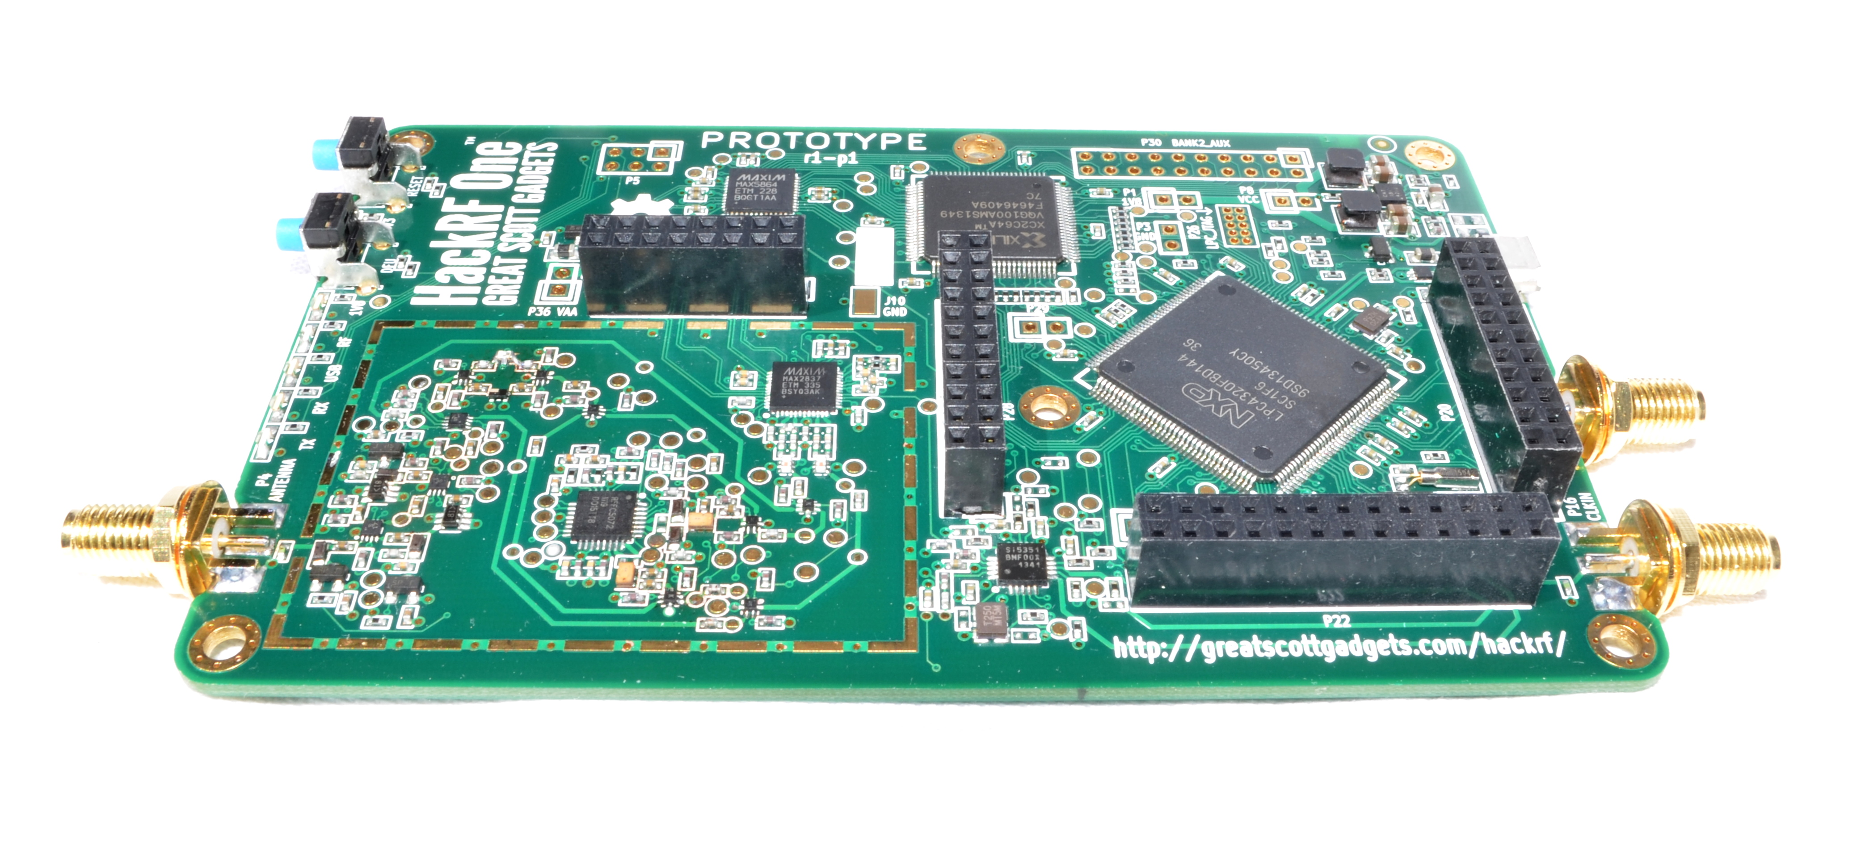
SOFTWARE DEFINED RADIO

Slide 5
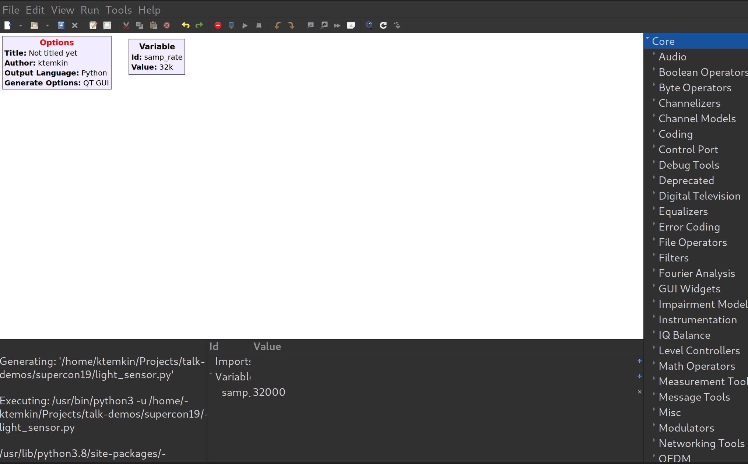
GNURADIO COMPANION

Slide 6
[time domain demo]

Slide 7
[frequency domain demo]

Slide 8
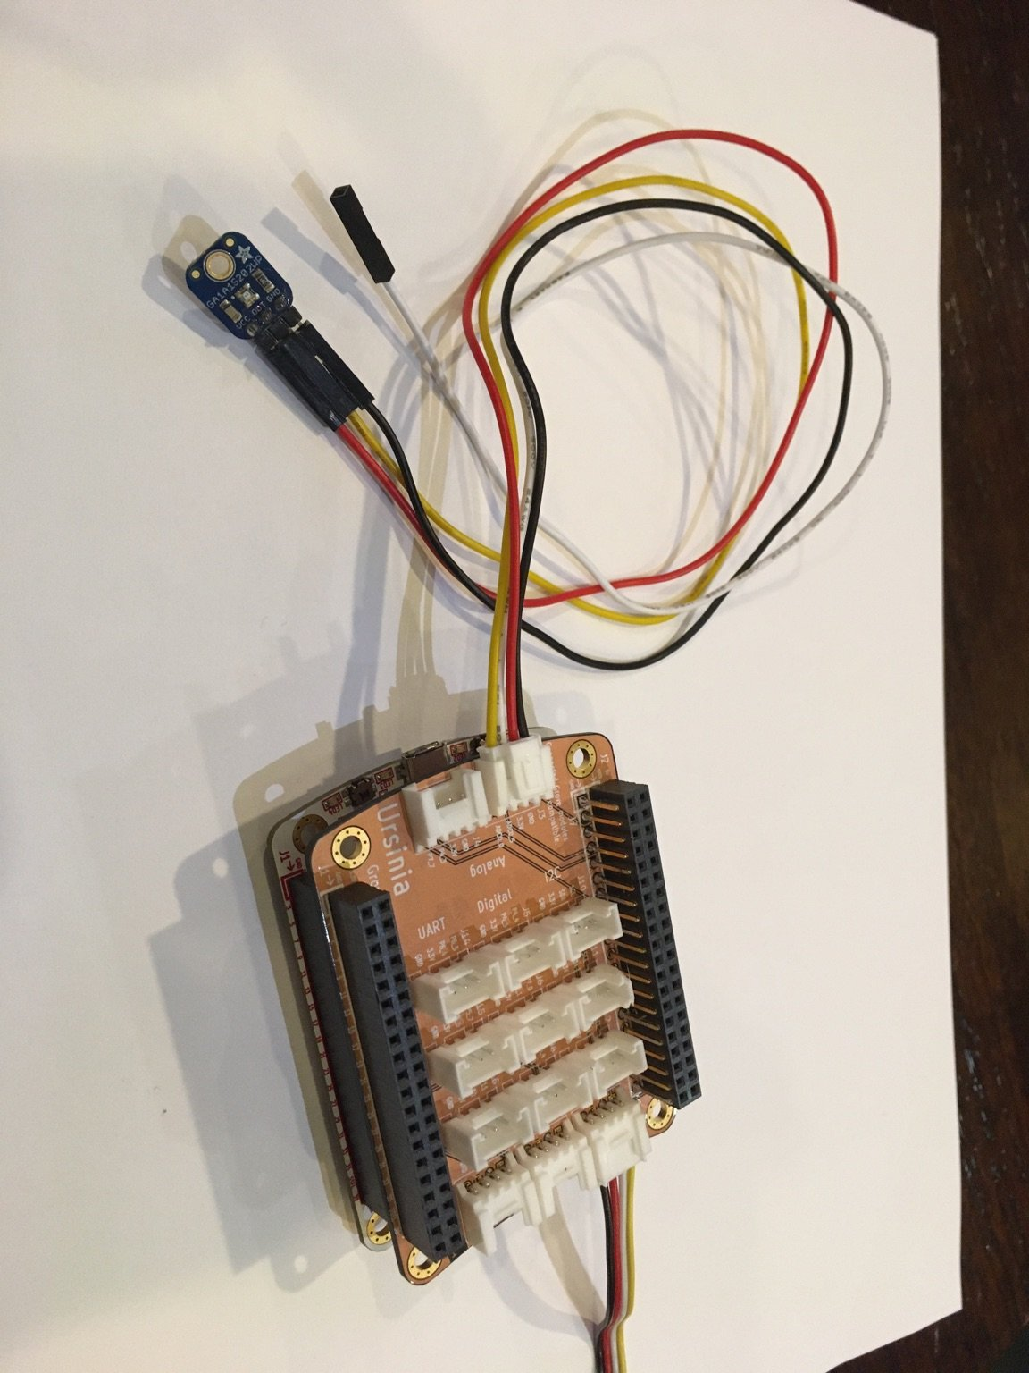

Slide 9
GREATFET ONE
USB INTERFACE TO THE WORLD

Slide 10
LIGHT SENSOR
LOG-SCALE, ANALOG

Slide 11
[interfacing demo]

Slide 12
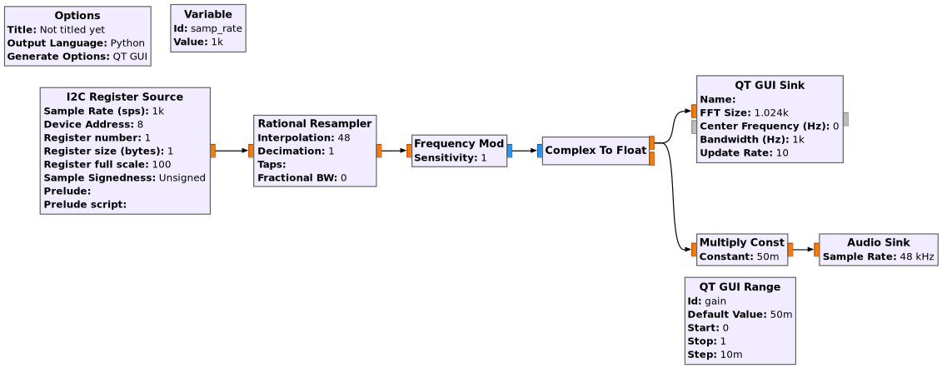

Slide 13
[more sensors]

Slide 14
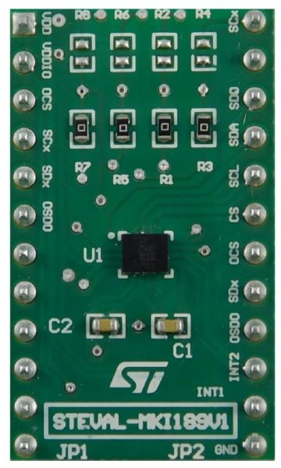
LSM6DSM
ACCELEROMETER

Slide 15
LSM6DSM
ACCELEROMETER
MICROPHONE

Slide 16
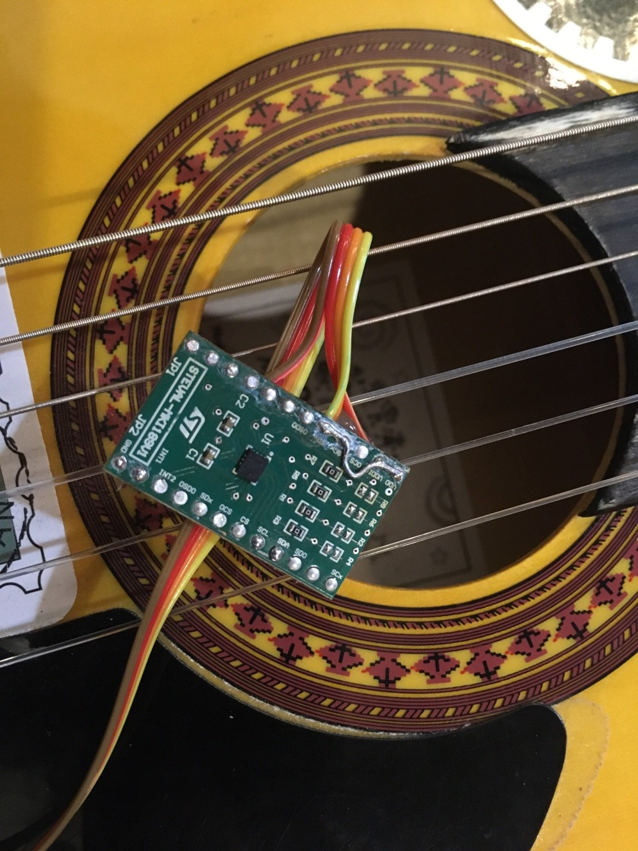
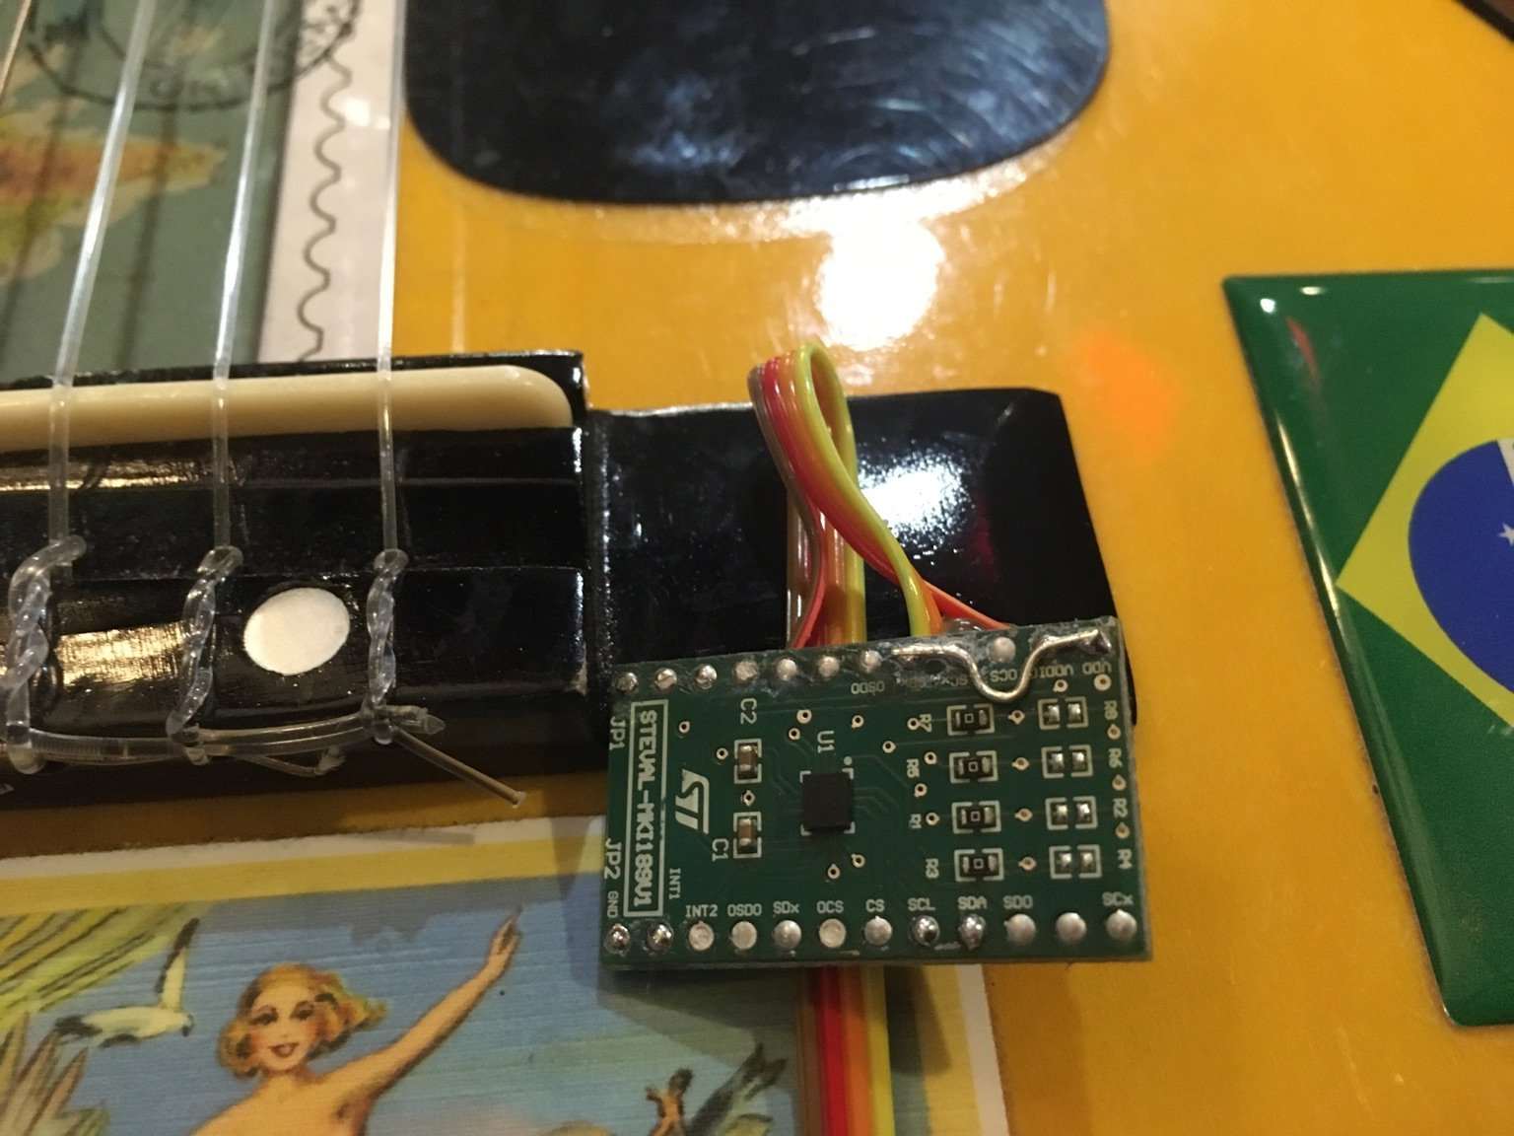

Slide 17
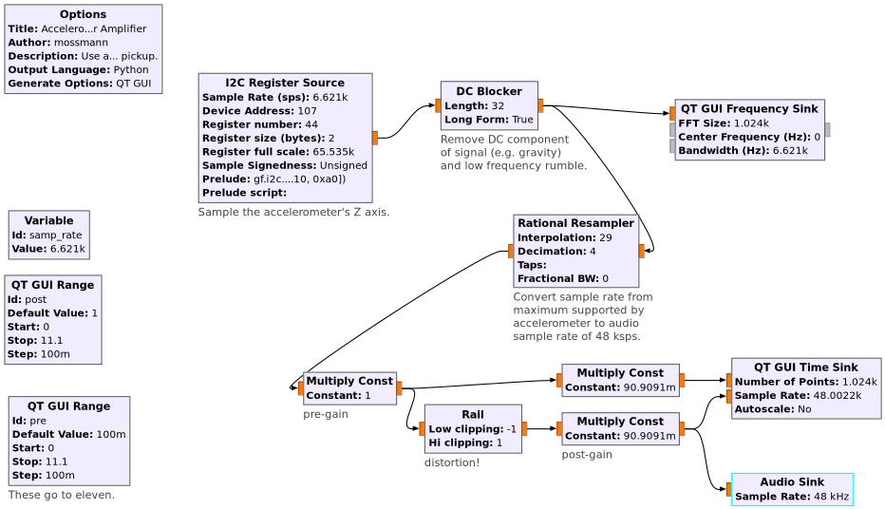

Slide 18
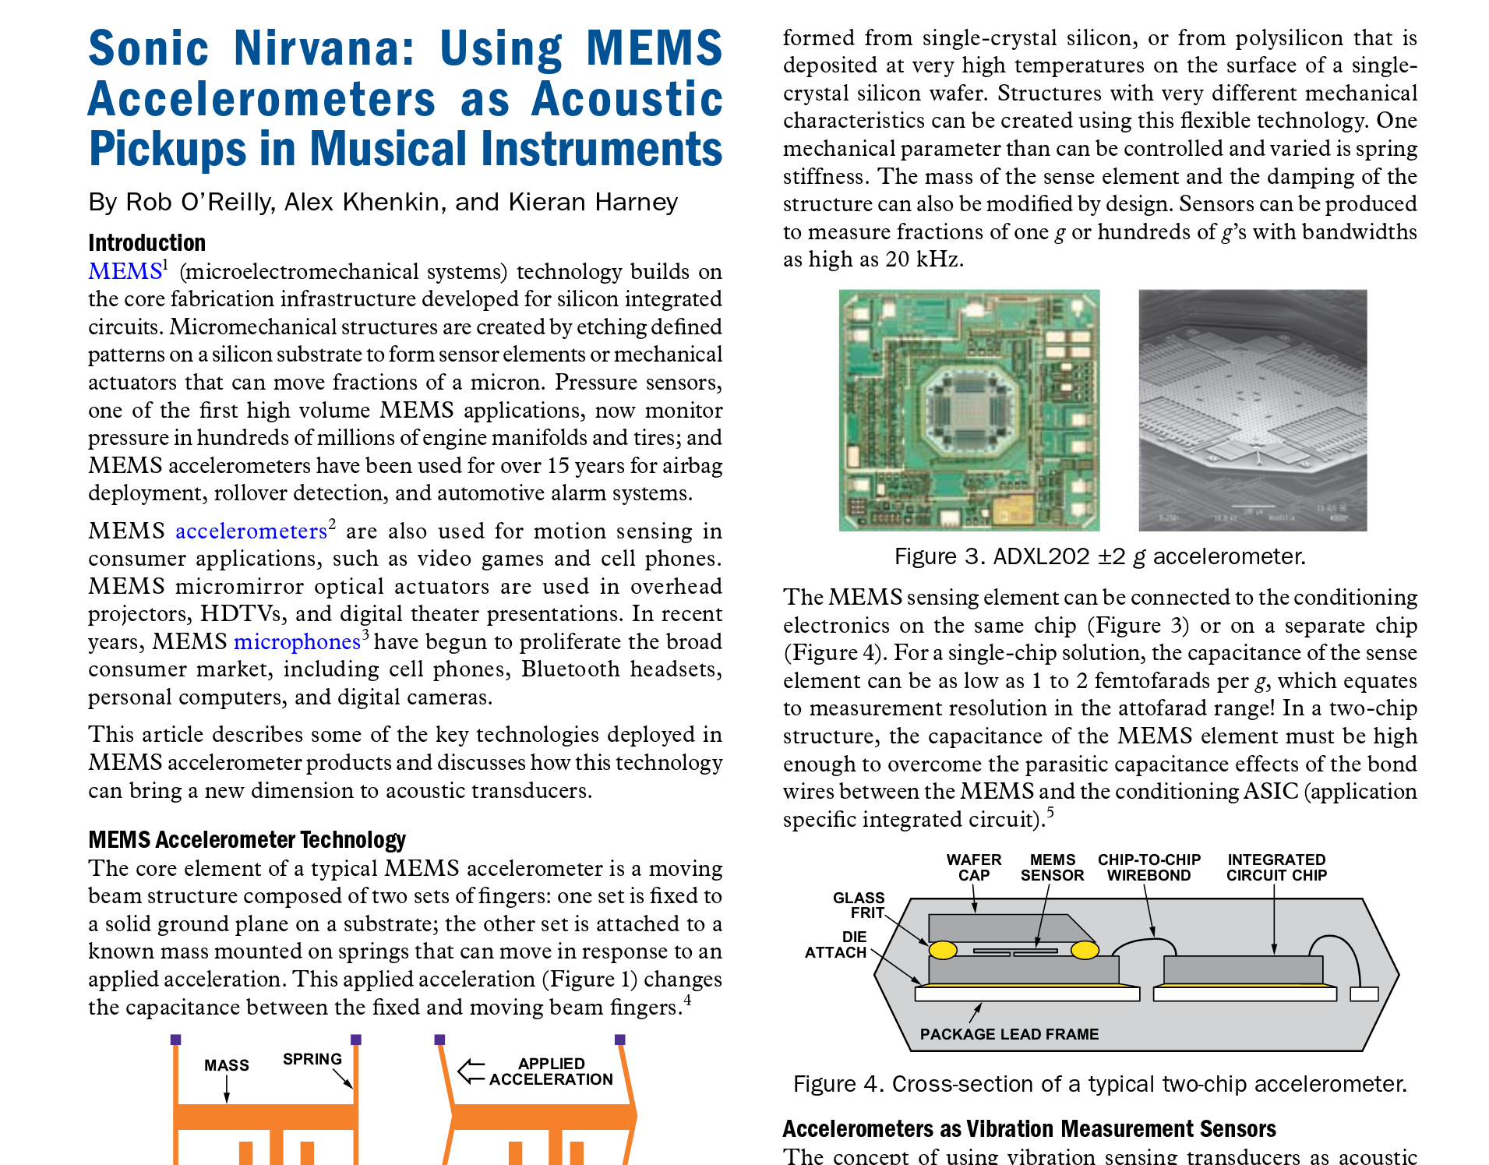

Slide 19
All code & demos are online!
https://github.com/greatscottgadgets/greatfet
https://github.com/ktemkin/presentations

Slide 20
QUESTIONS?

Slide 21


