Slide 1


DEVELOPING LOW-COST USB TOOLS
ACCESSIBLE USB
:
KATE TEMKIN • MIKAELA SZEKELY
TEARDOWN 2019

Slide 2


SO, WHO are YOU?
Katherine/Kate Temkin (@ktemkin):
software lead, Great Scott Gadgets
glitch witch & open-source-tool-builder
educational (reverse) engineer
lauded by the Daily Mail as a “cyber criminal”
Mikaela Szekely (@Qyriad):
student, and yet master*
got a bit too deep in some open-source USB stuff
apparently better at cybercrime (not caught by the Daily Mail)

Slide 3
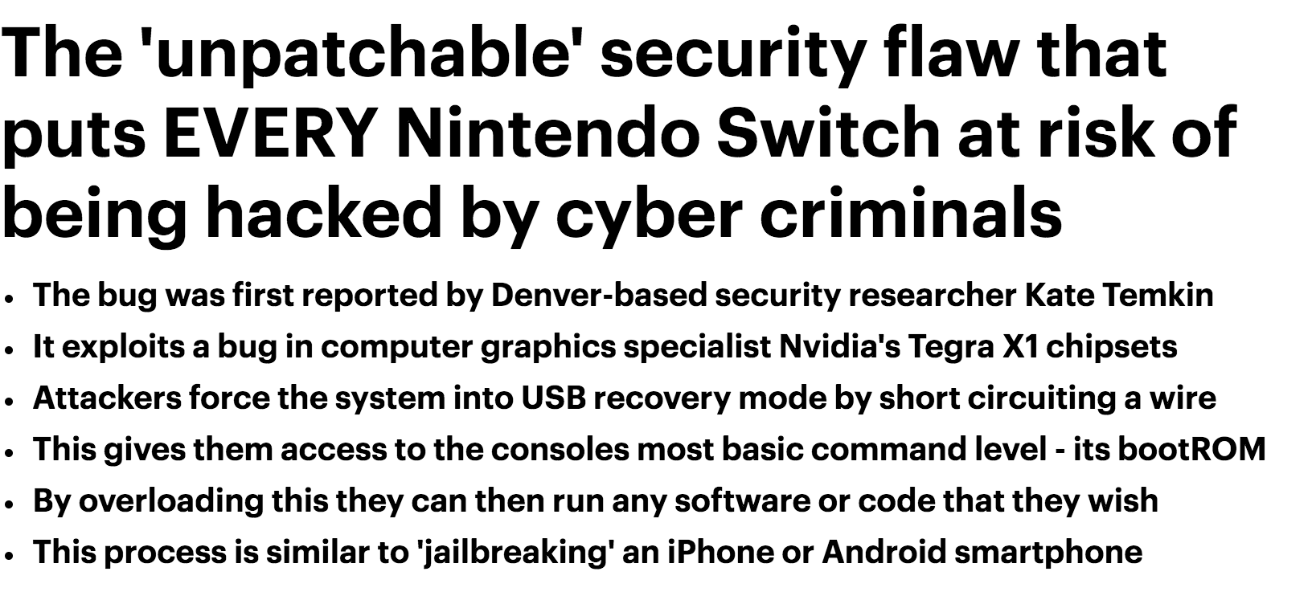



Notes:
And we’ve got some really interesting devices whose software stacks have been hardened to all hell

Slide 4
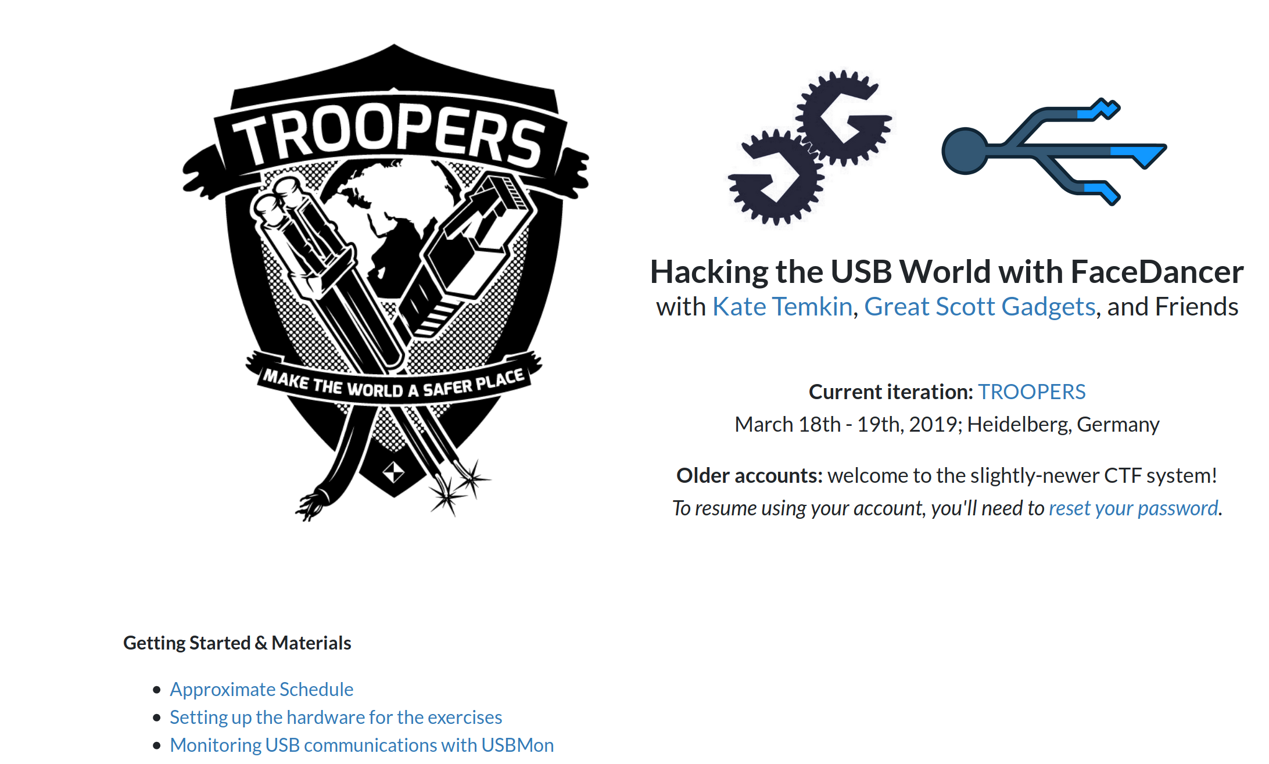
https://usbc.tf

Slide 5
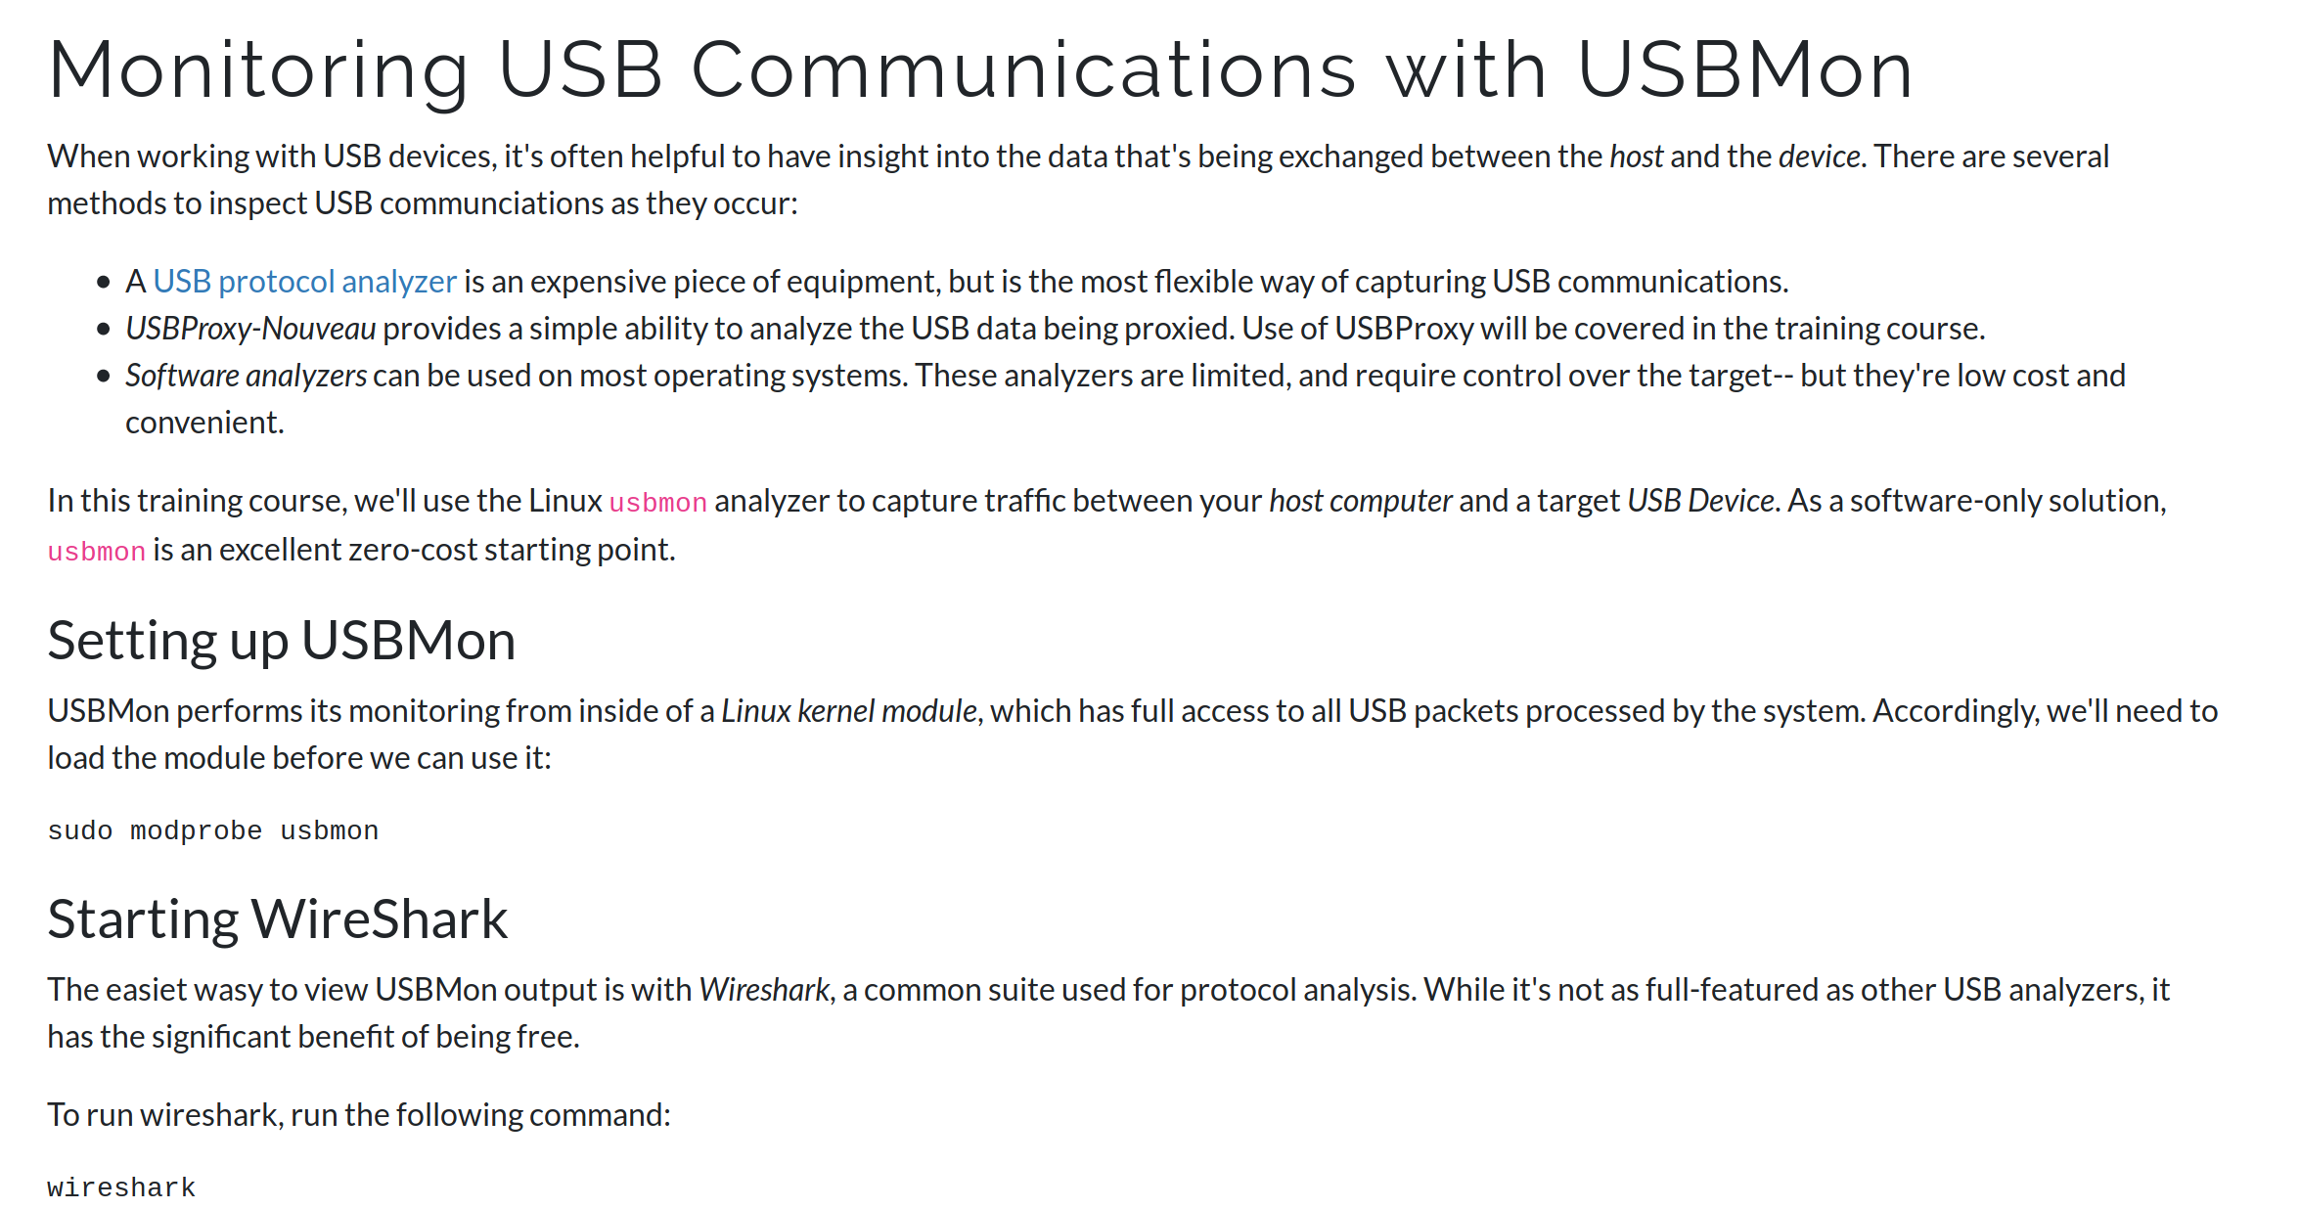

Slide 6
LET’S LOOK AT
WIRESHARK

Slide 7
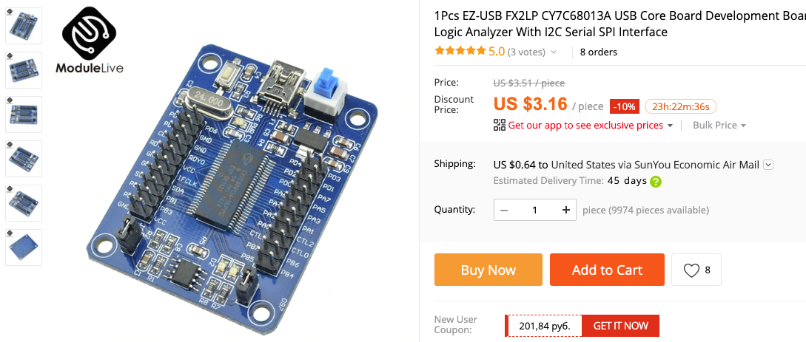
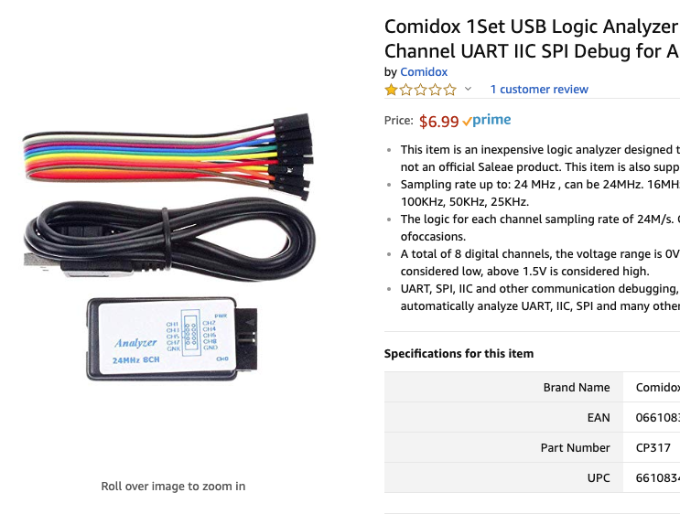
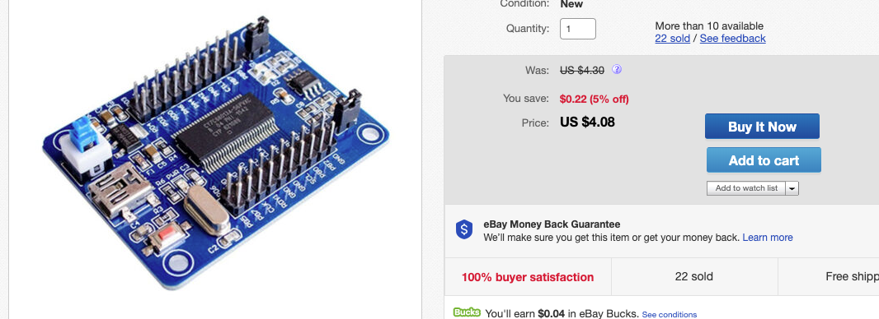
SUPER-CHEAP USB ANALYSIS
Super-cheap FX2 “LA” boards are really freaking cheap, and can capture up to 24MHz via Sigrok.
That’s enough for LS/FS USB!

Slide 8
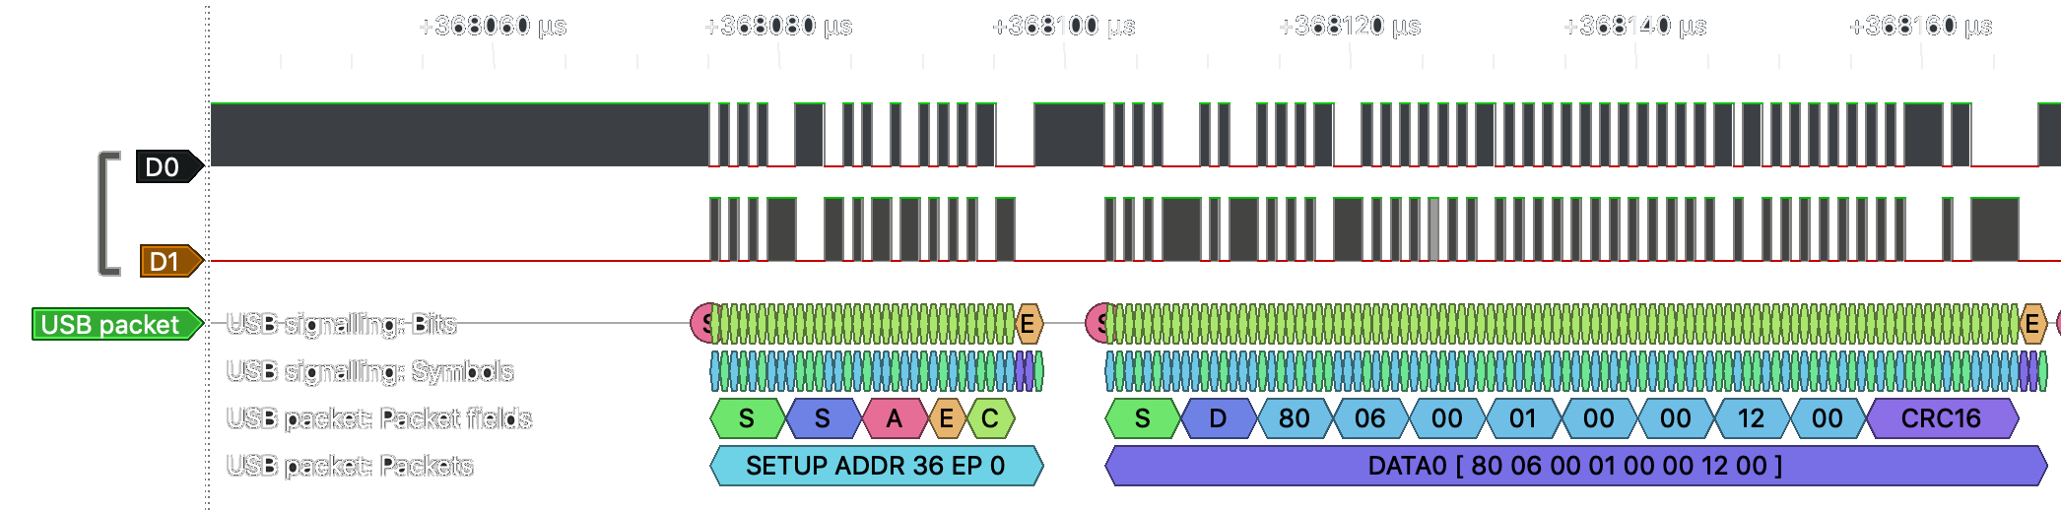
SIMPLE LS / FS ANALYSIS
REQUEST DECODE WITH SIGROK? YEP
DOES IT GO FAR ENOUGH? ...NOT REALLY

Slide 9
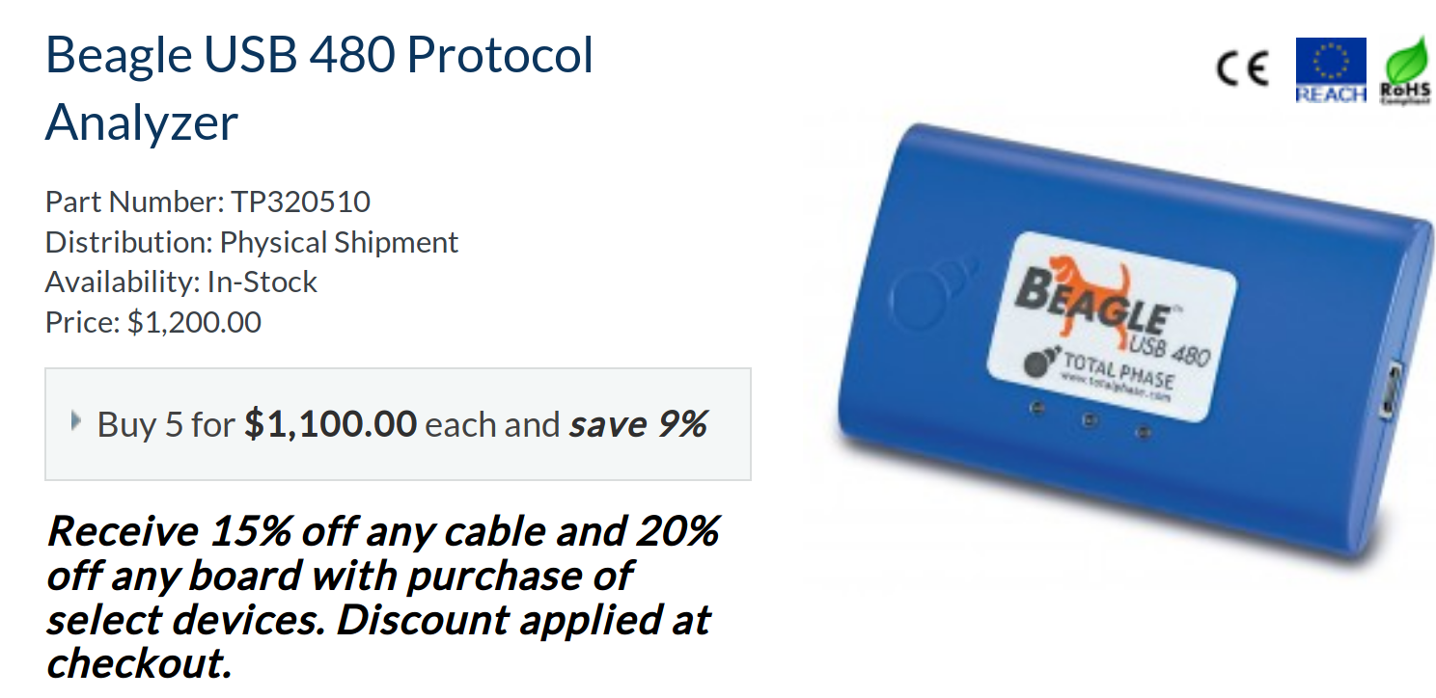
THE “STATE OF THE ART” IN HS ANALYSIS
Extremely useful tools...
…with extremely inaccessible price tags.

Slide 10
WAIT,
ISN’T USING USB
SUPER COMPLICATED?
– engineers who can’t decode USB
because analyzers are too damned expensive

Slide 11
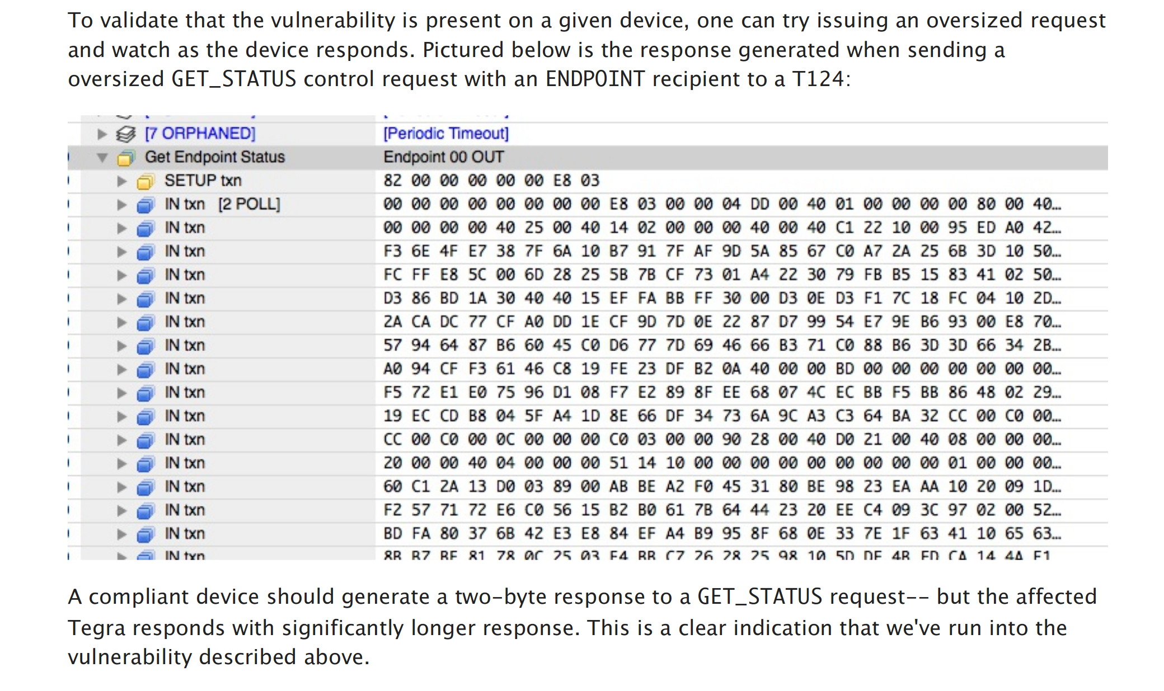

Slide 12
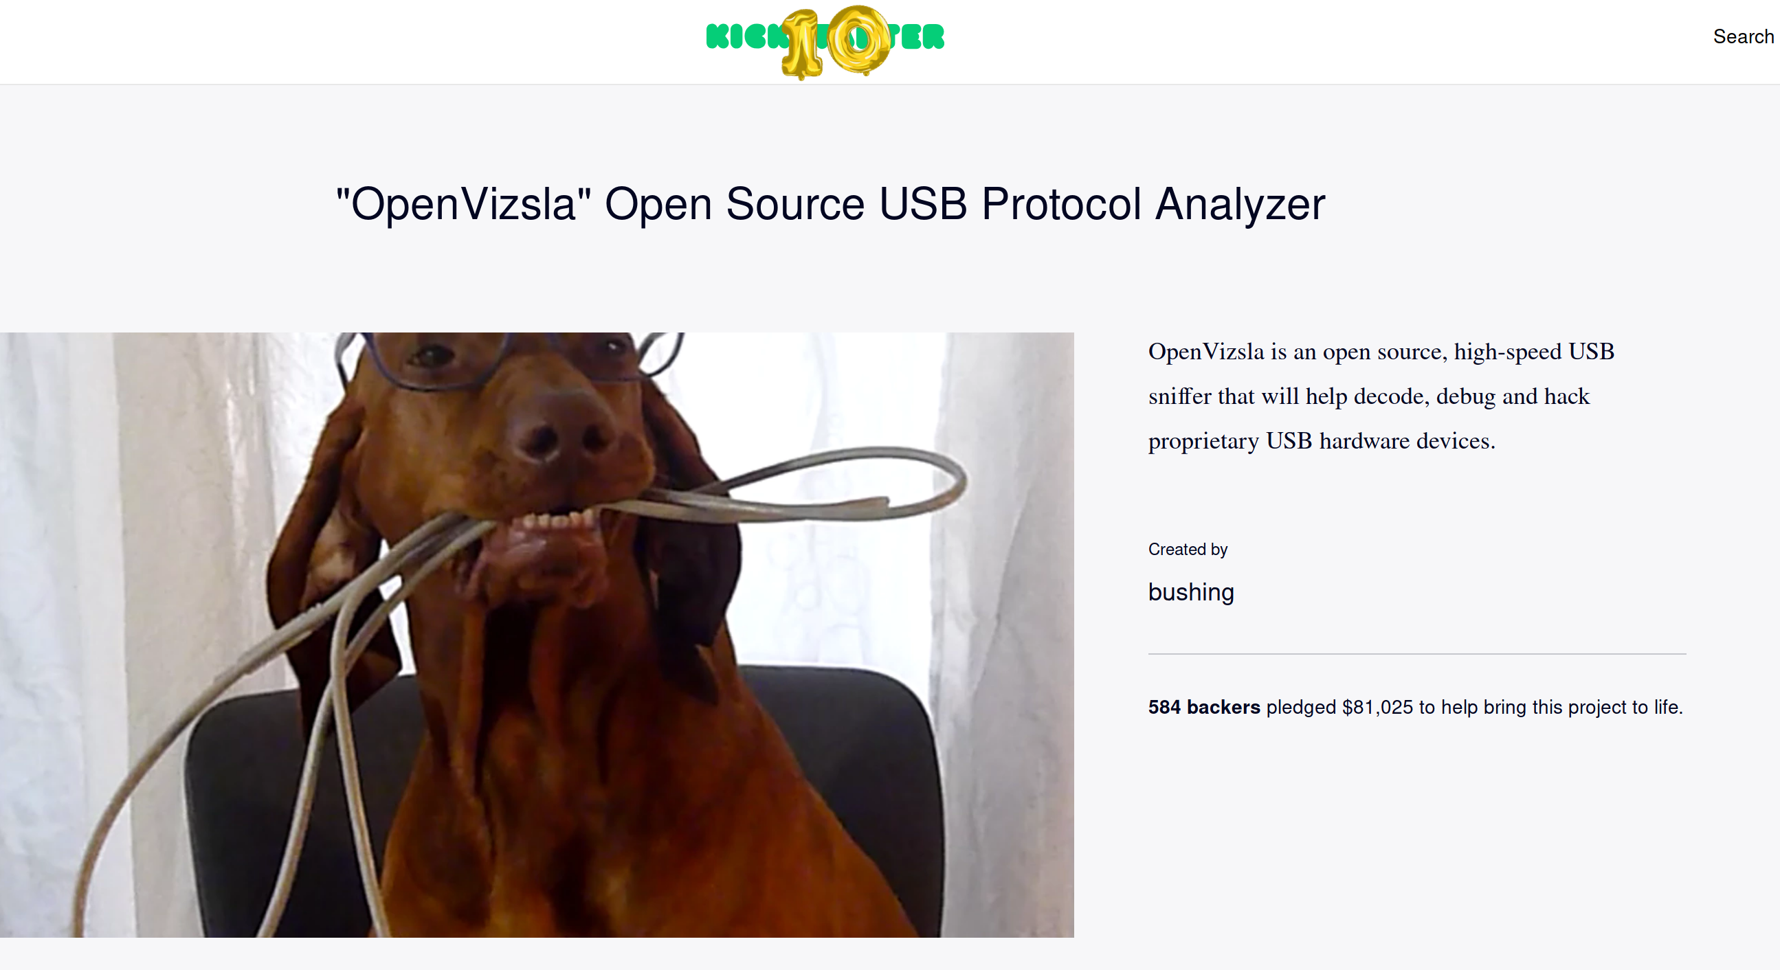

Slide 13
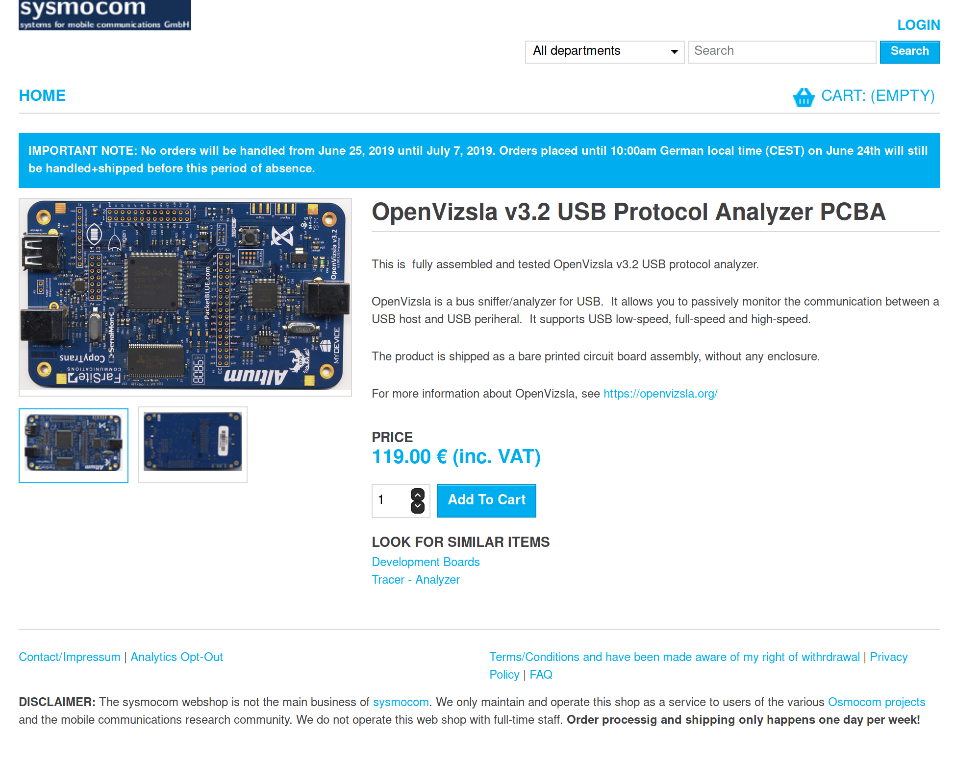

Slide 14
OKAY, SHOW ME THE
SOFTWARE

Slide 15
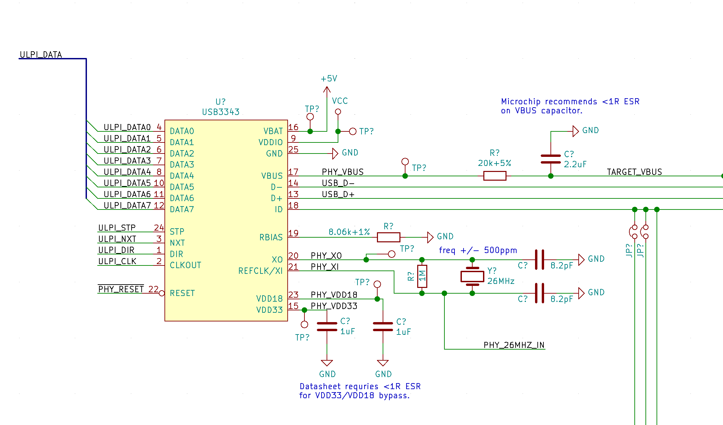

Slide 16
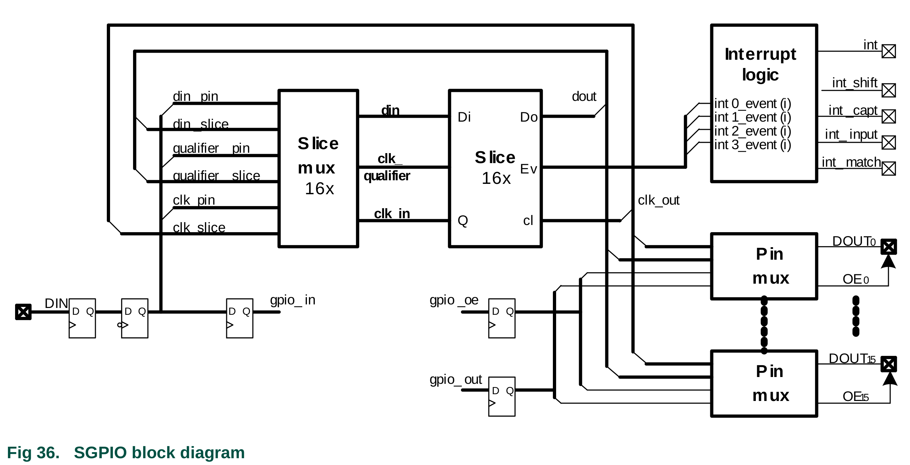
LPC43xx

Slide 17
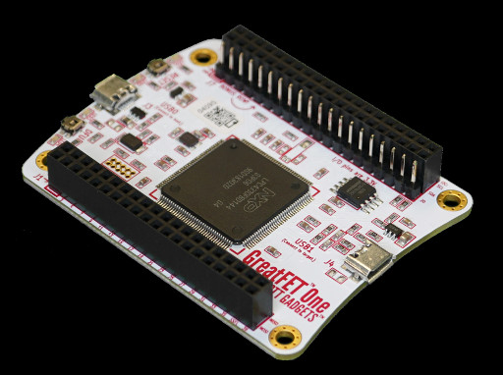
GreatFET One (codename Azalea)
Multi-tool for hardware hacking – including lots of USB functionality.
Centered around the LPC4330, so we have access to that 204MHz SGPIO fanciness.
Super-fast USB stack, so we can saturate the host’s USB bus with captured data.
Build them yourselves! Design files at https://github.com/greatfet-hardware

Slide 18
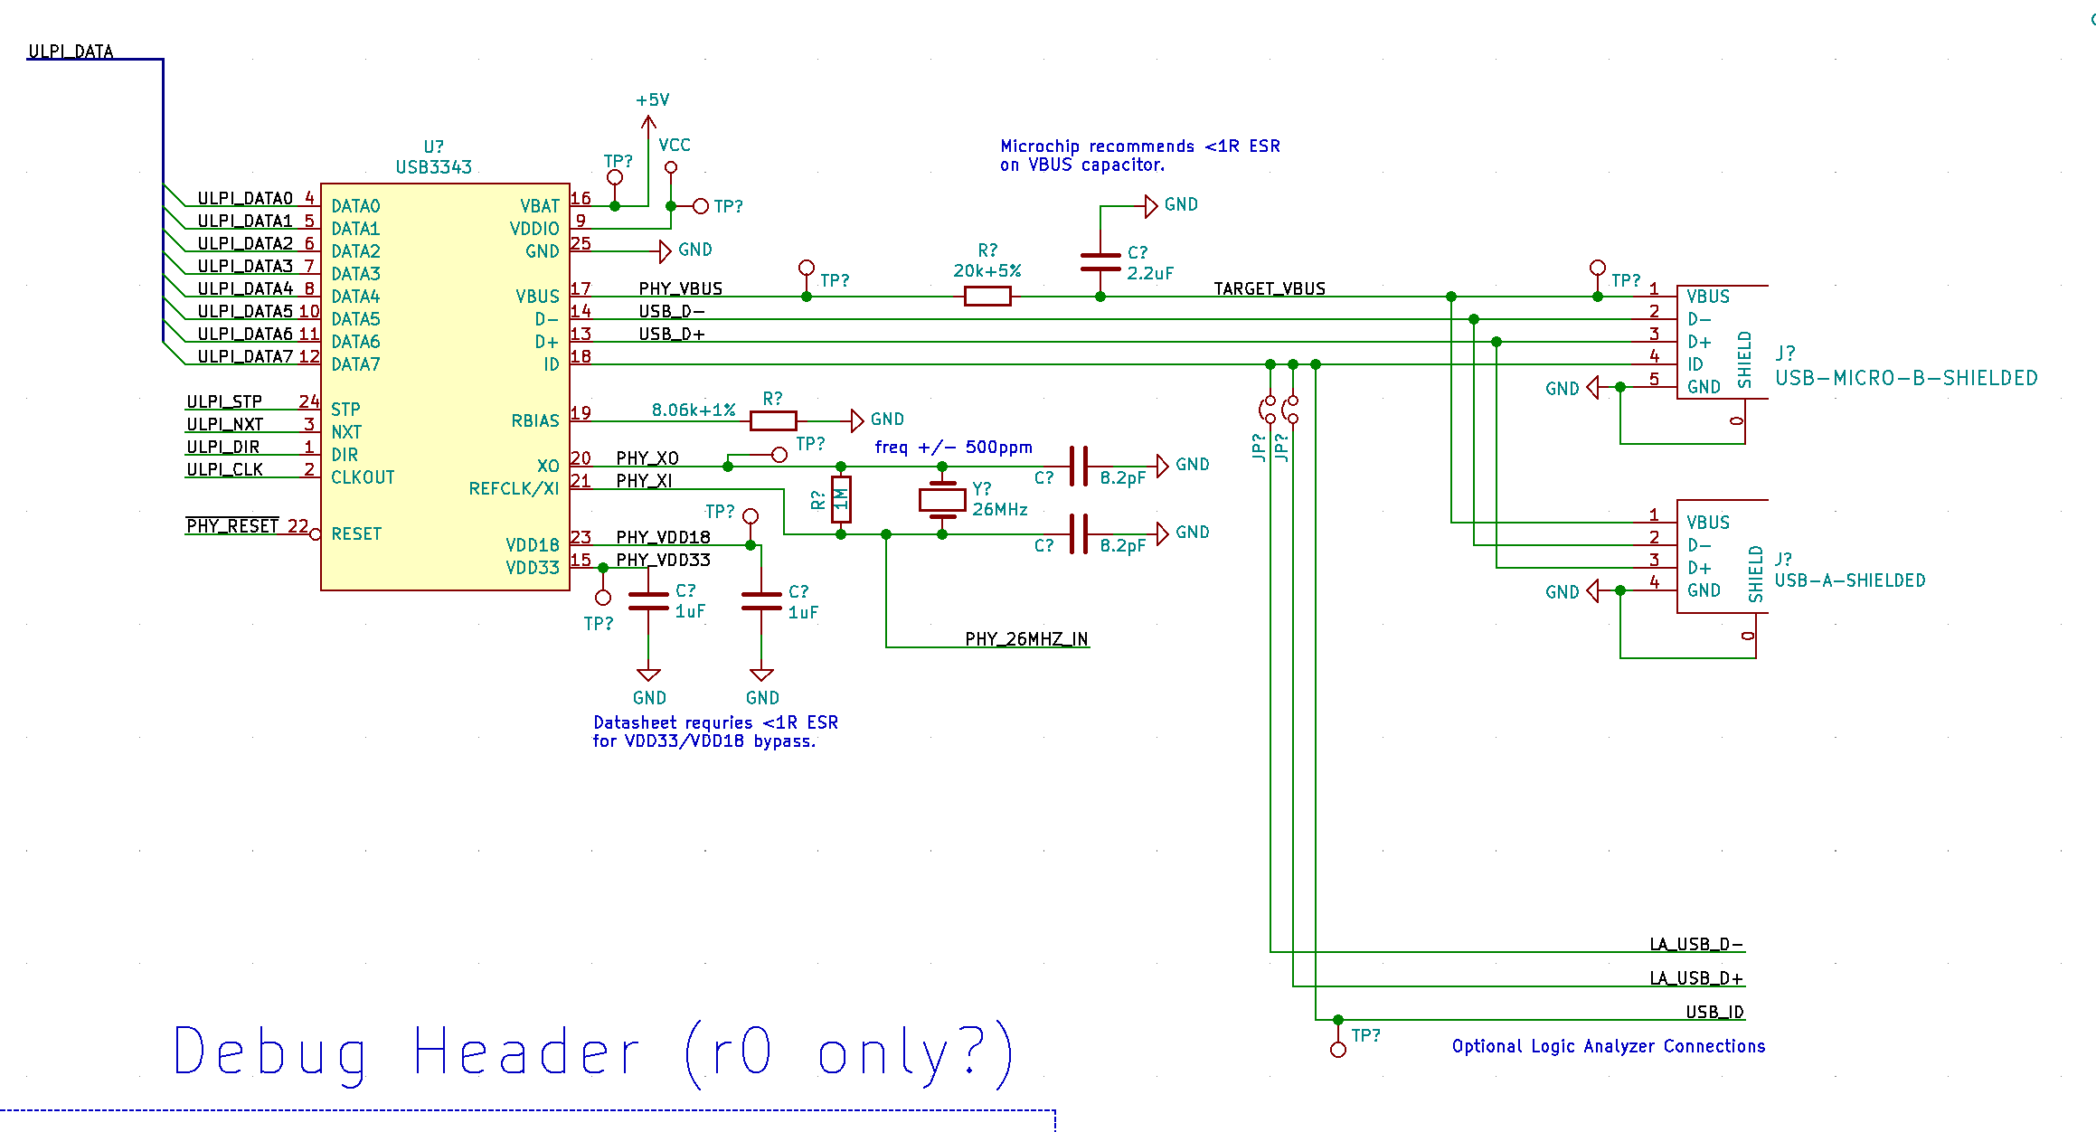
RHODODENDRON

Slide 19
RECIPE FOR A HIGH SPEED ANALYZER
Components:
LPC43xx; or similar
SDRAM for packet buffering*
ULPI PHY
SPI Flash
What this will get you:
a super-cheap analyzer, especially if you omit the SDRAM
  an SDRAM-less design can still capture a lot of stuff

Slide 20
RECIPE FOR A HIGH SPEED ANALYZER
Components:
LPC43xx; or similar
SDRAM for packet buffering*
ULPI PHY
SPI Flash
What this won’t get you:
working analysis software
  wait

Slide 21
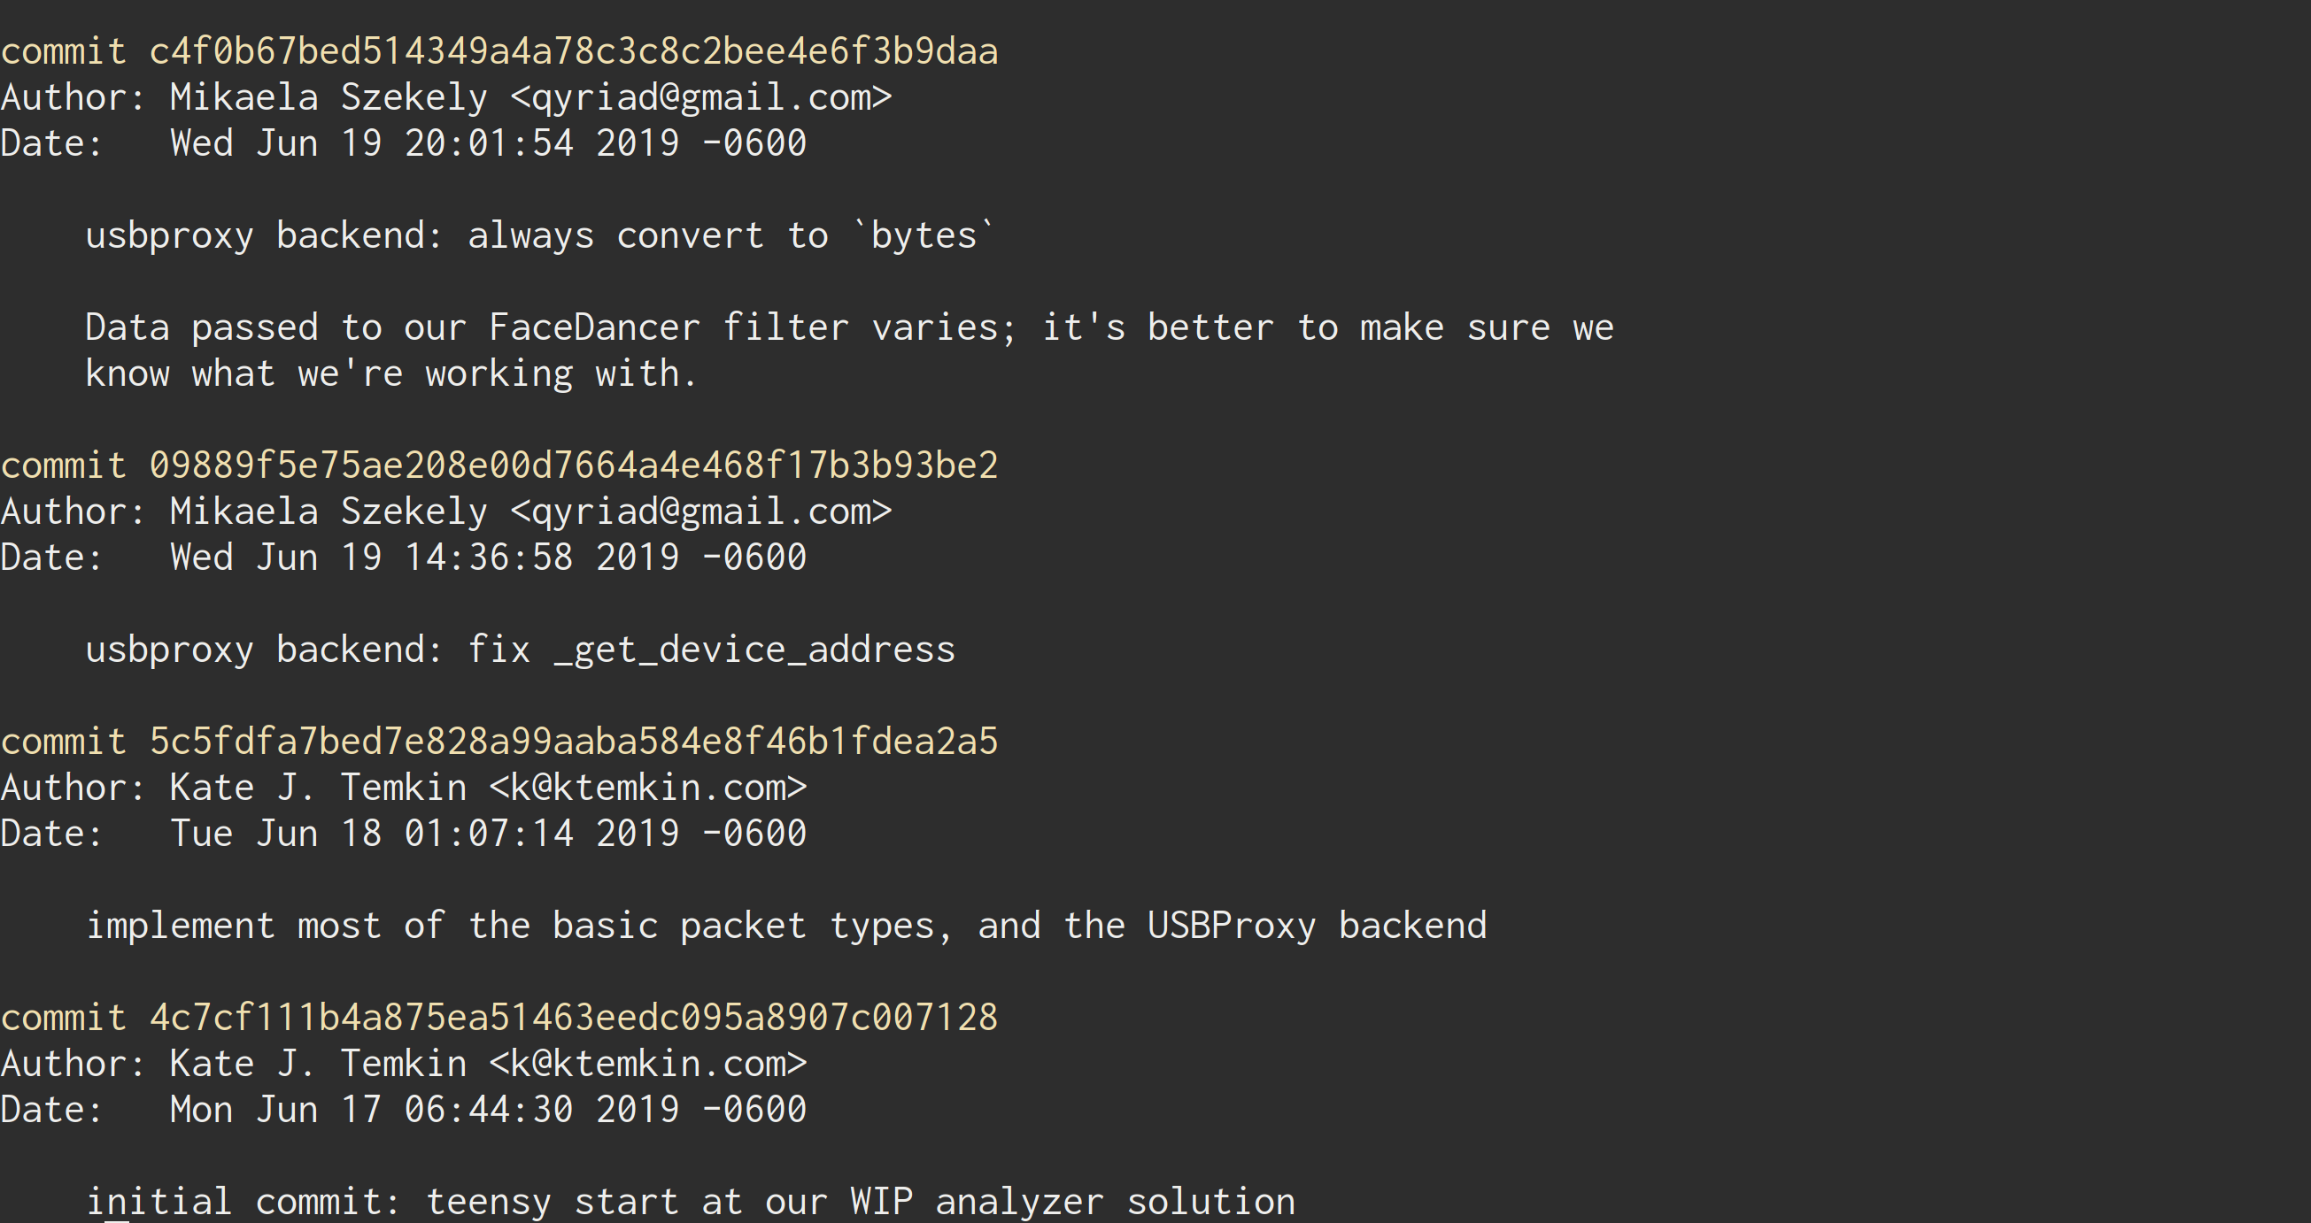

Slide 23
Backend
Frontend
Frontend
Decoders
ViewSB Architecture
Three component types run in their own processes; so they can start and stop independently.
All three components are designed to be easily swappable using simple, modular python.
All completely open-source, and contributor-friendly! https://github.com/usb-tools/viewsb

Slide 24
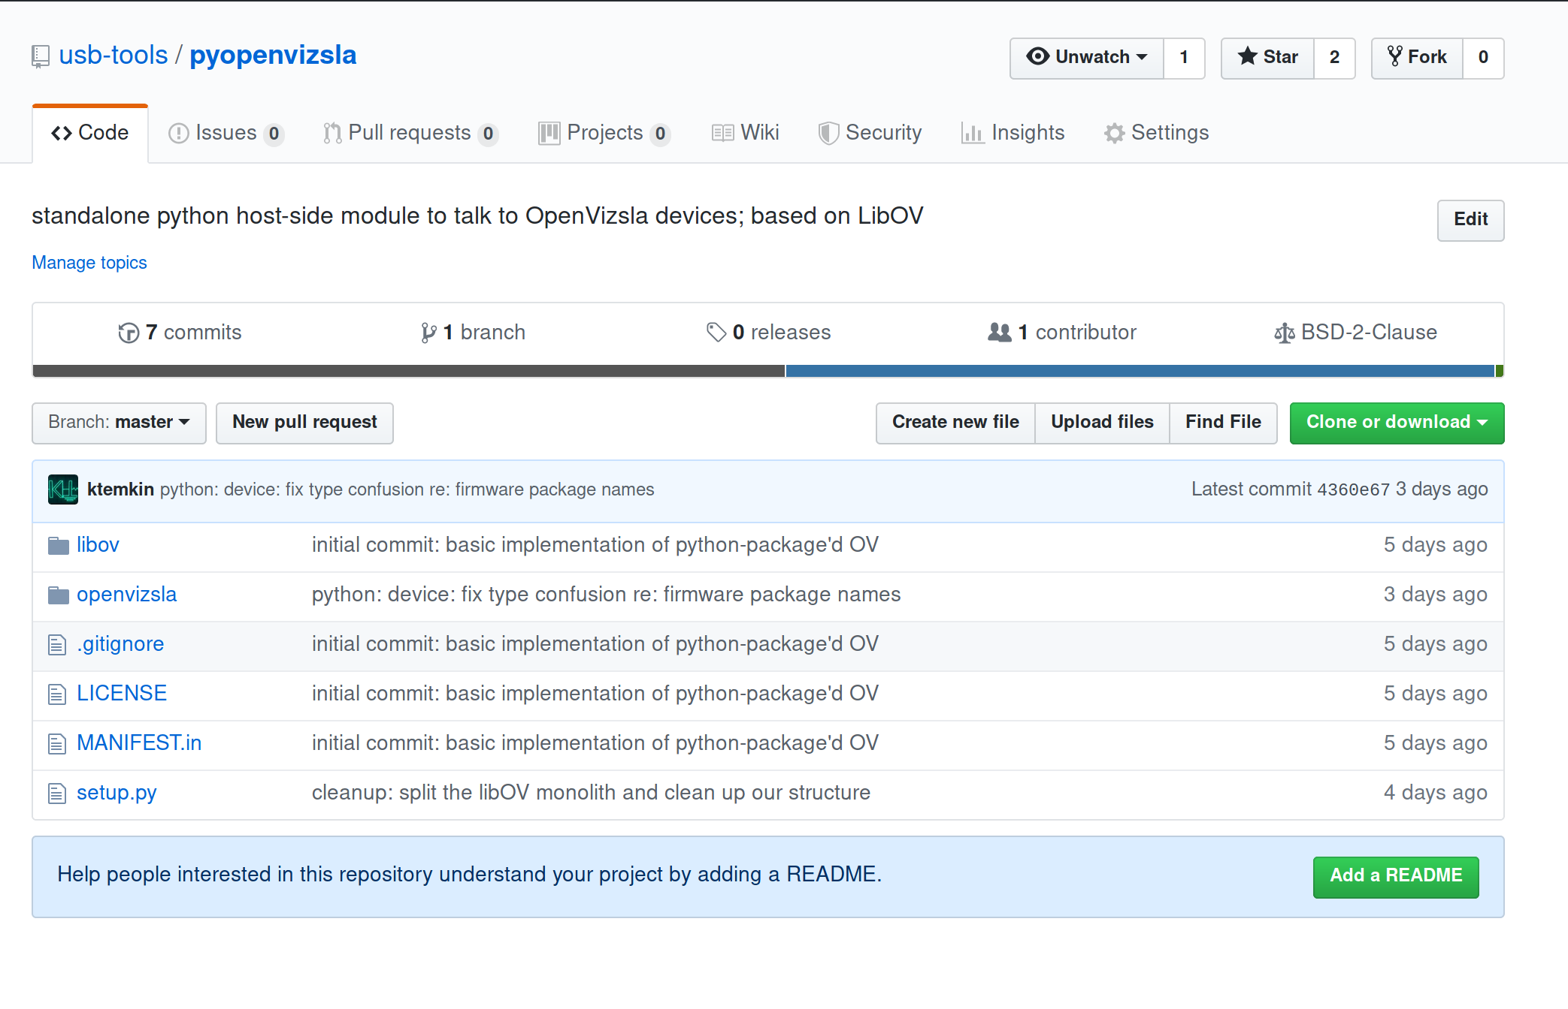

Slide 25
OKAY, SHOW ME THE
SOFTWARE

Slide 26
Backend
Frontend
Frontend
Decoders

Slide 27
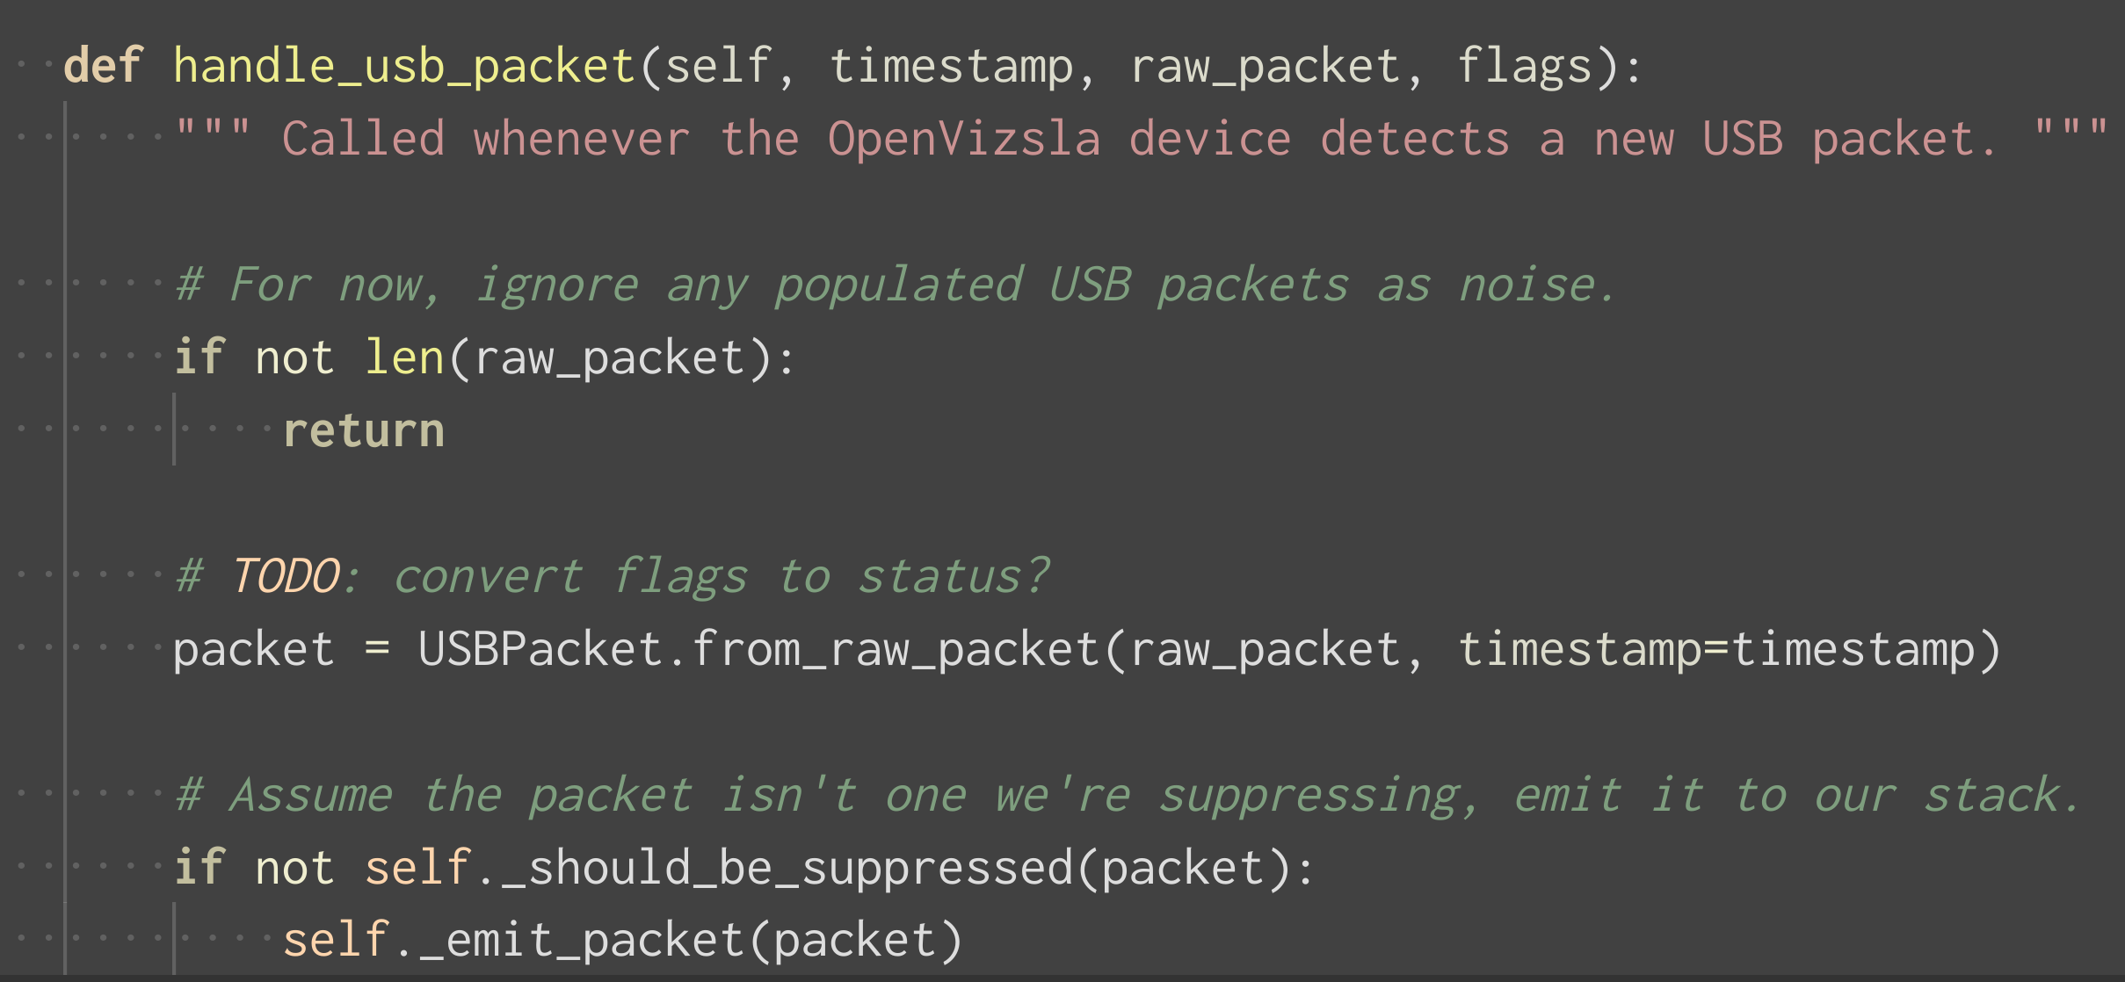

Slide 28
[capture-cli-ov.py]

Slide 29
Backend
Frontend
Frontend
Decoders

Slide 30
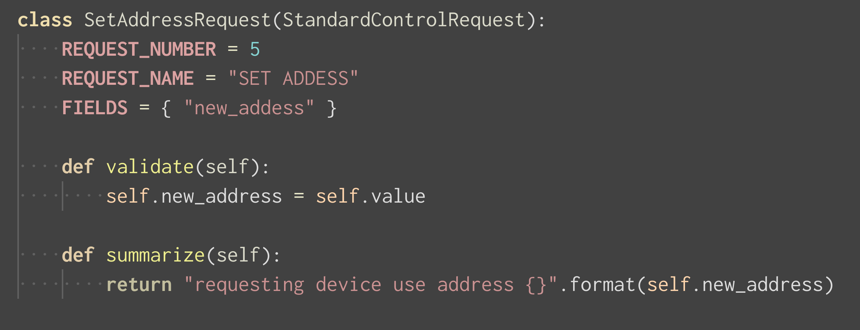

Slide 31
[capture-cli.py]

Slide 32
Backend
Frontend
Frontend
Decoders

Slide 33
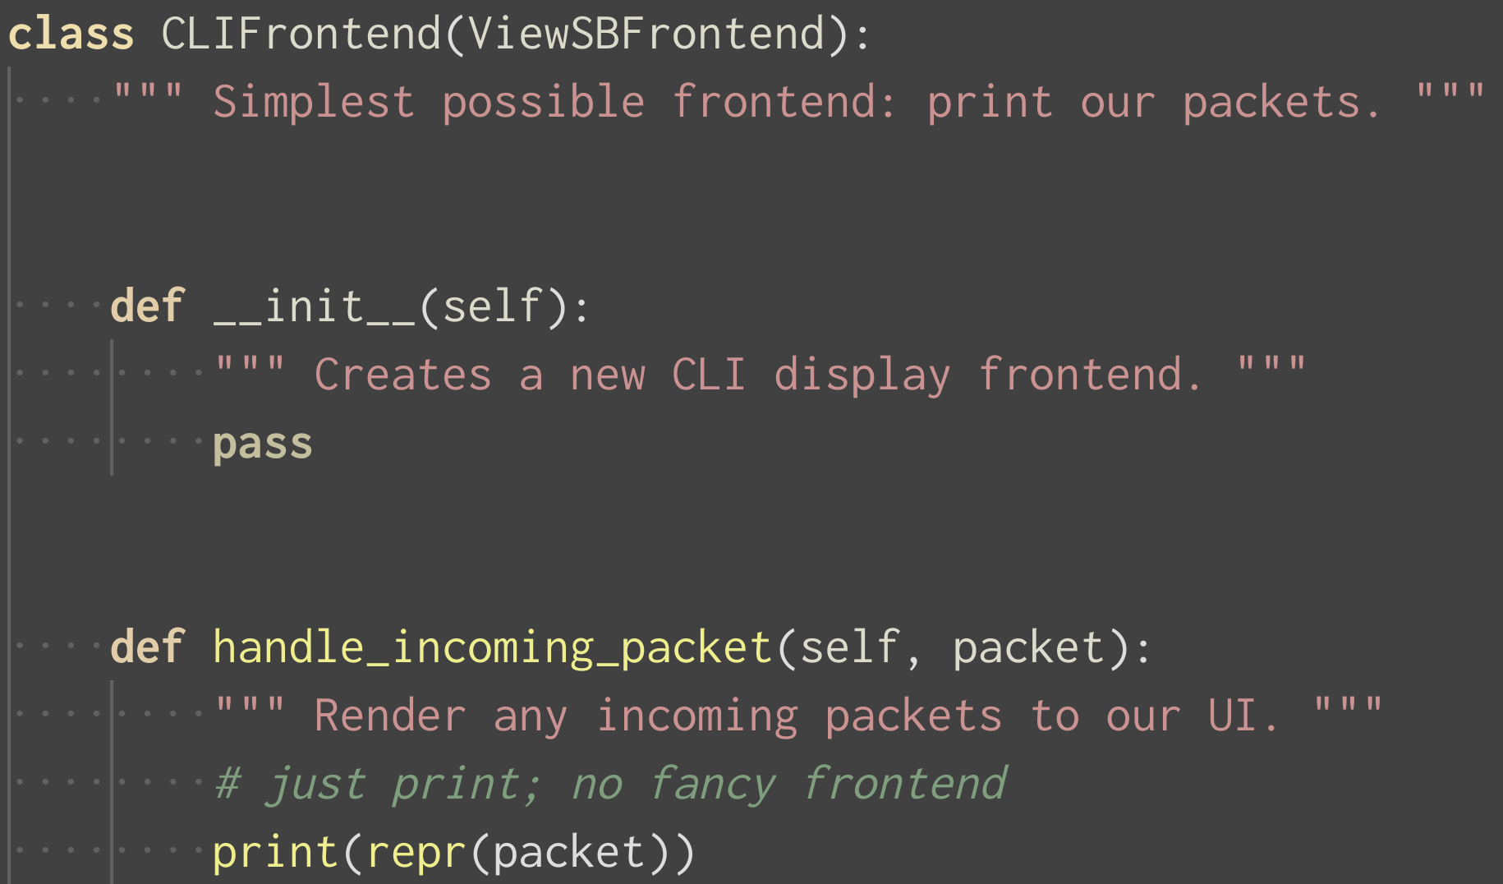

Slide 34
[capture-tui.py]

Slide 35
[oh, and we support usbmon]

Slide 36
BONUS
TIME

Slide 37
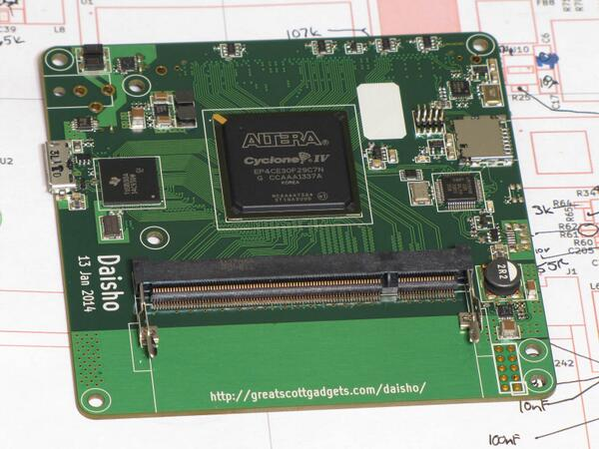
DAISHO

Slide 38
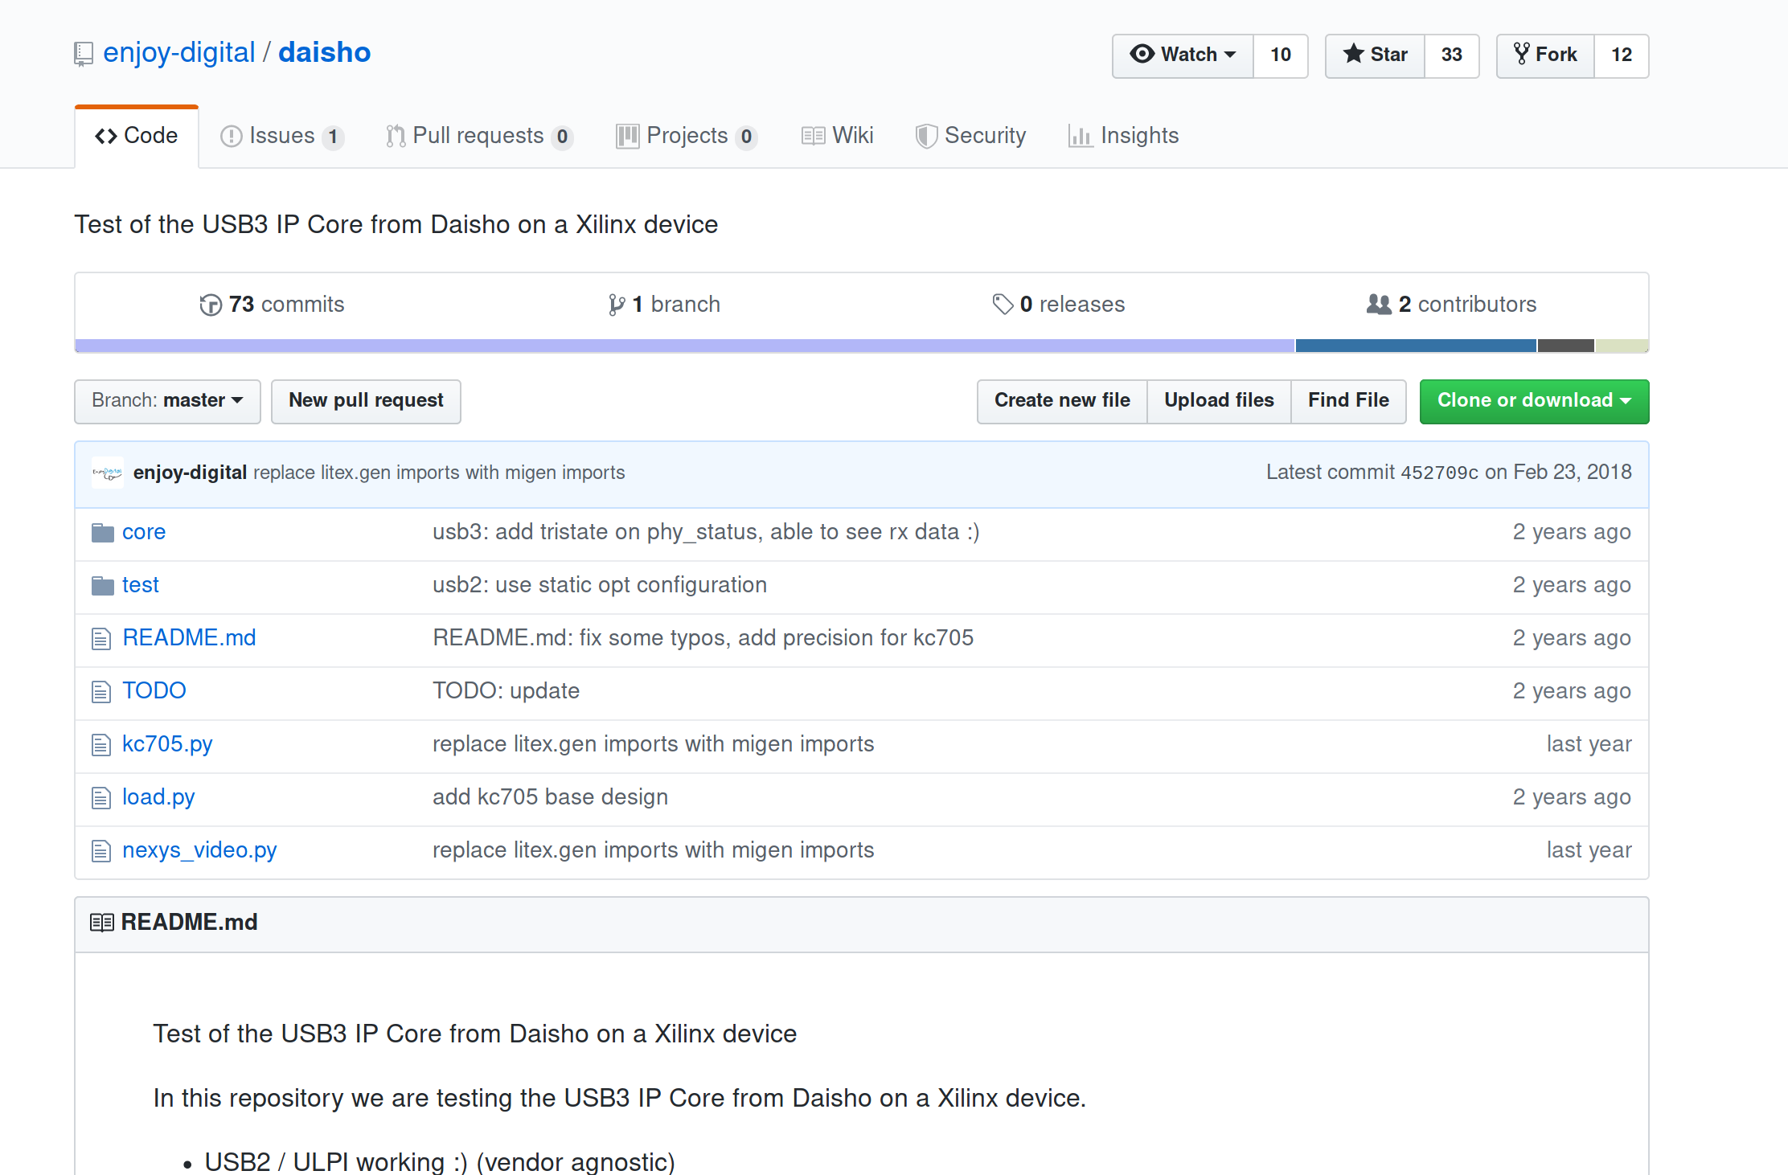
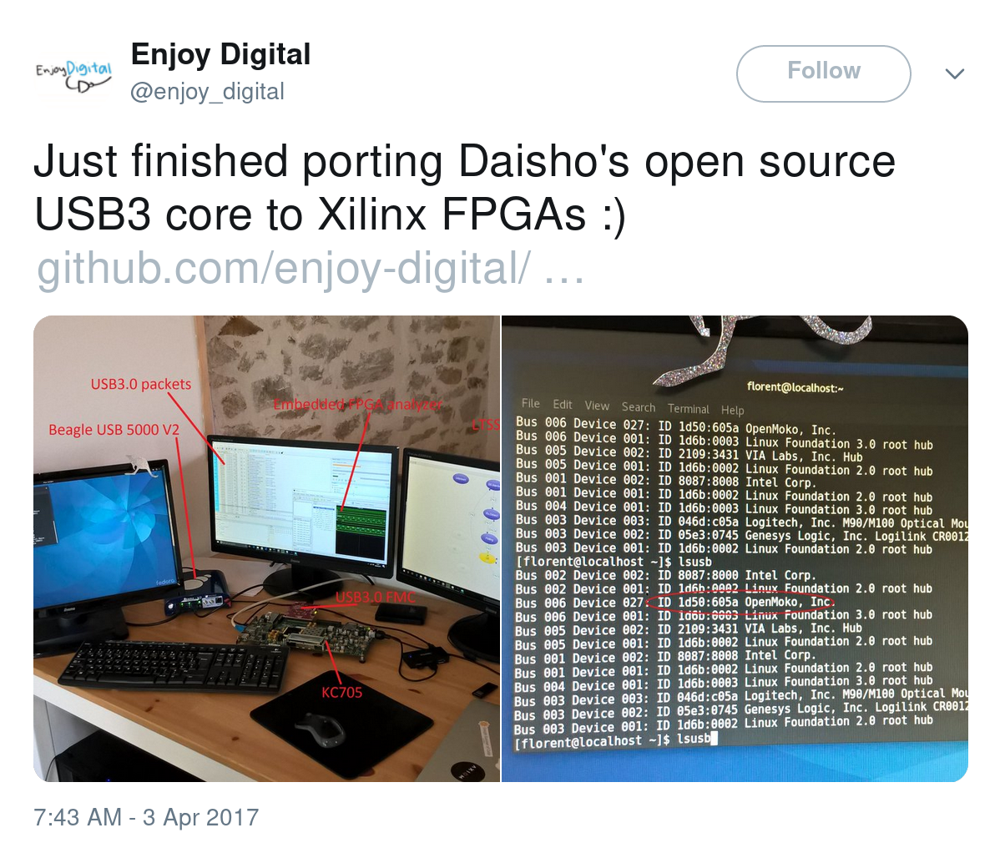
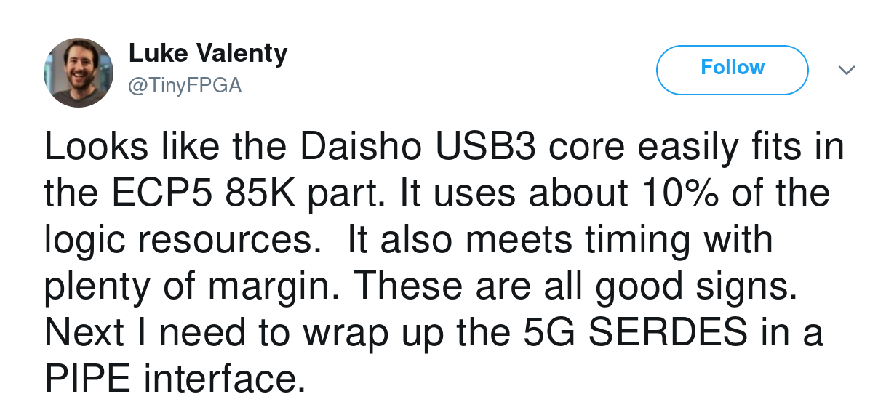

Slide 39
BONUS
QUESTIONS
?

