Slide 1


USB HACKING WITH USB-TOOLS
EVEN MORE
KATE TEMKIN • MIKAELA SZEKELY
TOORCON-21 2019

Slide 2


Katherine/Kate Temkin (@ktemkin):
software lead, Great Scott Gadgets
glitch witch & open-source-tool-builder
educational (reverse) engineer
lauded by the Daily Mail as a “cyber criminal”
Mikaela Szekely (@Qyriad):
student, and yet master*
got a bit too deep in some open-source USB stuff
apparently better at cybercrime (not caught by the Daily Mail)

Slide 3
SO, WHO are YOU?
WE DON’T
HAVE TIME!
Katherine/Kate Temkin (@ktemkin):
software lead, Great Scott Gadgets
glitch witch & open-source-tool-builder
educational (reverse) engineer
lauded by the Daily Mail as a “cyber criminal”
Mikaela Szekely (@Qyriad):
student, and yet master*
got a bit too deep in some open-source USB stuff
apparently better at cybercrime (not caught by the Daily Mail)

Slide 4
← Kate
Mikaela →

Slide 5
USB-TOOLS?
SO: WHAT ARE

Slide 6
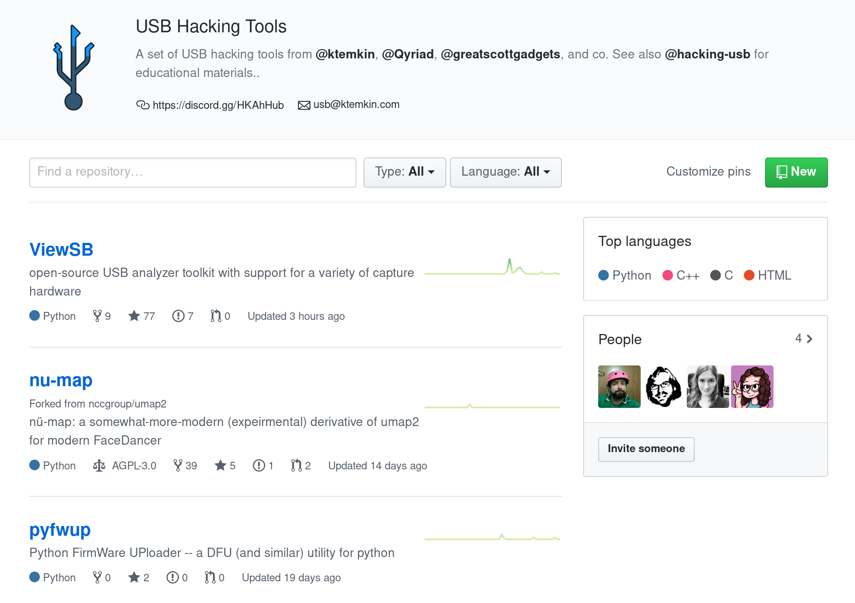

https://github.com/usb-tools

Slide 7
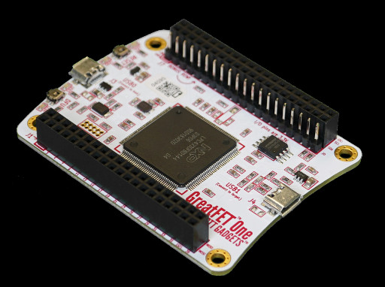
What’s new with FaceDancer?
Not too much – mostly that more hardware platforms are available.
What’s coming down the line?
Soon enoughTM: new asyncio-driven model
Mid-term: support for Linux UDC backends
Longer term: FPGA-based extensions

Slide 8
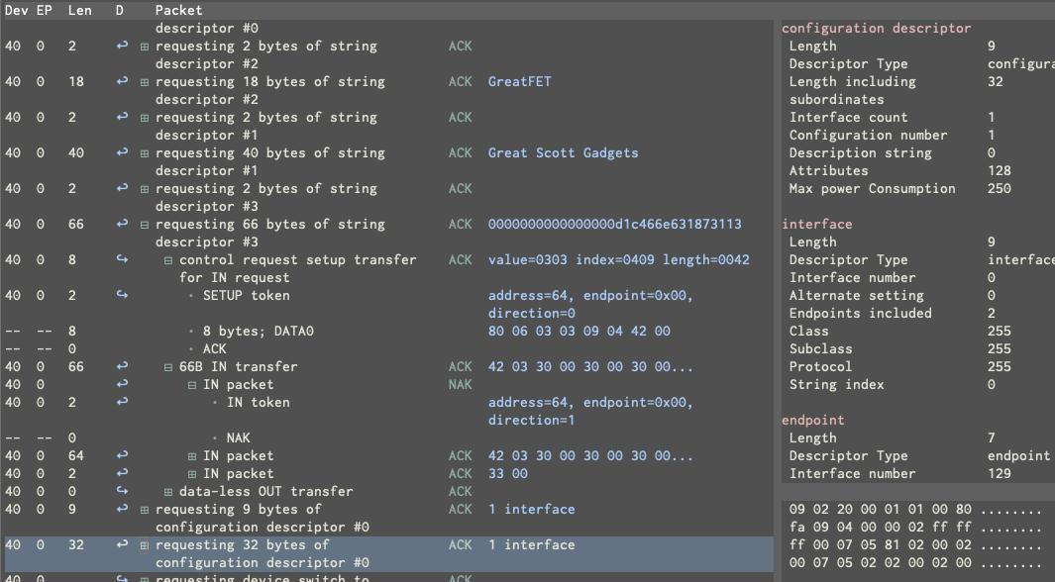
https://github.com/usb-tools/viewsb (TUI shown)
ViewSB: OPEN-SOURCE USB ANALYSIS

Slide 9
EXPENSIVE?
BUT ISN’T THAT

Slide 10
See also our open course materials:
https://usbc.tf
https://mini.usbc.tf
https://github.com/hacking-usb

Slide 11
KINDA LIMITED
OKAY, BUT THAT’S

Slide 12
RECIPE FOR A HIGH SPEED ANALYZER
Components:
LPC43xx; or similar, [or an ultra-cheap FPGA like the ECP5-12F]
SDRAM for packet buffering*
ULPI USB PHY
SPI Flash

Slide 13
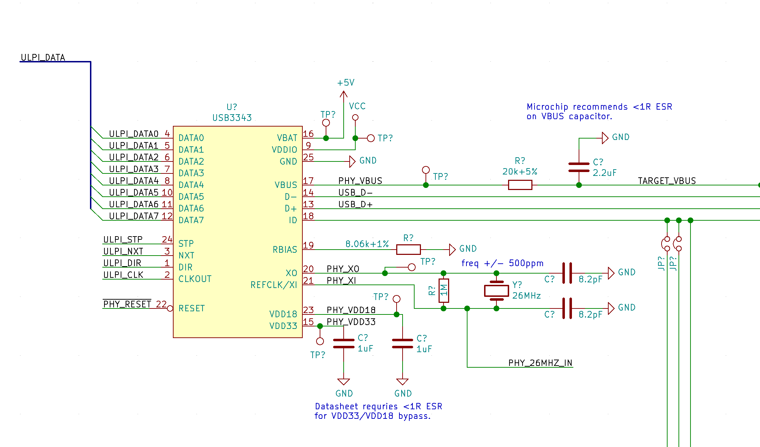

Slide 14
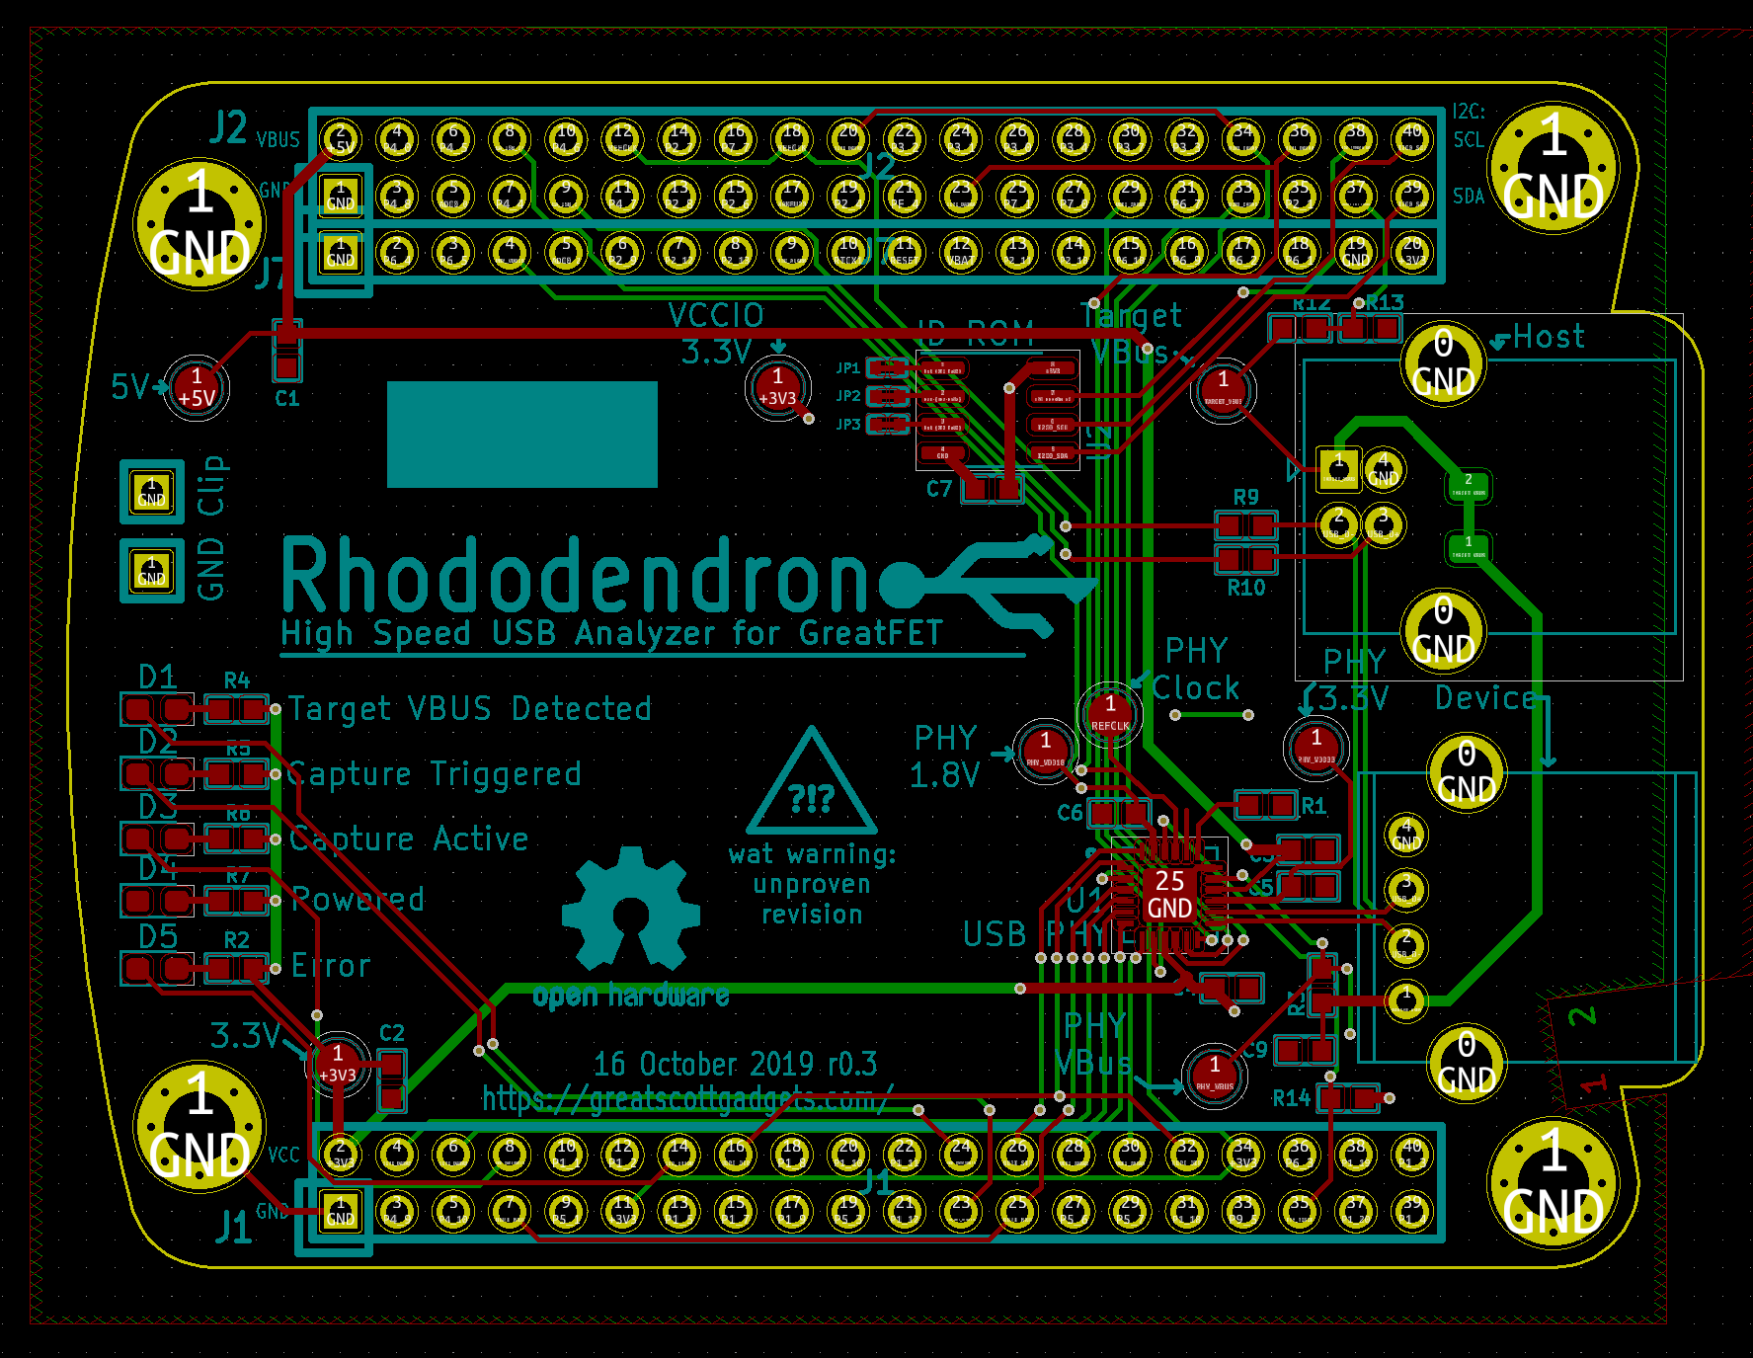

Slide 15
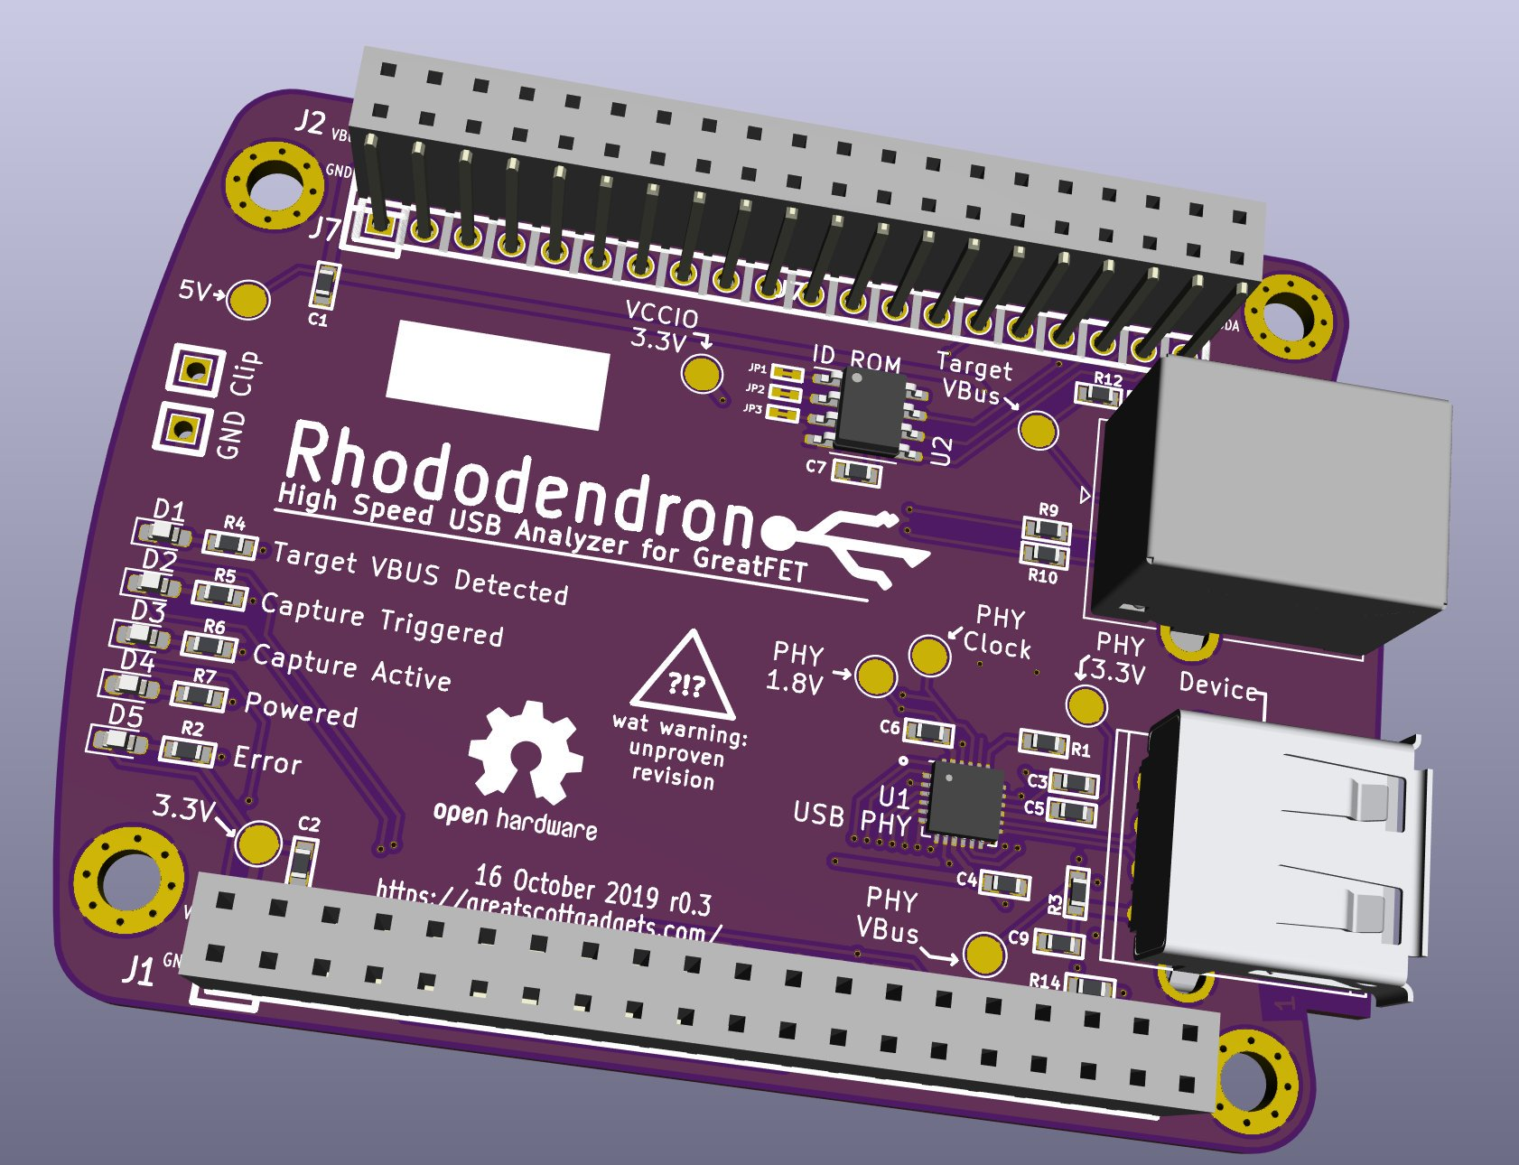

Slide 16
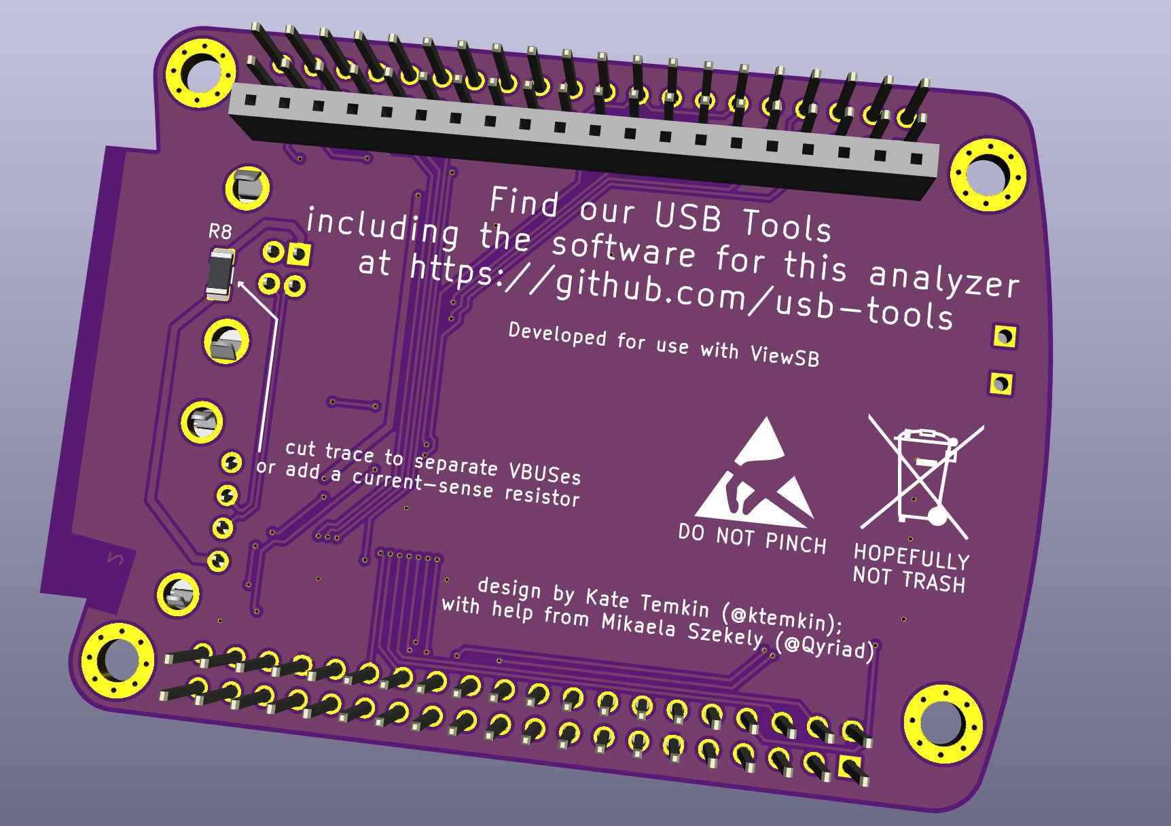

Slide 17
[rhododendron demo]

Slide 18
[rhododemodron]

Slide 19
IN-PROGRESS TOOLS: NUMAP
What is it now?
port of umap2 to the modern FaceDancer backend; which provides some
fancy host-fuzzing via FaceDancer emulation
very much a work in progress
a subtle dig at Dominic’s röck döts
What should it be?
a much more comprehensive tool for host and device fuzzing
a tool with original-umap style host identification; and host driver ID’ing
functional

Slide 20
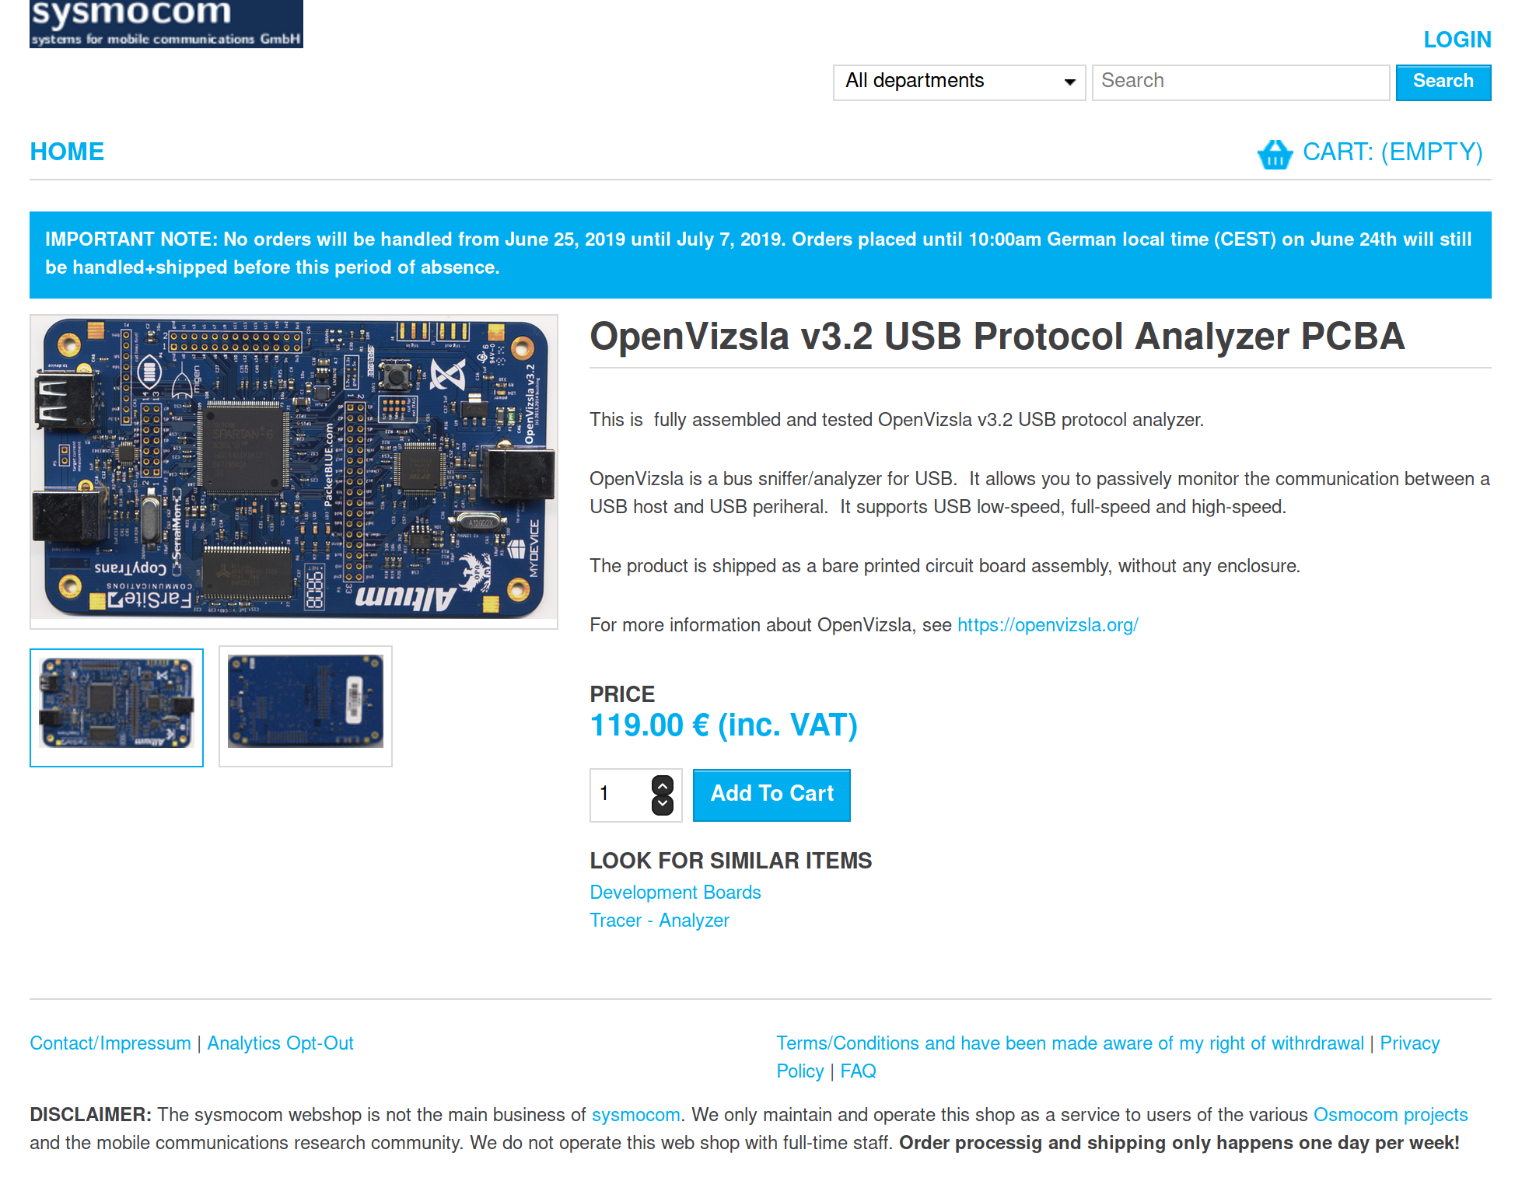

Slide 21
OTHER USB-TOOLS:
Primary tools:
FaceDancer (and USBProxy)
ViewSB
Supporting tools:
pyfwup – a tool for upgrading device firmware in pure python
pyopenvizsla – properly-pythonic OpenVizsla support drivers
  ...openvizsla?

Slide 22
QUESTIONS?

Slide 23
[software analysis demo]

