Slide 1
Disease Predictor
Using health data to estimate future impact

Slide 2
Agenda
Project Goals
Data Sources
Answers sought
Outcomes Review
Future Study
Questions

Slide 3
Disease predictor
Run through research to predict groups who are likely to have diabetes, hypertension or heart disease based on various health factors.
Team members
Tim Spendley
Kenway Tennant
Ipsita Purohit

Slide 4
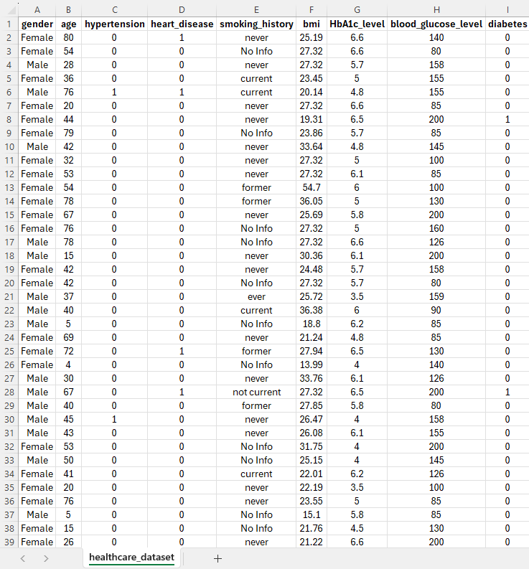
Healthcare Dataset
Source: https://www.kaggle.com/datasets/nanditapore/healthcare-diabetes
Data cleanup steps:
Removing missing values
Removing duplicates
Converting column headers to uppercase
Removing rows where smoking history has “no info” while finding correlation with smoking

Slide 5
Research Questions
Is there a correlation between age of the patient and hypertension and heart disease?
Find the count of males and females and percentage(%) of male and female population for each of the diseases?
Find the correlation between bmi and blood_sugar level and whether a person is diabetic?
What age group is diabetic? (Create a bar chart for each age group)
What age group suffers from heart disease and hypertension more?
What's the correlation between HbA1c level and diabetes, heart disease and hypertension?
What's the correlation between smoking history and the three diseases?
Compare census population data to the healthcare dataset. (Using the census API) (Data) (gender/age distribution) (Kenway) (compare for how accurate our study is compared to population)

Slide 6


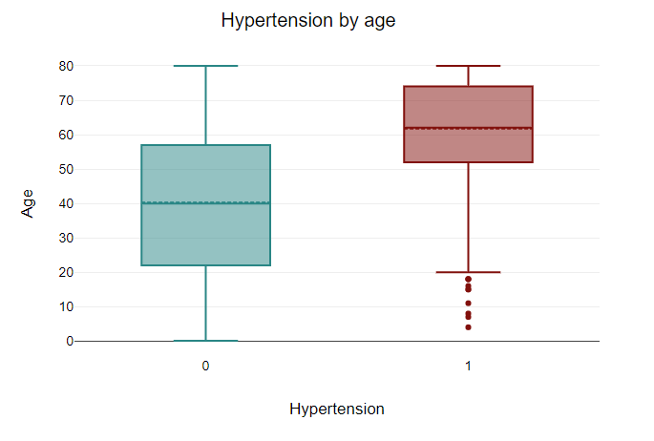
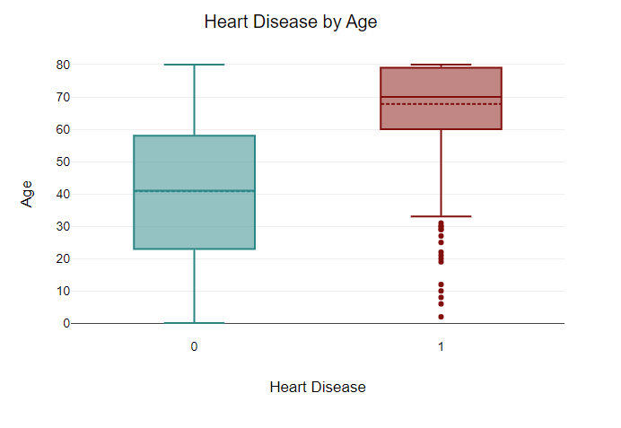



Q1-Correlation between hypertension, heart disease and age

Slide 7
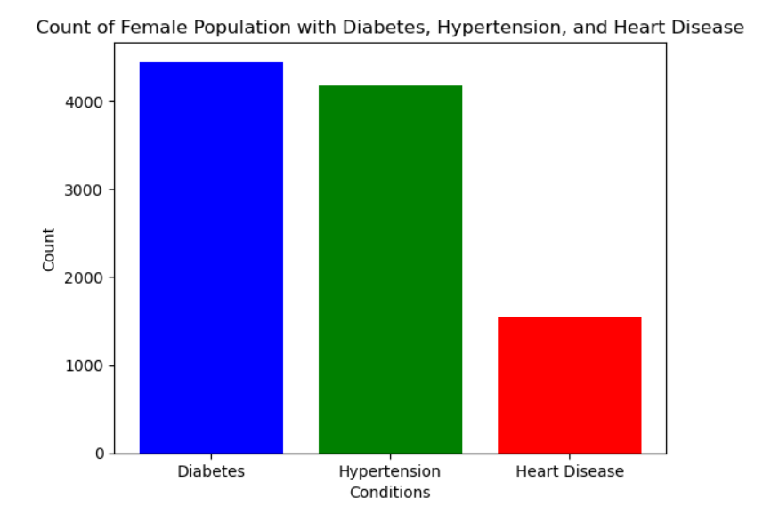
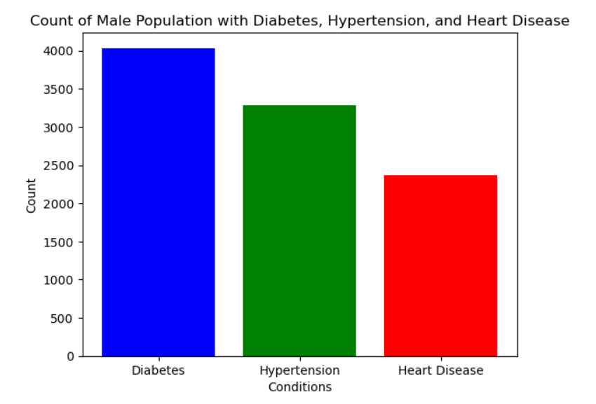
Q2-Count of males and females for each of the conditions

Slide 8
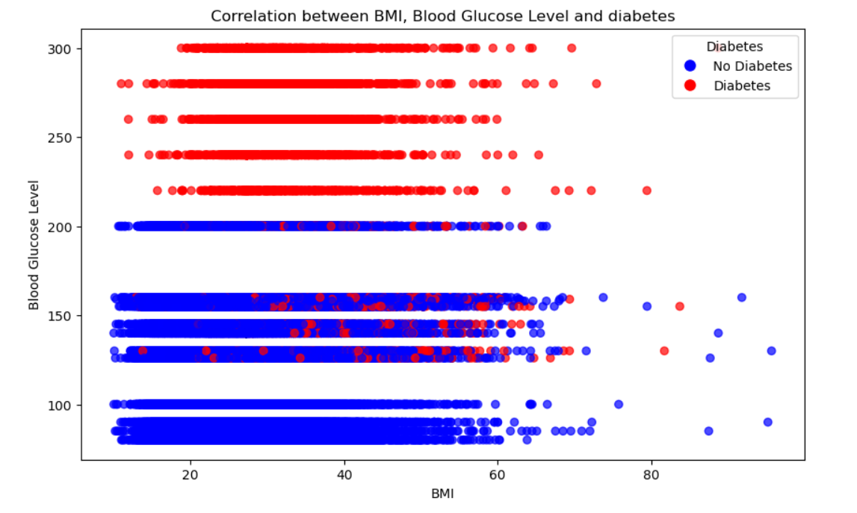
Q3 - Correlation between BMI, Blood Glucose Level and diabetes

Slide 9
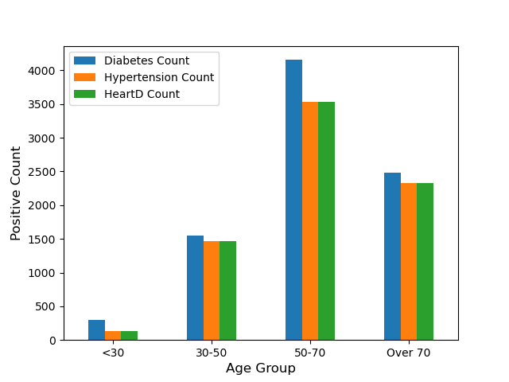
Q4-5: What age groups suffer more from diabetes, hypertension and heart disease.

Slide 10
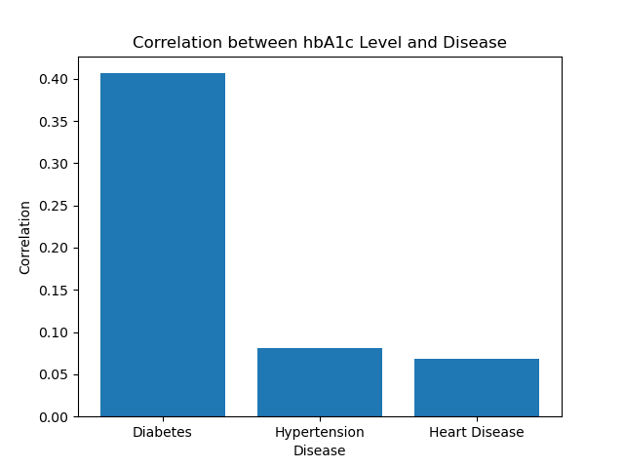
Q6: What is the correlation between hbA1c and diabetes, hypertension and heart disease?
Correlation for hbA1c to Diabetes is 0.40640837582948697.
Correlation for hbA1c to Hypertension is 0.08144051001364346.
Correlation for hbA1c to Heart Disease is 0.06813958220885297.

Slide 11
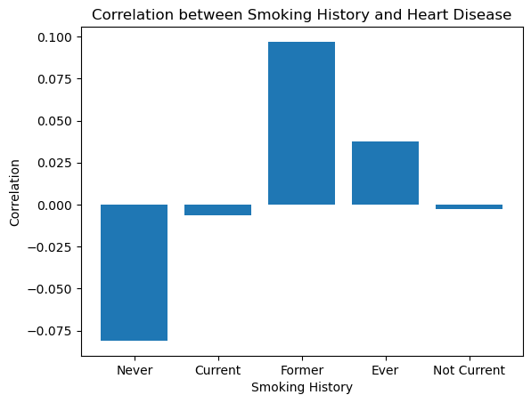

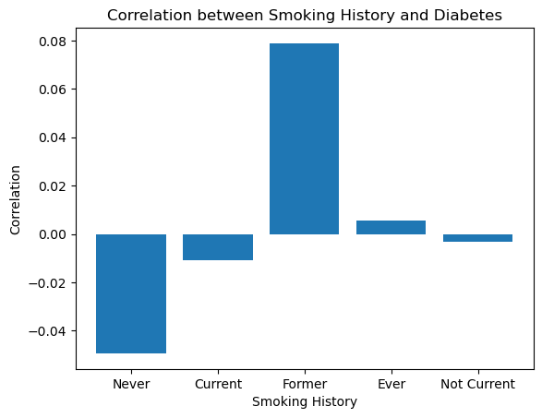
Q7: What's the correlation between smoking history and the three diseases?
Smoking History | Hypertension | Heart Disease | Diabetes
Never | -0.0229 | -0.0810 | -0.0494
Current | -0.0119 | -0.0062 | -0.0107
Former | 0.0969 | 0.0969 | 0.0789
Ever | 0.0373 | 0.0373 | 0.0056
Not Current | -0.0029 | -0.0029 | -0.0031

Slide 12
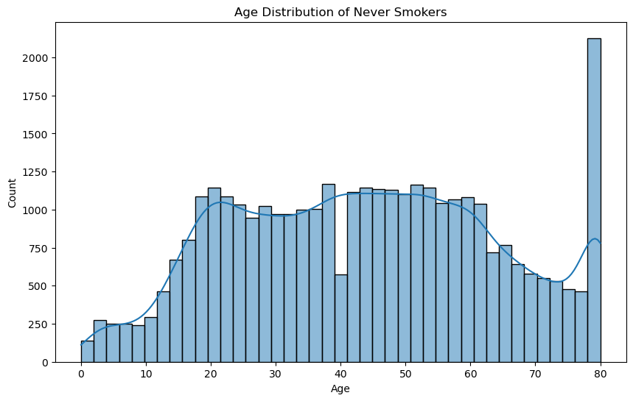
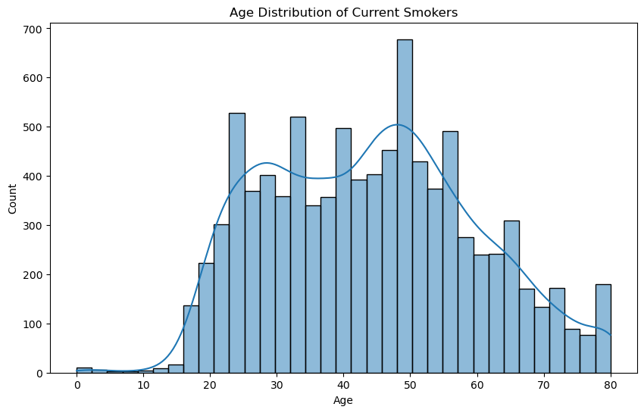
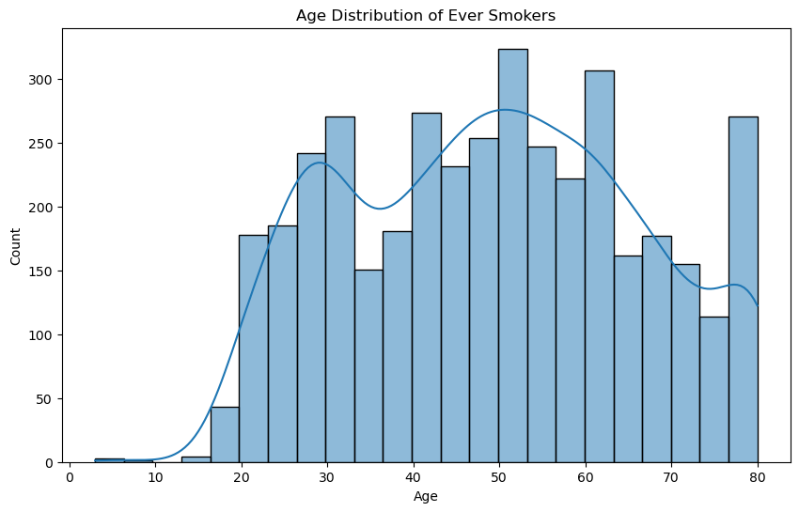
Q7: Smoking History Age Distribution

Slide 13
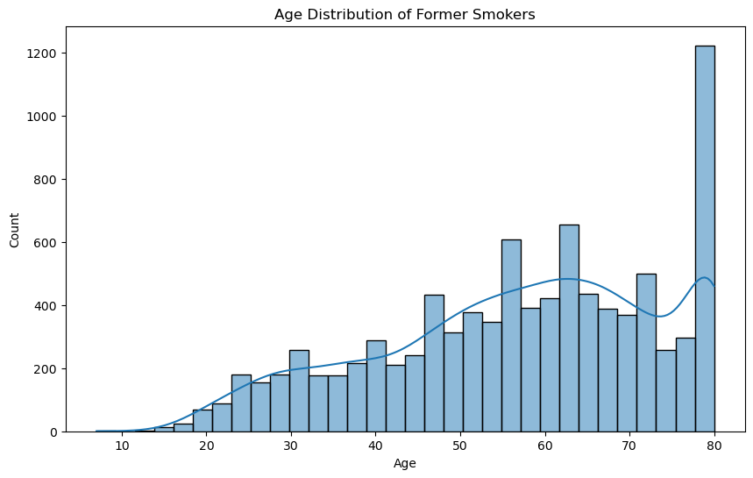
Q7: Smoking History Age Distribution
Smoking History | Mean
Current | 44.103
Ever | 49.147
Never | 43.875
Former | 57.02
Not current | 47.687

Slide 14
Q8: Compare census population data to the healthcare dataset.

Slide 15
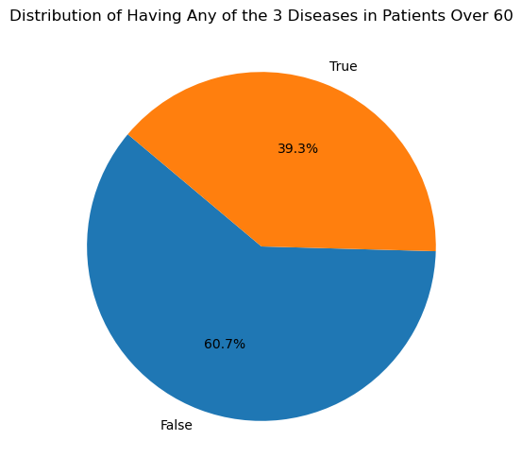
Q8: Compare census population data to the healthcare dataset.
Disease | Patients over 60 with disease
Hypertension | 18.1%
Heart Disease | 12.5%
Diabetes | 20.5%
Study shows that 4 in 10 people over the age of 60 suffer at least 1 of these diseases.

Slide 16
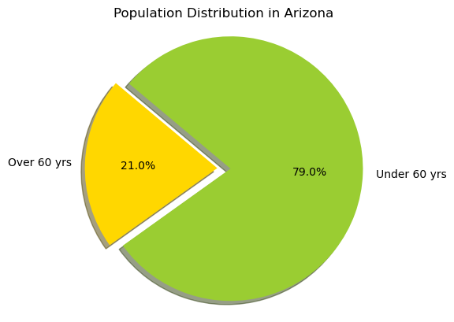
Q8: Compare census population data to the healthcare dataset.
Census data (2022)
Total Population in AZ | 7,172,282
Males over 60 in AZ | 806,708
Females over 60 in AZ | 699,638
total population over 60 in AZ | 1,506,346
592,360 people in Arizona are over 60 and suffering from at least one of the 3 diseases

Slide 17
Future Study
Look further into former smoker age distribution
Expand study application on AZ to every age group

Slide 18
Questions?

