Slide 1
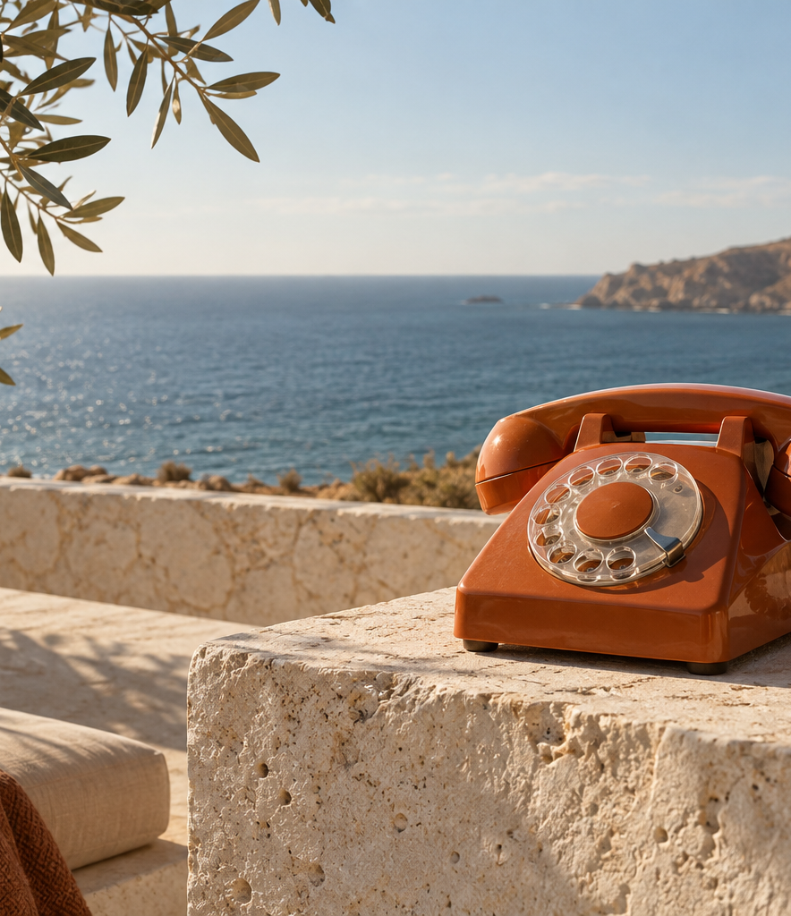

Good work.
More life.
Brand guide
September 2026
Notes:
Identity selected by Kevin on 13 September 2026. Reference: goodai-studio/DESIGN.md and current homepage. Image is generated conceptual brand artwork, not a documented location. See assets/IMAGE-PROVENANCE.md.

Slide 2
The feeling we leave people with
Go on. Knock off early.
Good’Ai helps business owners get repetitive work out of the way, so they can get more of their day back.
Reassuring, capable, plainspoken
Words to keep close
Talk about missed calls, copied details and follow-ups. Say what the system does and where people stay in control.
“We’ll sort it.”
“What’s eating your week?”
“Let’s take work off your plate.”
Notes:
Copy direction comes directly from founder feedback and the selected website. Brand promises describe intended value, not measured time savings. Never invent testimonials, client outcomes or certification claims.

Slide 3

The wordmark
Primary
Reversed
Dark olive lettering with rust punctuation.
Use the supplied outlined SVG or transparent PNG.
Paper lettering on dark olive.
Use the single-colour version for small marks.
Give the mark breathing room
Leave at least half the capital G height on every side. Keep it at least 120 px wide digitally or 25 mm in print. Preserve its proportions.
Notes:
Wordmark derives from the current Manrope website lettering, 650 requested weight with -0.07em tracking. Outlined exports preserve the intended typography without requiring a font installation. Clear space and minimum sizes are practical production rules for this kit, not a trademark registration claim.

Slide 4
Paper, ink and a little sunshine
Paper
Dark olive
Rust
Sage
#F7F5ED
#333B32
#A4432B
#DCE3CC
The everyday background
Headlines and body copy
Calls to action and emphasis
Quiet supporting surfaces
Supporting text #63685D Dividers #D5D6CA Raised surface #FFFEF9
Notes:
Exact values from DESIGN.md. Text contrast: dark olive on paper 10.61:1, rust on paper 5.63:1, muted text on paper 5.24:1. Dividers are not a text colour. Default composition uses mostly paper, olive type, then small rust accents.

Slide 5
Three voices, each with a job
Manrope
The clear everyday voice
Headings, body copy, buttons and prices.
Regular for copy, Medium for headings,
SemiBold for labels.
More life.
Fraunces Italic
A short expressive phrase in a headline.
Keep the surrounding copy in Manrope.
We’ll sort it.
Vibes
Brief handwritten reassurance.
Keep instructions and small text in Manrope.
Notes:
Font files and SIL Open Font License notices included in fonts/. Source roles verified in app/studio-fonts.css and app/globals.css. On a 1920x1080 canvas, start around 96–132 px for the main heading, 32–40 px for supporting text and 48–64 px for handwriting, then check at actual viewing size.

Slide 6
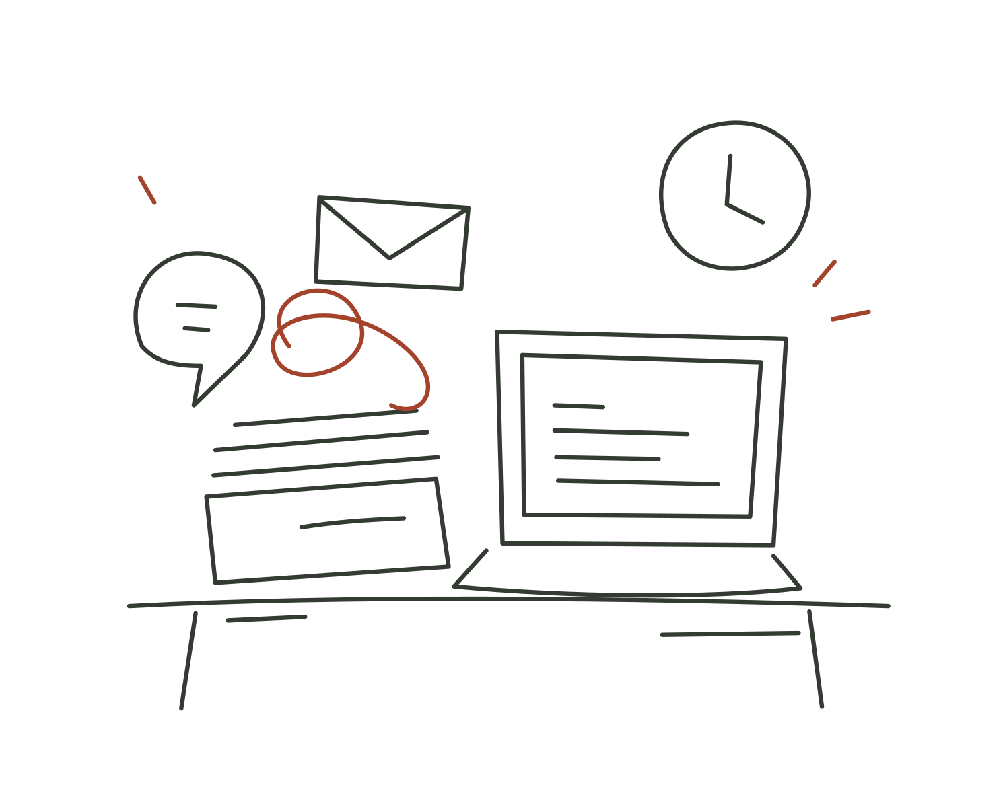
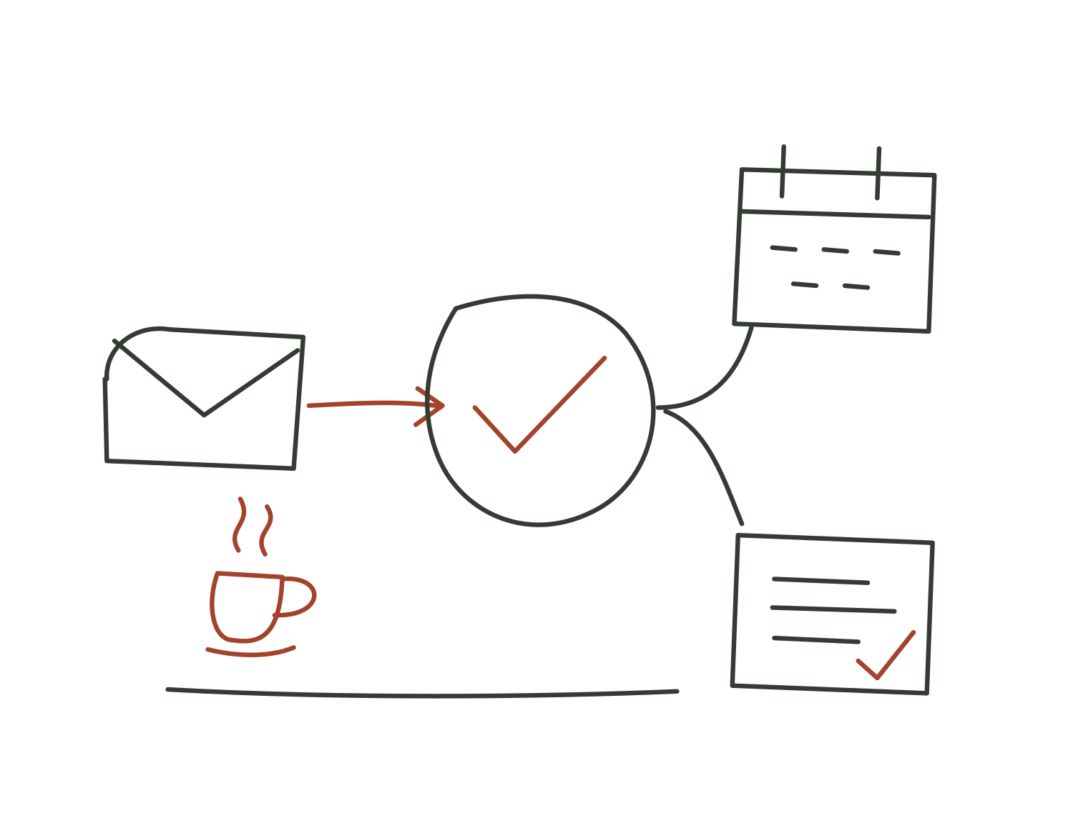
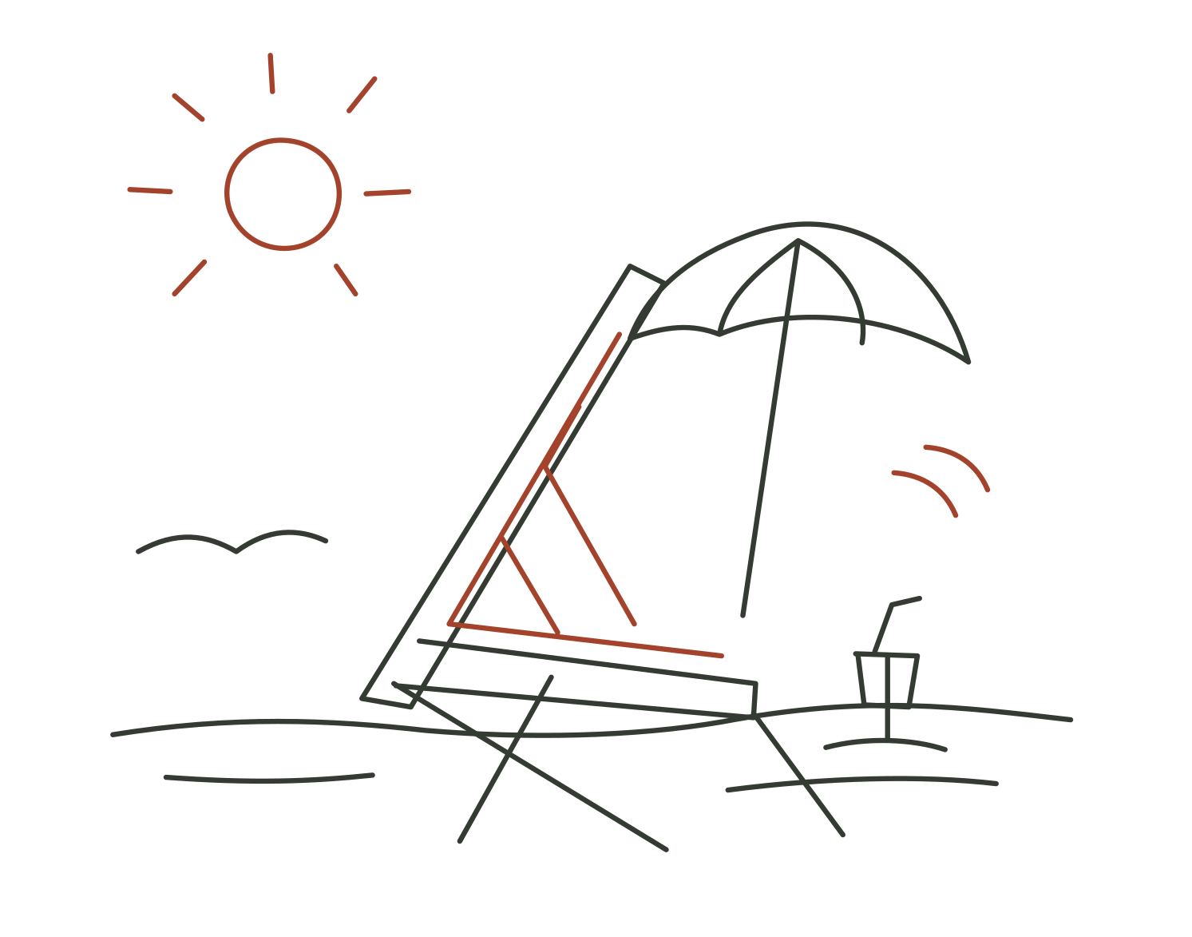
Draw the work out of the way
The work piles up
The pieces connect
The afternoon is yours
Loose olive linework, a few rust accents and plenty of paper. Drawings follow the meaning of the copy.
Notes:
Illustrations are the original SVG paths authored for ScrollStory.tsx, exported without changes. Web animation uses GSAP ScrollTrigger and stroke-dashoffset. In Canva use these as static assets or a simple reveal, rather than promising the website’s scroll behaviour inside a presentation. Reduced-motion website visitors see completed drawings.

Slide 7
A clear next step
Let’s take work
off your plate.
Primary enquiry
Use rust with paper text.
Ask for one useful next step.
Link to the shared business enquiry form.
Try the voice agent
Experience the service
Keep the demo visible, with the enquiry action close by. Let visitors choose when to start a call.
Short supporting line: “Want one for your business?”
Notes:
The primary destination is the existing SURVEY_URL in lib/links.ts. The retained ElevenLabs agent is agent_8501m0h2hvh0edr99jkqzr4rw53n. Loading the widget is not the same as validating a full call. Keep processing disclosure visible. Do not imply the sample workflows perform live operations.

Slide 8
Your Canva setup
01 Fonts and logos
02 Colours
Add the included fonts to your Brand Kit where your plan allows. Upload the logo SVGs or PNGs. The outlined logos work without font substitution.
Add the four main HEX values from this guide. Use paper as the default page background and rust for the action you want people to take.
03 The editable guide
04 Images and space
Import GoodAi-Brand-Guide.pptx into Canva. Check the text, line breaks and font choices after import. The PDF is a visual reference.
Use warm natural light, ordinary objects and room to breathe. Add real founder and workflow photography as it becomes available.
Notes:
Canva help: https://www.canva.com/en_au/help/upload-formats-requirements-variantb/ and https://www.canva.com/fr_be/help/import-files/ . Canva import and account-specific font availability have not been tested. Uploading fonts requires an eligible Canva plan. Keep included OFL notices. The supplied coastal image is generated conceptual artwork.

