Slide 1
Radiate Churn Prediction and Swiping Algorithm
Katie Gross

Slide 2
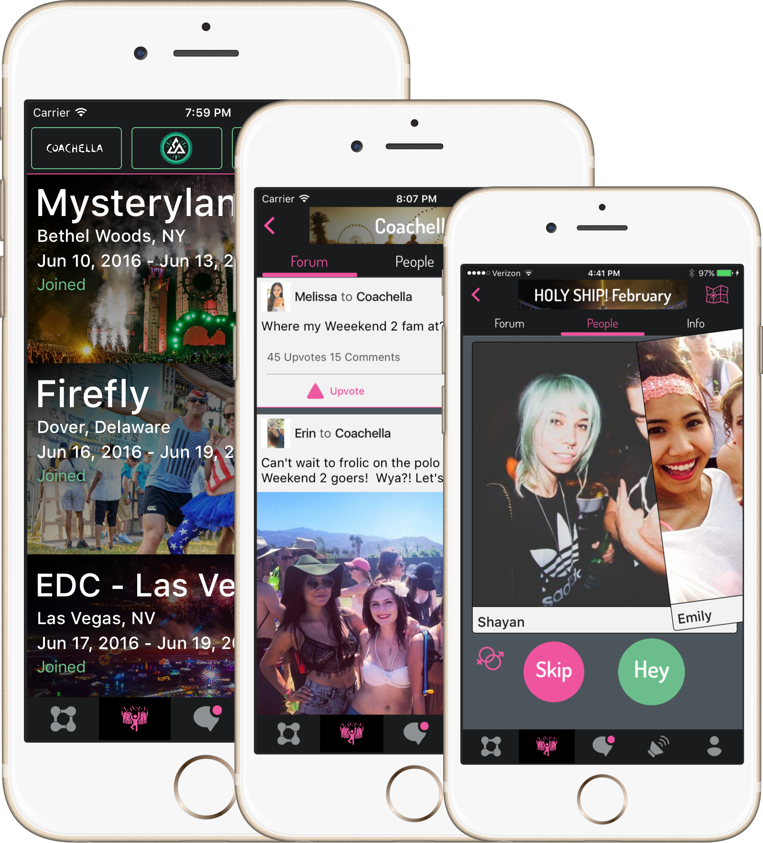
What is Radiate?
Radiate connects people with shared interests through the live events they attend, starting with music festivals.

Slide 3
What is the Problem?
Churn Prediction: Who will stop using the app, and how can we boost user retention?
Swiping Algorithm: How can we increase the number of matches?

Slide 4
Churn Prediction
Who will stop using the app, and how can we boost user retention?

Slide 5

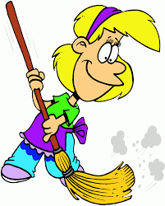
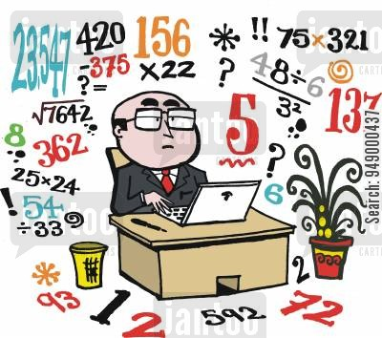
Churn: Data & Methodology
Business Problem & Churn Definition
Data Cleaning, EDA, & Feature Engineering
Modeling

Slide 6
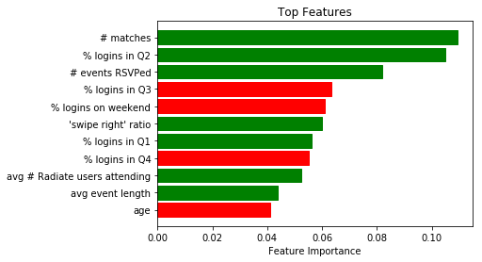
Churn: Results
Gradient
Boosting:
86% AUC

Slide 7
Churn: Key Business Takeaways
% Logins on Weekends → re-work marketing strategies to encourage users to login during the week
Age → focus marketing on younger demographic
‘Swipe Right’ Ratio → optimize swiping algorithm

Slide 8
Swiping Algorithm
How can we increase the number of matches?

Slide 9
Swiping: Data & Methodology
Collaborative Filtering (User-User)

Slide 10
Swiping: Topic Modeling on User Bios
TF-IDF and NMF
Topic 1
new, look, peopl, rave, meet
Topic 2
good, vibe, time, onli, alway
Topic 3
let, rage, weird, togeth, danc
Topic 4
love, music, life, festiv, bass

Slide 11
Swiping: Next Steps
Incorporate topic modeling
Scale out on Spark

Slide 12







Technology Used
{

Slide 13
Thank you!

