Slide 1
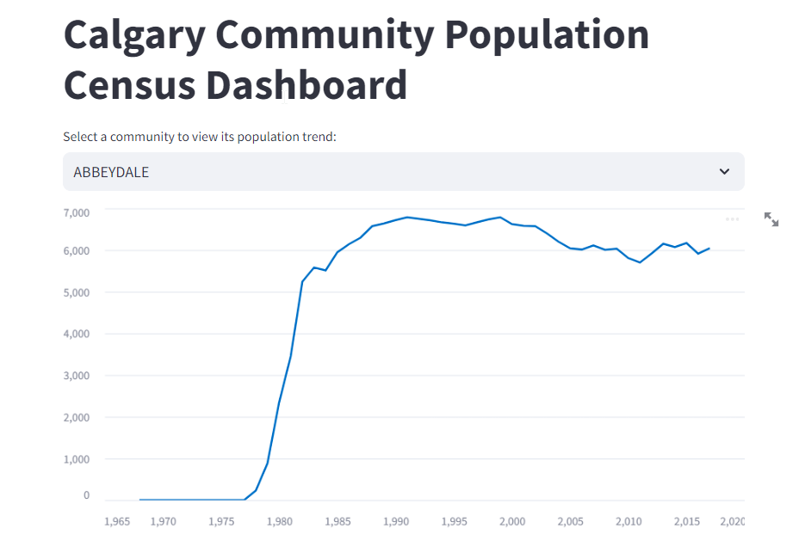
Calgary Community Population Census Dashboard
This dashboard uses Calgary census data to explore population trends by Community. This will help identify communities which need more attention and immigration services.

Slide 2
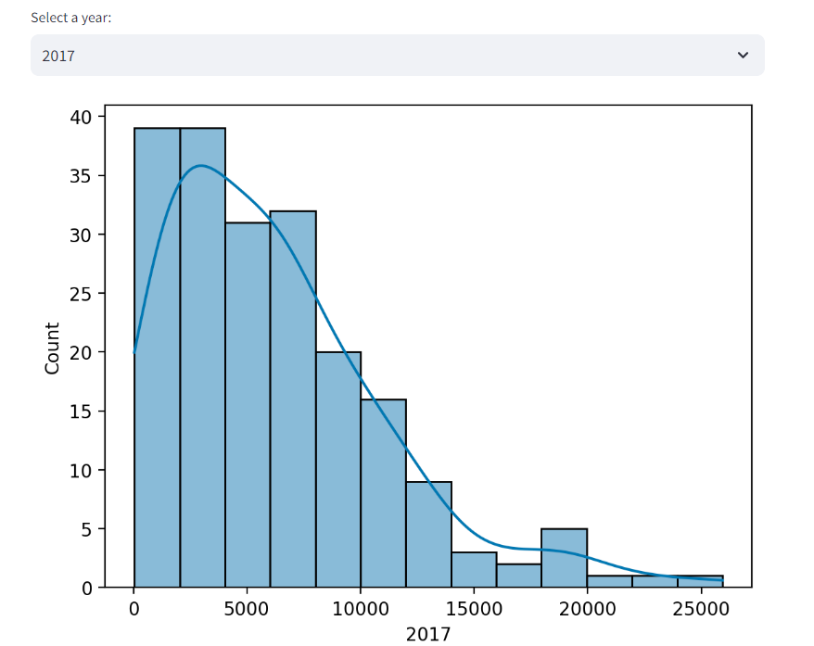
You can also explore by year

Slide 3
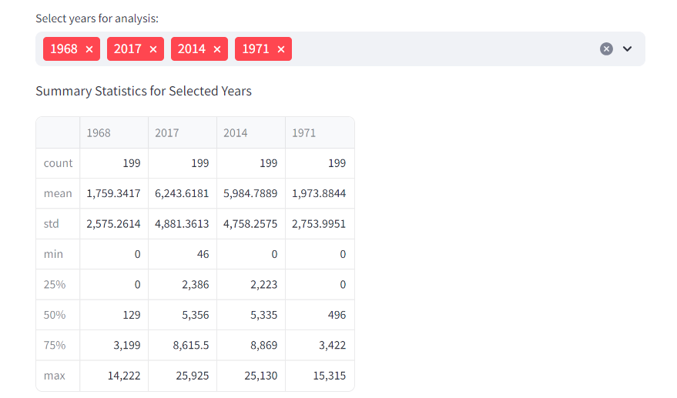
This shows the summary statistics for various census years

Slide 4
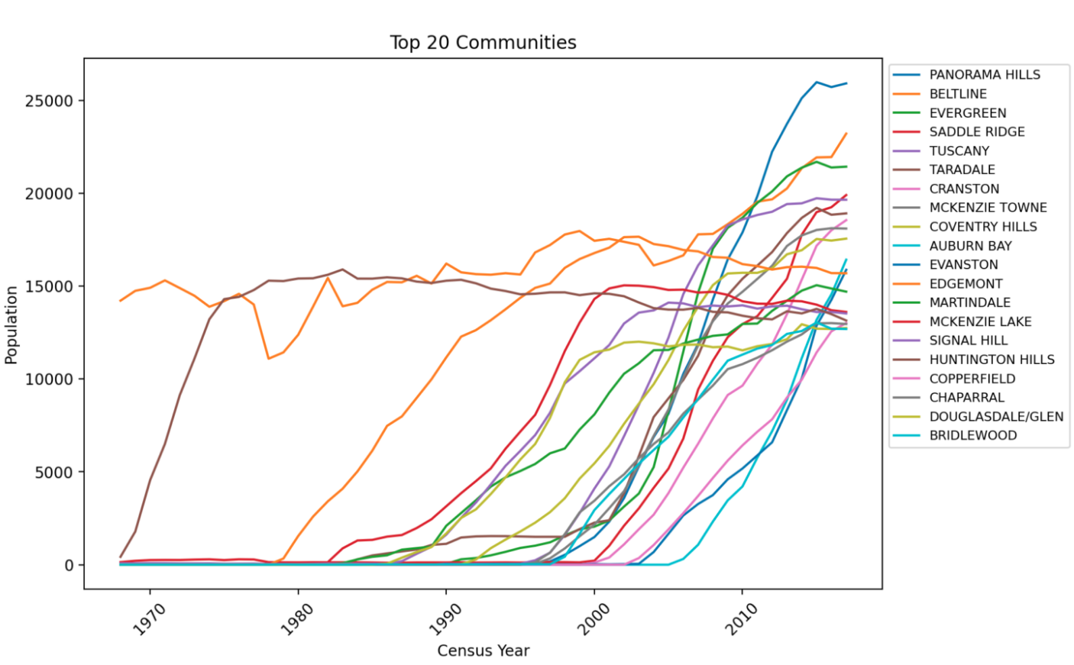
This chart shows the top communities that are experiencing population surges and are favoured by immigrants.

Slide 5
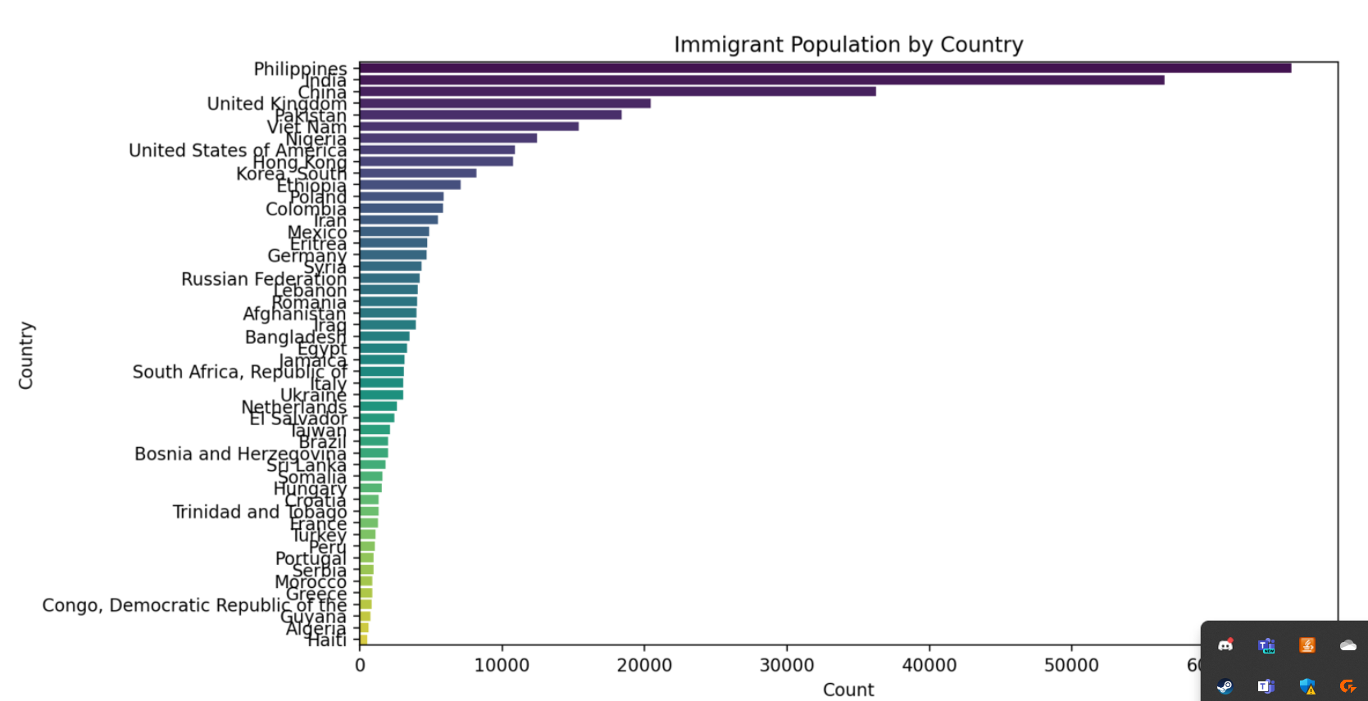
This chart shows the countries that newcomers have come from in Calgary

Slide 6
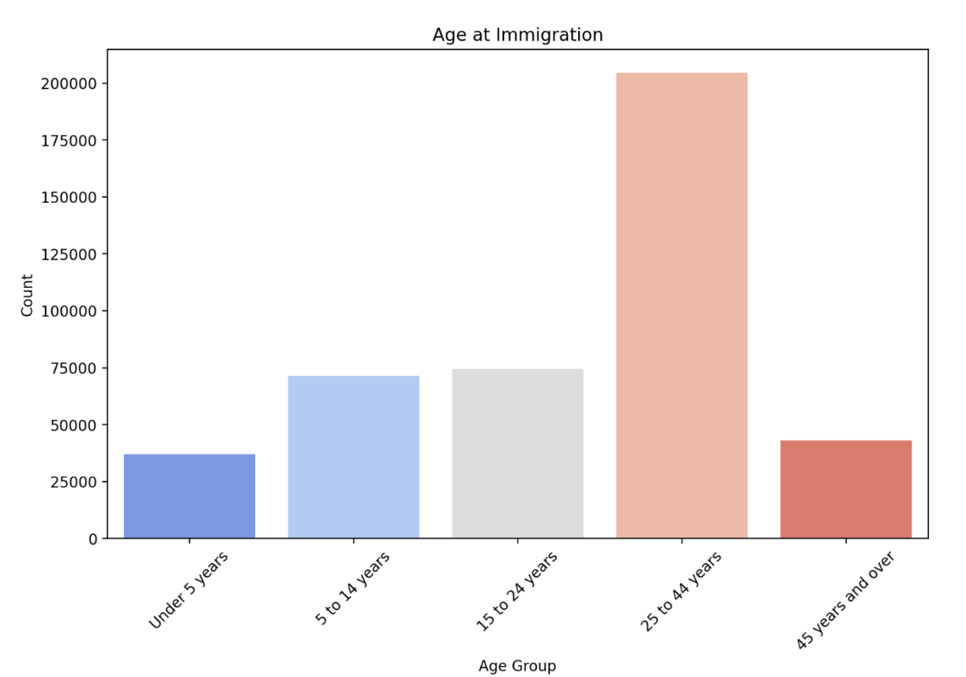
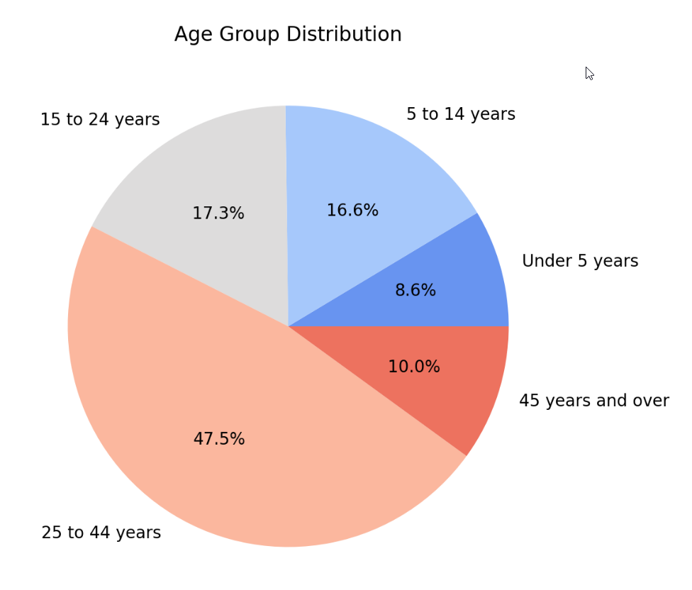
These two charts can help answer questions about the target age demographic of immigration.

Slide 7
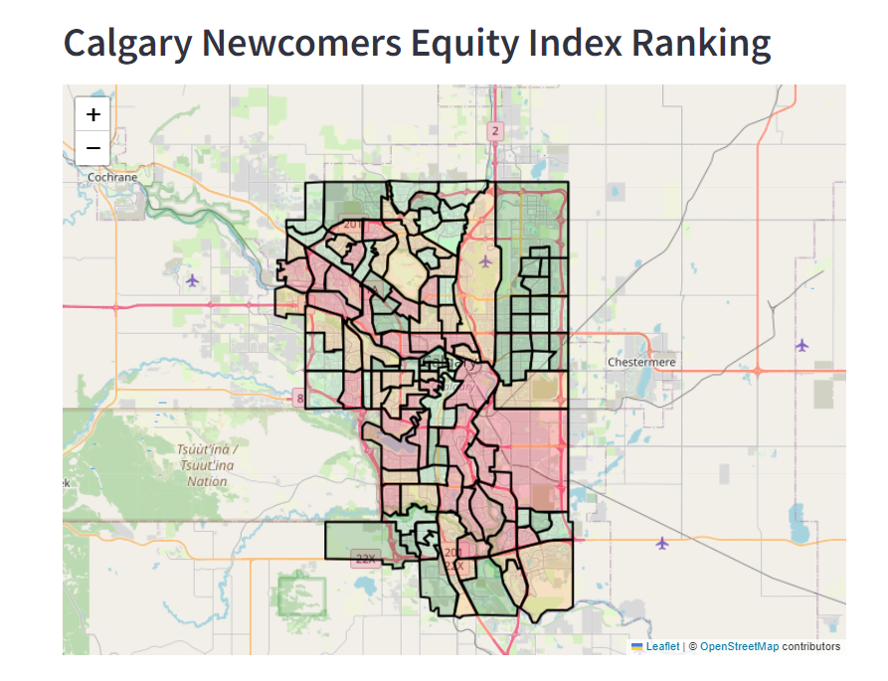
This interactive map shows a Equity index between 1-4 (1 is best, 4 is worst). The index is composed of 20 indicators across five domains or categories that affect overall health and wellbeing of Calgarians. The five domains are:
Economic opportunity
Human and social development
Governance and civic engagement
Physical environment and infrastructure
Population health
This can help answer questions about which areas in the city need to assist newcomers more

