Slide 1

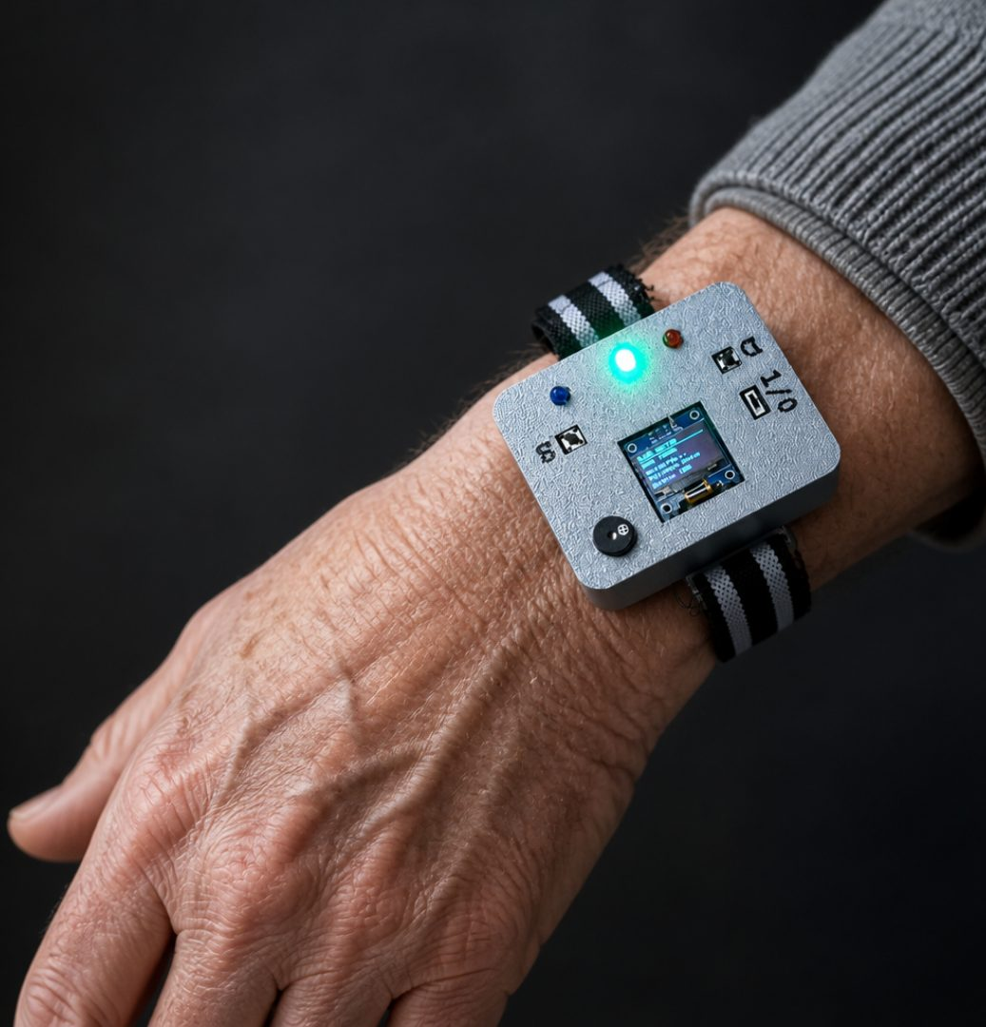

IoT-Based Smart
Elderly safety Band
A Wearable Real-Time Safety and
Emergency Alert System
TEAM NO : 14
TEAM MEMBERS:
K.G.N.RUVINDU 23/ENG/122
K.THARMEEGAN 23/ENG/139
S.PIRUTHTHIKAA 23/ENG/172
DETECT • ALERT • RESPOND

Slide 2

When Help Cannot Be Reached
The design starts with a simple constraint:
An emergency can happen when a phone is out of reach.
01 / EVENT
02 / CONSTRAINT
03 / CONSEQUENCE
Emergency event
Phone is unreachable
Delayed assistance
A fall or other urgent
situation starts the
chain.
The user may be unable
to unlock, hold or call
from a phone.
Time passes before a
caregiver can
understand what
happened.
ENGINEERING REQUIREMENT
Detect→Confirm→Alert→Cancel

Slide 3
From Problem to Engineering Objectives
01
02
03
04
DETECT
RESPOND
NOTIFY
OPERATE
Fall, inactivity and
manual panic
events.
Immediate buzzer,
LED and OLED
feedback.
Send emergency
information to
caregiver through
BLE.
Compact,
rechargeable and
wearable
prototype.
The objective is to demonstrate a complete emergency response prototype rather than only a sensor-based fall detector.
• LOW-COST • WEARABLE • REAL-TIME •USER-FRIENDLY

Slide 4
How the Wearable Works
WEARABLE BAND
CONTROLLER
CAREGIVER INTERFACE
ESP32-C3
App
MPU6050
panic button
Process locally.
Decide quickly.
BLE connection, current
mode and emergency
status.
cancel / sleep
sensing + local feedback
processing + BLE
wireless notification
LOCAL
WIRELESS
SENSING
→
→
→
PROCESSING
DECISION
→
FEEDBACK
NOTIFICATION

Slide 5
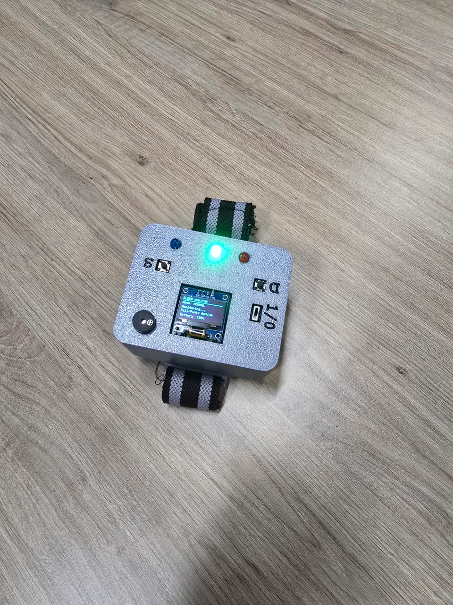
Hardware Architecture
PROCESSING & COMMUNICATION
ESP32-C3 Super Mini
Main controller · built-in Bluetooth Low energy
EXPLODED WEARABLE VIEW
MOTION SENSING
OLED
MPU6050
BUZZER
3-axis accelerometer · 3-axis gyroscope
LEDS
PANIC/CANCEL BUTTONS
USER INTERFACE
OLED · Buzzer · LEDs
Panic button · cancel / sleep button
LiPo battery
TP4056 charger
MT3608 boost
SELECTION RATIONALE
ESP32-C3 was selected because it
combines compact processing
capability with built-in Bluetooth Low
Energy.

Slide 6
From Sensor Data to Caregiver Alert
01
02
03
04
05
SENSE
PROCESS
DECIDE
ALERT
NOTIFY
MPU6050 +
buttons
ESP32-C3
firmware
Thresholds +
state
Buzzer + LED +
OLED
BLE → App
LOCAL DECISION PATH
MPU6050 → ESP32-C3 → Detection & control logic → OLED / buzzer / LED → BLE → App
Processing happens locally on the ESP32 so the wearable can respond before the app is involved.

Slide 7
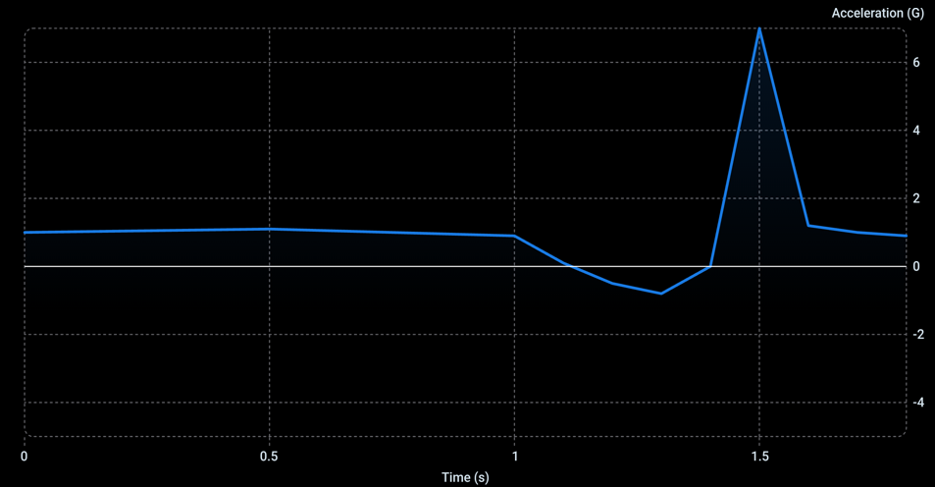
How Does the System Detect a Fall?
Fall Detection: Acceleration Analysis
Fall Detection: Acceleration Analysis
Motion monitoring
Abnormal movement and impact detection
Post-event inactivity
Warning state
Emergency alert
Cancellation window
Technical note: MPU6050 cannot directly measure an exact “1 m fall distance”. Fall
detection is inferred from acceleration and motion patterns.

Slide 8

More Than Fall Detection
01
MANUAL TRIGGER
02
PATTERN TRIGGER
03
TIME TRIGGER
PANIC
FALL
INACTIVITY
Manual emergency
activation using the panic
button.
Abnormal movement +
impact + post-event
inactivity.
No significant movement
detected for a defined
period.
USER CONTROL
Sleep Mode temporarily disables monitoring when
required. Cancel stops a false alert before
escalation.
Sleep Mode / Cancel

Slide 9
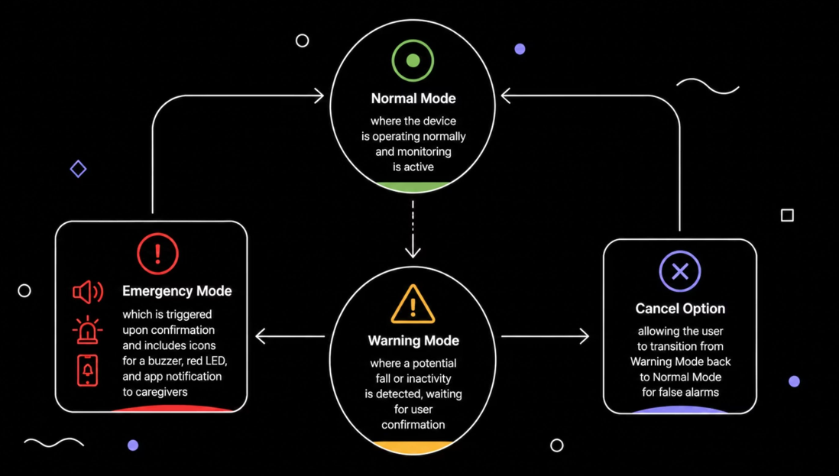
From Detection to Emergency Response
STATE 01
STATE 02
STATE 03
NORMAL
WARNING
EMERGENCY
monitoring
possible
event
confirmed /
timeout
Cancel → NORMAL
Buzzer
OLED alert
A cancellation stage helps reduce unnecessary emergency notifications.

Slide 10
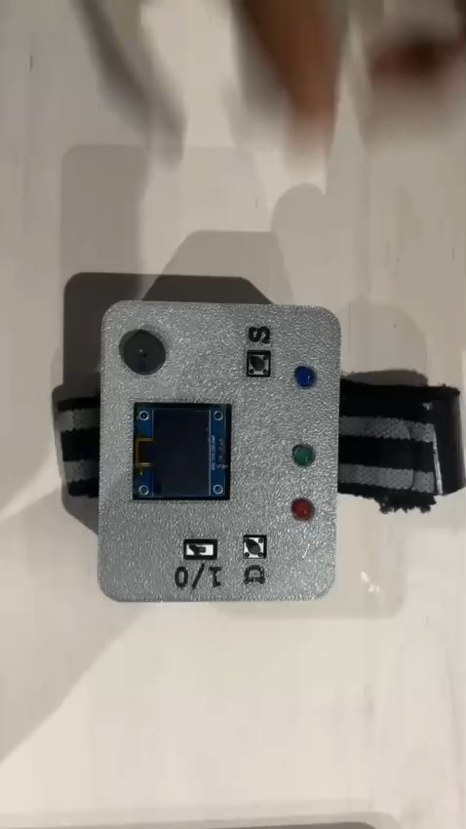
Live Prototype demonstration
DEMO SEQUENCE
01Normal monitoring
02Simulated fall
03Warning state
04Emergency alert
05App
06Panic button
07Cancellation

Slide 11

What We Achieved — and What Comes Next
ACHIEVED
CURRENT LIMITATIONS
FUTURE VERSION
✓ Wearable emergency
monitoring prototype
BLE range is limited.
Wi-Fi / GSM / cloud
Threshold-based detection can
produce false positives /
negatives.
GPS location
✓ Fall + inactivity + panic
detection
Machine-learning-based fall
classification
✓ Local audible / visual alerts
MPU6050 cannot directly
measure actual fall height.
Accurate battery monitoring
✓ BLE caregiver notification
Battery percentage needs
ADC-based voltage measurement for
accuracy.
Custom compact PCB +
improved enclosure
✓ Flutter monitoring
interface
Enclosure and long-term
wearable testing can improve.

Slide 12

Thank You!
Questions & Discussion

