Slide 1
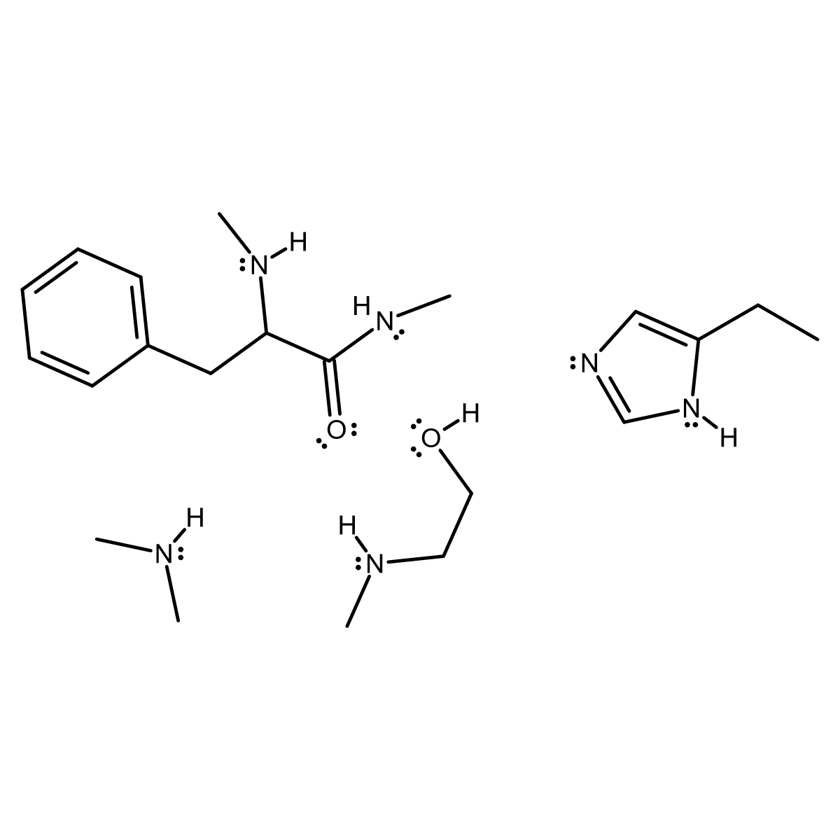
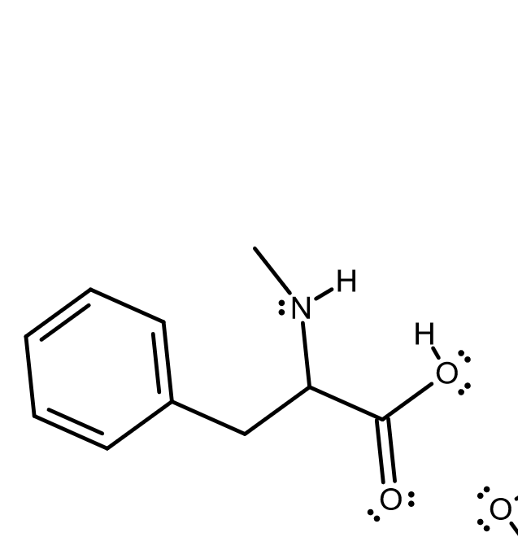
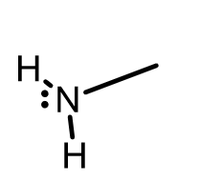
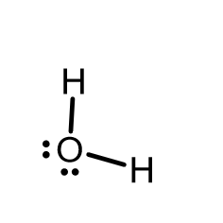

Karsten Theis

Slide 2
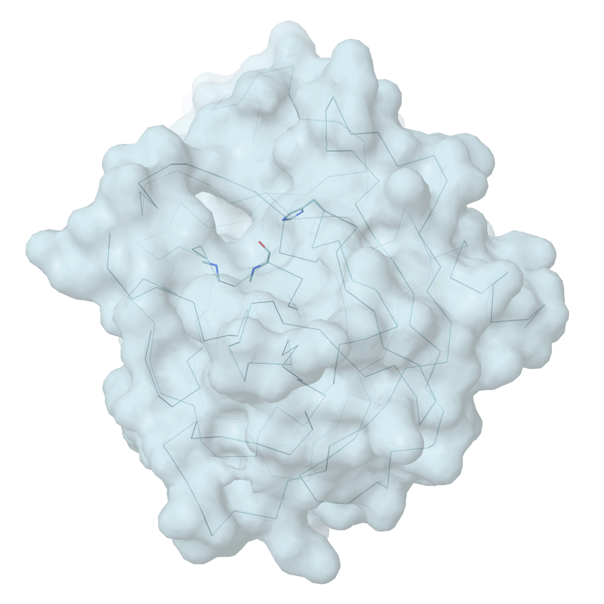
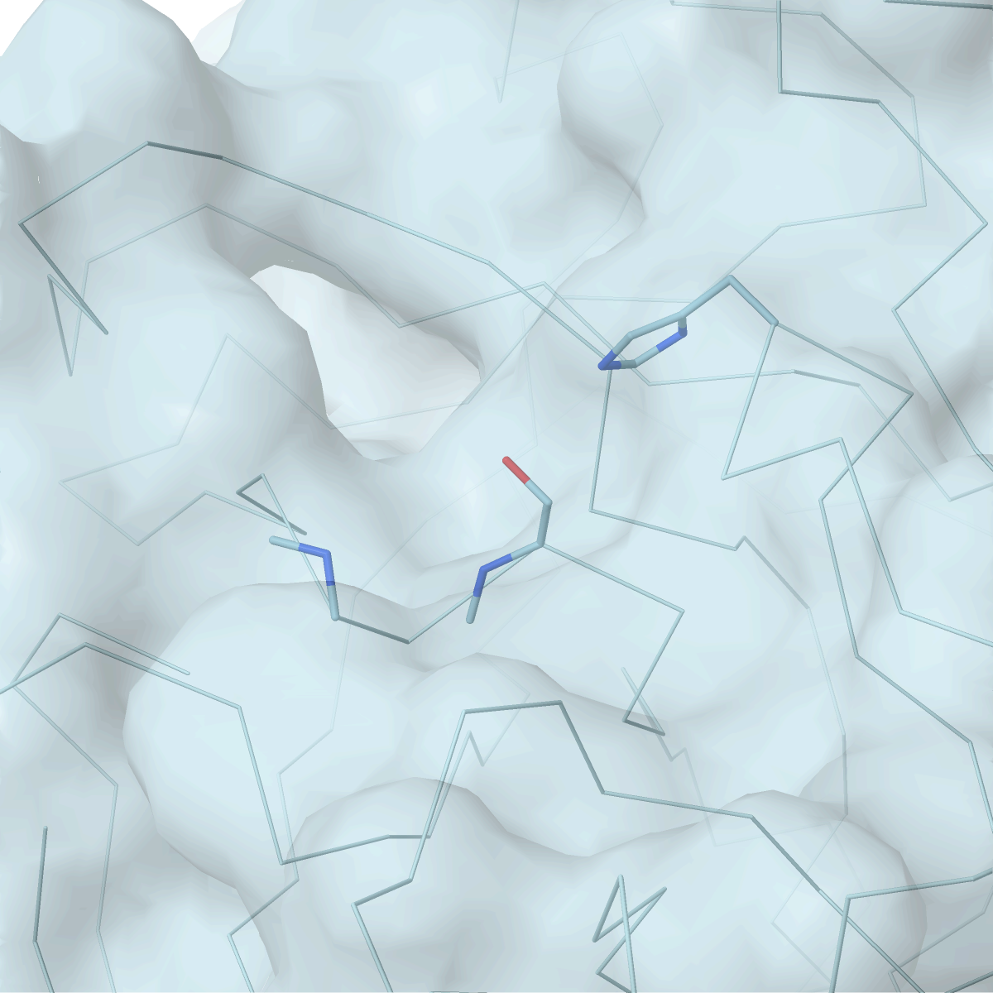
Chymotrypsin: 240 amino acids
Focus on active site and functional groups of 3 amino acids
Karsten Theis

Slide 3
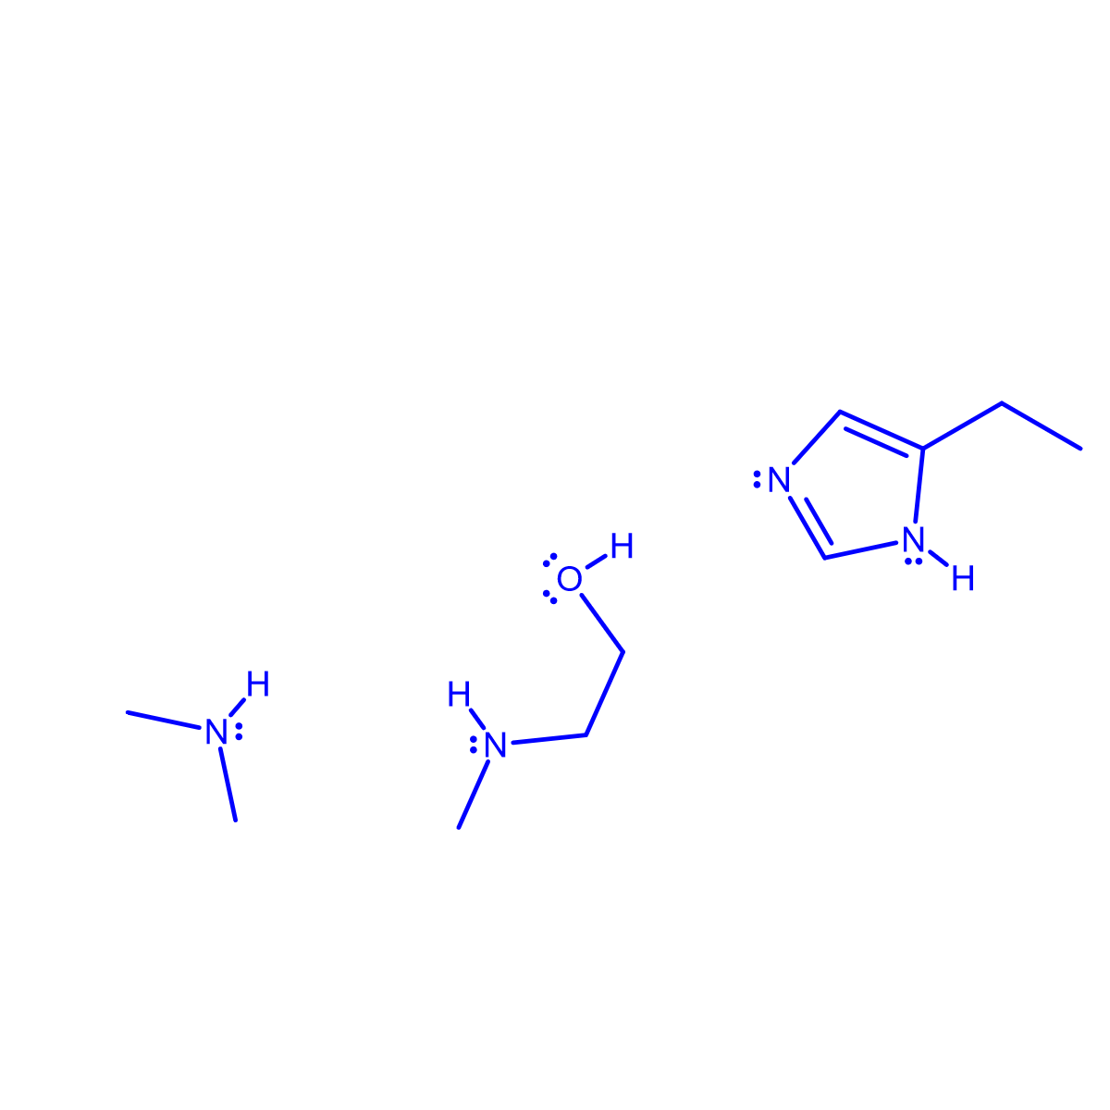
α
His 57
α
Gly 93
Ser 95
α
active site
Karsten Theis

Slide 4
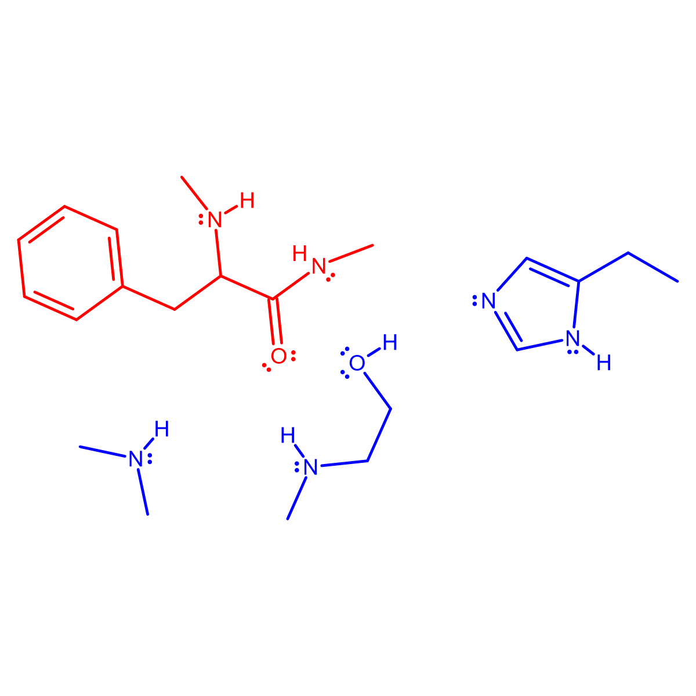
N-term.
:
:
:
C-term.
:
:
:
α
α
α
α
α
Karsten Theis

Slide 5
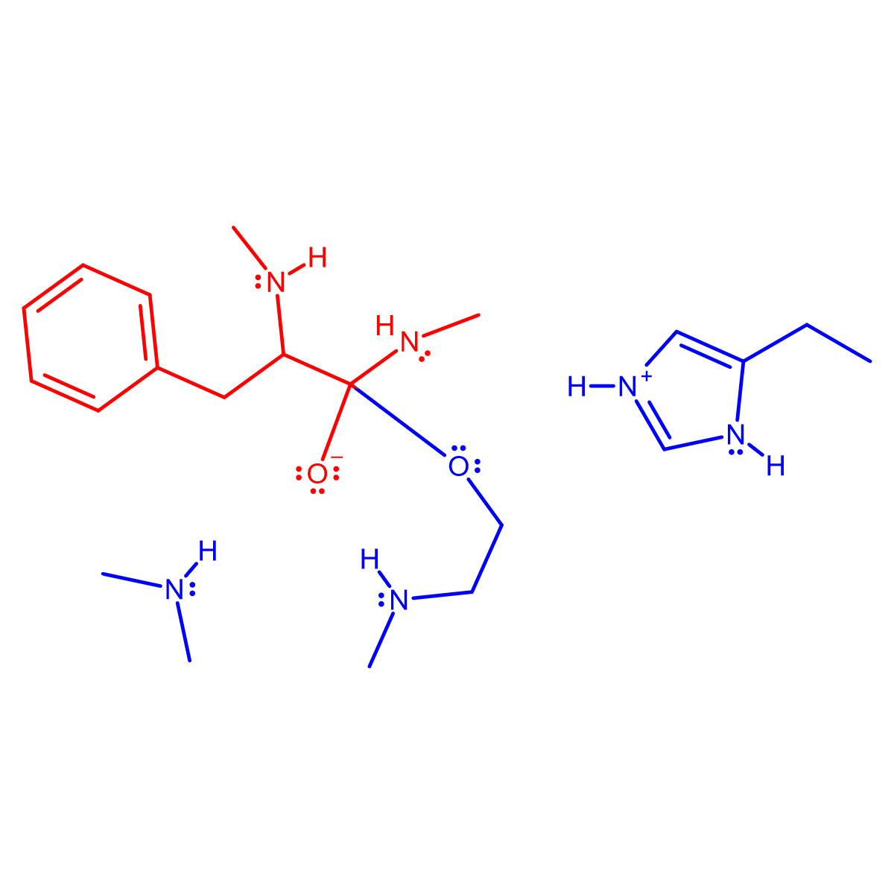
N-term.
:
:
:
C-term.
:
:
:
α
α
α
α
α
Karsten Theis

Slide 6
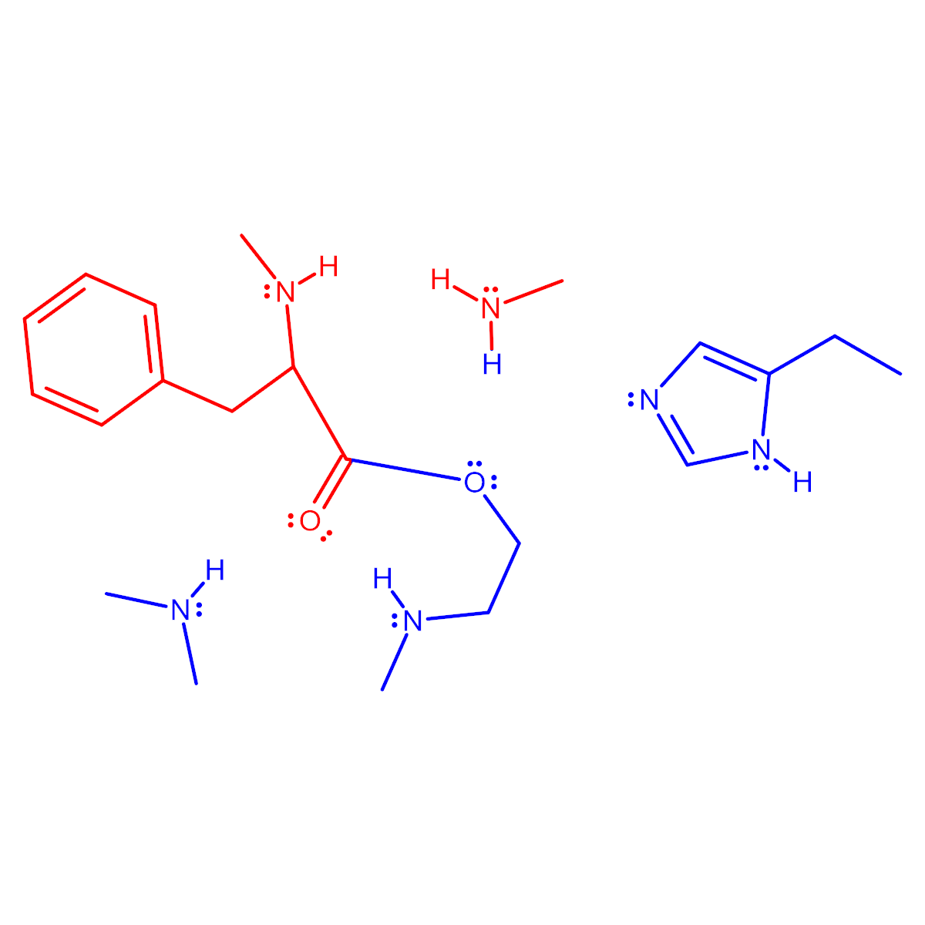
N-term.
:
:
:
C-term.
:
:
:
α
α
α
α
α
Karsten Theis

Slide 7
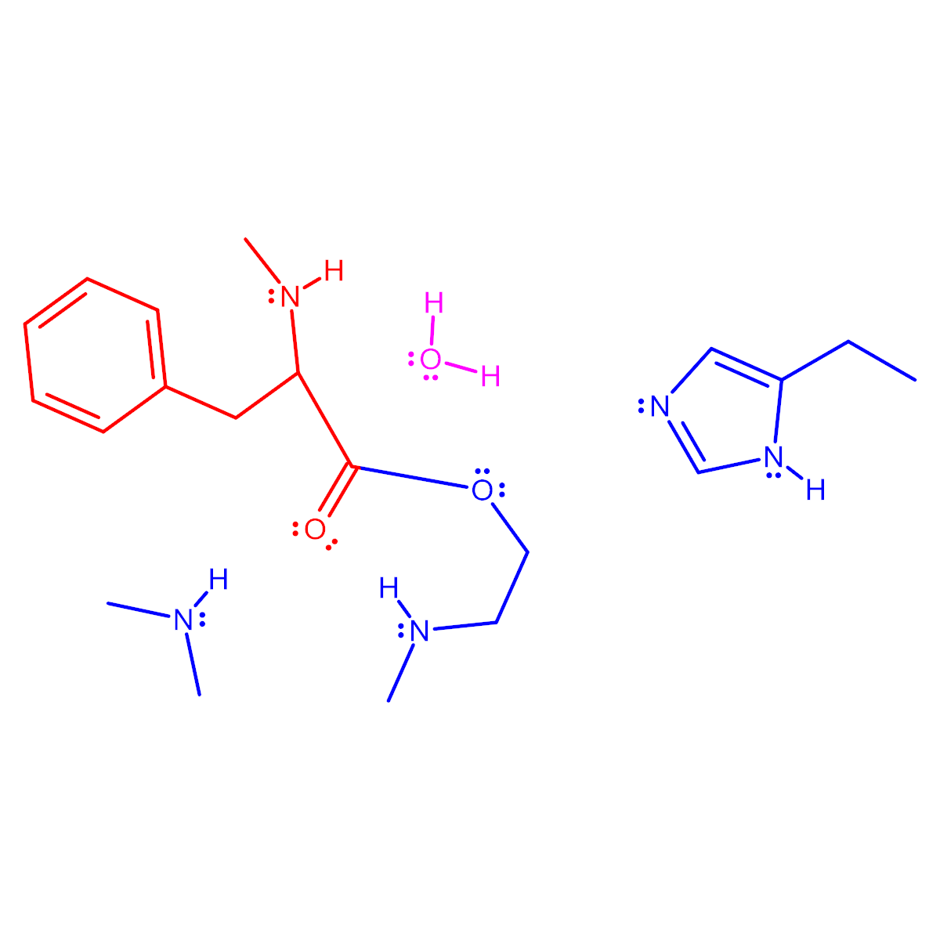
N-term.
:
:
:
α
α
α
α
Karsten Theis

Slide 8
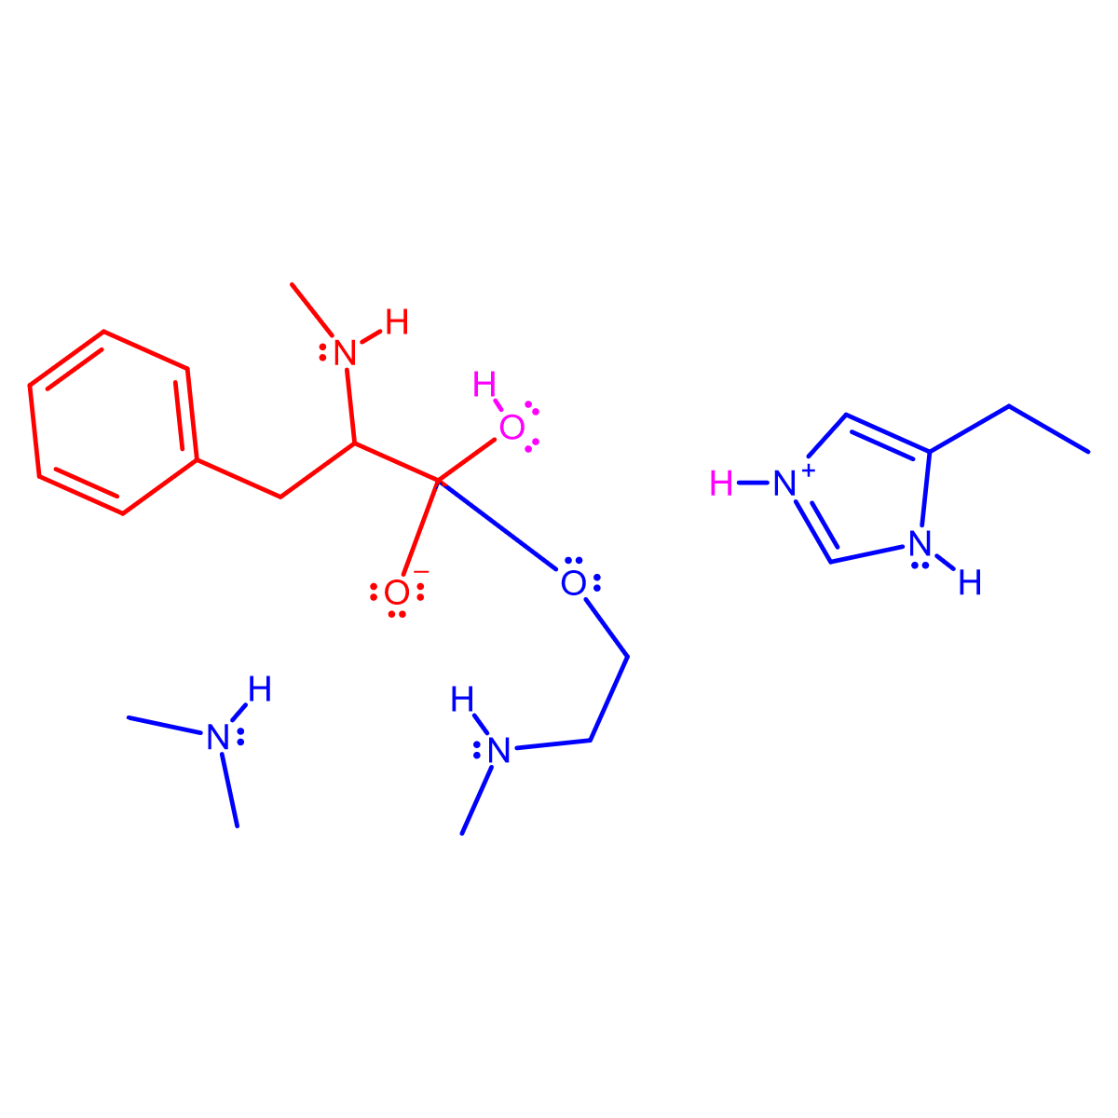
N-term.
:
:
:
α
α
α
α
Karsten Theis

Slide 9
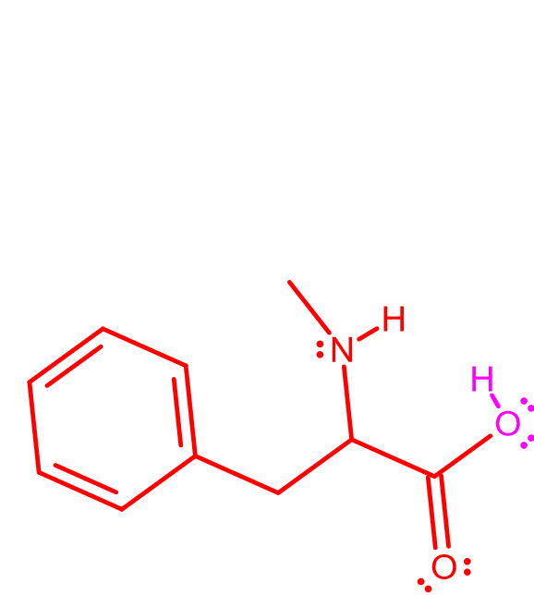
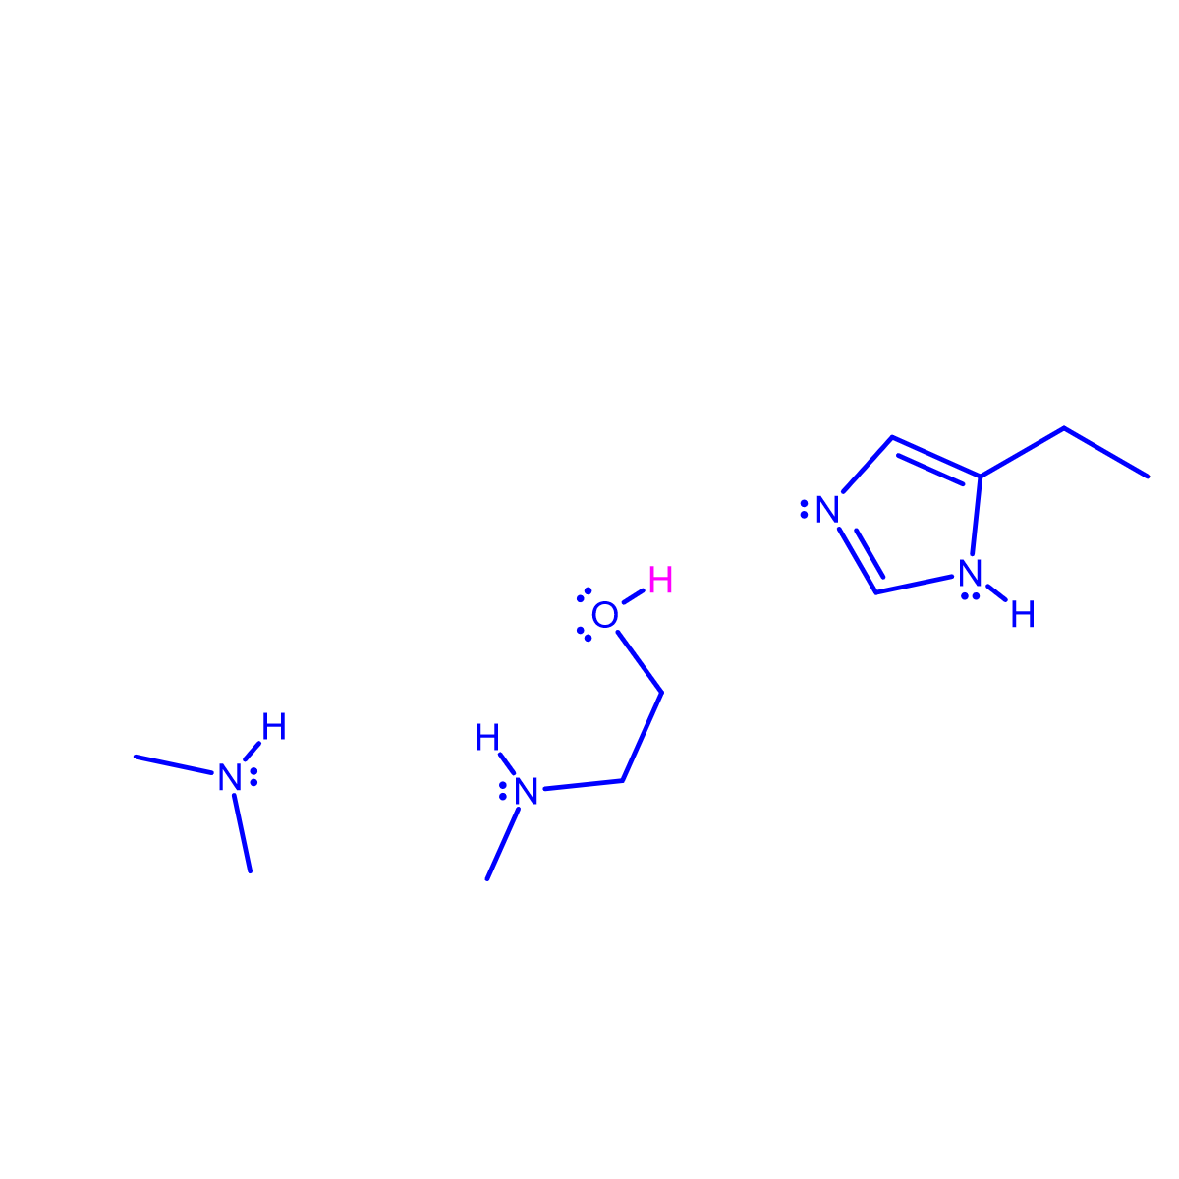
N-term.
:
:
:
α
α
α
α
Karsten Theis

Slide 10
Acknowledgements
My students for asking many questions about this mechanism and sharing their confusion regarding textbook images
Nina Theis for suggesting the slide showing the active site in the context of the entire enzyme
Scott Garman for suggesting better context for the C-alphas
Roderico Acevedo for suggestions and encouragement throughout this project
Karsten Theis 2020

