Slide 1

Predicting Fake and Legitimate News
Fake News Detection System
Kendall Herron

Slide 2

WHY?
Fake news can have significant and wide-ranging impacts on society, affecting various aspects of individuals, communities, and the broader public discourse.
Addressing the challenges posed by fake news requires a multi-faceted approach involving media literacy education, technological solutions, responsible journalism, and public awareness campaigns. By fostering a society that values accurate information and critical thinking, it is possible to mitigate the negative effects of fake news on individuals and communities.
Having this concern, I will create a fake news detection system for the Huggingface data set “train” that will help society identify the different texts of fake news.

Slide 3
Data
For the data, I choose a Huggingface data set of previous outcomes of news articles. With over 40 thousand different news articles that are either fake or true.
To upload this dataset, I utilized a pandas dataframe to read the train csv file.
All this data is online and easy to understand. There wasn’t a lot to clean up as the dataset wasn’t prone to discrepancies.

Slide 4
Data Cleaning
Below is an overview of the main issue I ran into while cleaning the data:
Problem1: This dataset had an irrelevant column.
Solution part 1: normalize the data.
Removing the column for data cleanness.

Slide 5
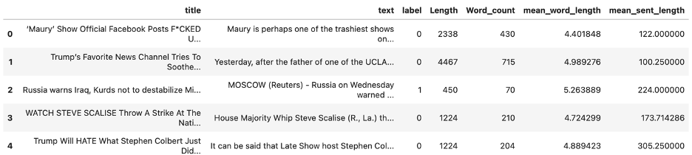
EDA
Below are a few couple pertinent findings:
Counts and length
Character count
Word count
Mean word length
Mean sentence length

Slide 6
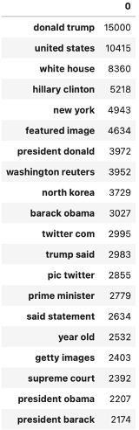
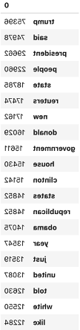
EDA
Display top 20 most frequently occurring words in the text data.
Provide insights into pairs of consecutive words that frequently appear together in the given text data.

Slide 7
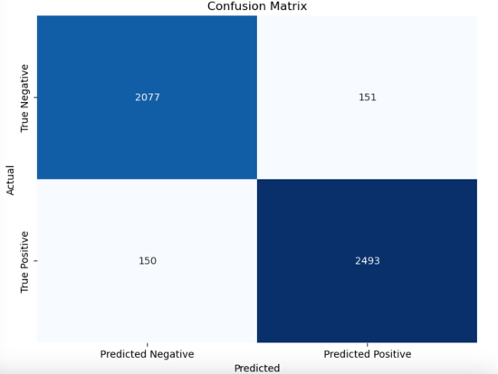
Algorithms
I tested the fake news cleaned dataset with one traditional classifier using scikit learn. Naïve Bayes had a accuracy on 93.82% with the corresponding confusion matrix.

Slide 8
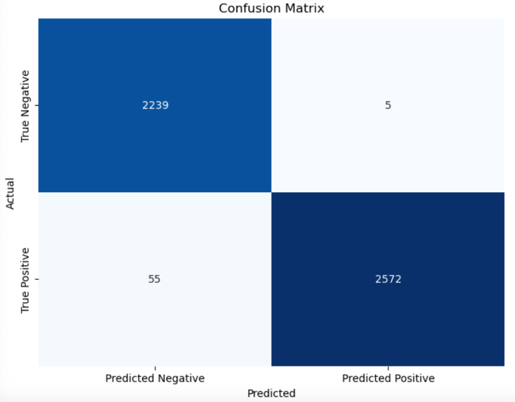
Algorithms
I tokenized the text, converting it into sequences of integers, padding the sequences to a consistent length, and splitting the data into training and validation sets. I trained the model using the Keras Sequential API using batch size of 128 on 5 epochs. It should be noted that this neural network, although is 98.77% accurate it’s also computationally expensive.

Slide 9
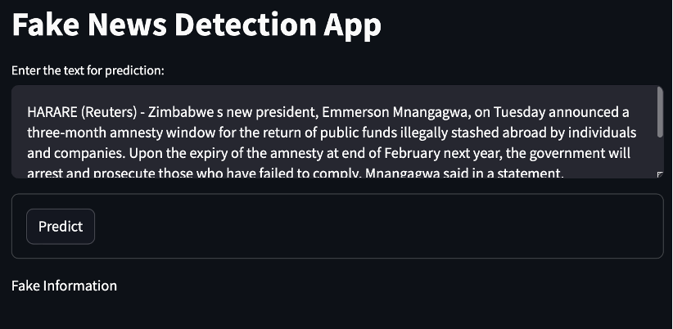
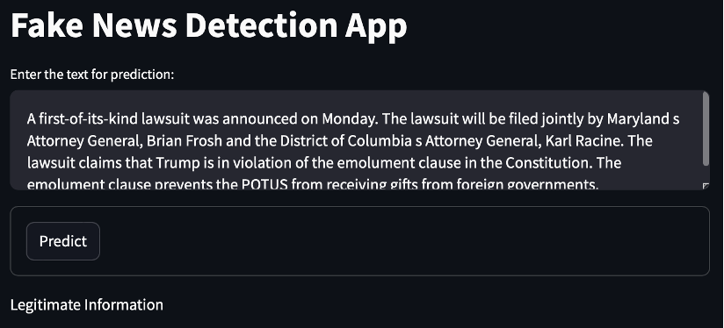
Predictions
In the final prediction application, the user can enter a text. The user can then select the predict button to see if the text is fake or legitimate.

Slide 10
Future Improvements
In the future, I would love to spend more time creating a batch system, wherein a user could import any text and to predict if the text is legitimate or fake. This fake news detection system would also be improved by connecting to an automation, where a user could receive a report of texts that are fake or legitimate to alert individuals.

Slide 11
Stay True!

