Slide 1
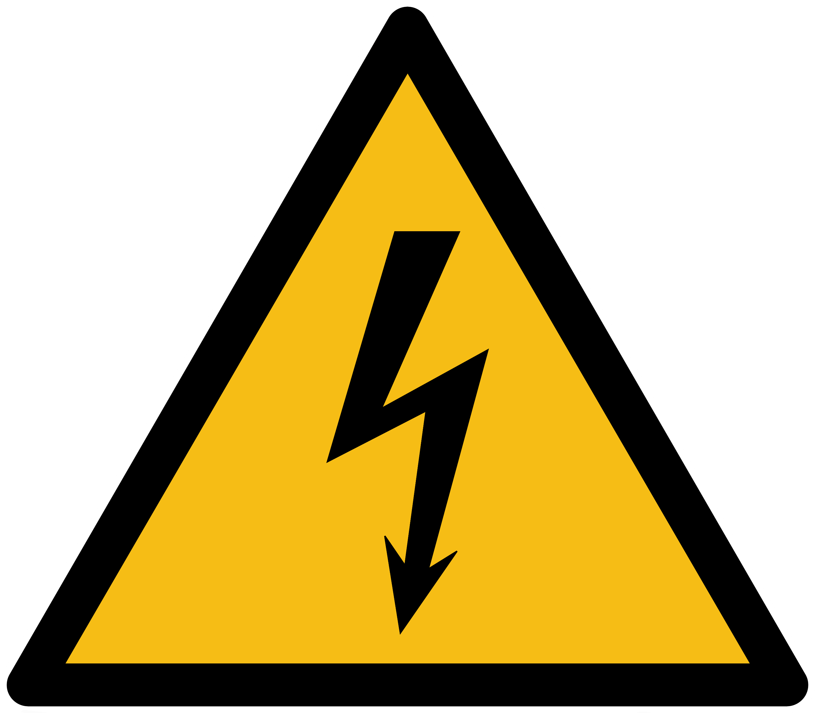
High Voltage
Always Energized

