Slide 1
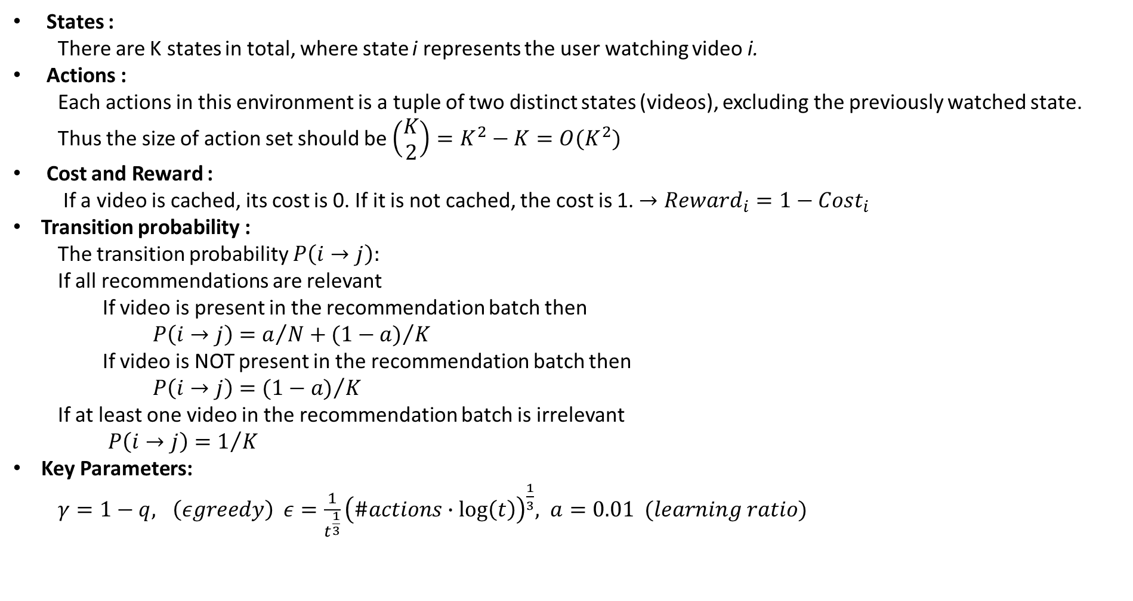
Understanding the Recommendation System Environment
States :
There are K states in total, where state i represents the user watching video i.
Actions :
Each actions in this environment is a tuple of two distinct states (videos), excluding the previously watched state. Thus the size of action set should be $\left(\begin{aligned}K \\ 2\end{aligned}\right)=K^{2}−K=O(K^{2})$
Cost and Reward :
If a video is cached, its cost is 0. If it is not cached, the cost is 1. $→Reward_{i}=1−Cost_{i}$
Transition probability :
The transition probability $P\left(i→j\right):$
If all recommendations are relevant
If video is present in the recommendation batch then
$P\left(i→j\right)=a/N+{(1−a)}/K$
If video is NOT present in the recommendation batch then
$P\left(i→j\right)={(1−a)}/K$
If at least one video in the recommendation batch is irrelevant
$P\left(i→j\right)=1/K$
Key Parameters:
$γ=1−q, \left(εgreedy\right) ε=\frac{1}{t^{\frac{1}{3}}}{\left(\#actions∙log\left(t\right)\right)}^{\frac{1}{3}}, a=0.01 (learning ratio)$

Slide 2
SlateQ Algorithm Description
\begin{itemize}
\item {\bf States}: As in the first phase,the implemented MDP environment represents a content recommendation system with a content
catalogue consisting of K items. Each item corresponds to a state, where state $i$ represents the user
watching video $i$. Therefore, there are K states in total.
\item {\bf Action} The actions are the recommendation batch of $N$ videos. However the slateQ algorithm completely avoids any referance to the action set, so in practice, the action has no use
\item {\bf Cost} The costs associated with watching a video depend on whether it is cached or not. If a video is
cached, its cost is 0. If it is not cached, the cost is 1.
\item {\bf Rewards} The rewards in this environment are defined as $reward_i = 1 - 2\cdot cost_i$. Therefore, if a video is cached,
the reward is 1, and if it is not cached, the reward is -1. In the previous phase we used the $reward_i = 1 - cost_i$, but we observed faster convergence with the updated version
\item The parameter $\gamma$ (discount factor), $\epsilon$ (exproration-exploitation trade off parameter for $\epsilon$-greedy) and $\alpha$ (learning rate) are the same as in part 1. Specificaly:
\begin{itemize}
\item $\gamma = 1-q$
\item $\epsilon = \frac{1}{t^{1/3}}(\#num \;of \;states\cdot \log t )^{1/3} $ where t is the number of episodes
\item $\alpha = 0.01$
\end{itemize}
\end{itemize}

Slide 3
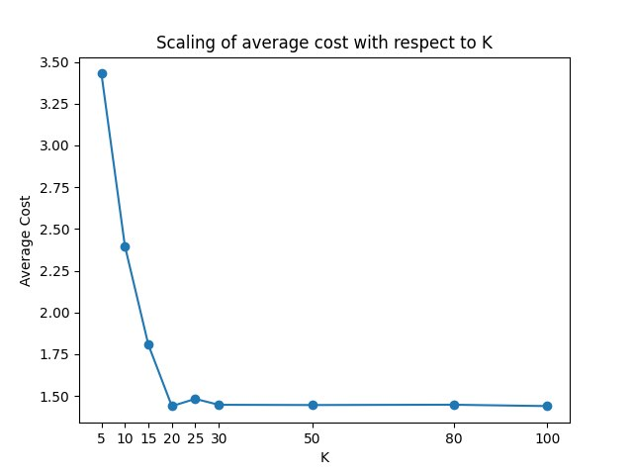
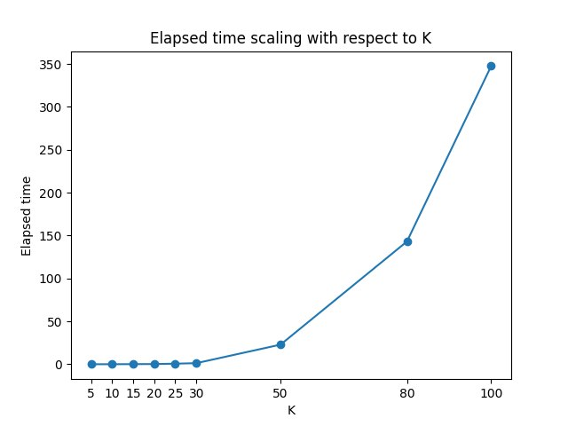
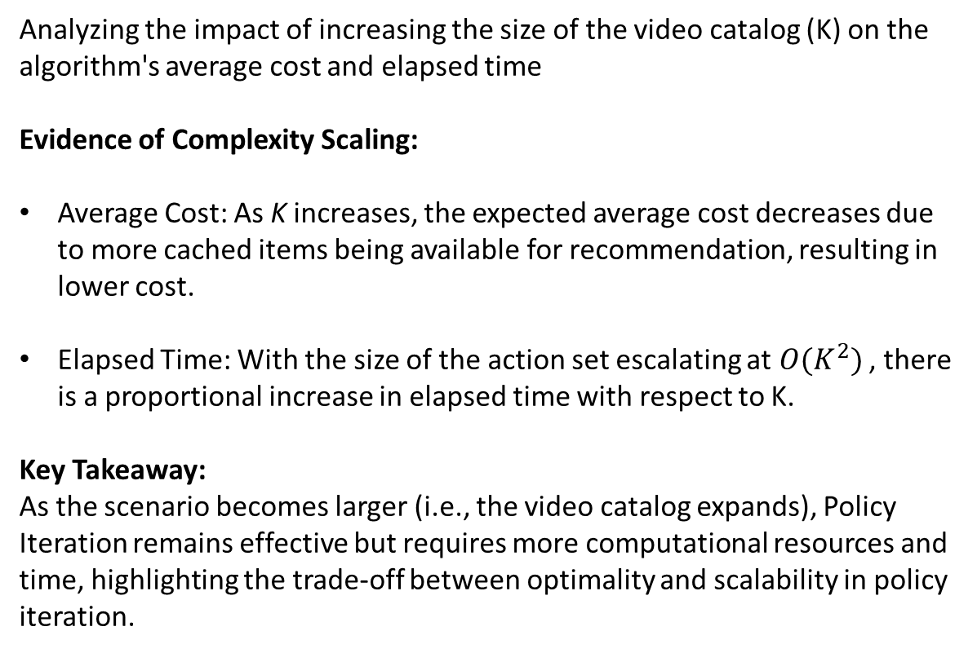
Solution Complexity and Scaling
Analyzing the impact of increasing the size of the video catalog (K) on the algorithm's average cost and elapsed time
Evidence of Complexity Scaling:
Average Cost: As K increases, the expected average cost decreases due to more cached items being available for recommendation, resulting in lower cost.
Elapsed Time: With the size of the action set escalating at$O(K^{2})$ , there is a proportional increase in elapsed time with respect to K.
Key Takeaway:
As the scenario becomes larger (i.e., the video catalog expands), Policy Iteration remains effective but requires more computational resources and time, highlighting the trade-off between optimality and scalability in policy iteration.

Slide 4
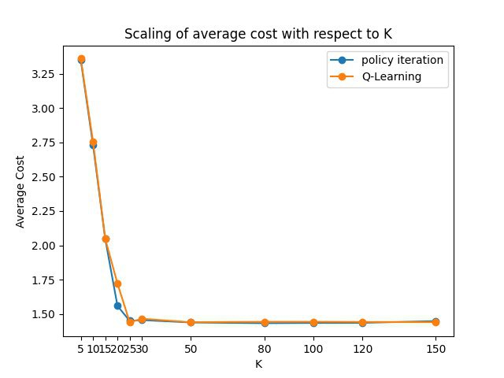
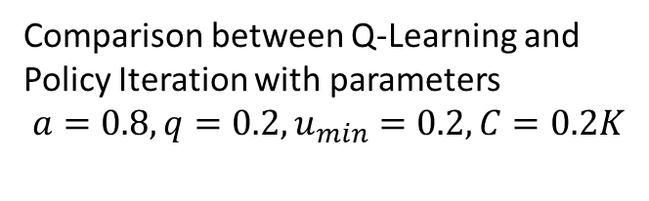
Optimal Policy Verification through Q-Learning
Evidence of Optimality:
1. Average Cost Comparison: The Q-Learning algorithm line coincides with the Policy Iteration line, indicating that they both achieve a similar average cost, hence showing the optimal policy effectiveness of Q-Learning.
2. Policy Comparison: Both algorithms may not find the exact same policies due to multiple equivalent policies, but both converge to a policy that minimizes the cost, indicating Q-Learning's ability to find an optimal policy.
Key Takeaway:
Q-Learning effectively identifies the optimal policy and performs as well as Policy Iteration in minimizing the cost.
Comparison between Q-Learning and Policy Iteration with parameters
$a=0.8, q=0.2, u_{min}=0.2, C=0.2K$

Slide 5
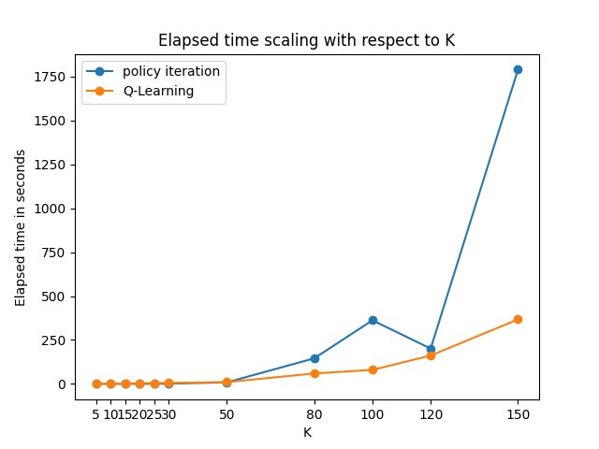
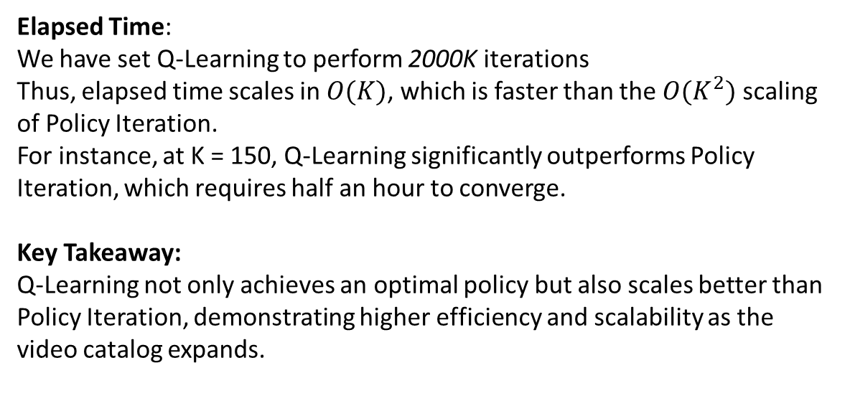
Solution Complexity and Scalability in Q-Learning
Elapsed Time:
We have set Q-Learning to perform 2000K iterations
Thus, elapsed time scales in $O(K)$, which is faster than the $O(K^{2})$ scaling of Policy Iteration.
For instance, at K = 150, Q-Learning significantly outperforms Policy Iteration, which requires half an hour to converge.
Key Takeaway:
Q-Learning not only achieves an optimal policy but also scales better than Policy Iteration, demonstrating higher efficiency and scalability as the video catalog expands.
Comparison between Q-Learning and Policy Iteration with parameters
$a=0.8, q=0.2, u_{min}=0.2, C=0.2K$

Slide 6
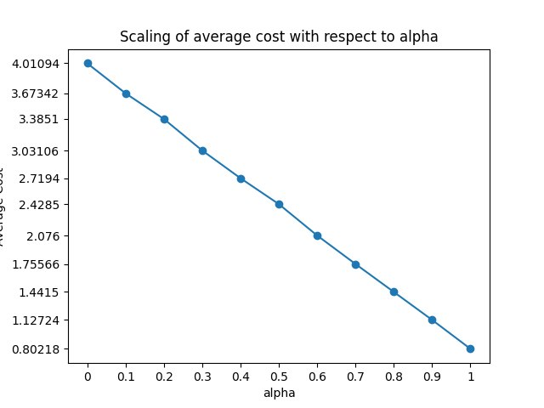
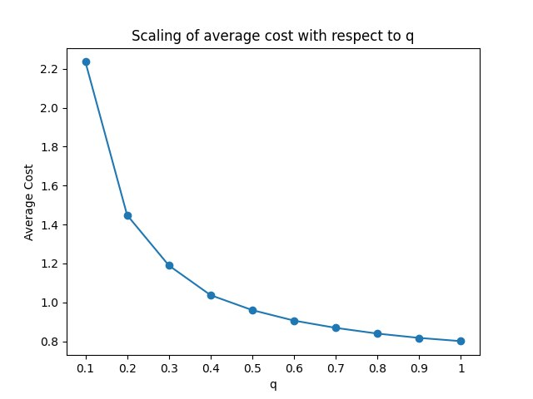
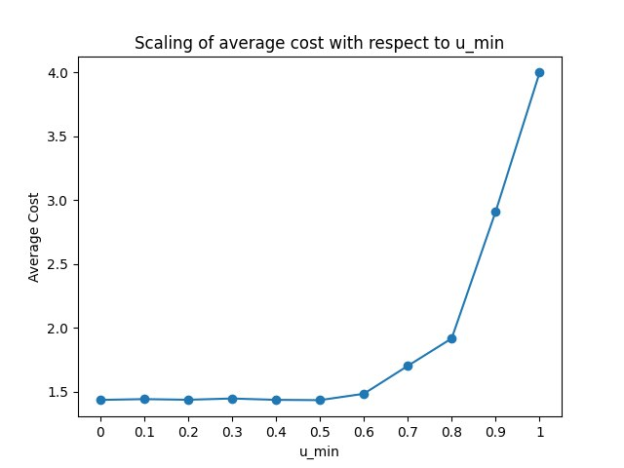
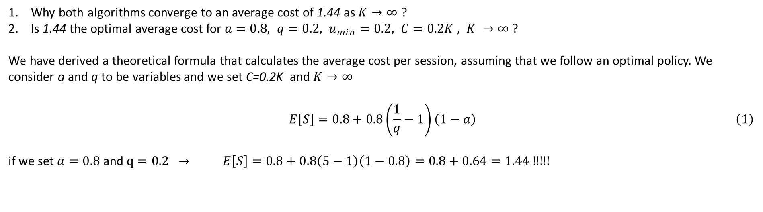
Interpretation of the results
Why both algorithms converge to an average cost of 1.44 as $K→∞$ ?
Is 1.44 the optimal average cost for $a=0.8, q=0.2, u_{min}=0.2, C=0.2K , K →∞$?
We have derived a theoretical formula that calculates the average cost per session, assuming that we follow an optimal policy. We consider a and q to be variables and we set C=0.2K and $K→∞$
$$\begin{aligned} E\left[S\right]=0.8+0.8\left(\frac{1}{q}−1\right)\left(1−a\right) \#\left(1\right) \end{aligned}$$
if we set $a=0.8$ and $q=0.2 →$ $E\left[S\right]=0.8+0.8\left(5−1\right)\left(1−0.8\right)=0.8+0.64=1.44 ‼‼!$

Slide 7

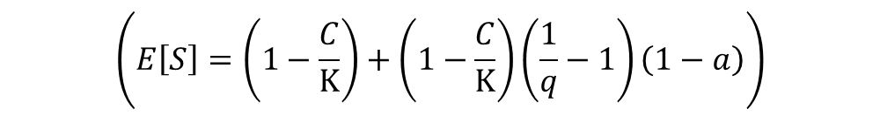
$$\left(E\left[S\right]=\left(1−\frac{C}{K}\right)+\left(1−\frac{C}{K}\right)\left(\frac{1}{q}−1\right)\left(1−a\right)\right)$$

