Slide 1

Variational Quantum Linear Solver
Introduction to Quantum Computing
Kalamarakis Theodoros: 2018030022
February 8 , 2023
GitHub Repository
https://github.com/kthod/VQLS_algorithm.git

Slide 2
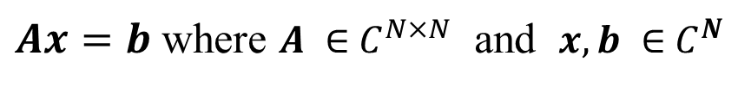
Introduction
$Ax=b$ where $A ∈{ C}^{N×N}$ and $x, b ∈{ C}^{N}$
Existing classical algorithms solves the problem with polynomial scaling in N

Slide 3
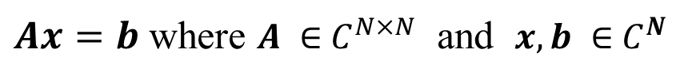
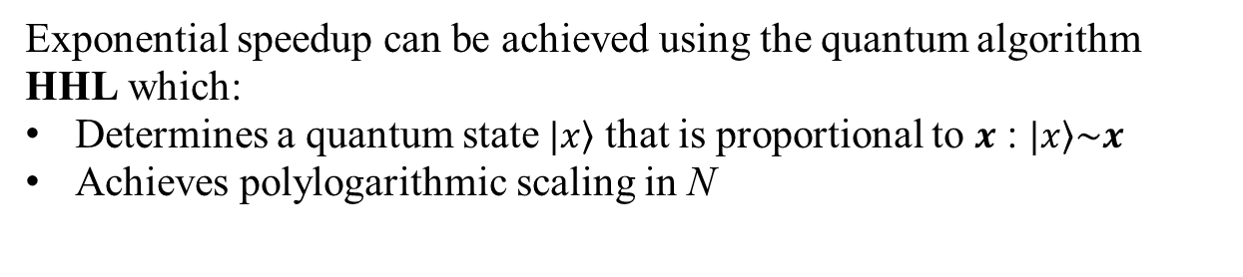
Introduction
$Ax=b$ where $A ∈{ C}^{N×N}$ and $x, b ∈{ C}^{N}$
Exponential speedup can be achieved using the quantum algorithm HHL which:
Determines a quantum state $\left.|x\right\rangle$ that is proportional to $x$ : $\left.|x\right\rangle \sim x$
Achieves polylogarithmic scaling in N

Slide 4
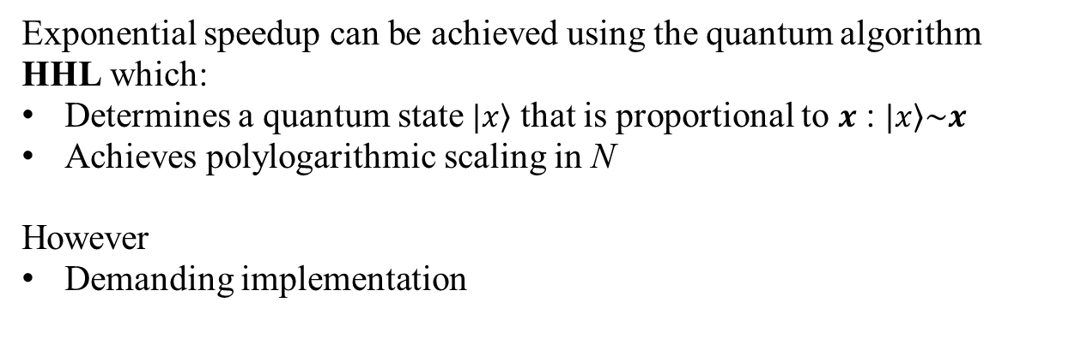
Introduction
$Ax=b$ where $A ∈{ C}^{N×N}$ and $x, b ∈{ C}^{N}$
Exponential speedup can be achieved using the quantum algorithm HHL which:
Determines a quantum state $\left.|x\right\rangle$ that is proportional to $x$ : $\left.|x\right\rangle \sim x$
Achieves polylogarithmic scaling in N
However
Demanding implementation

Slide 5
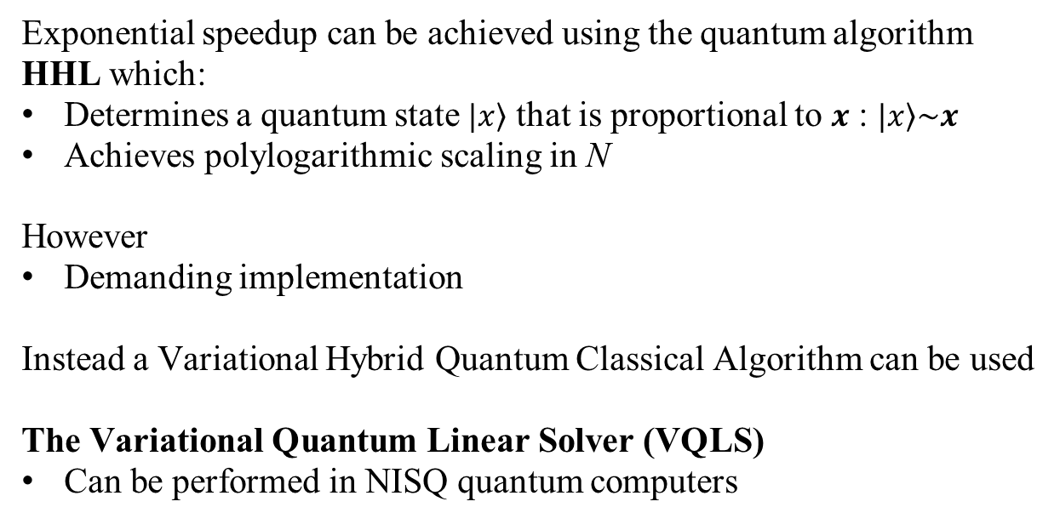
Introduction
$Ax=b$ where $A ∈{ C}^{N×N}$ and $x, b ∈{ C}^{N}$
Exponential speedup can be achieved using the quantum algorithm HHL which:
Determines a quantum state $\left.|x\right\rangle$ that is proportional to $x$ : $\left.|x\right\rangle \sim x$
Achieves polylogarithmic scaling in N
However
Demanding implementation
Instead a Variational Hybrid Quantum Classical Algorithm can be used
The Variational Quantum Linear Solver (VQLS)
Can be performed in NISQ quantum computers

Slide 6
Complexity of the VQLS algorithm
Complexity analysis on heuristic algorithms like the VHQCA is difficult

Slide 7
Complexity of the VQLS algorithm
Complexity analysis on heuristic algorithms like the VHQCA is difficult
However complexity can be determined by performing numerical simulation

Slide 8
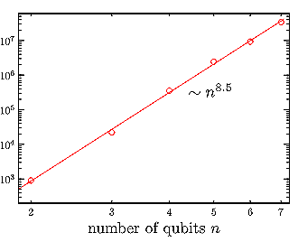
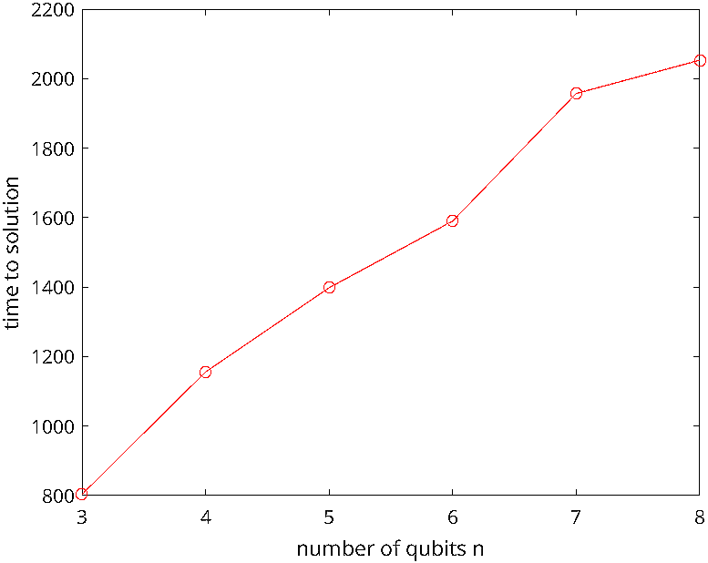
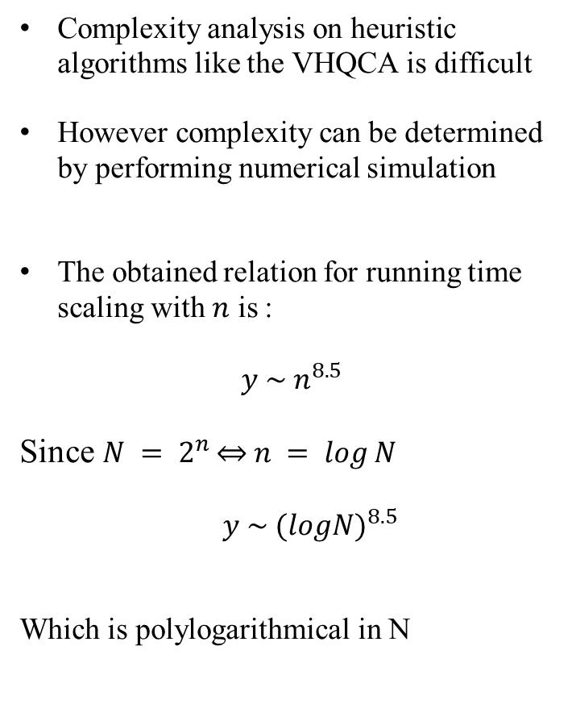
Complexity of the VQLS algorithm
Complexity analysis on heuristic algorithms like the VHQCA is difficult
However complexity can be determined by performing numerical simulation
The obtained relation for running time scaling with $n$ is :
$$y \sim { n}^{8.5}$$
Since $N = 2^{n }\underset{⇔}{ } n = \log{N}$
$y \sim {(logN)}^{8.5}$
Which is polylogarithmical in N
Time to solution scaling with n. Figure taken from original paper
Time to solution scaling with n. Measurements taken using our implementation of VQLS

Slide 9
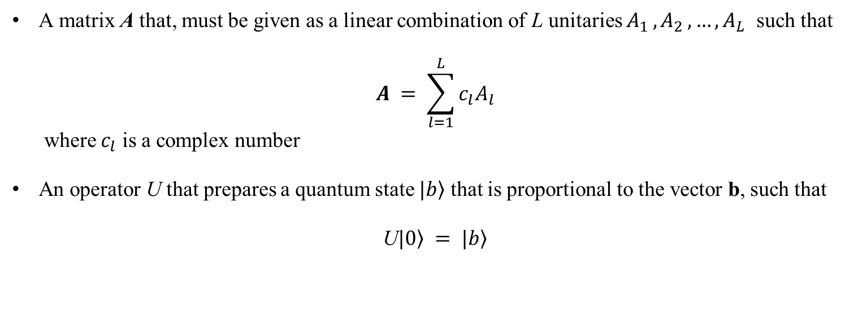
Description of the algorithm
Input
A matrix A that, must be given as a linear combination of L unitaries $A_{1 }{,A}_{2},…,A_{L}$ such that
$$A = \sum_{l=1}^{L}{c_{l}A_{l}}$$
where $c_{l}$ is a complex number
An operator U that prepares a quantum state $\left.|b\right\rangle$ that is proportional to the vector b, such that
U$\left.|0\right\rangle = \left.|b\right\rangle$

Slide 10
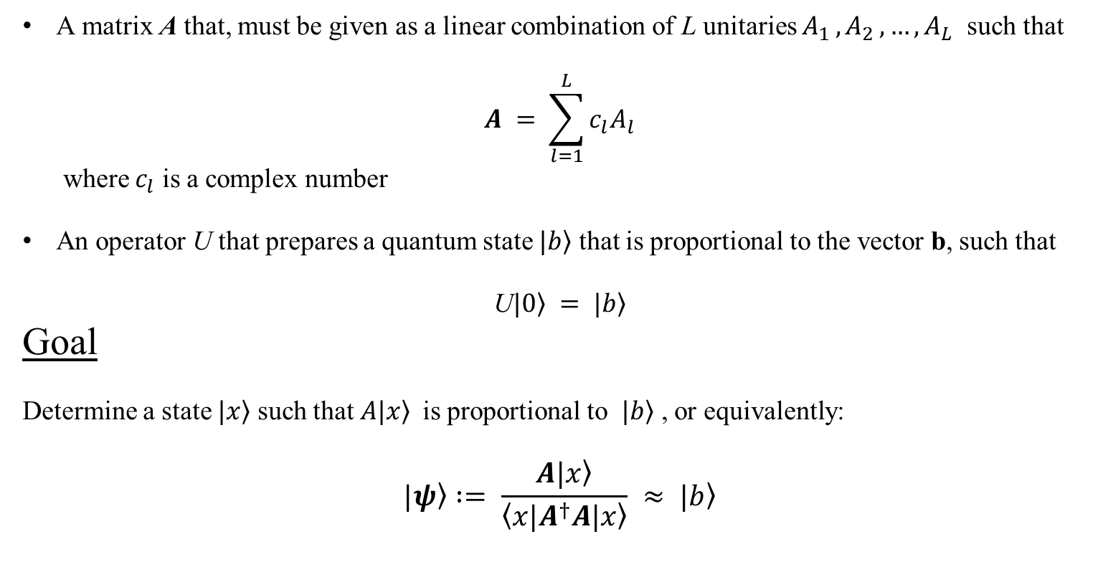
Description of the algorithm
Input
A matrix A that, must be given as a linear combination of L unitaries $A_{1 }{,A}_{2},…,A_{L}$ such that
$$A = \sum_{l=1}^{L}{c_{l}A_{l}}$$
where $c_{l}$ is a complex number
An operator U that prepares a quantum state $\left.|b\right\rangle$ that is proportional to the vector b, such that
U$\left.|0\right\rangle = \left.|b\right\rangle$
Goal
Determine a state $\left.|x\right\rangle$ such that $\left.A|x\right\rangle$is proportional to $\left.|b\right\rangle$ , or equivalently:
$$\left.|ψ\right\rangle := \frac{A\left.|x\right\rangle }{\left\langle x|A^{†}A\left.|x\right\rangle \right.} ≈ \left.|b\right\rangle$$

Slide 11
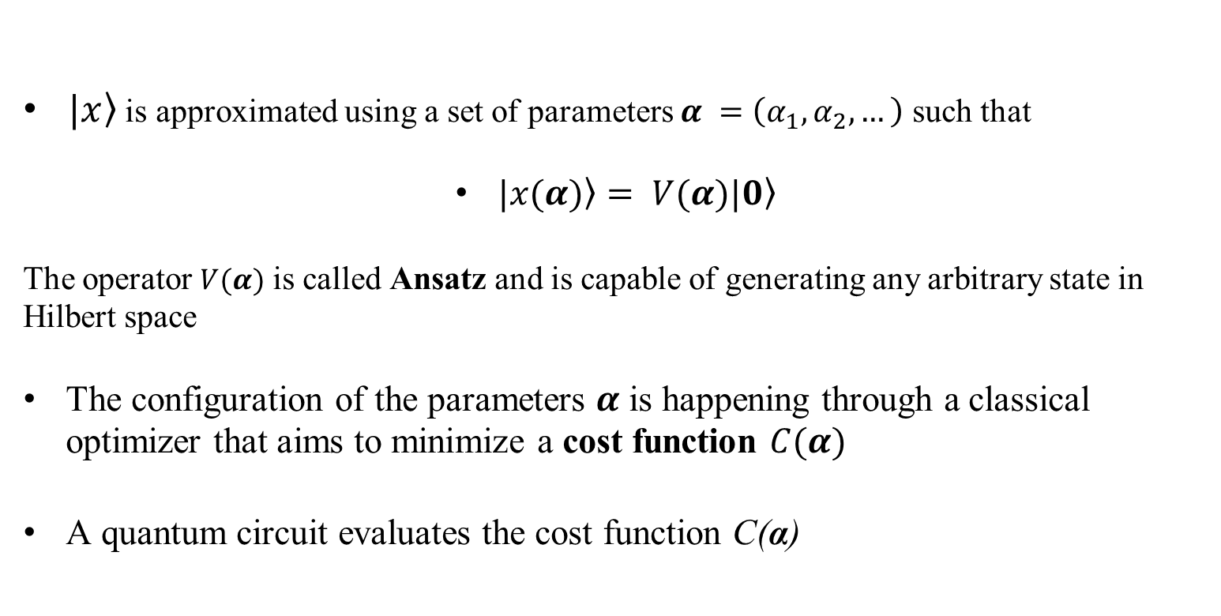
Description of the algorithm
$\left.|x\right\rangle$ is approximated using a set of parameters $α =\left(α_{1},α_{2},…\right)$ such that
$\left.|x(α)\right\rangle = V(α)|\left.0\right\rangle$
The operator $V(α)$ is called Ansatz and is capable of generating any arbitrary state in Hilbert space
The configuration of the parameters $α$ is happening through a classical optimizer that aims to minimize a cost function $C(α)$
A quantum circuit evaluates the cost function C(α)

Slide 12
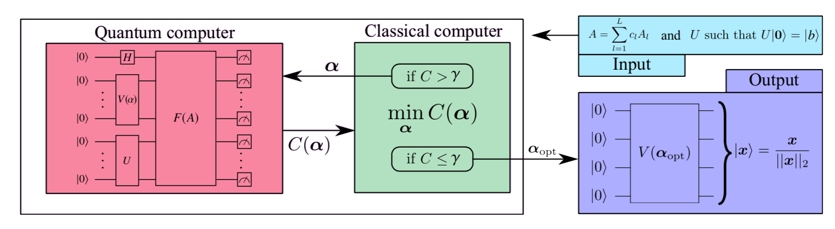
Description of the algorithm
Interaction between the Quantum circuit and the classical optimizer

Slide 13
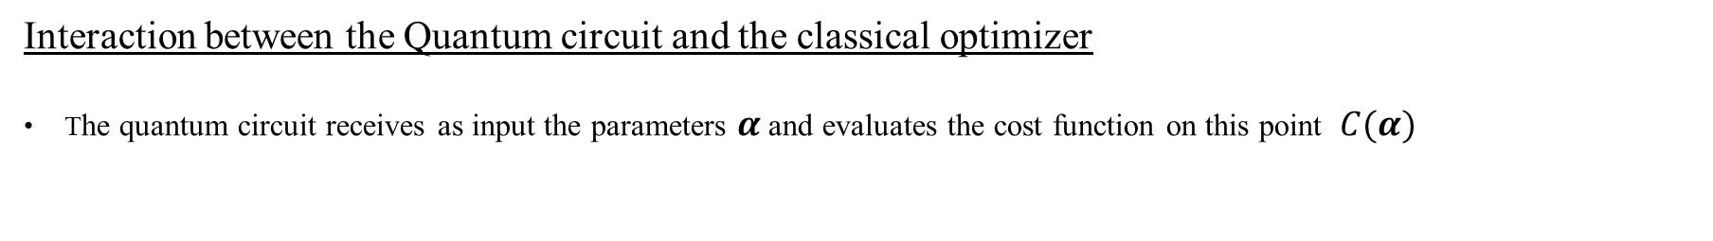
Description of the algorithm
Interaction between the Quantum circuit and the classical optimizer
The quantum circuit receives as input the parameters $α$ and evaluates the cost function on this point $C(α)$

Slide 14
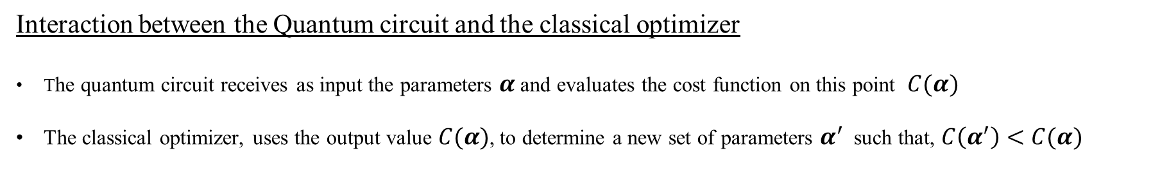
Description of the algorithm
Interaction between the Quantum circuit and the classical optimizer
The quantum circuit receives as input the parameters $α$ and evaluates the cost function on this point $C(α)$
The classical optimizer, uses the output value $C(α)$, to determine a new set of parameters $α^{′}$ such that, $C\left(α^{′}\right)<C(α)$

Slide 15
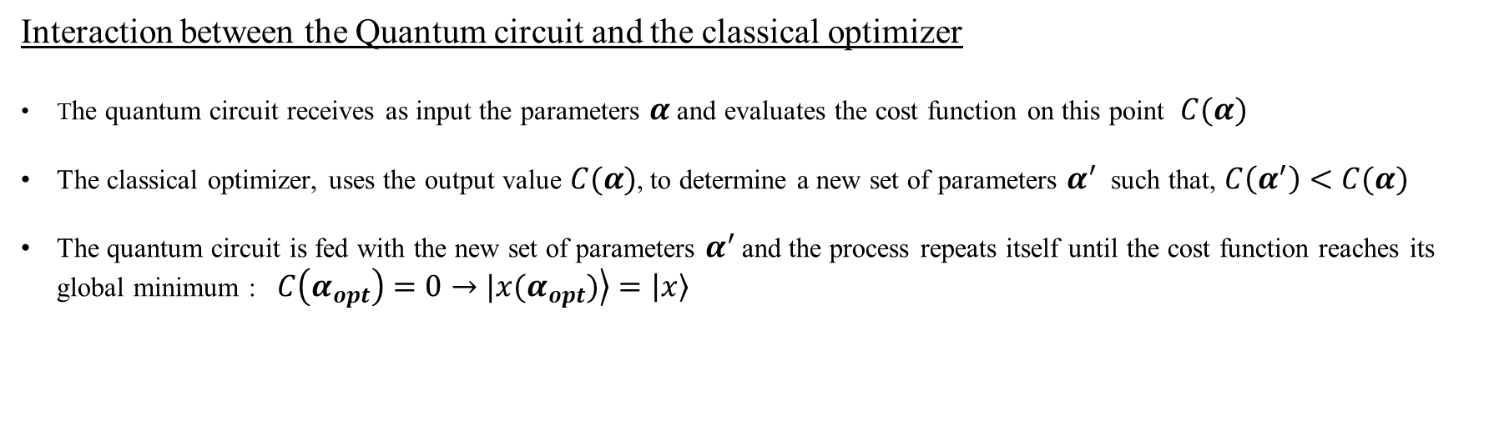
Description of the algorithm
Interaction between the Quantum circuit and the classical optimizer
The quantum circuit receives as input the parameters $α$ and evaluates the cost function on this point $C(α)$
The classical optimizer, uses the output value $C(α)$, to determine a new set of parameters $α^{′}$ such that, $C\left(α^{′}\right)<C(α)$
The quantum circuit is fed with the new set of parameters $α^{′}$ and the process repeats itself until the cost function reaches its global minimum : $C\left(α_{opt}\right)=0→\left.|x(α_{opt})\right\rangle =\left|\left.x\right\rangle \right.$

Slide 16
The Ansatz
Capable of generating any arbitrary state on Hilbert space, including the entangled ones

Slide 17
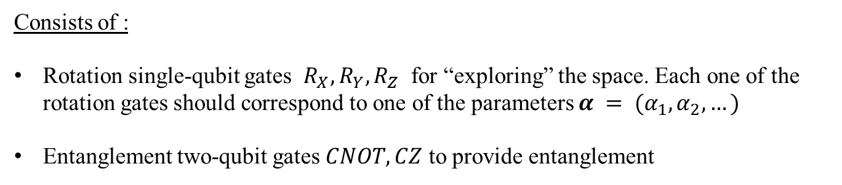
The Ansatz
Capable of generating any arbitrary state on Hilbert space, including the entangled ones
Consists of :
Rotation single-qubit gates $R_{X}, R_{Y}, R_{Z}$ for “exploring” the space. Each one of the rotation gates should correspond to one of the parameters $α = (α_{1},α_{2},…)$
Entanglement two-qubit gates $CNOT, CZ$ to provide entanglement

Slide 18
The Ansatz
Capable of generating any arbitrary state on Hilbert space, including the entangled ones
Consists of :
Rotation single-qubit gates $R_{X}, R_{Y}, R_{Z}$ for “exploring” the space. Each one of the rotation gates should correspond to one of the parameters $α = (α_{1},α_{2},…)$
Entanglement two-qubit gates $CNOT, CZ$ to provide entanglement
Distinguishing two types of Ansatzes:
The Fixed-Structure Anstatz
The Variable-Structure Ansatz
We are only concerned with Fixed-Structure Anstatz

Slide 19
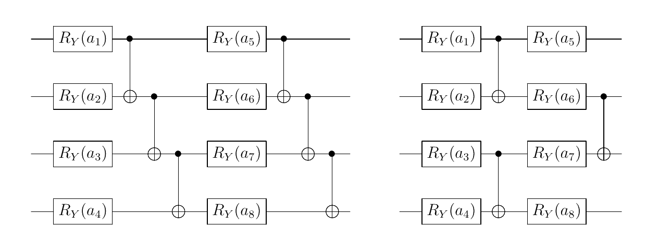
The Ansatz
Fixed-Structure Anstaz
Placement of the gates remains the same throughout the execution of the algorithm
Two examples are the following:
linear entanglement
alternating entanglement
Ansatz with alternating entanglement is more efficient in terms of effective parameters per two-qubit gate

Slide 20
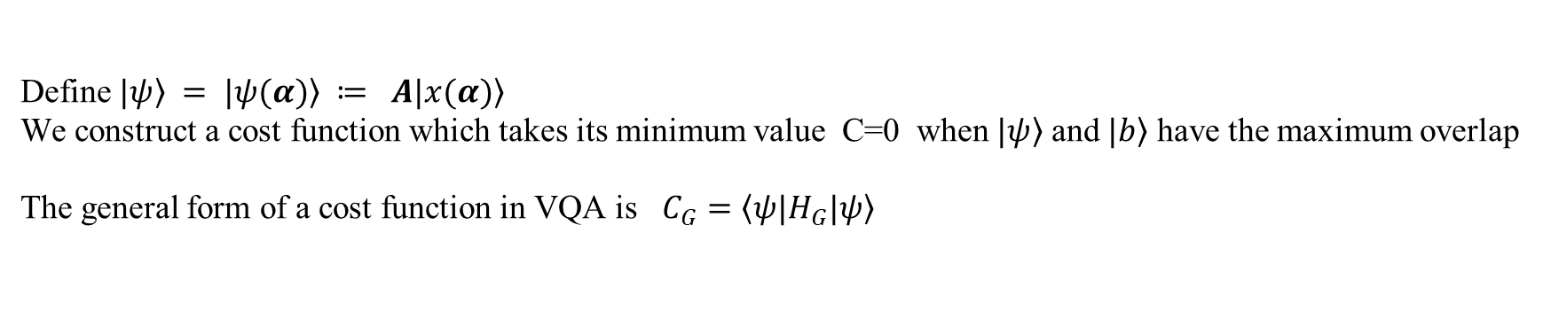
The Cost Function
Define $\left.|ψ\right\rangle = \left.|ψ(α)\right\rangle ≔ Α\left.|x(α)\right\rangle$
We construct a cost function which takes its minimum value C=0 when $\left.|ψ\right\rangle$ and $\left.|b\right\rangle$ have the maximum overlap
The general form of a cost function in VQA is $C_{G}=\left\langle ψ|Η_{G}\left.|ψ\right\rangle \right.$

Slide 21
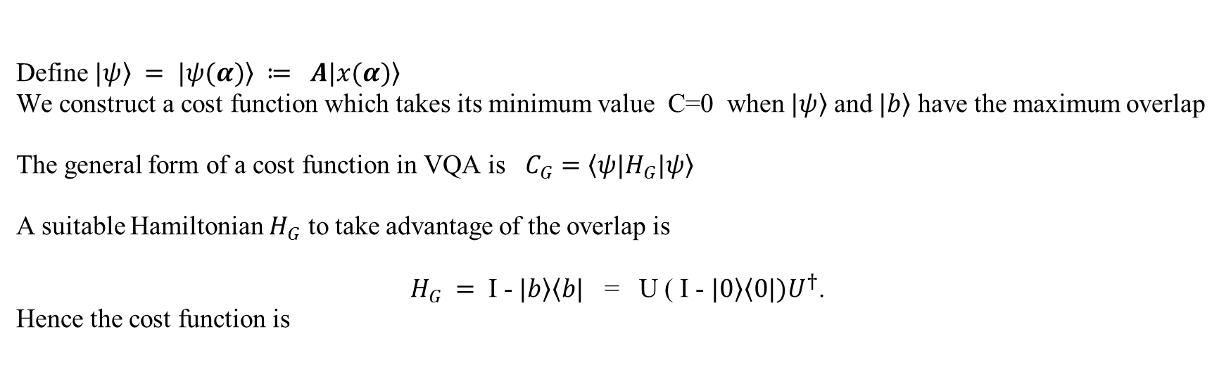

The Cost Function
Define $\left.|ψ\right\rangle = \left.|ψ(α)\right\rangle ≔ Α\left.|x(α)\right\rangle$
We construct a cost function which takes its minimum value C=0 when $\left.|ψ\right\rangle$ and $\left.|b\right\rangle$ have the maximum overlap
The general form of a cost function in VQA is $C_{G}=\left\langle ψ|Η_{G}\left.|ψ\right\rangle \right.$
A suitable Hamiltonian $H_{G}$ to take advantage of the overlap is
$H_{G} =$ I - $\left.|b\right\rangle \left\langle b|\right.$ = U ( I - $\left.|0\right\rangle \left\langle 0|\right.)U^{†}$.
Hence the cost function is
$${\hat{C}}_{G}=\left\langle ψ | \left(Ι − | b\right\rangle ⟨b|)|ψ\right\rangle =\left\langle ψ | ψ\right\rangle −{\left|\left\langle b | ψ\right\rangle \right|}^{2}$$
with $0≤$ ${\hat{C}}_{G}≤\left\langle ψ | ψ\right\rangle$

Slide 22
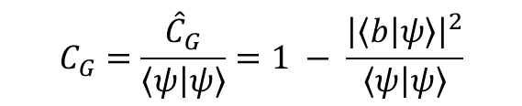
The Cost Function
Define $\left.|ψ\right\rangle = \left.|ψ(α)\right\rangle ≔ Α\left.|x(α)\right\rangle$
We construct a cost function which takes its minimum value C=0 when $\left.|ψ\right\rangle$ and $\left.|b\right\rangle$ have the maximum overlap
The general form of a cost function in VQA is $C_{G}=\left\langle ψ|Η_{G}\left.|ψ\right\rangle \right.$
A suitable Hamiltonian $H_{G}$ to take advantage of the overlap is
$H_{G} =$ I - $\left.|b\right\rangle \left\langle b|\right.$ = U ( I - $\left.|0\right\rangle \left\langle 0|\right.)U^{†}$.
Hence the cost function is
$${\hat{C}}_{G}=\left\langle ψ | \left(Ι − | b\right\rangle ⟨b|)|ψ\right\rangle =\left\langle ψ | ψ\right\rangle −{\left|\left\langle b | ψ\right\rangle \right|}^{2}$$
with $0≤$ ${\hat{C}}_{G}≤\left\langle ψ | ψ\right\rangle$
A potential small $\left\langle ψ | ψ\right\rangle$ would be problematic, so we use instead a normalized version of the cost function
$$C_{G}=\frac{{\hat{C}}_{G}}{\left\langle ψ | ψ\right\rangle }=1 − \frac{{\left|\left\langle b | ψ\right\rangle \right|}^{2}}{\left\langle ψ | ψ\right\rangle }$$

Slide 23
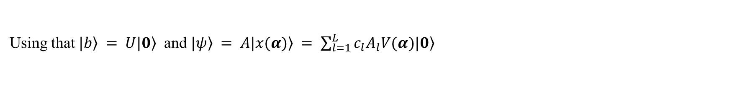
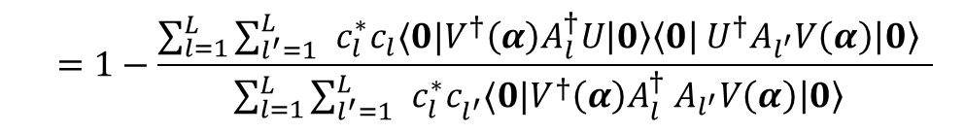
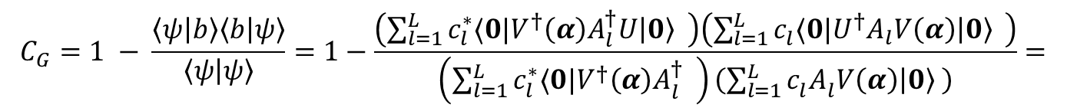
The Cost Function
Using that $\left.|b\right\rangle = U\left.|0\right\rangle$ and $\left.|ψ\right\rangle = Α\left.|x(α)\right\rangle = \sum_{l=1}^{L}{c_{l}A_{l}V(α)\left.|0\right\rangle }$
$$C_{G}=1 − \frac{\left\langle ψ | b\right\rangle \left\langle b | ψ\right\rangle }{\left\langle ψ | ψ\right\rangle }=1−\frac{\left(\sum_{l=1}^{L}{{c_{l}^{∗}⟨0|{V^{†}\left(α\right)A_{l}^{†}U\left|0\right\rangle }_{}^{ }}^{ }}\right)\left(\sum_{l=1}^{L}{{c_{l}^{}⟨0|{U^{†}A_{l}V\left(α\right)\left|0\right\rangle }_{}^{ }}^{ }}\right)}{\left(\sum_{l=1}^{L}{{c_{l}^{∗}⟨0|{V^{†}\left(α\right)A_{l}^{†}}_{}^{ }}^{ }}\right)\left(\sum_{l=1}^{L}{{c_{l}^{}A_{l}^{}V\left(α\right)\left|0\right\rangle }^{ }}\right)}=$$
$$=1−\frac{\sum_{l=1}^{L}{{{\sum_{l^{′}=1}^{L}{ }c}_{l}^{∗}c_{l}⟨0|{V^{†}\left(α\right)A_{l}^{†}U\left|0\right\rangle \left\langle 0\right|}_{}^{ }U^{†}{A_{l^{′}}V\left(α\right)\left|0\right\rangle }_{}^{ }}^{ }}}{\sum_{l=1}^{L}{{{\sum_{l^{′}=1}^{L}{ }c}_{l}^{∗}c_{l^{′}}^{}⟨0|{V^{†}\left(α\right)A_{l}^{†}}_{}^{ }{A_{l^{′}}V\left(α\right)\left|0\right\rangle }_{}^{ }}^{ }}}$$

Slide 24
The Cost Function
Using that $\left.|b\right\rangle = U\left.|0\right\rangle$ and $\left.|ψ\right\rangle = Α\left.|x(α)\right\rangle = \sum_{l=1}^{L}{c_{l}A_{l}V(α)\left.|0\right\rangle }$
$$C_{G}=1 − \frac{\left\langle ψ | b\right\rangle \left\langle b | ψ\right\rangle }{\left\langle ψ | ψ\right\rangle }=1−\frac{\left(\sum_{l=1}^{L}{{c_{l}^{∗}⟨0|{V^{†}\left(α\right)A_{l}^{†}U\left|0\right\rangle }_{}^{ }}^{ }}\right)\left(\sum_{l=1}^{L}{{c_{l}^{}⟨0|{U^{†}A_{l}V\left(α\right)\left|0\right\rangle }_{}^{ }}^{ }}\right)}{\left(\sum_{l=1}^{L}{{c_{l}^{∗}⟨0|{V^{†}\left(α\right)A_{l}^{†}}_{}^{ }}^{ }}\right)\left(\sum_{l=1}^{L}{{c_{l}^{}A_{l}^{}V\left(α\right)\left|0\right\rangle }^{ }}\right)}=$$
$$=1−\frac{\sum_{l=1}^{L}{{{\sum_{l^{′}=1}^{L}{ }c}_{l}^{∗}c_{l}⟨0|{V^{†}\left(α\right)A_{l}^{†}U\left|0\right\rangle \left\langle 0\right|}_{}^{ }U^{†}{A_{l^{′}}V\left(α\right)\left|0\right\rangle }_{}^{ }}^{ }}}{\sum_{l=1}^{L}{{{\sum_{l^{′}=1}^{L}{ }c}_{l}^{∗}c_{l^{′}}^{}⟨0|{V^{†}\left(α\right)A_{l}^{†}}_{}^{ }{A_{l^{′}}V\left(α\right)\left|0\right\rangle }_{}^{ }}^{ }}}$$
The above is called Global Cost Function
Can exhibit barren plateaus for a large number of qubits

Slide 25
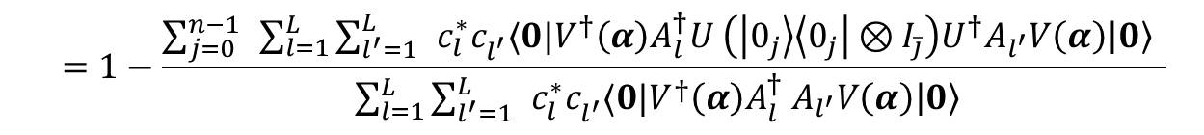
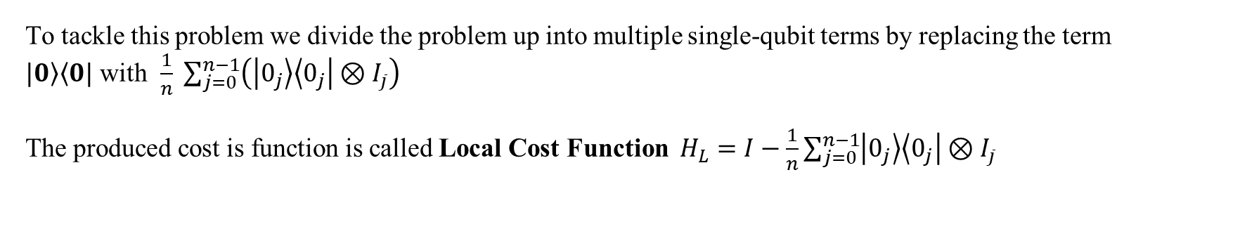
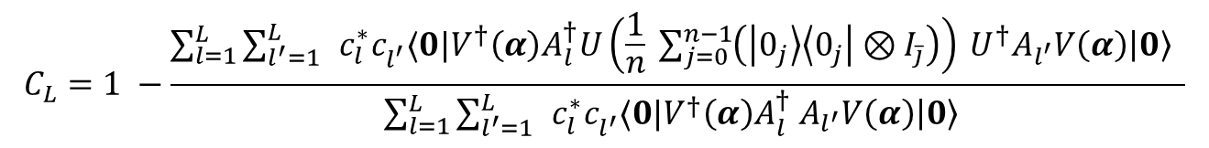
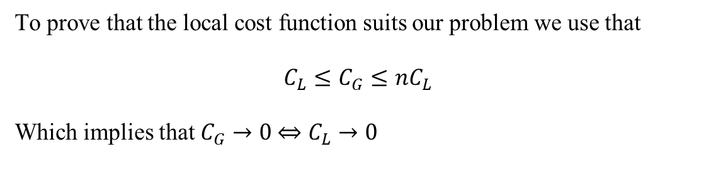
The Cost Function
To tackle this problem we divide the problem up into multiple single-qubit terms by replacing the term
$\left.|0\right\rangle \left\langle 0|\right.$ with $\frac{1}{n} \sum_{j=0}^{n−1}{\left(\left|0_{j}\right\rangle \left\langle 0_{j}\right|⊗I_{\overline{j}}\right)}$
The produced cost is function is called Local Cost Function $H_{L}=I−\frac{1}{n}\sum_{j=0}^{n−1}{\left|0_{j}\right\rangle \left\langle 0_{j}\right|⊗I_{\overline{j}}}$
$$C_{L}=1 −\frac{\sum_{l=1}^{L}{{{\sum_{l^{′}=1}^{L}{ }c}_{l}^{∗}c_{l^{′}}^{}⟨0|{V^{†}\left(α\right)A_{l}^{†}U\left(\frac{1}{n} \sum_{j=0}^{n−1}{\left(\left|0_{j}\right\rangle \left\langle 0_{j}\right|⊗I_{\overline{j}}\right)}\right)}_{}^{ }{U^{†}A_{l^{′}}V\left(α\right)\left|0\right\rangle }_{}^{ }}^{ }}}{\sum_{l=1}^{L}{{{\sum_{l^{′}=1}^{L}{ }c}_{l}^{∗}c_{l^{′}}^{}⟨0|{V^{†}\left(α\right)A_{l}^{†}}_{}^{ }{A_{l^{′}}V\left(α\right)\left|0\right\rangle }_{}^{ }}^{ }}}$$
$$=1−\frac{\sum_{j=0}^{n−1}{ }\sum_{l=1}^{L}{{{\sum_{l^{′}=1}^{L}{ }c}_{l}^{∗}c_{l^{′}}^{}⟨0|{V^{†}\left(α\right)A_{l}^{†}U}_{}^{ }\left(\left|0_{j}\right\rangle \left\langle 0_{j}\right|⊗I_{\overline{j}}\right){U^{†}A_{l^{′}}V\left(α\right)\left|0\right\rangle }_{}^{ }}^{ }}}{\sum_{l=1}^{L}{{{\sum_{l^{′}=1}^{L}{ }c}_{l}^{∗}c_{l^{′}}^{}⟨0|{V^{†}\left(α\right)A_{l}^{†}}_{}^{ }{A_{l^{′}}V\left(α\right)\left|0\right\rangle }_{}^{ }}^{ }}}$$
To prove that the local cost function suits our problem we use that
$$C_{L}≤C_{G}≤nC_{L}$$
Which implies that $C_{G}→0 \underset{⇔}{ }$ $C_{L}→0$

Slide 26


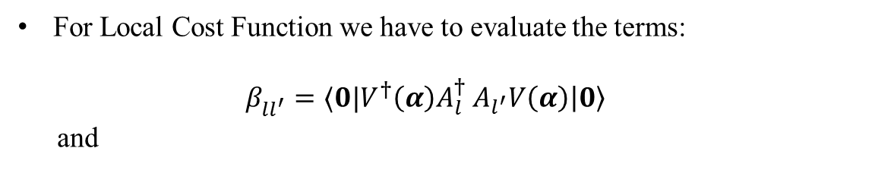
The Cost Function
Evaluation of the cost function using quantum circuit
For Global Cost Function we have to evaluate the terms:
$β_{ll^{′}}^{}=⟨0|{V^{†}\left(α\right)A_{l}^{†}}_{}^{ }{A_{l^{′}}V\left(α\right)\left|0\right\rangle }_{}^{ }$
and
$$γ_{ll^{′}}^{}=⟨0|{V^{†}\left(α\right)A_{l}^{†}U\left|0\right\rangle \left\langle 0\right|}_{}^{ }U^{†}{A_{l^{′}}V\left(α\right)\left|0\right\rangle }_{}^{ }$$
For Local Cost Function we have to evaluate the terms:
$β_{ll^{′}}^{}=⟨0|{V^{†}\left(α\right)A_{l}^{†}}_{}^{ }{A_{l^{′}}V\left(α\right)\left|0\right\rangle }_{}^{ }$
and
$$δ_{ll^{′}}^{(j)}=⟨0|{V^{†}\left(α\right)A_{l}^{†}U}_{}^{ }\left(\left|0_{j}\right\rangle \left\langle 0_{j}\right|⊗I_{\overline{j}}\right){U^{†}A_{l^{′}}V\left(α\right)\left|0\right\rangle }_{}^{ }$$
Using that $\left|0_{j}\right\rangle \left\langle 0_{j}\right|=\frac{1}{2} (I_{j}+Z_{j})$ , the last one can be rewritten as
$$δ_{ll^{′}}^{(j)}=β_{ll^{′}}+⟨0|{V^{†}\left(α\right)A_{l}^{†}U}_{}^{ }\left(Z_{j}⊗I_{\overline{j}}\right){U^{†}A_{l^{′}}V\left(α\right)\left|0\right\rangle }_{}^{ }$$

Slide 27
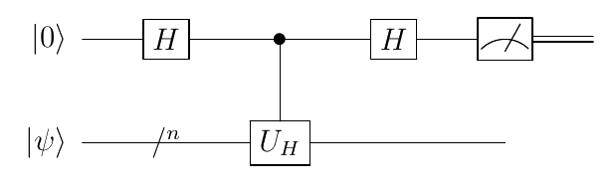
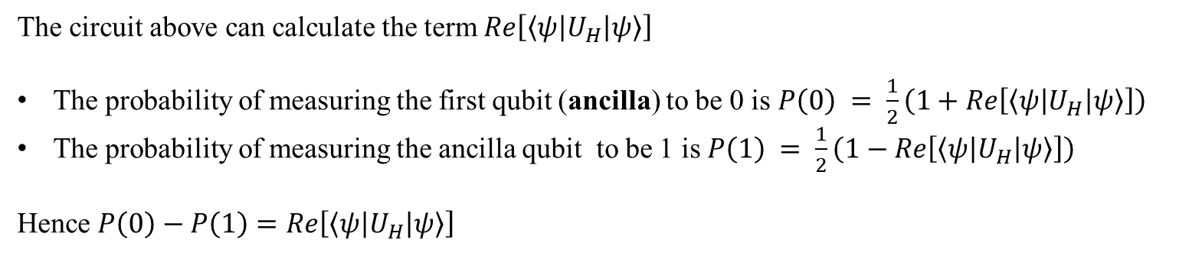
The Cost Function
How can we evaluate the previous terms?
We employ a quantum circuit called The Hadamard Test
The circuit above can calculate the term $Re\left[\left\langle ψ | U_{H} | ψ\right\rangle \right]$
The probability of measuring the first qubit (ancilla) to be 0 is $P\left(0\right) = \frac{1}{2}\left(1+Re\left[\left\langle ψ | U_{H} | ψ\right\rangle \right]\right)$
The probability of measuring the ancilla qubit to be 1 is $P\left(1\right) = \frac{1}{2}\left(1−Re\left[\left\langle ψ | U_{H} | ψ\right\rangle \right]\right)$
Hence $P\left(0\right)−P\left(1\right)=Re\left[\left\langle ψ | U_{H} | ψ\right\rangle \right]$

Slide 28
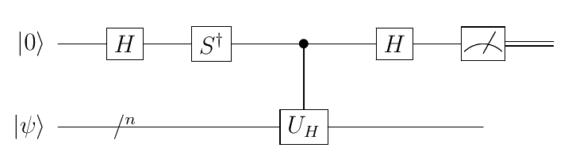
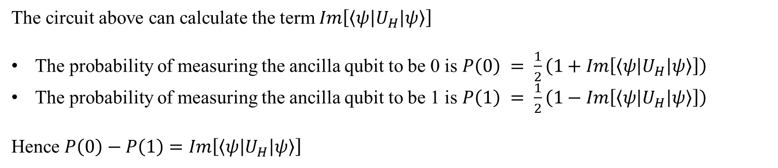
The Cost Function
For the Imaginary part we simple add a $S^{†}$ gate after the first Hadamard on the ancilla qubit
The circuit above can calculate the term $Im\left[\left\langle ψ | U_{H} | ψ\right\rangle \right]$
The probability of measuring the ancilla qubit to be 0 is $P\left(0\right) = \frac{1}{2}\left(1+Im\left[\left\langle ψ | U_{H} | ψ\right\rangle \right]\right)$
The probability of measuring the ancilla qubit to be 1 is $P\left(1\right) = \frac{1}{2}\left(1−Im\left[\left\langle ψ | U_{H} | ψ\right\rangle \right]\right)$
Hence $P\left(0\right)−P\left(1\right)=Im\left[\left\langle ψ | U_{H} | ψ\right\rangle \right]$

Slide 29
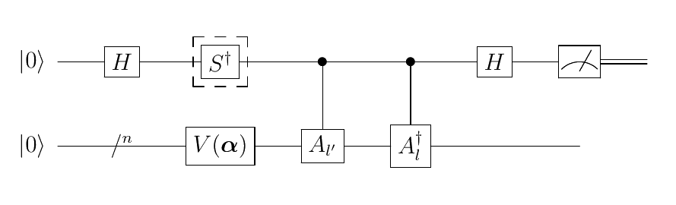
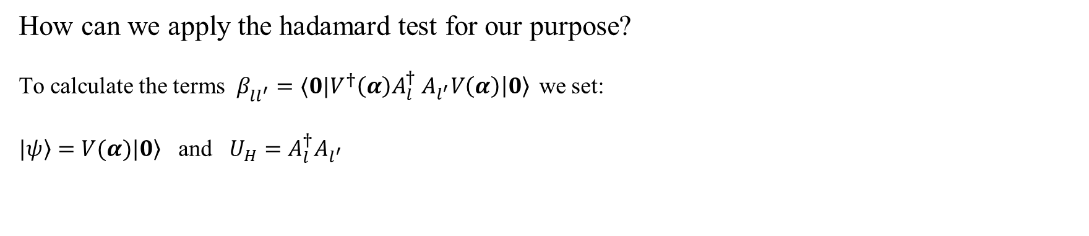
The Cost Function
How can we apply the hadamard test for our purpose?
To calculate the terms $β_{ll^{′}}^{}=⟨0|{V^{†}\left(α\right)A_{l}^{†}}_{}^{ }{A_{l^{′}}V\left(α\right)\left|0\right\rangle }_{}^{ }$we set:
$\left.|ψ\right\rangle =V(α)\left.|0\right\rangle$ and $U_{H}=A_{l}^{†}A_{l^{′}}$

Slide 30
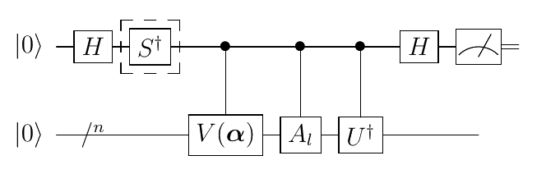
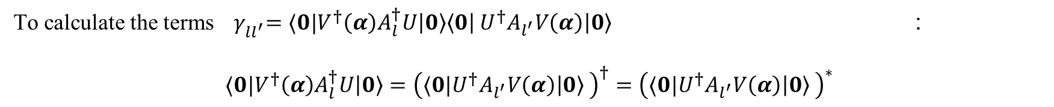
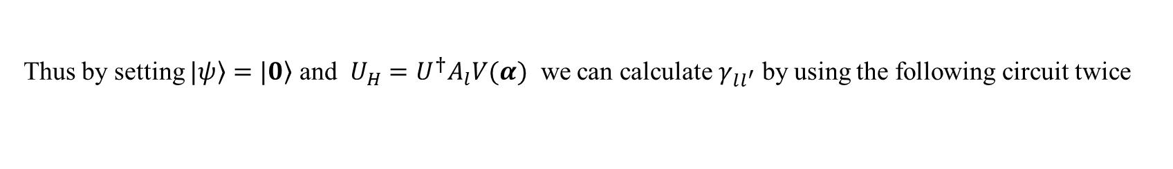
The Cost Function
To calculate the terms ${ γ}_{ll^{′}}^{}=⟨0|{V^{†}\left(α\right)A_{l}^{†}U\left|0\right\rangle \left\langle 0\right|}_{}^{ }U^{†}{A_{l^{′}}V\left(α\right)\left|0\right\rangle }_{}^{ }$ :
$$⟨0|V^{†}\left(α\right)A_{l}^{†}U\left|0\right\rangle ={\left(⟨0|U^{†}{A_{l^{′}}V\left(α\right)\left|0\right\rangle }_{}^{ }\right)}^{†}={\left(⟨0|U^{†}{A_{l^{′}}V\left(α\right)\left|0\right\rangle }_{}^{ }\right)}^{∗}$$
Thus by setting $\left.|ψ\right\rangle =\left.|0\right\rangle$ and $U_{H}={U^{†}Α}_{l}V(α)$ we can calculate $γ_{ll^{′}}$ by using the following circuit twice

Slide 31
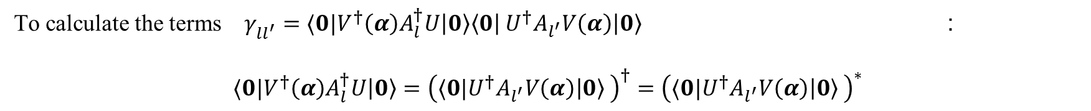
The Cost Function
To calculate the terms $γ_{ll^{′}}^{}=⟨0|{V^{†}\left(α\right)A_{l}^{†}U\left|0\right\rangle \left\langle 0\right|}_{}^{ }U^{†}{A_{l^{′}}V\left(α\right)\left|0\right\rangle }_{}^{ }$ :
$$⟨0|V^{†}\left(α\right)A_{l}^{†}U\left|0\right\rangle ={\left(⟨0|U^{†}{A_{l^{′}}V\left(α\right)\left|0\right\rangle }_{}^{ }\right)}^{†}={\left(⟨0|U^{†}{A_{l^{′}}V\left(α\right)\left|0\right\rangle }_{}^{ }\right)}^{∗}$$
Thus by setting $\left.|ψ\right\rangle =\left.|0\right\rangle$ and $U_{H}={U^{†}Α}_{l}V(α)$ we can calculate $γ_{ll^{′}}$ by using the following circuit twice
An alternative way to calculate these term is by using an different subroutine called The Hadamard-Overlap Test

Slide 32
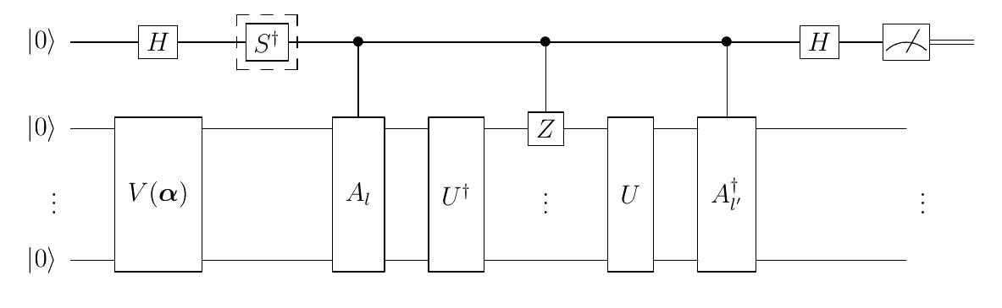
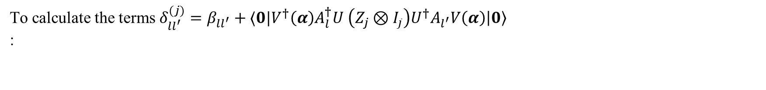
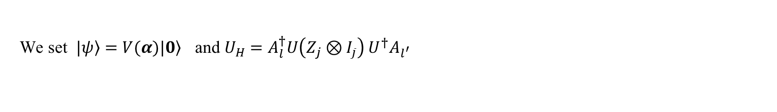
The Cost Function
To calculate the terms $δ_{ll^{′}}^{(j)}=β_{ll^{′}}+⟨0|{V^{†}\left(α\right)A_{l}^{†}U}_{}^{ }\left(Z_{j}⊗I_{\overline{j}}\right){U^{†}A_{l^{′}}V\left(α\right)\left|0\right\rangle }_{}^{ }$ :
We set $\left.|ψ\right\rangle =V(α)\left.|0\right\rangle$ and $U_{H}=$ $A_{l}^{†}U\left(Z_{j}⊗I_{\overline{j}}\right)$ $U^{†}A_{l^{′}}$

Slide 33
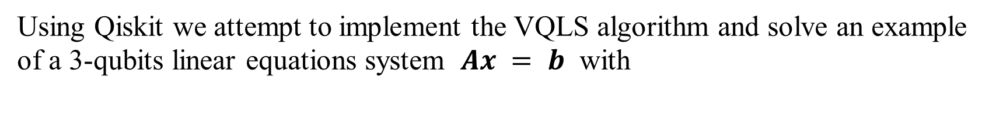
Qiskit Implementation
Using Qiskit we attempt to implement the VQLS algorithm and solve an example of a 3-qubits linear equations system $Ax = b$ with

Slide 34
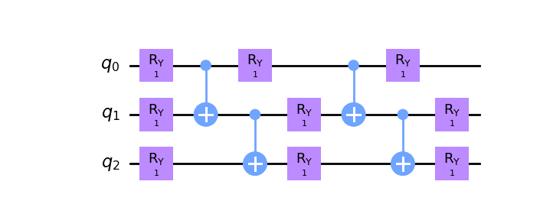
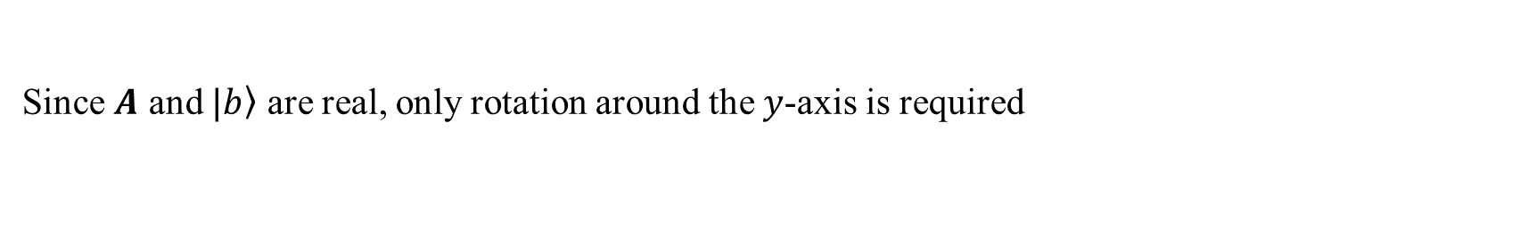
Qiskit Implementation
Linear entanglement ansatz was used with 9 rotation gates $R_{Y}$ (therefore 9 parameters)
and 4 CNOTs gates
Since $A$ and $\left.|b\right\rangle$ are real, only rotation around the $y$-axis is required

Slide 35
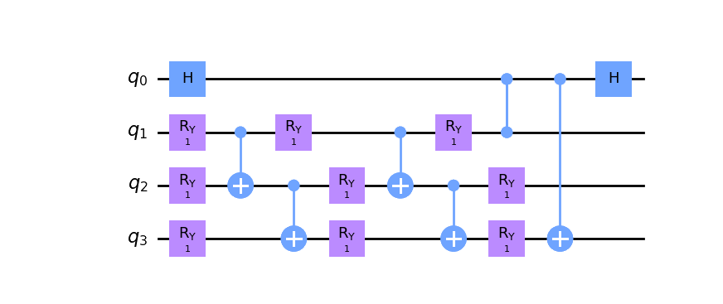
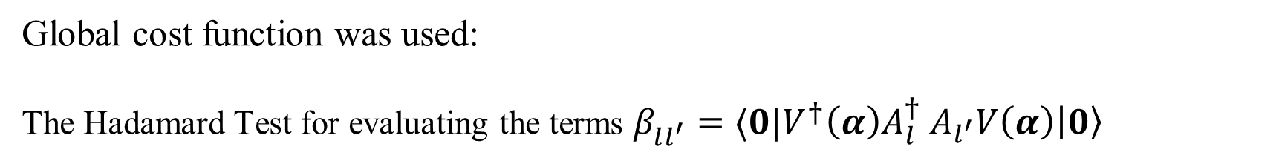
Qiskit Implementation
Global cost function was used:
The Hadamard Test for evaluating the terms $β_{ll^{′}}^{}=⟨0|{V^{†}\left(α\right)A_{l}^{†}}_{}^{ }{A_{l^{′}}V\left(α\right)\left|0\right\rangle }_{}^{ }$
With $A_{l}=Z_{1}$ and $A_{l^{′}}=X_{3}$

Slide 36
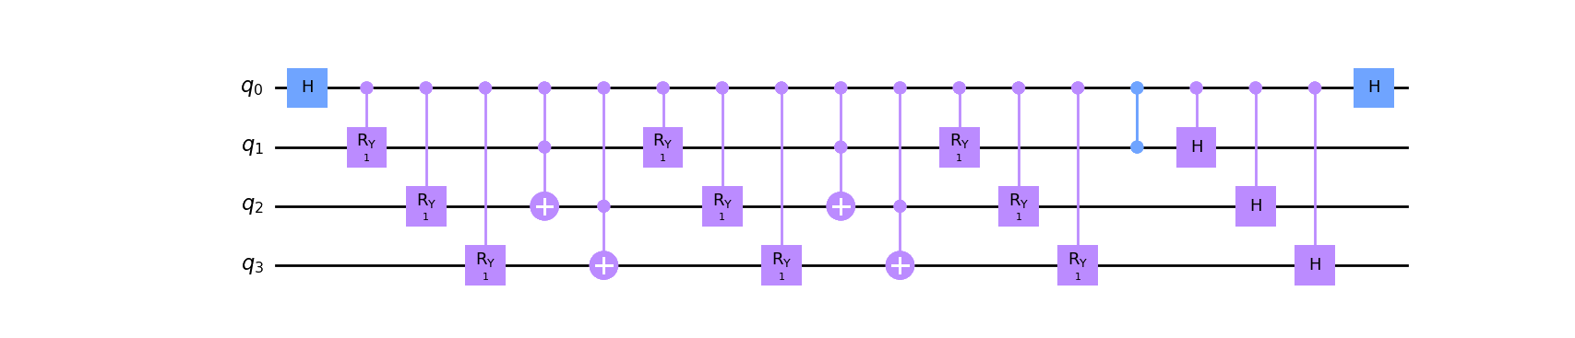
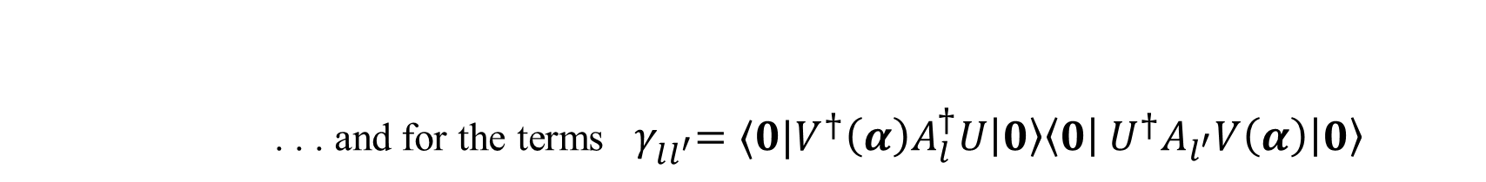
Qiskit Implementation
. . . and for the terms ${ γ}_{ll^{′}}^{}=⟨0|{V^{†}\left(α\right)A_{l}^{†}U\left|0\right\rangle \left\langle 0\right|}_{}^{ }U^{†}{A_{l^{′}}V\left(α\right)\left|0\right\rangle }_{}^{ }$
With $A_{l}=Z_{1}$

Slide 37
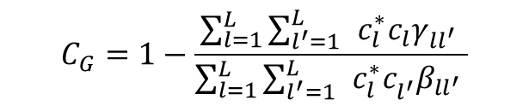
Qiskit Implementation
Our cost function is :
$$C_{G}=1−\frac{\sum_{l=1}^{L}{{{\sum_{l^{′}=1}^{L}{ }c}_{l}^{∗}c_{l}γ_{ll^{′}}}^{ }}}{\sum_{l=1}^{L}{{{\sum_{l^{′}=1}^{L}{ }c}_{l}^{∗}c_{l^{′}}^{}β_{ll^{′}}}^{ }}}$$
We minimize it using preferably a gradient free optimizer, like COBYLA, that is less vulnerable to barren plateaus

Slide 38
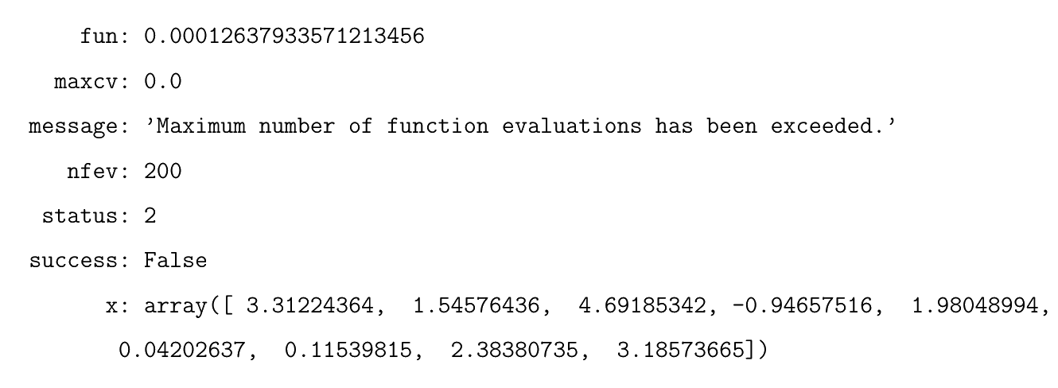

Qiskit Implementation
The output of the algorithm is:
fun is the final value of the cost function which is close to 0, as desired
x is optimal point $α_{opt}$ which corresponds to the solution $\left.|x\right\rangle =V(α_{opt})\left.|0\right\rangle$

Slide 39

Qiskit Implementation
To confirm that the obtained solution is correct we calculate the inner product
$$\left\langle xA | b\right\rangle$$
with the expectation of being close to 1. The output is:

Slide 40

Qiskit Implementation
To confirm that the obtained solution is correct we calculate the inner product
$$\left\langle xA | b\right\rangle$$
with the expectation of being close to 1. The output is:
. . . It works !!!

Slide 41
Referances
VQLS ALgorithm
https://arxiv.org/pdf/1909.05820.pdf
https://qiskit.org/textbook/ch-paper-implementations/vqls.html
https://pennylane.ai/qml/demos/tutorial_vqls.html
Anstaz
https://arxiv.org/pdf/2111.13730.pdf
Cost Function
https://qiskit.org/textbook/ch-paper-implementations/vqls.html

