Slide 1
Example with 8 EVs and 8 hours Horizon
EV | Energy Demand (KWh) | Elapsed Time of charging (h)
1 | 50 | 6
2 | 50 | 6
3 | 50 | 6
4 | 50 | 6
5 | 50 | 6
6 | 50 | 6
7 | 10 | 1
8 | 10 | 1

Slide 2

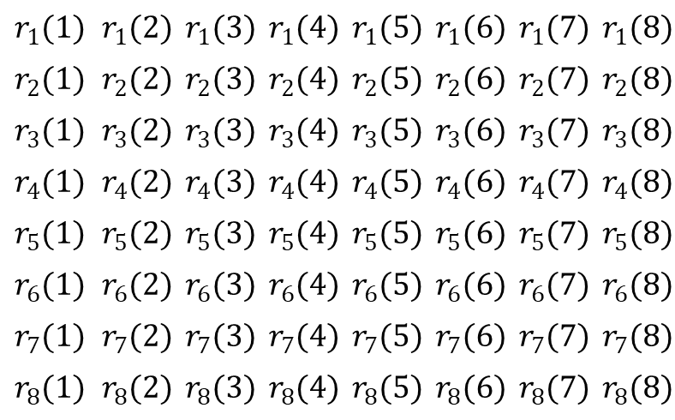
Optimization Variables
Horizon
$$r_{1}(1)$$ | $$r_{1}(2)$$ | $$r_{1}(3)$$ | $$r_{1}(4)$$ | $$r_{1}(5)$$ | $$r_{1}(6)$$ | $$r_{1}(7)$$ | $$r_{1}(8)$$
$$r_{2}(1)$$ | $$r_{2}(2)$$ | $$r_{2}(3)$$ | $$r_{2}(4)$$ | $$r_{2}(5)$$ | $$r_{2}(6)$$ | $$r_{2}(7)$$ | $$r_{2}(8)$$
$$r_{3}(1)$$ | $$r_{3}(2)$$ | $$r_{3}(3)$$ | $$r_{3}(4)$$ | $$r_{3}(5)$$ | $$r_{3}(6)$$ | $$r_{3}(7)$$ | $$r_{3}(8)$$
$$r_{4}(1)$$ | $$r_{4}(2)$$ | $$r_{4}(3)$$ | $$r_{4}(4)$$ | $$r_{4}(5)$$ | $$r_{4}(6)$$ | $$r_{4}(7)$$ | $$r_{4}(8)$$
$$r_{5}(1)$$ | $$r_{5}(2)$$ | $$r_{5}(3)$$ | $$r_{5}(4)$$ | $$r_{5}(5)$$ | $$r_{5}(6)$$ | $$r_{5}(7)$$ | $$r_{5}(8)$$
$$r_{6}(1)$$ | $$r_{6}(2)$$ | $$r_{6}(3)$$ | $$r_{6}(4)$$ | $$r_{6}(5)$$ | $$r_{6}(6)$$ | $$r_{6}(7)$$ | $$r_{6}(8)$$
$$r_{7}(1)$$ | $$r_{7}(2)$$ | $$r_{7}(3)$$ | $$r_{7}(4)$$ | $$r_{7}(5)$$ | $$r_{7}(6)$$ | $$r_{7}(7)$$ | $$r_{7}(8)$$
$$r_{8}(1)$$ | $$r_{8}(2)$$ | $$r_{8}(3)$$ | $$r_{8}(4)$$ | $$r_{8}(5)$$ | $$r_{8}(6)$$ | $$r_{8}(7)$$ | $$r_{8}(8)$$
$$r=$$
Num of EVs

Slide 3
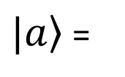

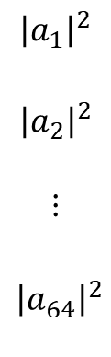
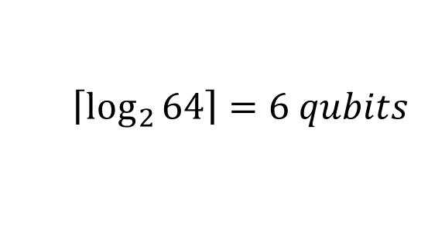

Method 1: Use one circuit for the entire matrix
$$a_{1}$$
$$a_{2}$$
$$⋮$$
$$a_{64}$$
$${\left|a_{1}\right|}^{2}$$
$${\left|a_{2}\right|}^{2}$$
$$⋮$$
$${\left|a_{64}\right|}^{2}$$
VQE Circuit
$\left.|a\right\rangle$ =
$$r=c∗$$
$$\left\lceil \left.\log_{2}{64}\right\rceil =6 \right.qubits$$

Slide 4
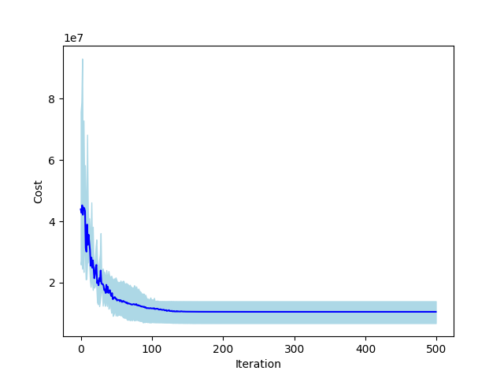
Method 1: Result

Slide 5


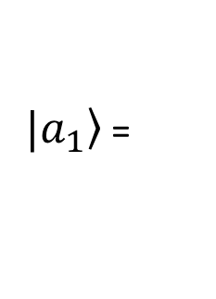
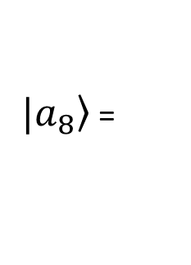



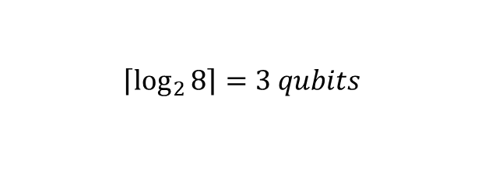
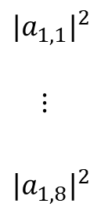

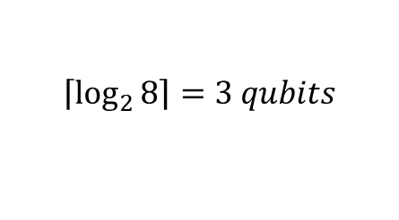

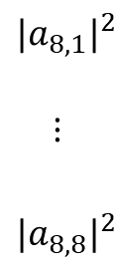

Method 2: Use a circuit for every column of the matrix
$$\left\lceil \left.\log_{2}{8}\right\rceil =3 \right.qubits$$
$$a_{1,1}$$
$$⋮$$
$$a_{1,8}$$
$${{|a}_{1,1}|}^{2}$$
$$⋮$$
$${{|a}_{1,8}|}^{2}$$
$$θ_{1}$$
VQE Circuit
$\left.|a_{1}\right\rangle$ =
$$r(1)=c∗$$
$$⋮$$
$$r=[r\left(1\right), …,r\left(8\right)]$$
$$\left\lceil \left.\log_{2}{8}\right\rceil =3 \right.qubits$$
$$a_{8,1}$$
$$⋮$$
$$a_{8,8}$$
$${{|a}_{8,1}|}^{2}$$
$$⋮$$
$${{|a}_{8,8}|}^{2}$$
$$θ_{8}$$
VQE Circuit
$\left.|a_{8}\right\rangle$ =
$$r(8)=c∗$$

Slide 6

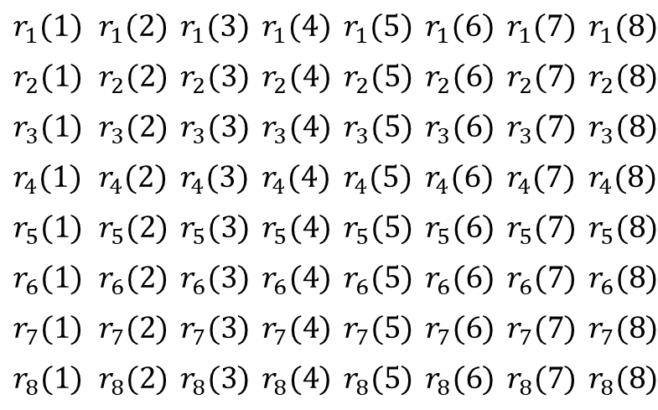

Method 2
$$r_{1}(1)$$ | $$r_{1}(2)$$ | $$r_{1}(3)$$ | $$r_{1}(4)$$ | $$r_{1}(5)$$ | $$r_{1}(6)$$ | $$r_{1}(7)$$ | $$r_{1}(8)$$
$$r_{2}(1)$$ | $$r_{2}(2)$$ | $$r_{2}(3)$$ | $$r_{2}(4)$$ | $$r_{2}(5)$$ | $$r_{2}(6)$$ | $$r_{2}(7)$$ | $$r_{2}(8)$$
$$r_{3}(1)$$ | $$r_{3}(2)$$ | $$r_{3}(3)$$ | $$r_{3}(4)$$ | $$r_{3}(5)$$ | $$r_{3}(6)$$ | $$r_{3}(7)$$ | $$r_{3}(8)$$
$$r_{4}(1)$$ | $$r_{4}(2)$$ | $$r_{4}(3)$$ | $$r_{4}(4)$$ | $$r_{4}(5)$$ | $$r_{4}(6)$$ | $$r_{4}(7)$$ | $$r_{4}(8)$$
$$r_{5}(1)$$ | $$r_{5}(2)$$ | $$r_{5}(3)$$ | $$r_{5}(4)$$ | $$r_{5}(5)$$ | $$r_{5}(6)$$ | $$r_{5}(7)$$ | $$r_{5}(8)$$
$$r_{6}(1)$$ | $$r_{6}(2)$$ | $$r_{6}(3)$$ | $$r_{6}(4)$$ | $$r_{6}(5)$$ | $$r_{6}(6)$$ | $$r_{6}(7)$$ | $$r_{6}(8)$$
$$r_{7}(1)$$ | $$r_{7}(2)$$ | $$r_{7}(3)$$ | $$r_{7}(4)$$ | $$r_{7}(5)$$ | $$r_{7}(6)$$ | $$r_{7}(7)$$ | $$r_{7}(8)$$
$$r_{8}(1)$$ | $$r_{8}(2)$$ | $$r_{8}(3)$$ | $$r_{8}(4)$$ | $$r_{8}(5)$$ | $$r_{8}(6)$$ | $$r_{8}(7)$$ | $$r_{8}(8)$$
$$r=$$
Sum = c
Since $sum([|{\left.​a_{i,1}\right|}^{2}, …,\left|{\left.​a_{i,1}\right|}^{2}\text{]}\right)=1 if r\left(i\right)=c∗[|{\left.​a_{i,1}\right|}^{2}, …,|{\left.​a_{i,1}\right|}^{2}\text{]}$
$$sum\left(r\left(i\right)\right)=c$$
We set c= max aggregate current rate

Slide 7
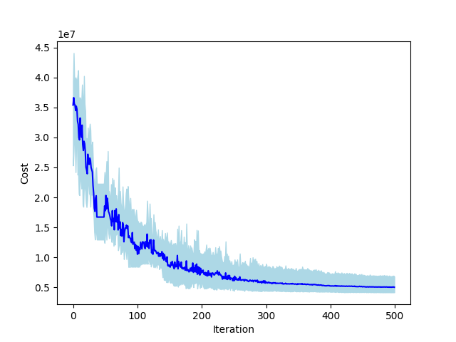
Method 2: Result

Slide 8







Method 3: Use a circuit for every row of the matrix
$$\left\lceil \left.\log_{2}{8}\right\rceil =3 \right.qubits$$
$$a_{1,1}$$
$$⋮$$
$$a_{1,8}$$
$${{|a}_{1,1}|}^{2}$$
$$⋮$$
$${{|a}_{1,8}|}^{2}$$
$$θ_{1}$$
VQE Circuit
$\left.|a_{1}\right\rangle$ =
$$r_{1}=c∗$$
$$r_{1}$$
$$⋮$$
$$r_{8}$$
$$⋮$$
$$r=$$
$$\left\lceil \left.\log_{2}{8}\right\rceil =3 \right.qubits$$
$$a_{8,1}$$
$$⋮$$
$$a_{8,8}$$
$${{|a}_{8,1}|}^{2}$$
$$⋮$$
$${{|a}_{8,8}|}^{2}$$
VQE Circuit
$\left.|a_{8}\right\rangle$ =
$$r_{8}=c∗$$
$$θ_{8}$$

Slide 9

Method 2
$$r_{1}(1)$$ | $$r_{1}(2)$$ | $$r_{1}(3)$$ | $$r_{1}(4)$$ | $$r_{1}(5)$$ | $$r_{1}(6)$$ | $$r_{1}(7)$$ | $$r_{1}(8)$$
$$r_{2}(1)$$ | $$r_{2}(2)$$ | $$r_{2}(3)$$ | $$r_{2}(4)$$ | $$r_{2}(5)$$ | $$r_{2}(6)$$ | $$r_{2}(7)$$ | $$r_{2}(8)$$
$$r_{3}(1)$$ | $$r_{3}(2)$$ | $$r_{3}(3)$$ | $$r_{3}(4)$$ | $$r_{3}(5)$$ | $$r_{3}(6)$$ | $$r_{3}(7)$$ | $$r_{3}(8)$$
$$r_{4}(1)$$ | $$r_{4}(2)$$ | $$r_{4}(3)$$ | $$r_{4}(4)$$ | $$r_{4}(5)$$ | $$r_{4}(6)$$ | $$r_{4}(7)$$ | $$r_{4}(8)$$
$$r_{5}(1)$$ | $$r_{5}(2)$$ | $$r_{5}(3)$$ | $$r_{5}(4)$$ | $$r_{5}(5)$$ | $$r_{5}(6)$$ | $$r_{5}(7)$$ | $$r_{5}(8)$$
$$r_{6}(1)$$ | $$r_{6}(2)$$ | $$r_{6}(3)$$ | $$r_{6}(4)$$ | $$r_{6}(5)$$ | $$r_{6}(6)$$ | $$r_{6}(7)$$ | $$r_{6}(8)$$
$$r_{7}(1)$$ | $$r_{7}(2)$$ | $$r_{7}(3)$$ | $$r_{7}(4)$$ | $$r_{7}(5)$$ | $$r_{7}(6)$$ | $$r_{7}(7)$$ | $$r_{7}(8)$$
$$r_{8}(1)$$ | $$r_{8}(2)$$ | $$r_{8}(3)$$ | $$r_{8}(4)$$ | $$r_{8}(5)$$ | $$r_{8}(6)$$ | $$r_{8}(7)$$ | $$r_{8}(8)$$
Sum = c
$$r=$$
Sum = c
Since $sum([|{\left.​a_{i,1}\right|}^{2}, …,\left|{\left.​a_{i,1}\right|}^{2}\text{]}\right)=1 if r_{i}=c∗[|{\left.​a_{i,1}\right|}^{2}, …,|{\left.​a_{i,1}\right|}^{2}\text{]}$
$$sum\left(r_{i}\right)=c$$
We set c= total rate needed for EV i

Slide 10
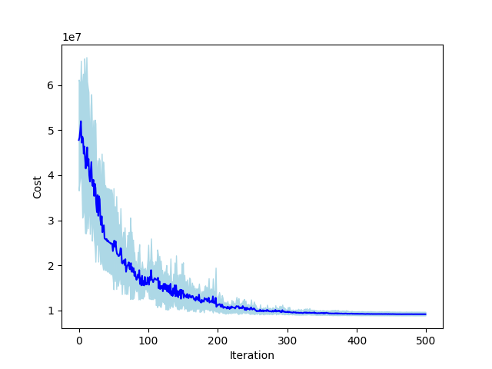
Method 3: Result

Slide 11
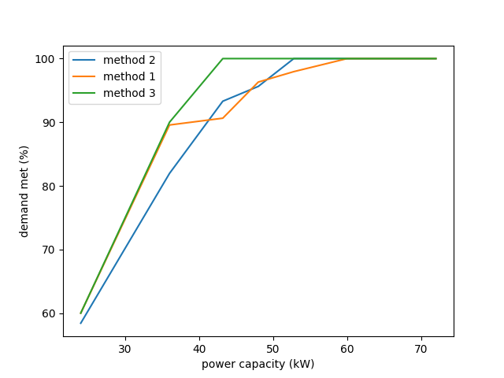
Comparison: % of Demand met w.r.t. power limit

