Slide 1
Shopee product matching
Team: Joshua Perez, Kuong Thong

Slide 2
Project Description
Teams are given files consisting of product images and CSV files which contain their product numbers.
Teams have to find matching products using the images provided
Accuracy is based on whether the product image matches the product number with another image’s product number.
The files this project contained came out to be 32000 images, which was too much for our hardware and memory to handle, so we cut the images down to 500, but we did make sure to keep duplicate images in our new sample.

Slide 3
Methods
Our first task was to convert the images into a 1D array and have each pixel equal a feature in the array.
We tested 3 different ways of converting out images to 1D arrays.
The first method used Keras

Slide 4
Keras
We used Keras to resize the images to 640 by 640
We then divided the dimensions by 4 to get an image that was 160 by 160
The array was then made to be 160 * 160 * 3
This created a problem because the array would take too long to create and the data would be too large.

Slide 5
CV2
This was a faster method to create a 1D array which we used for our Assignment 3.
We resized the images to 64 * 64
The accuracy was a lower than our next and final test to find a method to create a 1D array, so we used our next one.

Slide 6
PIL
We agreed to use the Pillow library to resize each image to 640*640 because that was the average size of image found in our dataset.
We converted each RGB pixel in the image into a feature and added it to our array
Con: We should have lowered the size because the runtime to accuracy difference shown later was a small increase over our CV2 64*64 image.

Slide 7
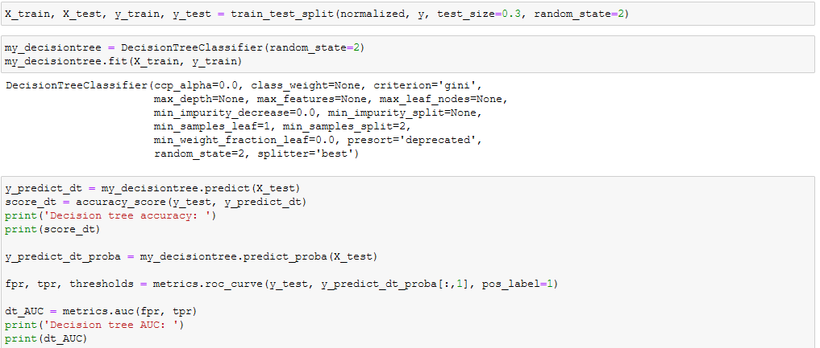
Decision Tree
Decision tree accuracy: 0.06666666666666667
Decision tree AUC: nan

Slide 8
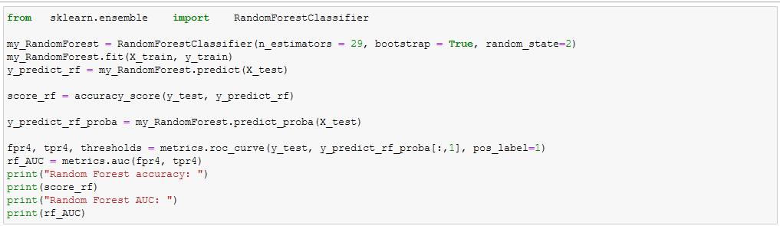
Random Forest
Random Forest accuracy: 0.1
Random Forest AUC: nan

Slide 9
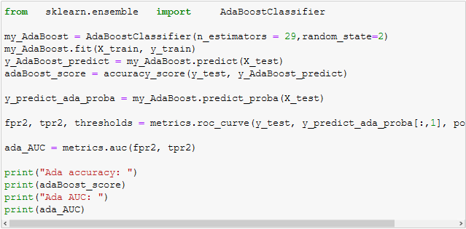
Ada Boost
Ada accuracy: 0.0
Ada AUC: nan

Slide 10
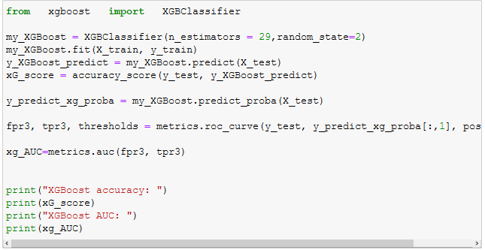
XgBoost
XGBoost accuracy: 0.1
XGBoost AUC: nan

Slide 11
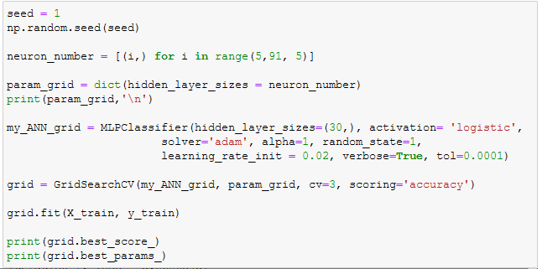
MLP and Grid Search
Accuracy = NA
AUC = NA

Slide 12
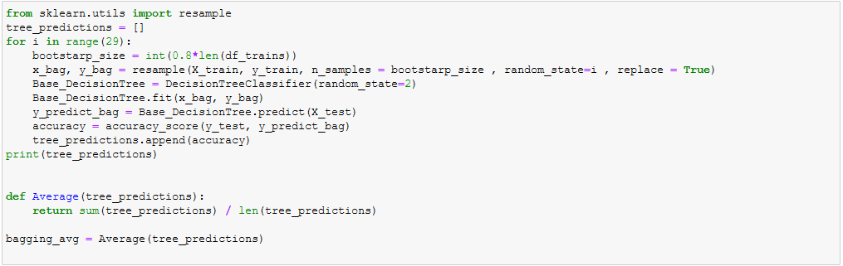
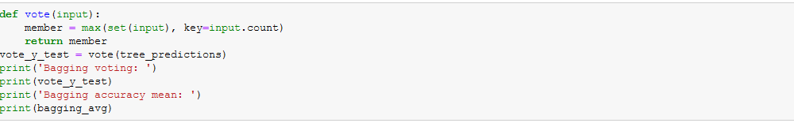
Decision Tree bagging and voting
Bagging voting: 0.06666666666666667
Bagging accuracy mean: 0.047126436781609195

Slide 13
Why we chose the methods
We chose CV2 and PIL to create our array because it was what we understood the most
CV2 allowed us to create a quick and small 1D array which had allowed our methods to have a relatively quick (VS PIL) runtime when input into the method
PIL was chosen because we could convert each RGB pixel into a feature and match the features against other images, which would result in higher matching accuracy

Slide 14
Results
Most of the methods we used came in close to about 6%-10% accuracy after running for ~2hours
We found that our CV2 array had very small differences in accuracy as opposed to PIL, but CV2 ran at 10-20x faster than our PIL array because it was 10x smaller in the amount of features.
We were not able to obtain ROC curves because all our methods resulted in NaN AUC values
Ada boost was the worst with 0% accuracy

Slide 15
Problems Encountered
A large array would make our runtimes 2-4 hours long
Finding a good method to create an array
Couldn’t Use TensorFlow because of RAM restrictions

Slide 16
Questions?

