Slide 1
NBA Shot Log
2014-2015

Slide 2
Agenda
Today’s NBA
Looking at the Data
Feature Distribution
Feature Engineering
Model Evaluation
Summary

Slide 3
Brief Introduction to the Modern NBA and Definitions
Definitions:
Field Goal: Any shot taken except for free throws (penalty shots).
Three Point Line: 22’ - 23’9” depending on location on court. Shot counts for 3 points instead of 2
Moneyball: Statistic revolution in sports. Statisticians began finding inefficiencies in the way the game was commonly played. They were able to create new metrics that disproved historical bias and could quantify concepts that were previously described by the eyeball test
The way the game is played has changed drastically since the moneyball statistical movement

Slide 4
A Look at the Data
Data taken from Kaggle
Every NBA shot from 2014-2015
Originally 110124 data points
13 columns

Slide 5
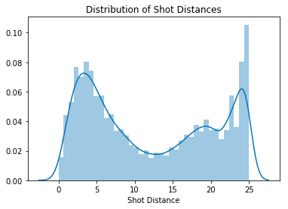
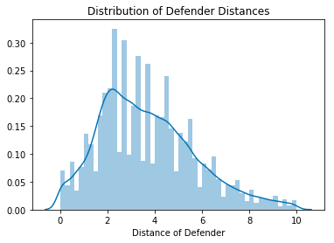
A look at the Features

Slide 6
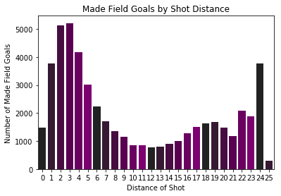

Slide 7
Features considered
Original features:
Shot Distance - Continuous
Distance of Defender - Continuous
Period - Categorical
Touch Time - Continuous
Final Margin - Continuous
Features engineered:
Categorical values for defender and shot distance
Touch time and dribbles squared and raised to multiple powers
DIST_DIST feature is shot distance multiplied by weighted defender distance
Weighted defender distance was calculated by limiting defender distance to 10 ft., subtracting 10 from the values, and taking the absolute value

Slide 8
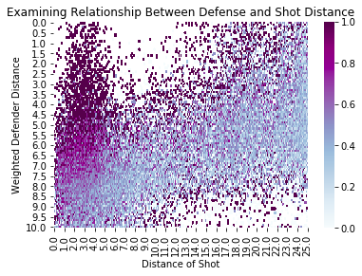
Which shots were most effective?
This heatmap shows the field goal percentage of each shot based on distance from the basket as well as our weighted ‘DISTANCE_RECIP’ variable where ‘10’ is a very close defender and ‘0’ where the defender should be a non-factor.

Slide 9
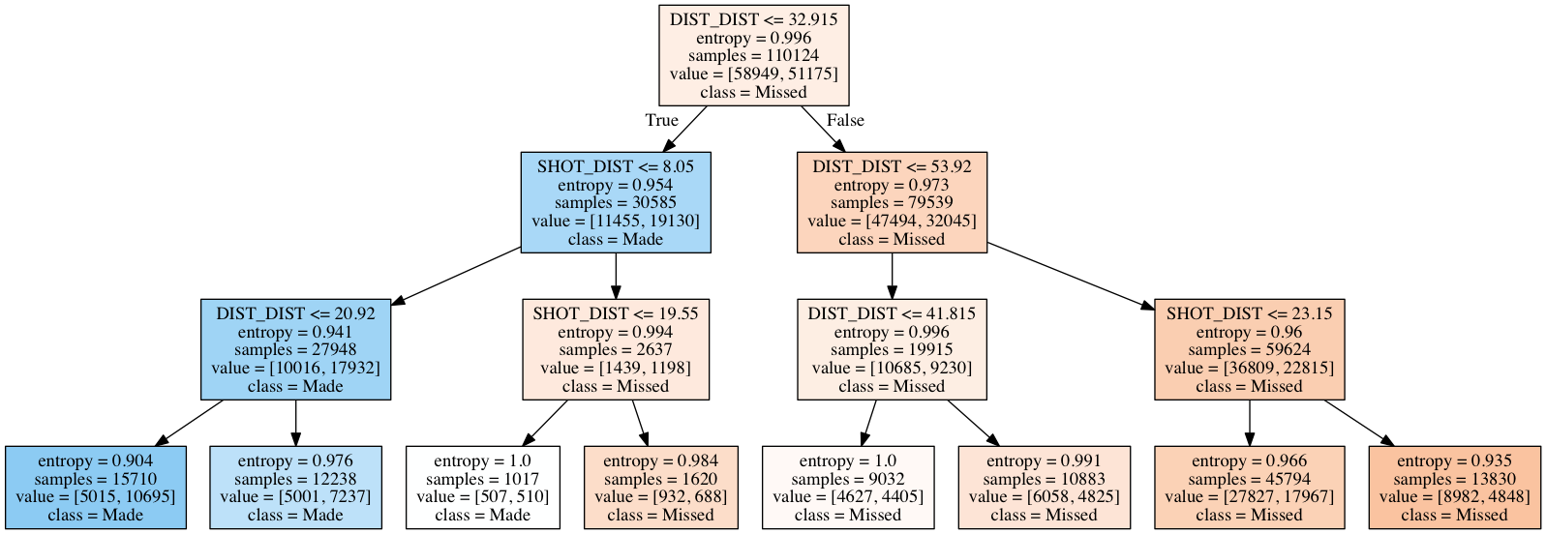
Simplified Learning Tree Feature Explanation

Slide 10
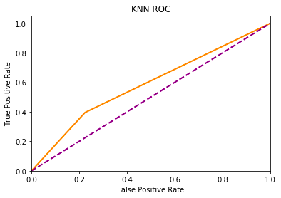
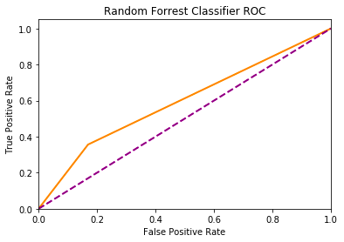



Slide 11
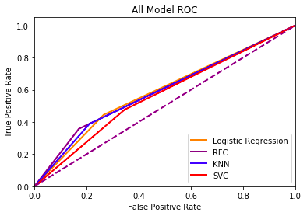
ROC Charts Merged

Slide 12
Model evaluation
Area under ROC curve:
RFC: 0.5946
Logistic Regression: 0.5897
KNN: 0.5873
SVC: 0.5551
SKLearn Score:
RFC: 0.6158
KNN: 0.6012
Logistic Regression: 0.6001
SVC: 0.5628
Tuning RFC:
Number of estimators tuned to 30
Each tree has a depth of 6
Reduced features based on feature importance method in SKLearn
Attempt to reduce features to just DIST_DIST and SHOT_DIST resulted in weaker performance
Normalized features for better performance

Slide 13
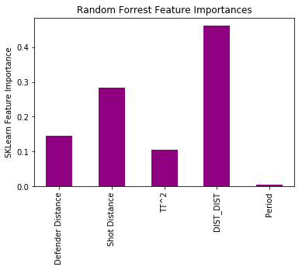
Feature Analysis

Slide 14
45.5%
Field goal percentage for 2014-2015 NBA season
64.4%
Model accuracy for shots made

Slide 15
Conclusions
Defender distance should be considered with shot
Mid-range shot is too frequently overlooked
Would like more data that can be acquired with web scraping technology
DIST_DIST feature can help coaches determine a good and bad shot

