Slide 1
Data Literacy
...what is data, where is it, and why should we care?

Slide 2
Data Lit Agenda
Discussion: Data in our Personal Lives
Definitions
The Stakes
Activity: Uncovering Data Sources
Data Myths
Using Data in your Research
Discussion: Thinking About & Using Data

Slide 3
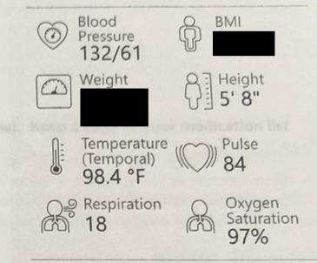
Data in Our Personal Lives
What is data?
What are some ways you created data today?
What health data is collected on patients?
Who owns all that data?
“After Visit Summary” - personal photo - Powered by Epic

Slide 4
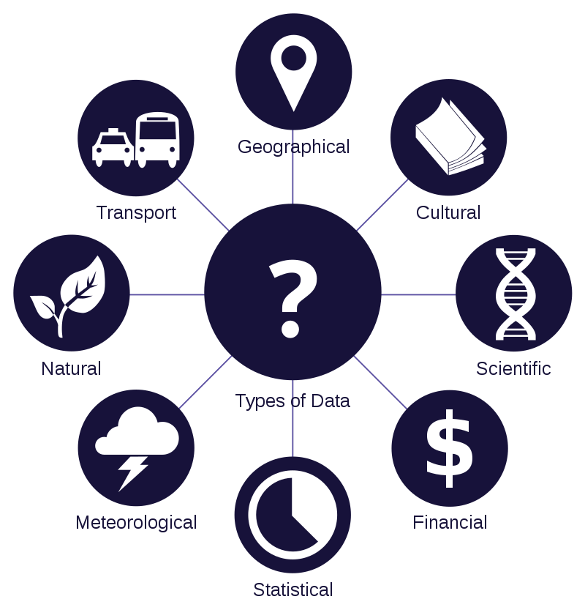
Data: Definitions
DATA
“individual units of information”
(Shannon, 1948)
“building blocks of information
(Kitchin, 2014)
“Data Types” by João Batista Neto — CC BY 3.0

Slide 5
Data: Definitions
BIG DATA
Many scholars still find it hard to define
But most agree on:
Volume + velocity
(Kitchin, 2014)
Complexity + technology
(Ward & Barker, 2013)

Slide 6
Data: Definitions
OPEN DATA
“Open data is data that can be freely used, re-used, and redistributed by anyone as publicly available resources.”
(Adapted from www.OpenDataHandbook.org)
Open data aspires to be findable, accessible, interoperable, and reusable (FAIR).
(Adapted from www.go-fair.org/fair-principles)

Slide 7

Data: The Stakes
Privacy vs. public good
Security vs. convenience
Power
Trust
“Data Privacy” by PICOL — CC BY 3.0
Notes:
How do we determine the risks and benefits of sharing health and medical data? When is it worth it lose a little privacy to further medical research? When is it worth it to potentially risk data security for the convenience of various apps, websites, etc.? How would you ever know you got your 10,000 steps again? A lot of these discussions come down to ownership, power, and trust -- much like we talked about last week. If a tech company owns all of your health data, do you have any power to control these situations anyway? Should you trust those tech companies? These are decisions we all have to make, and we often make them without thinking them through very carefully. In the health world, especially, it can be our health, or even our life, on the line when we’re being asked to give up this data, so it’s important to think through what that power dynamic means for patients.

Slide 8
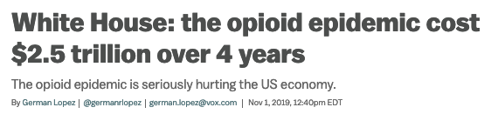

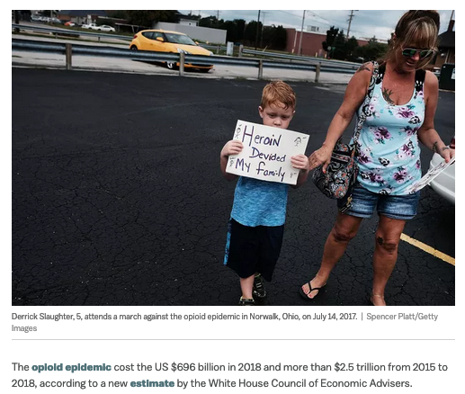
Uncovering Data Sources
White House: the opioid epidemic cost $2.5 trillion over 4 years | Vox | German Lopez

Slide 9
Uncovering Data Sources
What data sources are referenced in this article?
For you to better understand this article, what other data might have been helpful to know?
Why do you think the overall costs of the opioid epidemic cited in this article conflict so much?
Notes:
The White House report makes multiple references to open government data, including from the CDC (Wonder database, NVSS) and DHHS, as well as to several outside data reports, including several from Altarum.

Slide 10
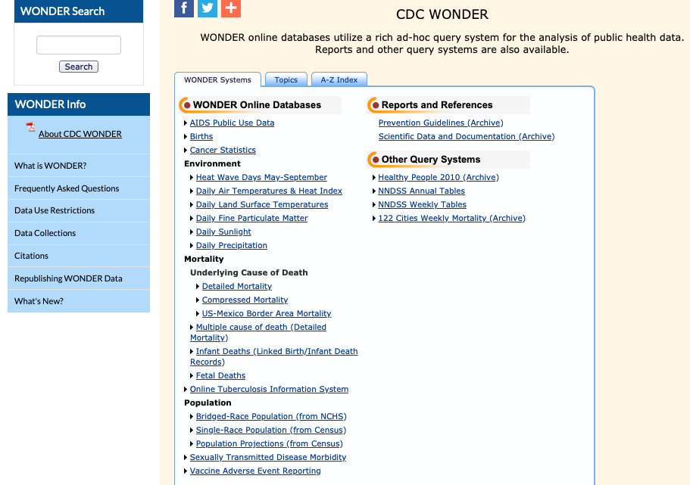
Data Sources in the Article
CDC Wonder Database: wonder.cdc.gov

Slide 11
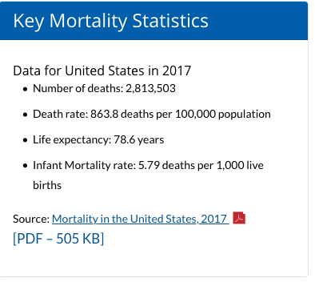
Data Sources in the Article
CDC National Vital Statistics: cdc.gov/nchs/nvss/index.htm
https://www.cdc.gov/nchs/nvss/deaths.htm

Slide 12
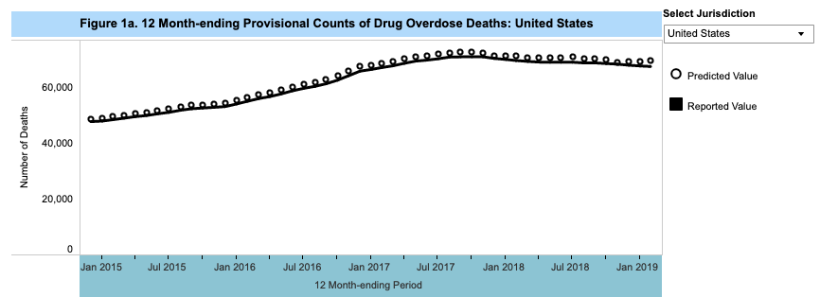
Data Sources in the Article
CDC National Vital Statistics | Provisional Drug Overdose Death Counts
https://www.cdc.gov/nchs/nvss/vsrr/drug-overdose-data.htm

Slide 13
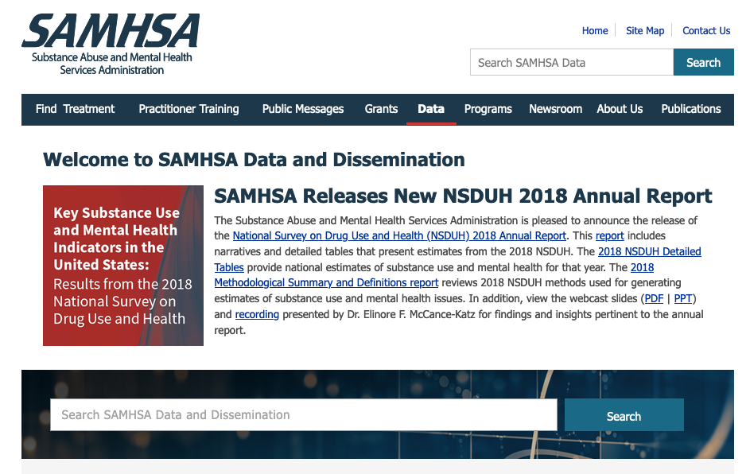
Data Sources in the Article
DHHS Substance Abuse and Mental Health Services Administration: samhsa.gov/data
Notes:
And of course, not all open data sources always stay open: https://sunlightfoundation.com/2019/10/22/a-huge-loss-or-a-skewed-dataset/

Slide 14
Data Myths
Data is not:
Objective fact
Free from bias
(Just) computer-generated*
It can be:
Full of errors
Manipulated
Always human-influenced*
Essentially, data’s just like any other source.
Notes:
Add sources here so I have examples to cite. Article about genome data excluding people of color.

Slide 15
Using Data in your Research
What data’s often used for in research papers:
Supporting evidence for your argument
Benchmarking
Visualization
What to avoid when using data:
Cherry-picking
Confirmation bias

Slide 16
Using Data in your Research
Where to find free, open data
Centers for Disease Control (CDC)
National Institutes of Health (NIH)
ICPSR
Data.gov
Data.WA.gov
...and many more!

Slide 17
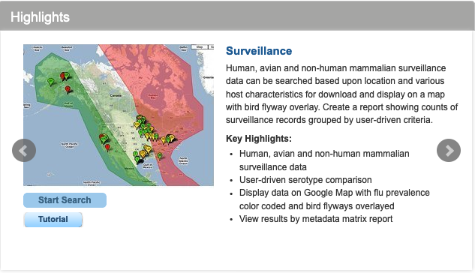
Potential Data Sources
NIH: Influenza Research Database: fludb.org

Slide 18
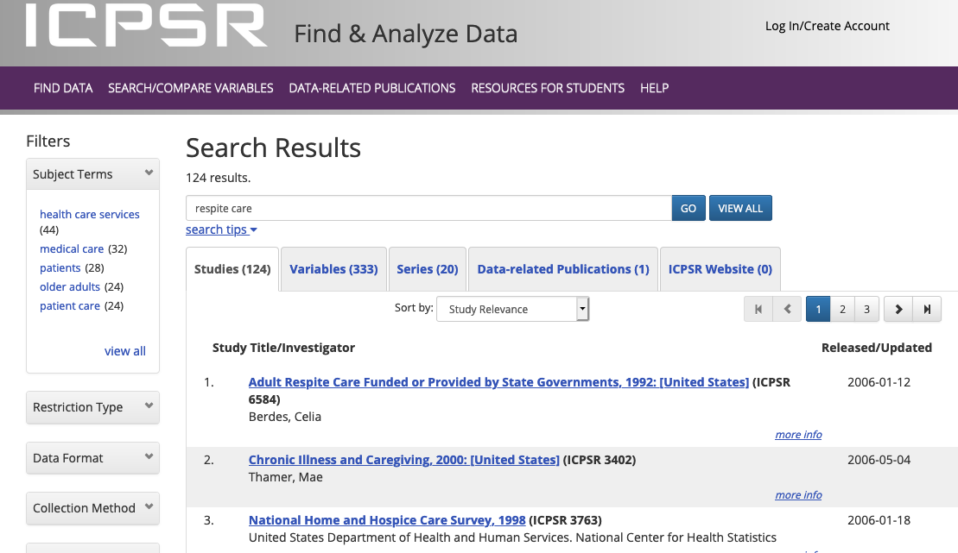
Potential Data Sources
Institute for Social Research (ICPSR) - https://www.icpsr.umich.edu/icpsrweb/ICPSR/

Slide 19
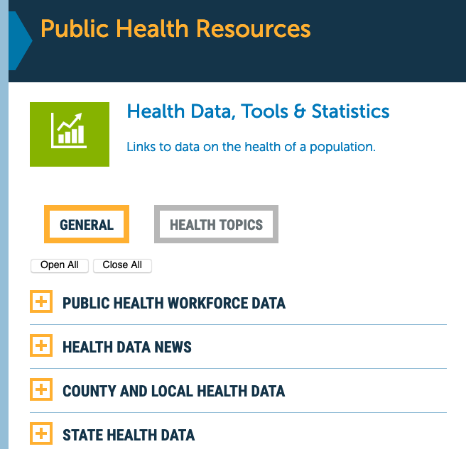
Potential Data Sources
Partners in Information Access for the Public Health Workforce Data: www.phpartners.org/ph_public/health_stats

Slide 20
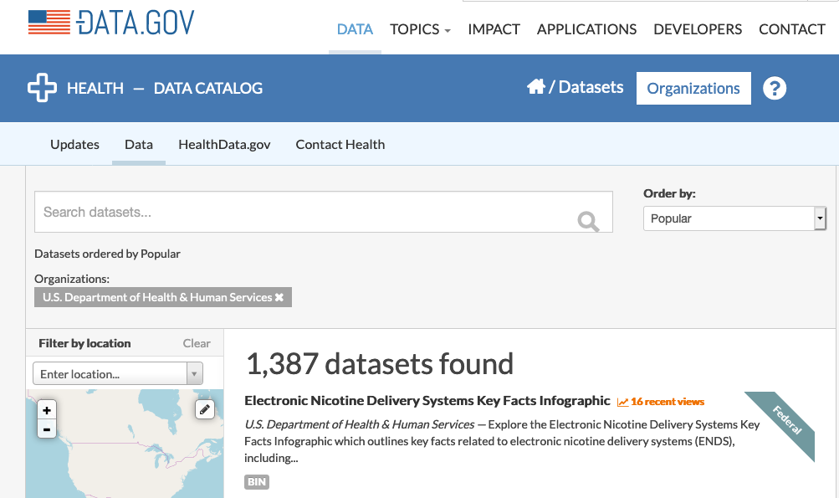
Potential Data Sources
www.data.gov

Slide 21
Final Discussion
Would your literature review benefit from a data source? If so, what might it be?
By next Tuesday: Join the discussion on Canvas and answer at least one question there.

Slide 22
References
Ahmad, F.B., Escobedo, L.A., Rossen, L.M., Spencer, M.R., Warner, M., & Sutton, P. (2019). Provisional drug overdose death counts. National Center for Health Statistics. Retrieved from https://www.cdc.gov/nchs/nvss/vsrr/drug-overdose-data.htm.
FAIR Principles. (n.d.) Retrieved from https://www.go-fair.org/fair-principles/.
Kitchin, R. (2014). The data revolution: Big data, open data, data infrastructures and their consequences. Sage: Los Angeles.
Lopez, G. (2019). White House: the opioid epidemic cost $2.5 trillion over 4 years. Vox. Retrieved from https://www.vox.com/policy-and-politics/2019/11/1/20943599/opioid-epidemic-cost-white-house-economic-advisers.

Slide 23
References
Shannon, C. E. (1948). A mathematical theory of communication. Bell system technical journal, 27(3), 379-423.
Ward, J. S., & Barker, A. (2013). Undefined by data: a survey of big data definitions. arXiv preprint arXiv:1309.5821.
What Is Open Data?. (n.d.). Retrieved from http://opendatahandbook.org/guide/en/what-is-open-data.
Note: with the exception of the initial personal photo and website screenshots, images in this presentation are from the Wikimedia Commons, an open access media resource.

Slide 24
Databases
CDC Wonder: https://wonder.cdc.gov/
CDC National Vital Statistics System: https://www.cdc.gov/nchs/nvss/index.htm
Data.gov: https://www.data.gov/
Data.WA.gov: https://data.wa.gov/
DHHS Substance Abuse and Mental Health Services Administration: https://www.samhsa.gov/data/
NIH Influenze Research Database: https://www.fludb.org
Inter-university Consortium for Political and Social Research (ICPSR): https://www.icpsr.umich.edu/icpsrweb/ICPSR/
Partners in Information Access for the Public Health Workforce | Health Data, Tools, and Statistics: https://www.phpartners.org/ph_public/health_stats

Slide 25
Open Data Resources
Open Data Institute | What is Open Data and Why Should We Care (with GIFs): https://theodi.org/article/what-is-open-data-and-why-should-we-care/
World Bank | Open Data in 60 Seconds: http://opendatatoolkit.worldbank.org/en/open-data-in-60-seconds.html

