Slide 1
Governing Equation & FVM

Slide 2




Governing Equation (Vector form)
Mass Conservation
$$ε\frac{∂ρ}{∂t}+∇∙\left(ρu\right)=0$$
Momentum Conservation
$$\frac{∂}{∂t}\left(ρu\right)+\frac{1}{ε^{2}}\left(ρu∙∇\right)u=−∇P−\frac{μ}{K}u$$
$$\frac{∂}{∂t}\left(ερβ_{h}h_{m}\right)+∇∙\left(ρuh_{m}\right)=∇∙\left(Γ∇h_{m}\right)+q_{sf}$$
Energy Conservation
$$\frac{∂}{∂t}\left(\left(1−ε\right)ρ_{s}c_{p,s}T_{s}\right)=∇∙\left(k_{s,eff}∇T_{s}\right)−q_{Sf}$$

Slide 3




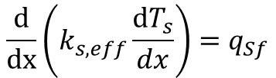
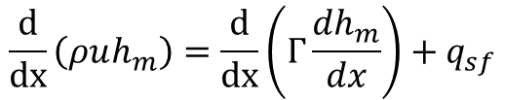
Governing Equation (1-D, steady)
$$\frac{d}{dx}\left(ρu\right)=0$$
In porous media,
Pressure drop & Darcy’s resistance
is very larger than other terms (almost zero)
Mass Conservation
Momentum Conservation
$$\frac{1}{ε^{2}}\frac{d}{dx}ρu^{2}=−\frac{dP}{dx}−\frac{ν}{K}ρu$$
$$0=−\frac{dP}{dx}−\frac{ν}{K}ρu$$
$$−\frac{dP}{dx}=\frac{ν}{K}ρu$$
or
$$\frac{d}{dx}\left(ρuh_{m}\right)=\frac{d}{dx}\left(Γ\frac{dh_{m}}{dx}\right)+q_{sf}$$
Energy Conservation
$$\frac{d}{dx}\left(k_{s,eff}\frac{dT_{s}}{dx}\right)=q_{Sf}$$

Slide 4

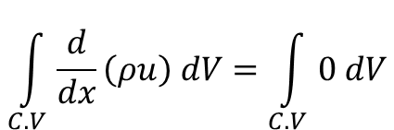




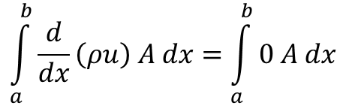
Finite Volume Method
Mass Conservation
$$\frac{d}{dx}\left(ρu\right)=0$$
$$\int_{C.V}{\frac{d}{dx}\left(ρu\right) dV}=\int_{C.V}{0 dV}$$
A
C.V
$$\int_{a}^{b}{\frac{d}{dx}\left(ρu\right) A dx}=\int_{a}^{b}{0 A dx}$$
$$δx$$
$$(ρ_{b}u_{b}−ρ_{a}u_{a})A=0$$
x=a
x=b
$$ρ_{b}u_{b}A=ρ_{a}u_{a}A$$
or
$$ρ_{b}u_{b}A=ρ_{a}u_{a}A=ρuA=\dot{m}$$

Slide 5
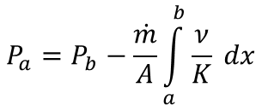
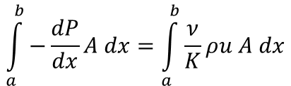
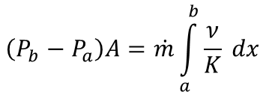
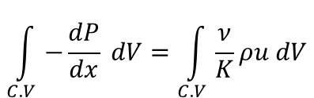
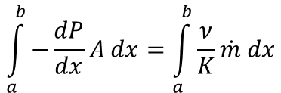

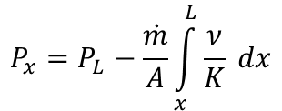
Finite Volume Method
$$−\frac{dP}{dx}=\frac{ν}{K}ρu$$
$$\int_{C.V}{−\frac{dP}{dx} dV}=\int_{C.V}{\frac{ν}{K}ρu dV}$$
Momentum Conservation
A
$$\int_{a}^{b}{−\frac{dP}{dx}A dx}=\int_{a}^{b}{\frac{ν}{K}ρu A dx}$$
C.V
$$\int_{a}^{b}{−\frac{dP}{dx}A dx}=\int_{a}^{b}{\frac{ν}{K}\dot{m} dx}$$
$$δx$$
$$\left(P_{b}−P_{a}\right)A=\dot{m}\int_{a}^{b}{\frac{ν}{K} dx}$$
x=a
x=b
$$P_{a}=P_{b}−\frac{\dot{m}}{A}\int_{a}^{b}{\frac{ν}{K} dx}$$
or
$$P_{x}=P_{L}−\frac{\dot{m}}{A}\int_{x}^{L}{\frac{ν}{K} dx}$$
If a=x, b=L

Slide 6
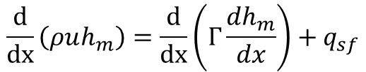
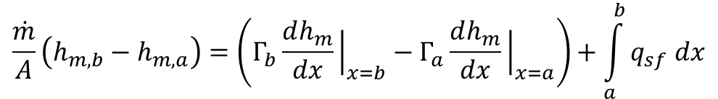
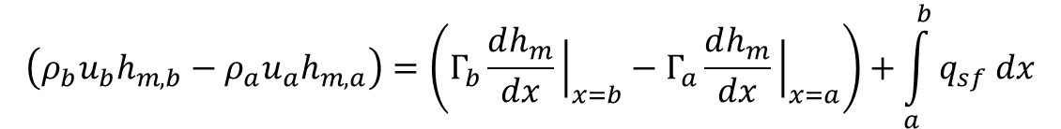
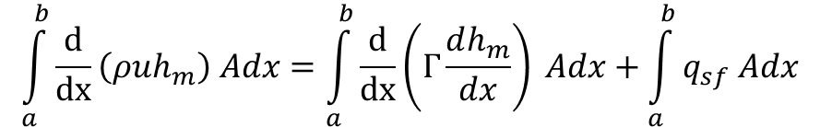
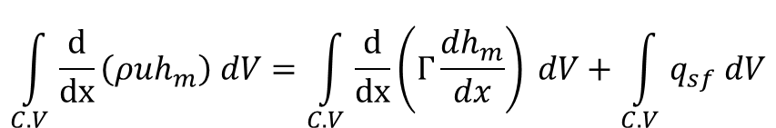
Finite Volume Method
Fluid Energy Conservation
$$\frac{d}{dx}\left(ρuh_{m}\right)=\frac{d}{dx}\left(Γ\frac{dh_{m}}{dx}\right)+q_{sf}$$
A
$$\int_{C.V}{\frac{d}{dx}\left(ρuh_{m}\right) dV}=\int_{C.V}{\frac{d}{dx}\left(Γ\frac{dh_{m}}{dx}\right) dV}+\int_{C.V}{q_{sf} dV}$$
C.V
$$\int_{a}^{b}{\frac{d}{dx}\left(ρuh_{m}\right) Adx}=\int_{a}^{b}{\frac{d}{dx}\left(Γ\frac{dh_{m}}{dx}\right) Adx}+\int_{a}^{b}{q_{sf} Adx}$$
$$δx$$
x=a
x=b
$$\left(ρ_{b}u_{b}h_{m,b}−ρ_{a}u_{a}h_{m,a}\right)=\left(Γ_{b}\frac{dh_{m}}{dx}{\left.​\right|}_{x=b}−Γ_{a}\frac{dh_{m}}{dx}{\left.​\right|}_{x=a}\right)+\int_{a}^{b}{q_{sf} dx}$$
$$\frac{\dot{m}}{A}\left(h_{m,b}−h_{m,a}\right)=\left(Γ_{b}\frac{dh_{m}}{dx}{\left.​\right|}_{x=b}−Γ_{a}\frac{dh_{m}}{dx}{\left.​\right|}_{x=a}\right)+\int_{a}^{b}{q_{sf} dx}$$

Slide 7
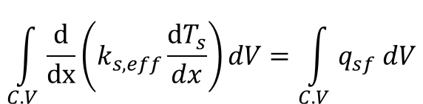
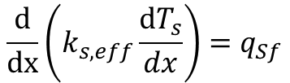
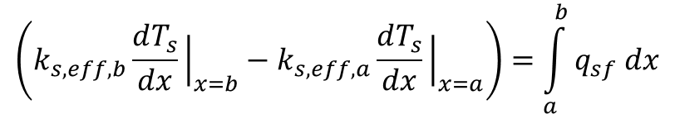
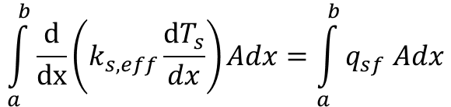
Finite Volume Method
Solid Energy Conservation
$$\frac{d}{dx}\left(k_{s,eff}\frac{dT_{s}}{dx}\right)=q_{Sf}$$
A
$$\int_{C.V}{\frac{d}{dx}\left(k_{s,eff}\frac{dT_{s}}{dx}\right)dV}=\int_{C.V}{q_{sf} dV}$$
C.V
$$\int_{a}^{b}{\frac{d}{dx}\left(k_{s,eff}\frac{dT_{s}}{dx}\right)Adx}=\int_{a}^{b}{q_{sf} Adx}$$
$$δx$$
x=a
x=b
$$\left(k_{s,eff,b}\frac{dT_{s}}{dx}{\left.​\right|}_{x=b}−k_{s,eff,a}\frac{dT_{s}}{dx}{\left.​\right|}_{x=a}\right)=\int_{a}^{b}{q_{sf} dx}$$

Slide 8
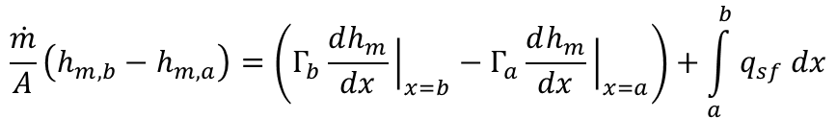
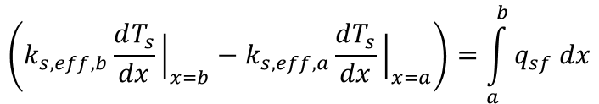

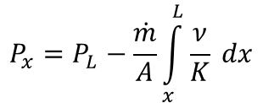
Sub-Summary
Mass Conservation
$$ρuA=\dot{m}$$
Depend on Properties
= Depend on Energy Equation
$$P_{x}=P_{L}−\frac{\dot{m}}{A}\int_{x}^{L}{\frac{ν}{K} dx}$$
Momentum Conservation
$$\frac{\dot{m}}{A}\left(h_{m,b}−h_{m,a}\right)=\left(Γ_{b}\frac{dh_{m}}{dx}{\left.​\right|}_{x=b}−Γ_{a}\frac{dh_{m}}{dx}{\left.​\right|}_{x=a}\right)+\int_{a}^{b}{q_{sf} dx}$$
Fluid Energy Conservation
$$\left(k_{s,eff,b}\frac{dT_{s}}{dx}{\left.​\right|}_{x=b}−k_{s,eff,a}\frac{dT_{s}}{dx}{\left.​\right|}_{x=a}\right)=\int_{a}^{b}{q_{sf} dx}$$
Solid Energy Conservation

Slide 9
Energy Conservation Discretization

Slide 10




Finite Difference
Object of this chapter : Transforming all equation(including face and derivative) to expressions for cells
face
In structured mesh
$$\frac{∂φ}{∂x}{\left.​\right|}_{x=f}≈\frac{φ_{c1}−φ_{c0}}{dS}$$
dr
C1,other
c0
$$dS$$
c1
c0 : center of standard cell
Interpolation method
c1 : center of neighbor in contact with face
First order
$$φ_{f}≈φ_{c0}+\frac{∂φ}{∂x}{\left.​\right|}_{x=c0}dr$$
Centered
$$\frac{∂φ}{∂x}{\left.​\right|}_{x=c0}≈\frac{φ_{c1}−φ_{c1,other}}{2dS}$$

Slide 11
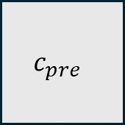
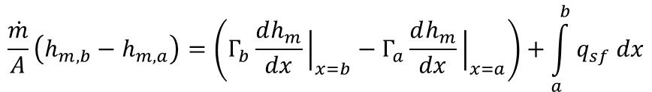

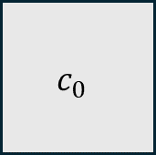
Finite Difference
$$c_{pre}$$
$$c_{0}$$
$$c_{post}$$
Fluid Energy Conservation Discretization
$$\frac{\dot{m}}{A}\left(h_{m,b}−h_{m,a}\right)=\left(Γ_{b}\frac{dh_{m}}{dx}{\left.​\right|}_{x=b}−Γ_{a}\frac{dh_{m}}{dx}{\left.​\right|}_{x=a}\right)+\int_{a}^{b}{q_{sf} dx}$$
x=a
x=b
$$\frac{\dot{m}}{A}\left(\left\{h_{m,0 }+\frac{dh_{m}}{dx}{\left.​\right|}_{x=0}dr\right\}−\left\{h_{m,0 }−\frac{dh_{m}}{dx}{\left.​\right|}_{x=0}dr\right\}\right)=\left(Γ_{b}\frac{h_{m,post}−h_{m,0}}{dS}−Γ_{a}\frac{h_{m,0}−h_{m,pre}}{dS}\right)+q_{sf,0}dS$$
$$\frac{\dot{m}}{A}\left(2\frac{dh_{m}}{dx}{\left.​\right|}_{x=0}dr\right)=\left(Γ_{b}\frac{h_{m,post}−h_{m,0}}{dS}−Γ_{a}\frac{h_{m,0}−h_{m,pre}}{dS}\right)+q_{sf,0}dS$$
$$\frac{\dot{m}}{A}\left(2\frac{h_{m,post}−h_{m,pre}}{2dS}dr\right)=\left(Γ_{b}\frac{h_{m,post}−h_{m,0}}{dS}−Γ_{a}\frac{h_{m,0}−h_{m,pre}}{dS}\right)+q_{sf,0}dS$$
$$\left(\frac{\dot{m}}{2A}−\frac{Γ_{a}}{dS}\right)h_{m,pre}+\left(\frac{Γ_{b}+Γ_{a}}{dS}\right)h_{m,0}+\left(\frac{\dot{m}}{2A}−\frac{Γ_{b}}{dS}\right)h_{m,post}=q_{sf,0}dS$$

Slide 12

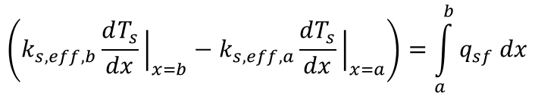
Finite Difference
$$c_{pre}$$
$$c_{0}$$
$$c_{post}$$
Solid Energy Conservation Discretization
x=a
x=b
$$\left(k_{s,eff,b}\frac{dT_{s}}{dx}{\left.​\right|}_{x=b}−k_{s,eff,a}\frac{dT_{s}}{dx}{\left.​\right|}_{x=a}\right)=\int_{a}^{b}{q_{sf} dx}$$
$$k_{s,eff,b}\frac{T_{s,post}−T_{s,0}}{dS}−k_{s,eff,a}\frac{T_{s,0}−T_{s,pre}}{dS} =q_{sf,0}dS$$
$$\left(\frac{k_{s,eff,a}}{dS}\right)T_{s,pre}−(\frac{k_{s,eff,b}+k_{s,eff,a}}{dS})T_{s,0}+(\frac{k_{s,eff,b}}{dS})T_{s,post}=q_{sf,0}dS$$
or
$$k_{s,eff,a}T_{s,pre}−(k_{s,eff,b}+k_{s,eff,a})T_{s,0}+k_{s,eff,b}T_{s,post}=q_{sf,0}dS^{2}$$

Slide 13
Mixed Boundary Condition

Slide 14




Boundary Condition type
1. Dirichlet boundary condition
$$φ_{∂Ω}=Const$$
$$\frac{∂φ}{∂n}{\left.​\right|}_{∂Ω}=Const$$
2. Neumann boundary condition
3. Cauchy boundary condition
$$φ_{∂Ω}+\frac{∂φ}{∂n}{\left.​\right|}_{∂Ω}=Const$$
4. Robin boundary condition
$$c_{0}φ_{∂Ω}+c_{1}\frac{∂φ}{∂n}{\left.​\right|}_{∂Ω}=Const$$

Slide 15
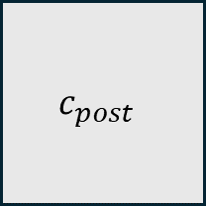
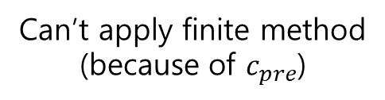
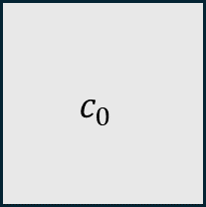
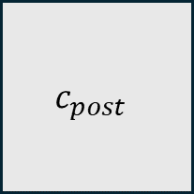
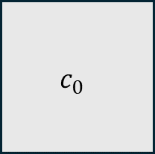
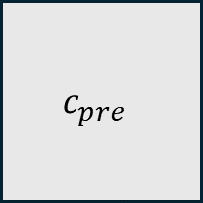
Application of Boundary Condition
Boundary
Interior
$$c_{0}$$
$$c_{post}$$
$$c_{pre}$$
$$c_{0}$$
$$c_{post}$$
Boundary Face
Can’t apply finite method
(because of $c_{pre}$)
Can apply finite method
We can get n-2 equations using finite method in interior cells
And then We can get 2 equations from Boundary condition

Slide 16





Application of Boundary Condition
1. Dirichlet boundary condition
$$φ_{∂Ω}=Const$$
Boundary
$$c_{0}$$
$$c_{post}$$
Using Interpolation
Boundary Face
$$φ_{∂Ω}≈φ_{c0}+\frac{∂φ}{∂x}{\left.​\right|}_{x=c0}dr$$
$$\frac{∂φ}{∂x}{\left.​\right|}_{x=c0}≈\frac{φ_{cpost}−φ_{c0}}{dS}$$
$$φ_{∂Ω}=φ_{c0}+\frac{φ_{cpost}−φ_{c0}}{dS}dr$$
Then,
or
$${(1−\frac{dr}{dS})φ}_{c0}+\frac{dr}{dS}φ_{cpost}=φ_{∂Ω}$$

Slide 17





Application of Boundary Condition
$$\frac{∂φ}{∂n}{\left.​\right|}_{∂Ω}=Const$$
Boundary
2. Neumann boundary condition
$$c_{0}$$
$$c_{post}$$
Using Interpolation
Boundary Face
$$φ_{∂Ω}≈φ_{c0}+\frac{∂φ}{∂x}{\left.​\right|}_{x=c0}dr$$
$$\frac{∂φ}{∂n}{\left.​\right|}_{∂Ω}≈\frac{φ_{c0}−φ_{∂Ω}}{dr}$$
$$\frac{∂φ}{∂n}{\left.​\right|}_{∂Ω}≈\frac{∂φ}{∂x}{\left.​\right|}_{x=c0}$$
Then,
or
$$φ_{c0}−φ_{cpost}=−\frac{∂φ}{∂n}{\left.​\right|}_{∂Ω}dS$$

Slide 18
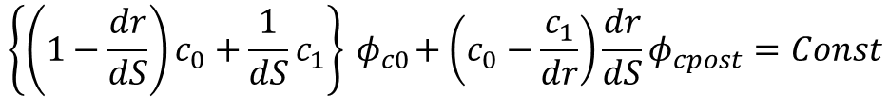


Application of Boundary Condition
$$c_{0}φ_{∂Ω}+c_{1}\frac{∂φ}{∂n}{\left.​\right|}_{∂Ω}=Const$$
Boundary
4. Robin boundary condition
$$c_{0}$$
$$c_{post}$$
Using Interpolation
Boundary Face
$$φ_{∂Ω}≈φ_{c0}+\frac{∂φ}{∂x}{\left.​\right|}_{x=c0}dr$$
$$\frac{∂φ}{∂n}{\left.​\right|}_{∂Ω}≈\frac{φ_{c0}−φ_{∂Ω}}{dr}$$
$$c_{0}φ_{∂Ω}+c_{1}\frac{φ_{c0}−φ_{∂Ω}}{dr}=Const$$
Then,
$$\left\{\left(1−\frac{dr}{dS}\right)c_{0}+\frac{1}{dS}c_{1}\right\}{ φ}_{c0}+\left(c_{0}−\frac{c_{1}}{dr}\right)\frac{dr}{dS}φ_{cpost}=Const$$
or

Slide 19
Solver process

Slide 20
Initialize Fluid Enthalpy & Solid Temperature
Flow chart
Create linear system : AE=B, CT=D
(E : Enthalpy vector, T : Solid Temperature vector)
Get E & T vectors
Converge?
no
yes
end

