Slide 1
Image Segmentation using Minimum Planar Multisink Cuts with Connectivity Prior
Advisor: Dr. Ivona Bezakova
Presented by: Ketan Joshi

Slide 2
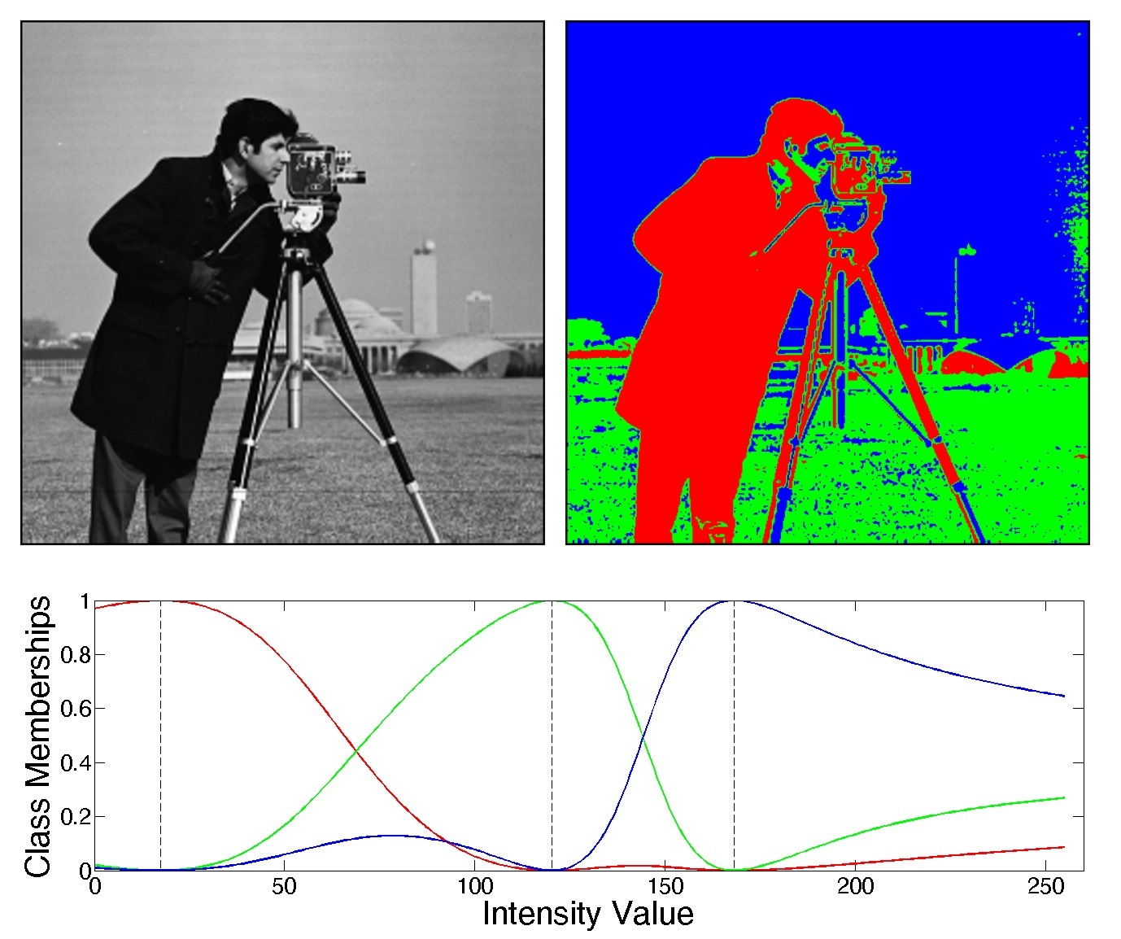
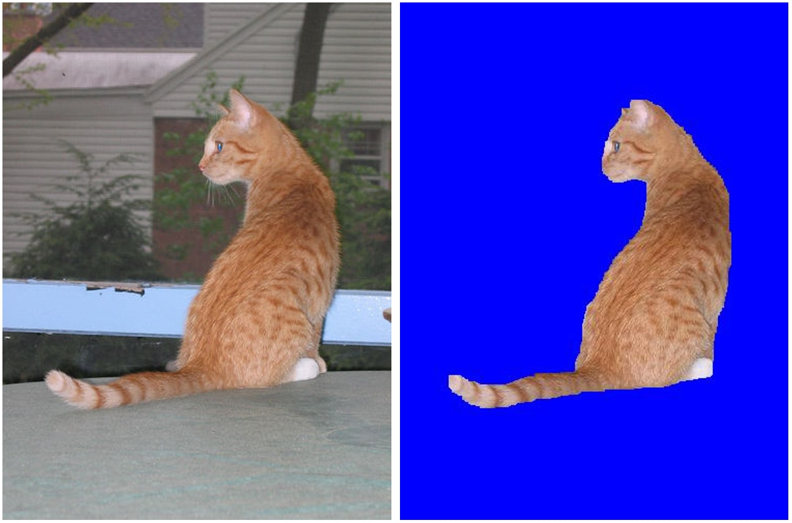
Image Segmentation
Image Courtesy: mathworks.com Image Courtesy: https://filebox.ece.vt.edu/~jbhuang/teaching/ece5554-4554/fa16/hw4.html

Slide 3
Image Segmentation
Image segmentation is a problem of dividing an image into a multiple sets of pixels
Why we do it?? → dividing image into a meaningful representation(segments) enabling ease to analyze.
Image segmentation is used as a preprocessing steps in variety of applications.
In Image Analysis, it is important that a correctly segmented image is fed to algorithms used for analysis.

Slide 4
Some of the existing image segmentation algorithms are:
- Watershed segmentation
- Histogram based segmentation
- Segmentation using K-means algorithms
- Segmentation using edge detection.
Applications include object detection, fingerprint matching, face detection, medical imaging (find tumor cells, infected tissue etc.)

Slide 5
Problem
The algorithms mentioned may provide partial results, with images having thin, elongated shapes. e.g legs of insect or blood vessels.
The above mentioned algorithms consider the overall image properties (color, intensity, saturation) of the image.
We need better algorithms where we require a detailed segmentation of the image.
The algorithm proposed in the [1] uses planar graphs with Multisink cuts with connectivity priors.
It ensures connectivity constraints between pixels. The algorithm uses dynamic programming to solve the problem in polynomial time O(n^4).

Slide 6
Related Work
There exist many graph cut image segmentation approaches which makes use of Maxflow-mincut, Finding shortest path, Markov random fields.
Some of the existing algorithm have a problem called shrinking bias, which means the algorithm have bias towards shorter contrast boundaries providing bad results in such cases
Paper [2] uses an optimized version of Dijkstra’s algorithm. The algorithm proposed is a merge of graph cut and Dijkstra’s algorithm. It is a heuristic approach which tries to find the global minimum of energy function consisting of color coherence between foreground and background.
The paper also proposed another algorithm a slower than the previous one which decomposes the problem into subproblems, finds lower bounds to the subproblem and then combine results.

Slide 7
Attack Plan
Milestone 1 :
Background reading (related works):
Implementation of data structures for efficiently handling planar graphs
Draft of Background and Related work
Milestone 2 :
Implementing the dynamic programming skeleton of the algorithm, with less efficient subroutines
Draft of:
- Algorithm description
- Implementation details and challenges
Milestone 3 :
Implement image preprocessing to convert images to planar graphs and your data structures
Experimentation on images
Draft of
- Experiments
- Conclusion

Slide 8
Goal
An implementation of the proposed algorithm[1] which will be an interactive image segmentation algorithm. Where user will select several foreground seed points and one background seed point which they want to segment as an initial seed points. Based on those seed points it will segment the image.

Slide 9
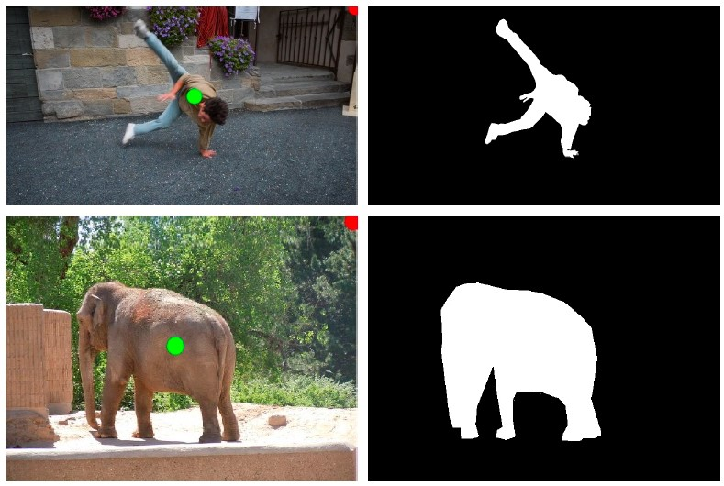
Image Courtesy: http://vladlen.info/publications/interactive-image-segmentation-latent-diversity/

Slide 10
Thank you!!

Slide 11
References
[1] Minimum Planar Multi-sink Cuts with Connectivity Priors, I. Bezakova and Z. Langley.
[2] Graph cut based image segmentation with connectivity priors.
Vicente, S., Kolmogorov, V., Rother, C.

