Slide 1
⚓ AEGISLIFE INSURANCE
Risk Analytics &
Claims Intelligence
Executive findings, board decisions and full data lineage
Kartik Tripathi

Slide 2
BOARD BRIEF
The One-Page Bottom Line
Everything that follows supports these three numbers and three decisions
4.71
49.0%
35.9%
Gross loss ratio
Claims fraud-flagged
Claim approval rate
₹4.71 of filed claim exposure per ₹1 of premium
₹29.8M of flagged claim value concentrated in North
₹117.6M sits in pending claims awaiting a decision
Three decisions requested today
01
Fund a fraud investigation surge in North
02
Approve actuarial repricing of Property and Health
03
Clear the ₹117.6M pending-claims backlog
Source: Executive KPI dashboard · claim_history × policy_details (SQL Query #1)
2

Slide 3
PORTFOLIO OVERVIEW
Portfolio at a Glance
Full book · all regions · all product lines
1,406
₹252.9K
35.9%
4.71
49.0%
Total claims
Avg. claim amount
Approval rate
Gross loss ratio
Fraud ratio
Two loss ratios, one book.
4.71 measures every claim filed against premium; on approved claims only, the paid ratio is 1.69. The 3.02-point gap is the value currently sitting in pending and rejected claims.
Source: Executive KPI dashboard — recomputed from claim_history × policy_details
3

Slide 4
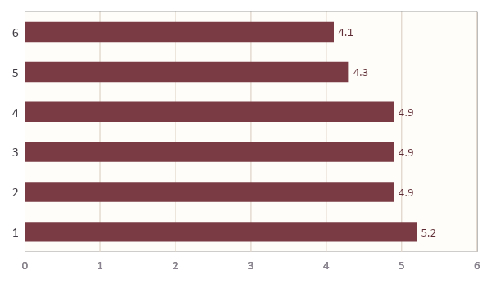
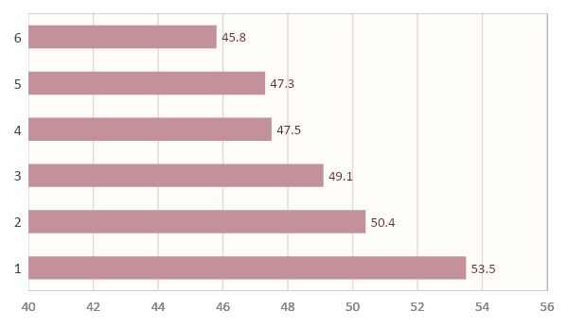
WHAT THE DATA REVEALS
Regional Risk
Loss ratio and fraud exposure, side by side
Loss ratio by region
Fraud ratio by region (%)
South carries the widest loss-ratio spread (1.1 points over North-East), while North runs 4.5 points above the 49.0% portfolio fraud average — ₹29.8M of flagged claim value.
Source: Executive KPI dashboard — Loss Ratio and Fraud Ratio by Region
4

Slide 5
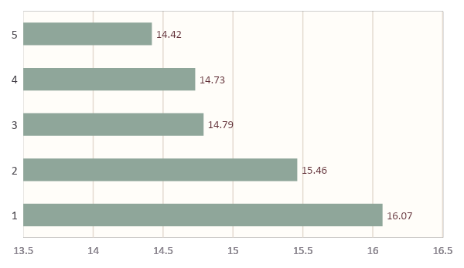
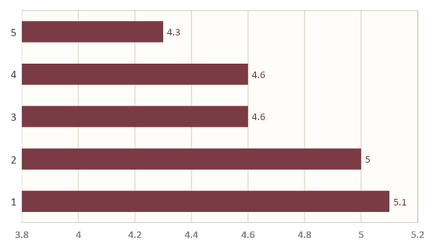
WHAT THE DATA REVEALS
Product Economics
Premium is spread evenly; risk is not
Annual premium by product (₹M)
Loss ratio by product
Property (5.1) and Health (5.0) sit above the 4.71 portfolio line while contributing only ~40% of premium. Vehicle is the largest line and the lowest loss ratio — the strongest earner.
Source: Executive & Regional Manager dashboards — policy_details × claim_history
5

Slide 6
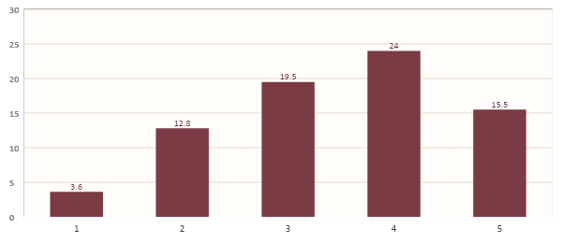
WHAT THE DATA REVEALS
Premium Growth by Policy Year
Total annual premium on policies written each year (₹M)
6.7×
growth 2020 → 2023. Treat 2024 as a partial writing year, not a confirmed decline.
Source: Regional Manager dashboard — policy_details.policy_start_date
6

Slide 7
DISTRIBUTION HEALTH
Agent Productivity & Lapse
300 agents · policies sold vs. lapse rate
Highest-lapse agents
57
Agent | Region | Sold | Lapse
AGT5079 | Central | 289 | 0.29
AGT5207 | Central | 283 | 0.29
AGT5190 | East | 255 | 0.29
AGT5264 | South | 229 | 0.29
AGT5154 | North | 184 | 0.29
AGT5168 | East | 174 | 0.29
agents above a 0.25 lapse rate — 19% of the force, holding 2,885 lapsed policies.
Source: agent_info — lapsed_policies ÷ total_policies_sold
7

Slide 8
STATISTICAL VALIDATION
What the Statistics Confirm
Three hypotheses tested on the full claim population (n = 1,406)
Does claim type drive approval?
Does risk score predict claim size?
Do smokers claim more?
Chi-square test of independence
Pearson correlation (Fisher’s Z CI)
Welch’s two-sample t-test
χ² = 6.28 · df = 8 · p = 0.616
r = −0.016 · p = 0.557
t = 1.88 · p = 0.060 · Δ = ₹14.1K
NOT SUPPORTED
NOT SUPPORTED
NOT SUPPORTED
Approval decisions are not linked to claim type.
Risk score does not explain claim value.
Directionally higher, not significant at α = 0.05.
Source: Python EDA & statistical testing notebook — claim_history × policy_details × customer_master
8

Slide 9
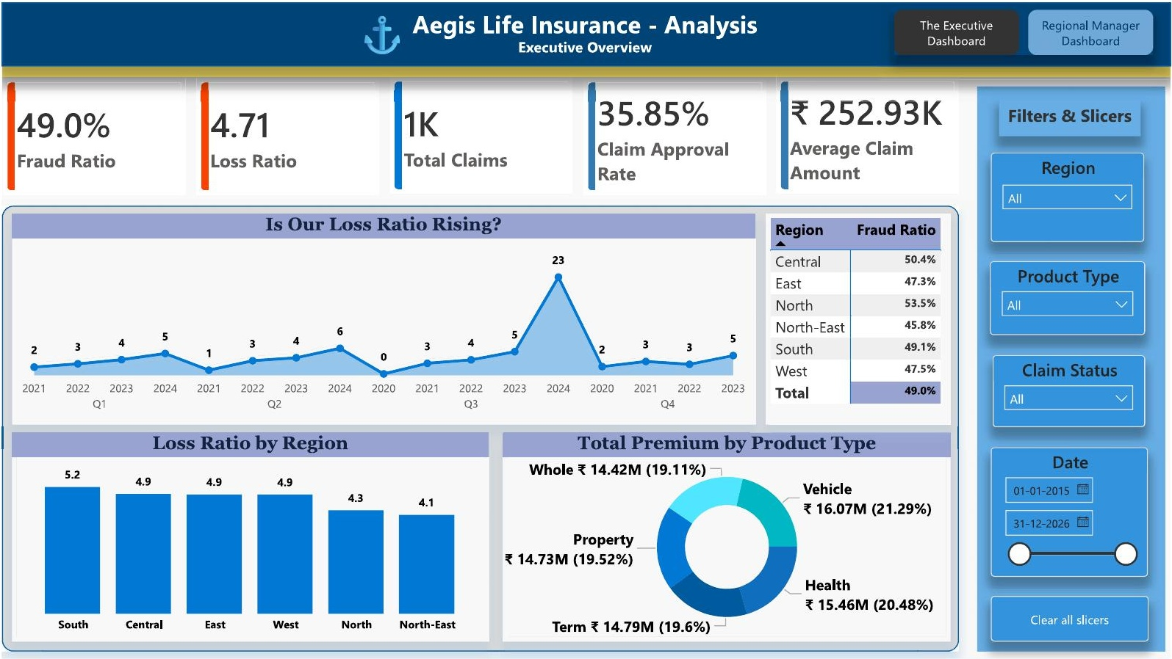
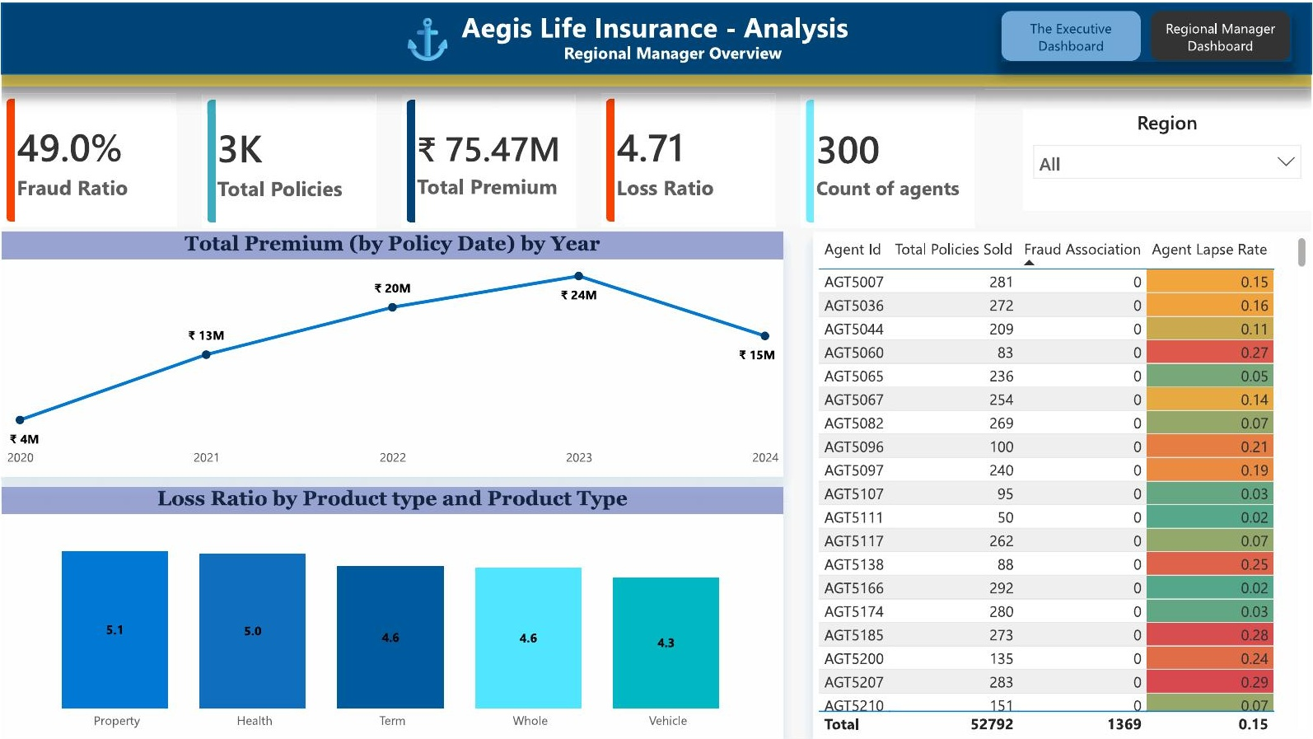
BUSINESS INTELLIGENCE
Interactive Drill-Down Dashboards
Region, product, claim status and date slicers drive every figure in this deck
Executive view — portfolio KPIs, loss and fraud by region
Regional manager view — agent-level drill-down across 300 agents
Both views are live and filterable; every slide figure can be reproduced by applying the matching slicer combination.
Source: ageis_risk_analytics_Dashboard.pdf — Executive and Regional Manager pages
9

Slide 10
STRATEGIC INSIGHTS
Top Five Findings
Each finding traces to a single verifiable figure
01
North is the fraud epicentre
53.5%
vs 49.0% portfolio · ₹29.8M flagged
02
Property and Health erode margin
5.1 / 5.0
loss ratio vs 4.71 portfolio
03
Two-thirds of claims never pay out
35.9%
approval rate · ₹117.6M pending
04
One in five agents leaks policies
57 agents
above 0.25 lapse · 2,885 policies
05
Risk score has no predictive power
r = −0.016
p = 0.557 · not significant
Sources: Executive & Regional dashboards, claim_history, agent_info, EDA notebook
10

Slide 11
DECISIONS REQUESTED
Three Decisions for the Board
Owner and success metric attached to each
01
02
03
Fund a fraud investigation surge in North
Approve repricing of Property and Health
Clear the pending-claims backlog
OWNER
OWNER
OWNER
Head of Claims Integrity
Chief Underwriting Officer
Claims Operations Lead
SUCCESS METRIC
SUCCESS METRIC
SUCCESS METRIC
North fraud ratio ≤ 49.0%
Both lines ≤ 4.71 loss ratio
Pending below 20% of claims
A fourth workstream — a structured retention programme for the 57 high-lapse agents — proceeds at management level and needs no board approval.
Recommendations map to findings 01–04 on the previous slide
11

Slide 12
PROJECTED IMPACT
What the Decisions Are Worth
Conservative estimates computed from the figures already presented
Action | Target movement | Basis of estimate | Estimated impact
01 · North fraud surge | 53.5% → 45.8% | 17.6 fewer flagged claims × ₹242.6K avg | ₹4.3M exposure removed
02 · Property & Health repricing | → 4.71 portfolio line | ₹14.73M × 0.39 + ₹15.46M × 0.32 premium base | ₹10.7M exposure closed
04 · High-lapse agent programme | 0.25+ → 0.15 median | 2,885 lapsed policies, 20% retained | ₹14.8M premium retained
₹29.8M combined addressable exposure across the three actions — before any second-order retention or pricing effects.
Sources: claim_history (regional fraud value), policy_details (premium by product), agent_info
12

Slide 13
APPENDIX A1
Data Quality & Lineage
Five tables, foreign-key validated, zero remediation required
1,648
2,828
1,406
300
1,000
Customer master
Policy details
Claim history
Agent info
Customer feedback
✓ validated
✓ validated
✓ validated
✓ validated
✓ validated
0
0
0
100%
Duplicate rows
Missing values
Invalid date sequences
FK integrity, policy → customer & agent
Source: Python EDA notebook — data-quality checks; AegisLife DDL schema constraints
14

Slide 14
APPENDIX A2
Source Traceability — Portfolio & Regional
Every figure mapped to its source table and the query or script that produced it
Slide / figure | Source table(s) | SQL query / Python output
02 · Loss ratio 4.71 | claim_history × policy_details | SQL Query #1 — SUM(claim_amount)/SUM(premium)
02 · Fraud ratio 49.0% | claim_history.fraud_flag | EDA: fraud_flag.mean() on 1,406 claims
03 · Approval rate 35.9% | claim_history.claim_status | EDA: value_counts(normalize=True)
03 · Paid ratio 1.69 | claim_history (approved only) | SQL Query #1 filtered on status = Approved
04 · Loss ratio by region | policy_details × customer_master.region | SQL Query #2 — GROUP BY region
04 · Fraud ratio by region | claim_history × customer_master | EDA: groupby(region).fraud_flag.mean()
04 · ₹29.8M flagged, North | claim_history.claim_amount | EDA: sum of fraud-flagged North claims
Source: ageis_risk_analytics.ipynb · AegisLife_Combined_Data.xlsx
15

Slide 15
APPENDIX A2
Source Traceability — Product, Agents & Tests
Every figure mapped to its source table and the query or script that produced it
Slide / figure | Source table(s) | SQL query / Python output
05 · Premium by product | policy_details.annual_premium | SQL Query #3 — GROUP BY product_type
05 · Loss ratio by product | claim_history × policy_details | SQL Query #3 with claim join
06 · Premium by policy year | policy_details.policy_start_date | EDA: resample by start-year, sum premium
07 · Agent lapse rate | agent_info | lapsed_policies ÷ total_policies_sold
08 · Chi-square, claim type | claim_history | scipy.stats.chi2_contingency output
08 · Pearson correlation | customer_master × claim_history | scipy.stats.pearsonr + Fisher Z CI
08 · Welch t-test, smokers | customer_master × claim_history | scipy.stats.ttest_ind(equal_var=False)
Source: ageis_risk_analytics.ipynb · AegisLife_Combined_Data.xlsx
16

Slide 16
APPENDIX A3
Method, Assumptions & Limitations
How the numbers were produced and where to treat them with care
Method
Excel/SQL extract of five source tables, joined on policy_id, customer_id and agent_id; analysis and testing in Python (pandas, scipy); dashboards built on the same joined view.
Assumptions
Gross loss ratio uses all filed claims; paid ratio uses approved claims only. Impact estimates apply the stated conversion rates to current volumes with no pricing or inflation adjustment.
Limitations
2024 is a partial writing year and understates growth. Fraud flag indicates suspicion, not confirmed fraud. All three hypothesis tests failed to reject H₀, so no predictive claim is made from risk score, claim type or smoking status.
Source: ageis_risk_analytics.ipynb — method, statistical outputs and known limitations
17

Slide 17
Thank You
Questions and discussion welcome. Appendix follows: data quality, source traceability and method.
AegisLife Insurance · Risk Analytics & Claims Intelligence

