Slide 1
Asymptotic statistics of nodal domains of quantum chaotic billiards in the semiclassical limit
Kyle Konrad
Alex Barnett
Dartmouth College

Slide 2
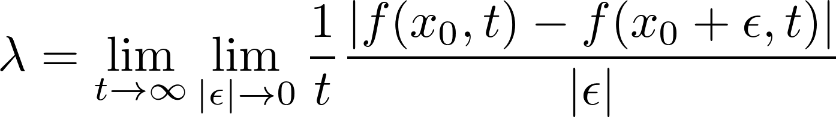
Classical Chaos
Notes:
Simple way to characterize chatoic systems: lyapunov exponent
Rate at which trajectories diverge
error ~ e^{\lambda t} \epsilon

Slide 3
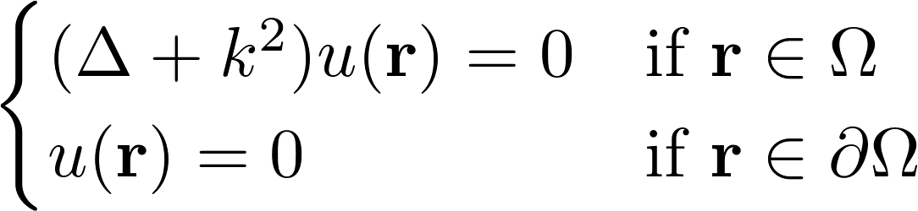
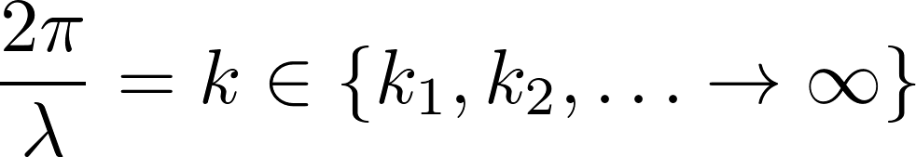
Quantum Chaos
Viewer by Alex Barnett
Notes:
QM is theory of self adjoint linear operators on hilbert space
(laplacian is energy operator)
Counterintuitive to have chaotic(=nonlinear) behavior
QM says everything is a wave
Governed by wave equation
Helmholtz is time independent wave equation
Boundary is impermeable, u → 0
Quantized eigenvalues
Applications in quantum comp. & info, quantum dots

Slide 4
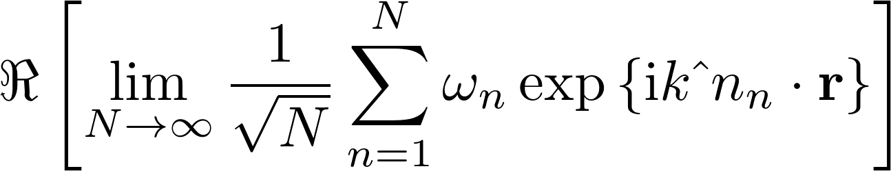
Random Plane Wave
Notes:
Superposition of plane waves in all directions with random phase and amplitude
Left: eigenfunction; right: rpw

Slide 5
Nodal domains
Notes:
Connected region of constant sign
Nodal lines are fixed on vibrational surface

Slide 6

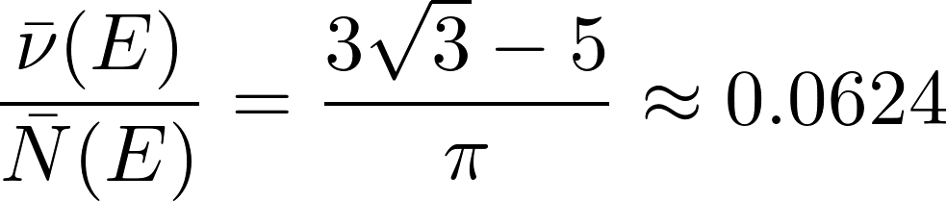
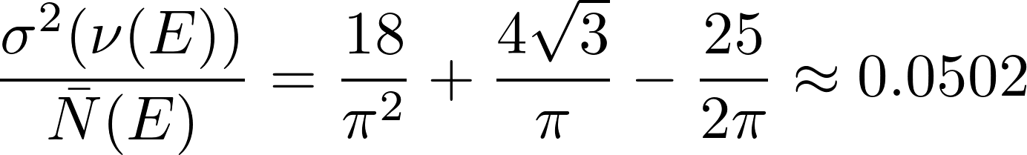
Percolation Model
E. Bogomolny and C. Schmit. Percolation model for nodal domains of chaotic wavefunctions. Physical Review Letters, 88(11), 2002.
Size:
Mean:
Variance:
Notes:
Sites are dual to a graph
Each connected component is a nodal domain
Grid spacing = lambda / sqrt(2) (by average momentum)

Slide 7
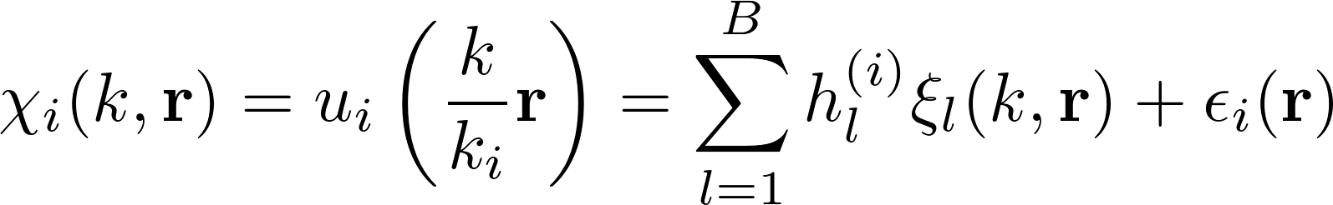
Scaling method
E. Vergini. Calculation by scaling of highly excited states of billiards. Physical Review E, (3):2204–2207, 1995.
A. Barnett. Asymptotic rate of quantum ergodicity in chaotic euclidean billiards. Communications in Pure and Applied Mathematics, 59(10):1457–1488, 2006.
Notes:
Uses B \approx k basis funcs
O(B^3) time to solve general eigenvalue prob
NB = O(k^3) basis function evaluations
Single basis set for multiple eigenfunctions
Basis evaluations are expensive
xi_j are plane waves or fundamental solutions (satisfy helmholtz)

Slide 8
Counting
DFS/BFS hybrid nodal domain traversal
  While pop
    For each neighbor
      If unseen and same sign
        push
  Smaller constant that DFS or BFS
O(N) time and space
  N is number of evaluation points
  Visits each point once
  Uses N bits to store “already seen”
Notes:
Hybrid because:
DFS requires more comparisons
Recheck neighbors
Stack is faster than queue

Slide 9
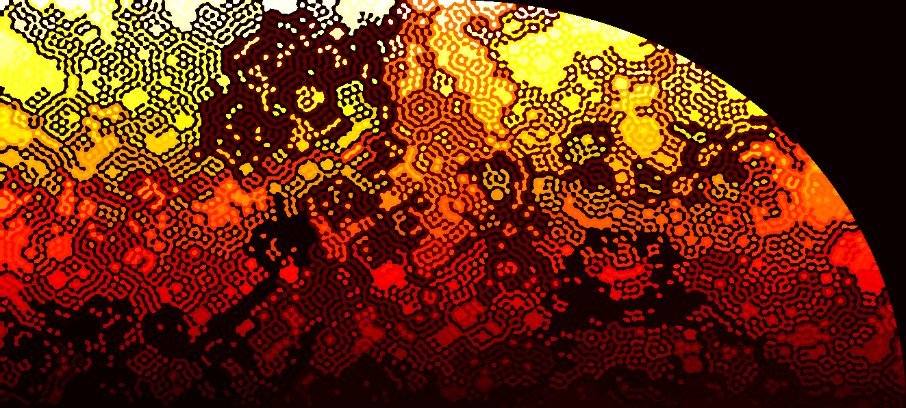
k = 400.0013
1417 nodal domains

Slide 10
Interpolation
Problem: Coarse sampling creates ambiguities
Solution: use the fact that eigenfunctions satisfy Helmholtz

Slide 11
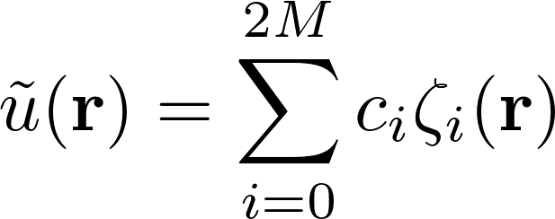
Interpolation
Performed with a single matrix multiply (at each point)
Notes:
P = L H^+
Pseudoinverse computed using SVD
Fill vector with stencil values, P gives vector of values on inner square

Slide 14
Billiards
Quarter Stadium
Quarter Sinai
Neutrally stable orbits
Hard chaos
Notes:
Vertical in left half are neutrally stable
Measure zero subset
Desymmetrized for efficiency
Basis set has odd-odd symmetry
Can reflect across x- and y-axes

Slide 15
Results
Relative error from conjectured value
 | Sinai | Stadium
Size | 8.65e-4 | 1.4e-3
Mean | 4.61e-2 | 0.14
Variance | 0.775 | >50
Notes:
Size agrees
Mean is close
Variance is way off
Also checked on percolation and RPWs
All agree for percolation
Size and mean agree for RPW

Slide 16
Sinai

Slide 17
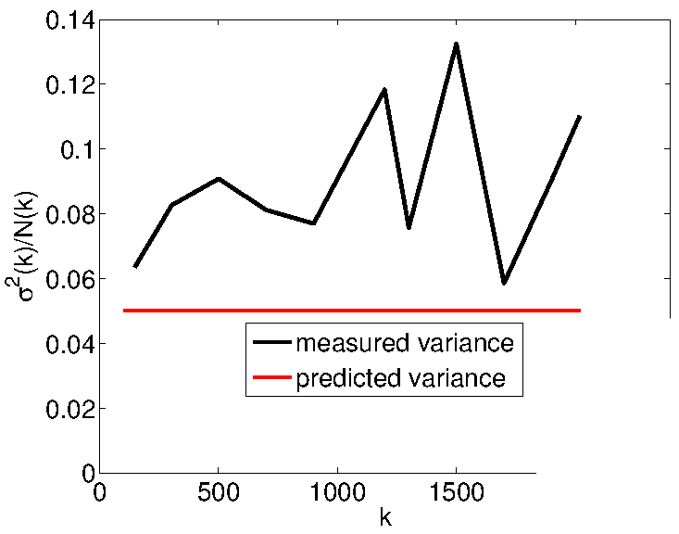
Sinai
Notes:
Approximately normal – slight left skew

Slide 18
Stadium

Slide 19
Bouncing Ball Mode
Notes:
Scars of periodic orbits
Probability mass concentrated in square, low wing tip mass

Slide 20
Stadium
Notes:
Strong left skew – due to bouncing ball modes (low wing tip mass)
Variance is hugely off

Slide 21
Data Collected
1e5 eigenfunctions
800GB
1.5e9 nodal domains
8000 CPU hours
Notes:
Condor cluster ~30 cores
Also used Andes (24 core, 96GB) and Polaris

Slide 22

Notes:
Alex presents June 7 in Montreal
My picture on right

Slide 23
Acknowledgements
Many thanks to...
Alex Barnett,
Sarunas Burdulis,
Dan Rockmore,
Devin Balkcom,
and the Neukom Institute
Notes:
Neukom Scholars Program

