Slide 1


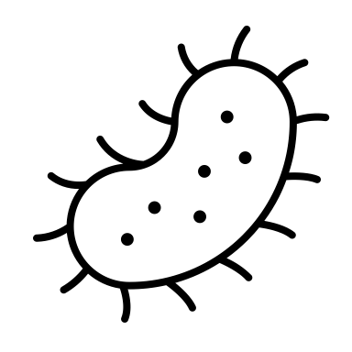


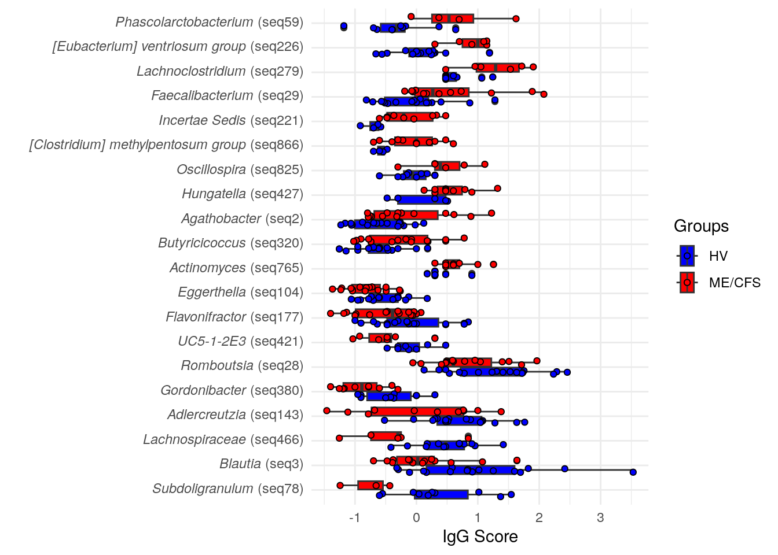


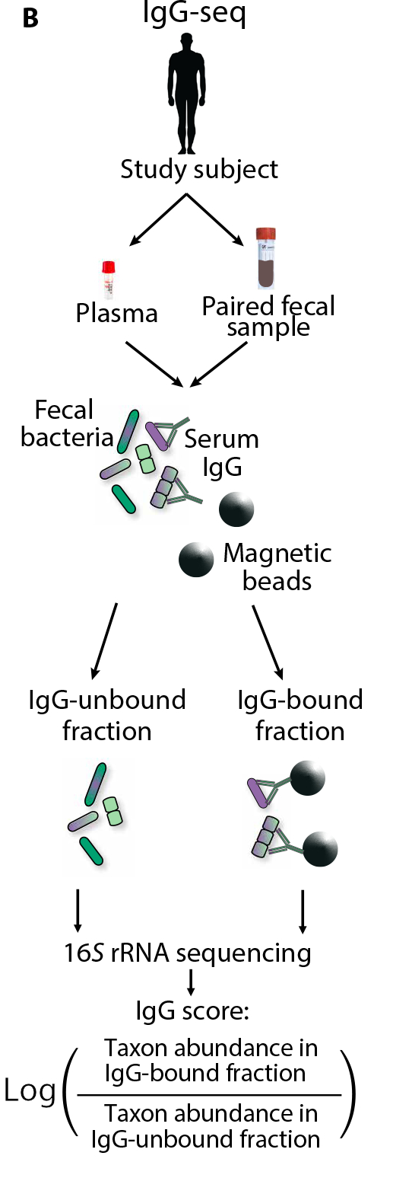

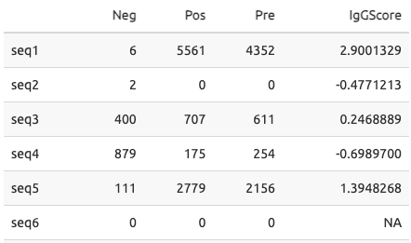


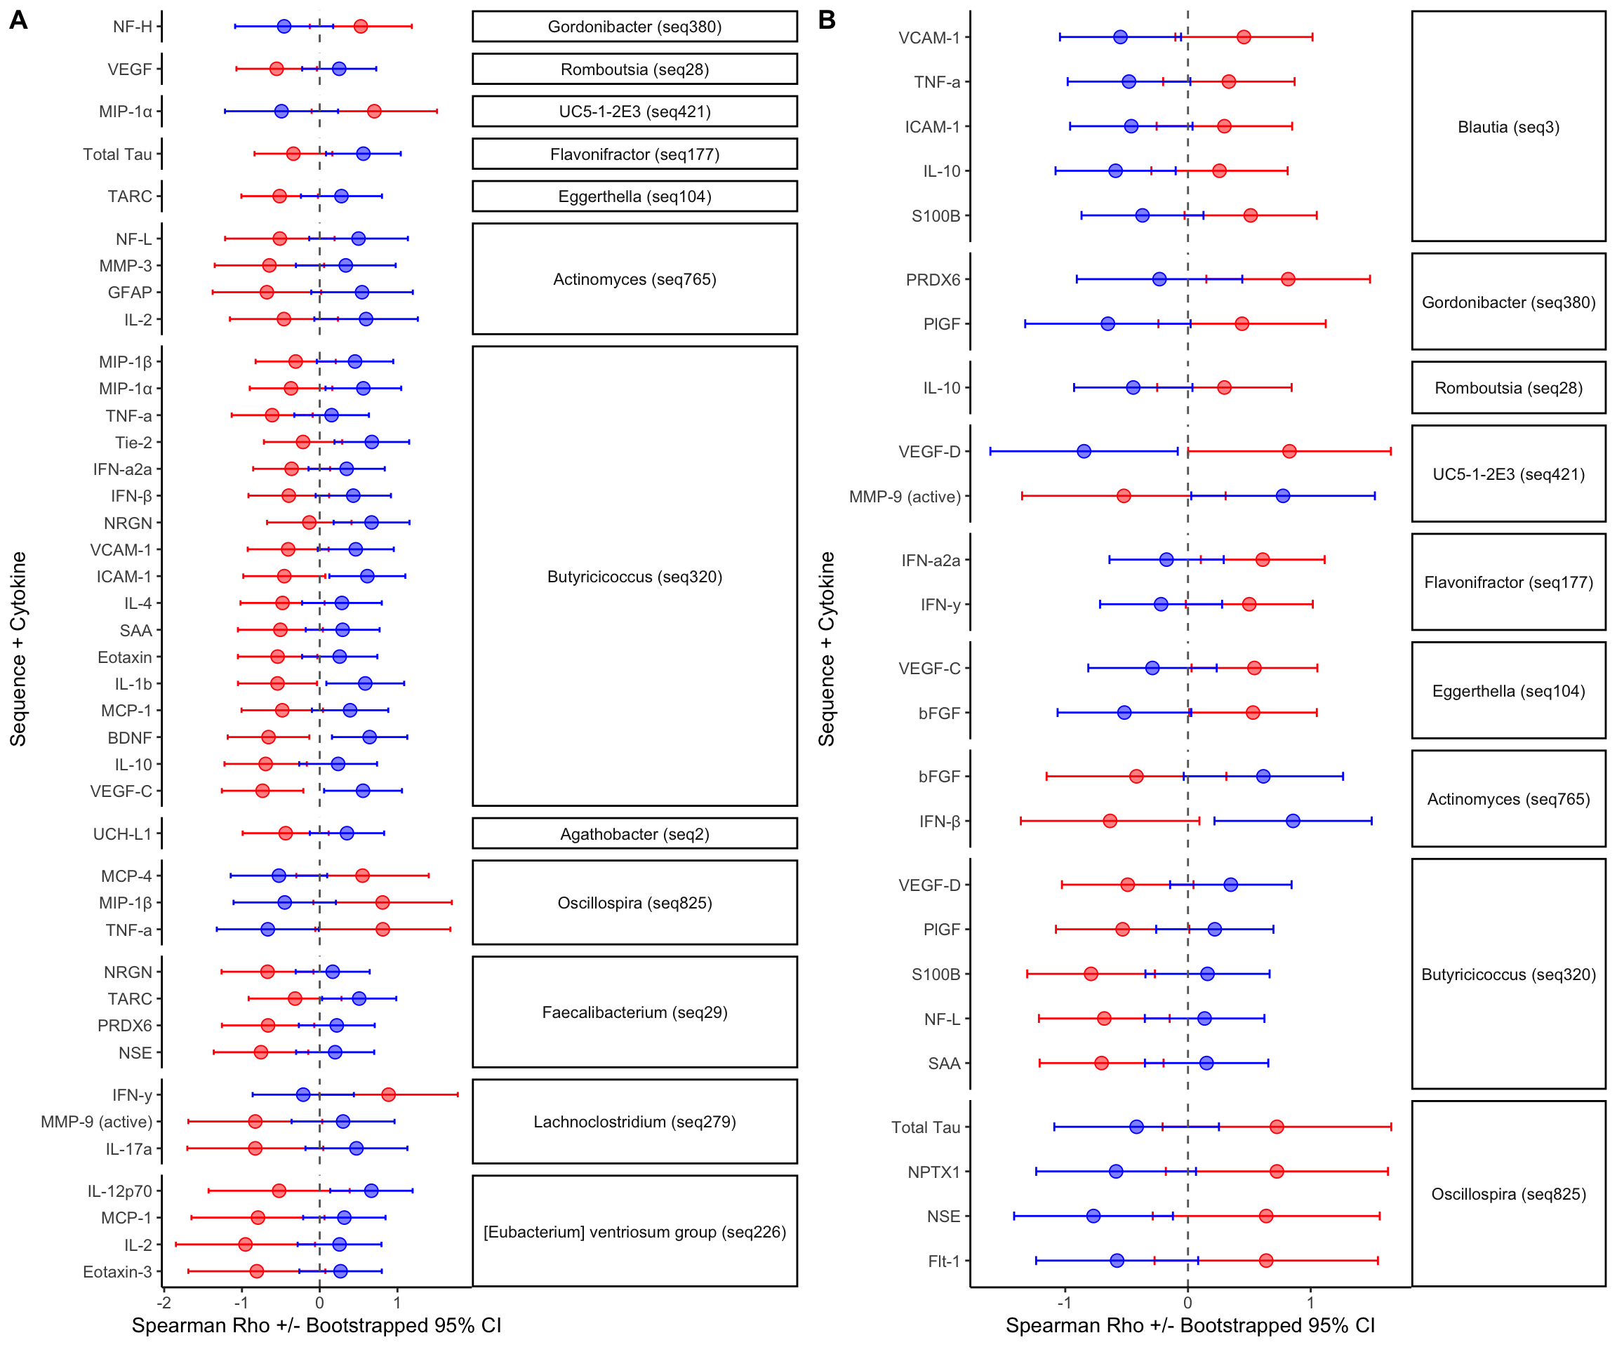
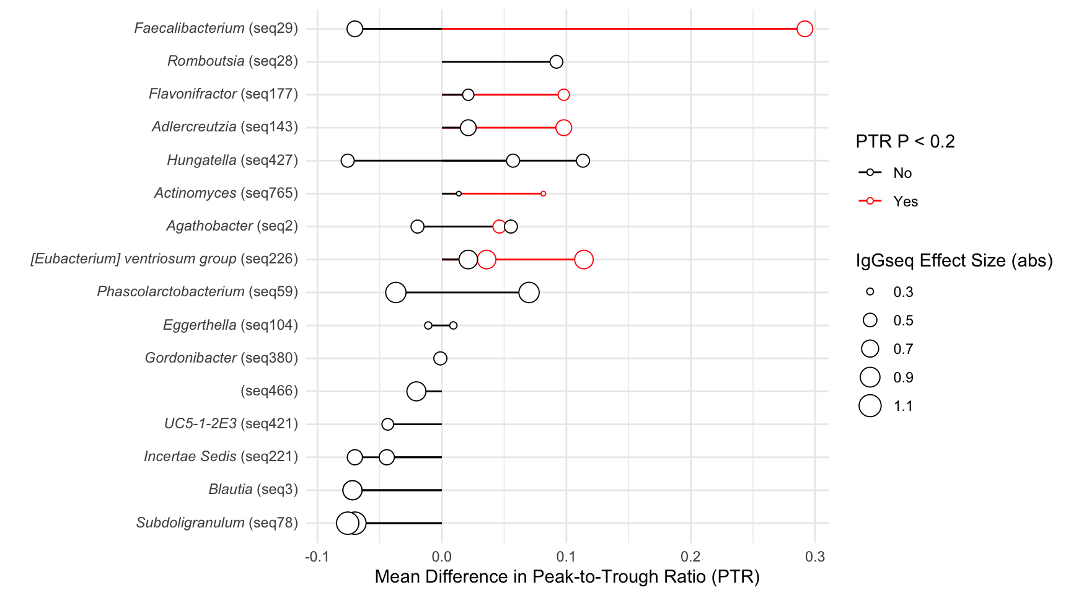

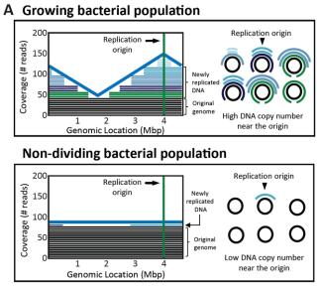





IgG Sequencing Identifies Translocating Gut Microbes that Correlate with Differential Cytokine Response and Reduced Bacterial Growth Rates in
Post-Infectious Myalgic Encephalomyelitis/
Chronic Fatigue Syndrome (PI-ME/CFS)
Bacteria Escaping the Gut Barrier
Reduced Immune Response and Have
Lower Growth Rates in PI-ME/CFS
Kathryn E McCauley¹, Carlotta Vizioli², Andrew S Burns³, Shreni Mistry³, Avindra Nath², Brian Walitt², Jennifer J Barb⁴
¹Bioinformatics and Computational Biosciences Branch, National Institute of Allergy and Infectious Diseases, National Institutes of Health, Bethesda, MD,²Section of Infections of the Nervous System, National Institute of Neurological Disorders and Stroke, National Institutes of Health, Bethesda, MD, ³NIAID Microbiome Program, National Institute of Allergy and Infectious Disease, National Institutes of Health, Bethesda, MD, ⁴Translational Biobehavioral and Health Disparities Branch, National Institutes of Health Clinical Center, Bethesda, MD
Background
PI-ME/CFS is a debilitating condition with severe fatigue, cognitive impairments, and gastrointestinal distress, typically as a result of previous bacterial or viral infection
Gut Microbiota of PI-ME/CFS and Paired IgG-Negative Pools Exhibit Reduced Diversity
Several Microbiota Members Have Differential IgG-Scores and Produce SCFAs
When gut bacteria escape the intestinal wall, typically because of gut damage, they can cause disease
Immunoglobulin-G (IgG) is a systemic antibody absent in the gut, but binds to microbes upon their departure
Figure 1. (A) ME/CFS gut microbiota exhibits reduced richness but not diversity. (B) The IgG-negative fraction has reduced richness and diversity compared to the Pre-sort and IgG-Positive fractions (c) This difference occurs in a condition specific manner across all three fractions. (d) Microbiota composition between ME/CFS and HV is distinct. (e) Canberra composition of all three fractions, linking within-subject samples. (f) Typically, IgG Negative fractions are compositionally-distinct from Pre-sort and IgG-Positive fractions, with no difference between ME/CFS and HV.
*
*
Figure 2. Differential IgG scores were observed between HV and ME/CFS for 20 bacterial taxa. Taxa are sorted by the magnitude of difference between ME/CFS and HV. Points represent the IgG Score, with positive values indicating relatively increased IgG response for that taxon and negative values indicating decreased IgG response. Results are from a linear model with p value < 0.05.
Short Chain Fatty Acids (SCFAs), including butyrate, are produced by microbiota and vital to gut health
*
*
Hypothesis: Interrogating microbes that cross the intestinal barrier and carry markers of IgG may reveal potential mechanisms of ME/CFS
*
*
*
Methods
*
*
Participants were identified through the NIH Intramural ME/CFS Study, enrolled between 2016 and 2019 [NCT 02669212]
Paired stool, serum, and cerebrospinal fluid samples were collected from N=16 PI-ME/CFS participants and N=19 Healthy Volunteers (HVs)
Magnetic beads separated bacteria into pools of IgG-bound and IgG-unbound bacteria
Pools underwent 16S rRNA gene sequencing of the V4 region (IgG-seq)
Reads were processed with Nephele (nephele.niaid.nih.gov)
Cytokines from plasma and cerebrospinal fluid were obtained from the V-PLEX cytokine panel 1 (human) kit (MesoScale.com)
Bacterial Growth Rates were estimated from paired metagenomic reads using Growth Rate InDex tool (GRiD)
*
Table 1. Example of IgG Score Calculations for One Subject’s IgG-Negative fraction, IgG-Positive Fraction, and Pre-sort Fraction.
*
*
*
*Indicates Short-Chain Fatty Acid Producers
Butyricicoccus Translocation in PI-ME/CFS Negatively Correlates with Cytokines in Plasma and CSF
Bacteria With Differential Translocation Have Nominally Higher Metabolic Activity in Healthy Volunteers
Plasma
Cerebrospinal Fluid (CSF)
Figure 3. Interaction correlations of cytokines with IgG scores in (A) plasma and (B) cerebrospinal fluid. Correlations were performed within PI-ME/CFS and HV separately using a non-parametric boostrap test. Interactions were identified when there was less than 5% overlap between confidence intervals. Significant taxa-cytokine interactions are grouped by ASV and sorted by significance from Figure 2.
Figure 4. Peak-to-Trough Ratios (PTRs) for taxa with differential translocation effects are higher in Healthy Volunteers than ME/CFS. Points indicate the Mean Difference in PTR, with the IgG effect size (see Figure 2) represented by the size of the circle. Red indicates that the difference in PTR between groups exhibited modest trends (P < 0.2). PTRs were obtained from metagenomic reads. Representative sequences from IgG-seq analysis were mapped to reference genomes to link IgG scores to PTR values.
Korem T, Zeevi D, Suez J, et al. Growth dynamics of gut microbiota in health and disease inferred from single metagenomic samples. Science. 2015;349(6252):1101-1106. doi:10.1126/science.aac4812
Vujkovic-Cvijin I, Welles HC, Ha CWY, et al. The systemic anti-microbiota IgG repertoire can identify gut bacteria that translocate across gut barrier surfaces. Sci Transl Med. 2022;14(658):eabl3927. doi:10.1126/scitranslmed.abl3927
Conclusions
This message will be removed before the poster is printed: I’ve re-done this figure to include differential PTRs for ALL genomes that mapped at 100% identity. I was previously attempting to identify a “best” mapping between 16S and genomes using various scoring factors, but it wasn’t perfect. I feel that it is more honest to the data, and tells the same story with more confidence behind it.
PI-ME/CFS is characterized by relatively few taxa that exhibit differential translocation potential
ME/CFS
HV
These taxa correlate with both plasma and cerebrospinal fluid cytokines, indicating that translocation of these microbes may initiate a response of the immune system
Preliminary evidence suggests that IgG-targeted microbes have increased metabolic activity in Healthy Volunteers, which was not present in the microbiota from ME/CFS participants
Limitations
Learn about previous mechanistic research in PI-ME/CFS!
Learn about Nephele, a free cloud microbiome analysis platform!
In ”Autologous” IgG-seq, in which the stool sample and serum sample are derived from the same subject, no bacterial counts in both pools results in a missing value for IgG-seq scores for that taxon and no currently-accepted methods for recovering those zeroes and missing values exist, leading to difficulty in interpretation and generalization of results.
Citations
Currently points to ME/CFS Manuscript. Jen, what did you use for your citation-sharing software?
Confirmation of these findings is difficult – we performed correlative confirmation by employing paired cytokine data and bacterial growth estimates, each with their own limitations
nephele.niaid.nih.gov
PubMed ID: 38383456
Funding to conduct study protocols was obtained from the NIH Common Fund. This project has been funded in part with Federal funds from the National Institute of Allergy and Infectious Diseases (NIAID), National Institutes of Health, Department of Health and Human Services under BCBB Support Services Contract HHSN316201300006W/75N93022F00001 to Guidehouse Digital.

