Slide 1


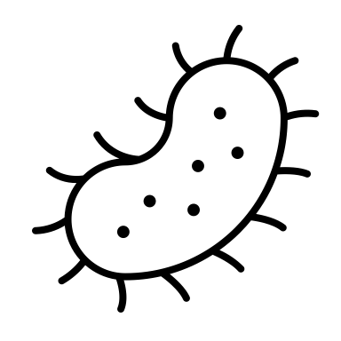


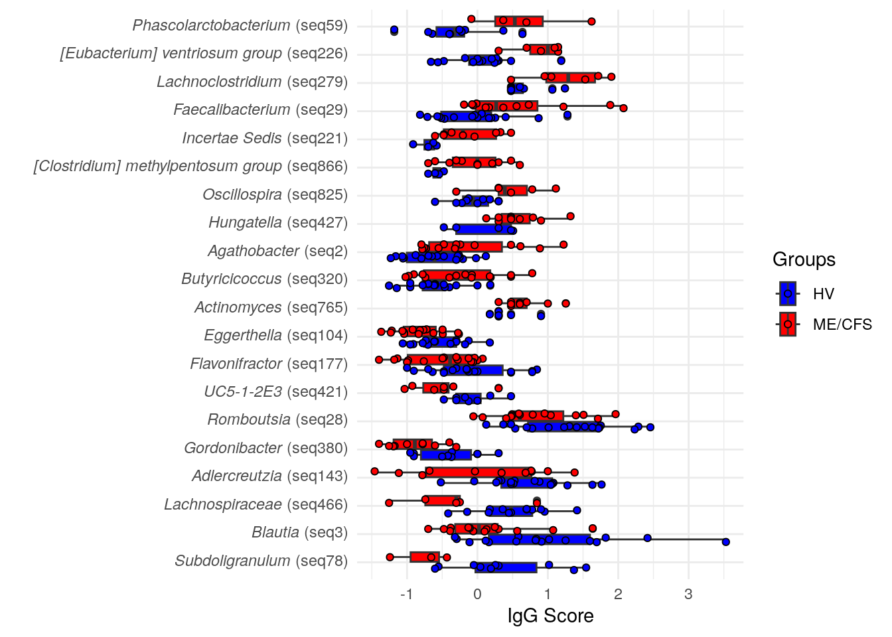


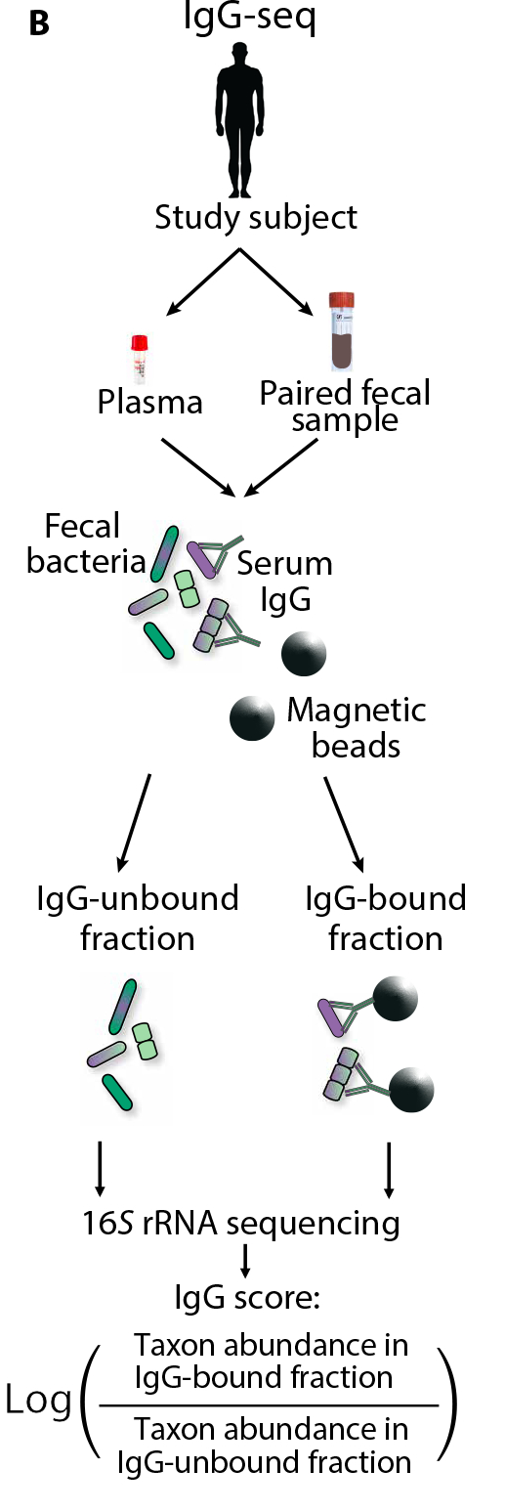
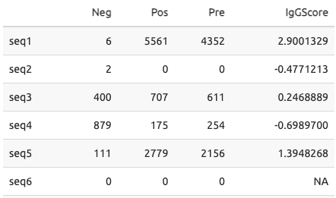



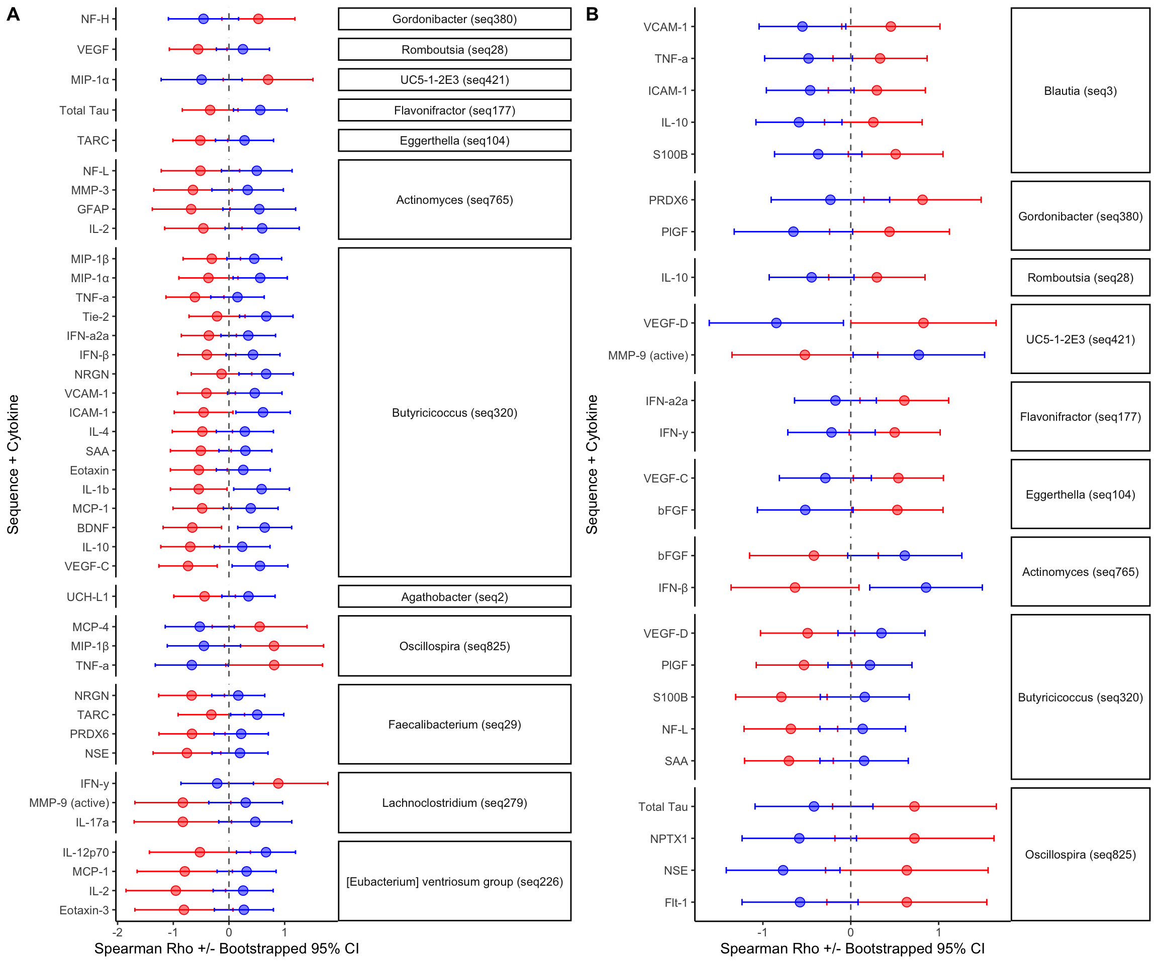
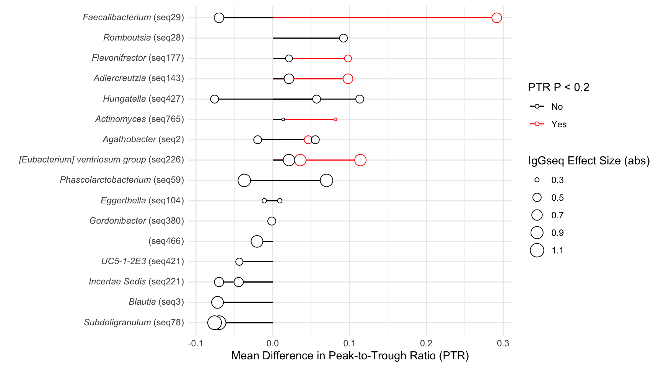
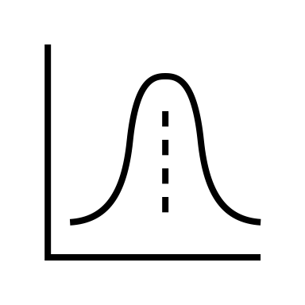
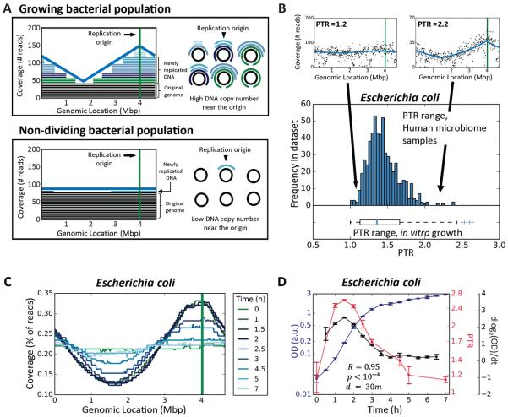




IgG Sequencing Identifies Translocating Gut Microbes that Correlate with Differential Cytokine Response and Reduced Bacterial Growth Rates in
Post-Infectious Myalgic Encephalomyelitis/
Chronic Fatigue Syndrome (PI-ME/CFS)
Bacteria Escaping the Gut Barrier
Reduce Local Immune Response and
Have Lower Growth Rates in PI-ME/CFS
Kathryn E McCauley¹, Carlotta Vizioli², Andrew S Burns³, Shreni Mistry³, Avindra Nath², Brian Walitt², Jennifer J Barb⁴
¹Bioinformatics and Computational Biosciences Branch, National Institute of Allergy and Infectious Diseases, National Institutes of Health, Bethesda, MD,²Section of Infections of the Nervous System, National Institute of Neurological Disorders and Stroke, National Institutes of Health, Bethesda, MD, ³NIAID Microbiome Program, National Institute of Allergy and Infectious Disease, National Institutes of Health, Bethesda, MD, ⁴Translational Biobehavioral and Health Disparities Branch, National Institutes of Health Clinical Center, Bethesda, MD
Background
PI-ME/CFS is a debilitating condition with post-exertional malaise, cognitive impairments, and gastrointestinal distress, typically due to previous bacterial or viral infection
Gut Microbiota of PI-ME/CFS and Paired IgG-Negative Pools Exhibit Reduced Diversity
Several Microbiota Members Have Differential IgG Binding and Produce SCFAs
When gut bacteria escape the intestinal wall, typically because of gut damage, they can cause disease
PI-ME/CFS gut microbiota has reduced diversity
IgG-Negative fraction also exhibited lower diversity
This difference was not dependent on PI-ME/CFS status
Immunoglobulin-G (IgG) is a systemic antibody absent in the gut, but binds to microbes upon their departure
*
*
Figure 2. Differential IgG scores were observed between HV and PI-ME/CFS for 20 bacterial taxa. Taxa are sorted by the magnitude of difference between PI-ME/CFS and HV. Points represent the IgG Score, with positive values indicating relatively increased IgG response for that taxon and negative values indicating decreased IgG response. Results are from a linear model with P value < 0.05.
Short Chain Fatty Acids (SCFAs), including butyrate, are produced by microbiota and vital to gut health
Figure 1. (A) PI-ME/CFS gut microbiota exhibits reduced richness but not diversity. (B) The IgG-negative fraction has reduced richness and diversity compared to the Pre-sort and IgG-Positive fractions (c) This difference occurs in a condition specific manner across all three fractions. (d) Microbiota composition between PI-ME/CFS and HV is distinct. (e) Canberra composition of all three fractions, linking within-subject samples. (f) IgG Negative fractions are compositionally-distinct from Pre-sort and IgG-Positive fractions, with no difference between PI-ME/CFS and HV.
*
*
Hypothesis: Interrogating microbes that cross the intestinal barrier and carry markers of IgG may reveal potential mechanisms of PI-ME/CFS
*
*
*
*
*
HV
PI-ME/CFS
Methods
HV PI-ME/CFS
HV PI-ME/CFS
*
Participants were identified through the NIH Intramural ME/CFS Study, enrolled between 2016 and 2019 [NCT 02669212]¹
Paired stool, serum, and cerebrospinal fluid samples were collected from N=16 PI-ME/CFS participants and N=19 Healthy Volunteers (HVs)
Magnetic beads separated bacteria into pools of IgG-bound and IgG-unbound bacteria from paired stool and serum for “Autologous” IgG-seq²
Pools underwent 16S rRNA gene sequencing of the V4 region (IgG-seq)
Reads were processed with Nephele (nephele.niaid.nih.gov)
Cytokines from plasma and cerebrospinal fluid were obtained from the V-PLEX cytokine panel 1 (human) kit (MesoScale.com)
Bacterial Growth Rates were estimated from paired metagenomic reads using Growth Rate InDex tool (GRiD) to obtain a Peak-to-Trough Ratio^{3,4}
Table 1. Example of IgG Score Calculations for One Subject’s IgG-Negative fraction, IgG-Positive Fraction, and Pre-sort Fraction.
*
*
*
Microbiota composition was also quite distinct
Composition of all three fractions, linking within-subject samples
IgG-Negative fractions are distinct from other fractions
*Indicates Short-Chain Fatty Acid Producers
Butyricicoccus spp. Translocation in PI-ME/CFS Negatively Correlates with Cytokines in Plasma and CSF
Bacteria With Differential Translocation Exhibit Nominally Lower Growth Rates in PI-ME/CFS
Plasma
Cerebrospinal Fluid (CSF)
Figure 3. Interaction correlations of cytokines with IgG scores in (A) plasma and (B) cerebrospinal fluid. Correlations were performed within PI-ME/CFS and HV separately using a non-parametric bootstrap test. Interactions were identified when there was less than 5% overlap between confidence intervals. Significant taxa-cytokine interactions are grouped by ASV and sorted by significance from Figure 2.
Figure 4. Peak-to-Trough Ratios (PTRs) for taxa with differential translocation are higher in Healthy Volunteers than PI-ME/CFS. Points indicate the Mean Difference in PTR, with the IgG effect size (see Figure 2) represented by the size of the circle. A red outline indicates that the difference in PTR between groups exhibited modest trends (P < 0.2). PTRs were obtained from paired metagenomic samples applied to a curated database of stool genomes. Representative sequences from IgG-seq analysis were mapped to reference genomes to link IgG scores to PTR values. Circles to the left of y-axis labels indicate the directionality of IgG-score differences from Figure 2.
Figure 1. IgG-seq protocol, from Citation 2.
Figure 2. Theory of Growth Rate estimation from metagenomic data, from Citation 3.
Conclusions
PI-ME/CFS is characterized by relatively few taxa that exhibit differential translocation potential
PI-ME/CFS
HV
These taxa correlate with both plasma and cerebrospinal fluid cytokines, indicating that translocation of these microbes may initiate a response of the immune system
Preliminary evidence suggests that IgG-targeted microbes have increased metabolic activity in Healthy Volunteers, which was not present in the microbiota from PI-ME/CFS participants
Get a copy of the poster, see our citations, and explore mechanistic
PI-ME/CFS research at NIH!
Learn about Nephele, a free cloud microbiome analysis platform!
Limitations
Amplicon sequencing is limited in its ability to provide species specificity or information about the conserved functions of microbiota with the ability to translocate
In ”Autologous” IgG-seq, performed here in which the stool sample and serum sample are derived from the same subject, no bacterial counts in both pools results in a missing value for IgG-seq scores for that taxon and limited techniques are available to recover meaningful values for those taxa.
Confirmation of these findings is difficult – we performed correlative confirmation by employing paired cytokine data and bacterial growth estimates, each with their own limitations
ktmbiome-niaid.github.io/IgGSeq-in-PI-MECFS
nephele.niaid.nih.gov
Funding to conduct study protocols was obtained from the NIH Common Fund. We wish to acknowledge Martin Stengelin, Mingyue Wang, Anu Mathew, and George Sigal from MesoScale for cytokine analysis. This project has been funded in part with Federal funds from the National Institute of Allergy and Infectious Diseases (NIAID), National Institutes of Health, Department of Health and Human Services under BCBB Support Services Contract HHSN316201300006W/75N93022F00001 to Guidehouse Digital.

