Slide 1
SARS-CoV-2 Recombinant Detection Tutorial
Katherine Eaton
2022 April 27

Slide 2
Overview
Tutorial Zip
data : sequences and metadata
resources: metadata of pango-designation issues
results: output of detection tools
slides: presentation slides
Tool Demo* and Comparison (15 min)
Nextclade: Identify putative recombinants.
sc2rf (“scarf”): Plot recombination breakpoints.
UShER: Refine lineage assignments.
*I will demo the web browser versions. But all tools have command-line versions for high-throughput analyses.

Slide 3
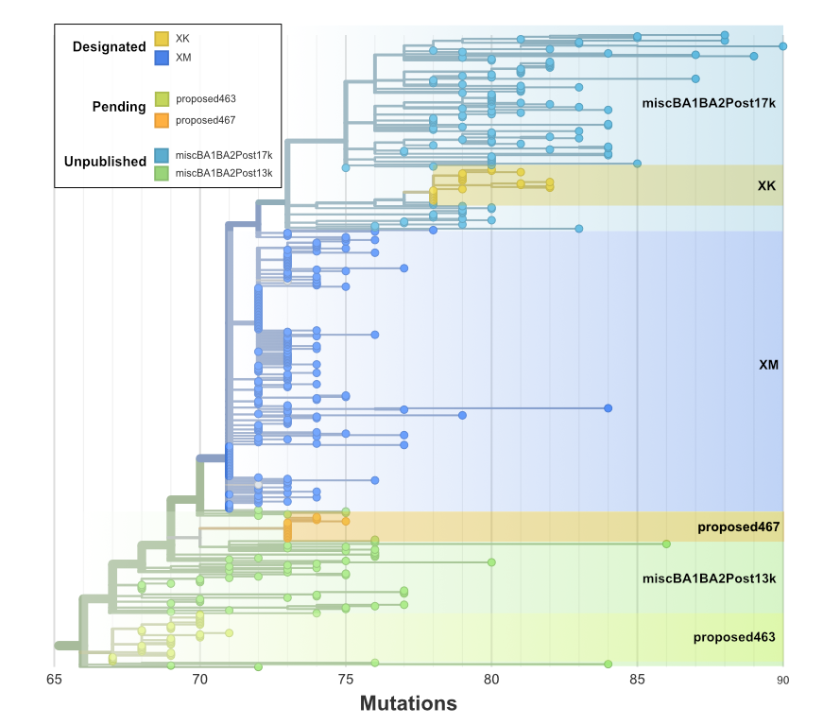
Why are recombinants hard to classify?
Algorithms assume that recombination is not occurring.
Rapidly evolving nomenclature that varies by program.
Designated (X*)
Pending (proposed*)
Unpublished (misc*)
Not all recombinant lineages are in public databases.
XK, XL

Slide 4
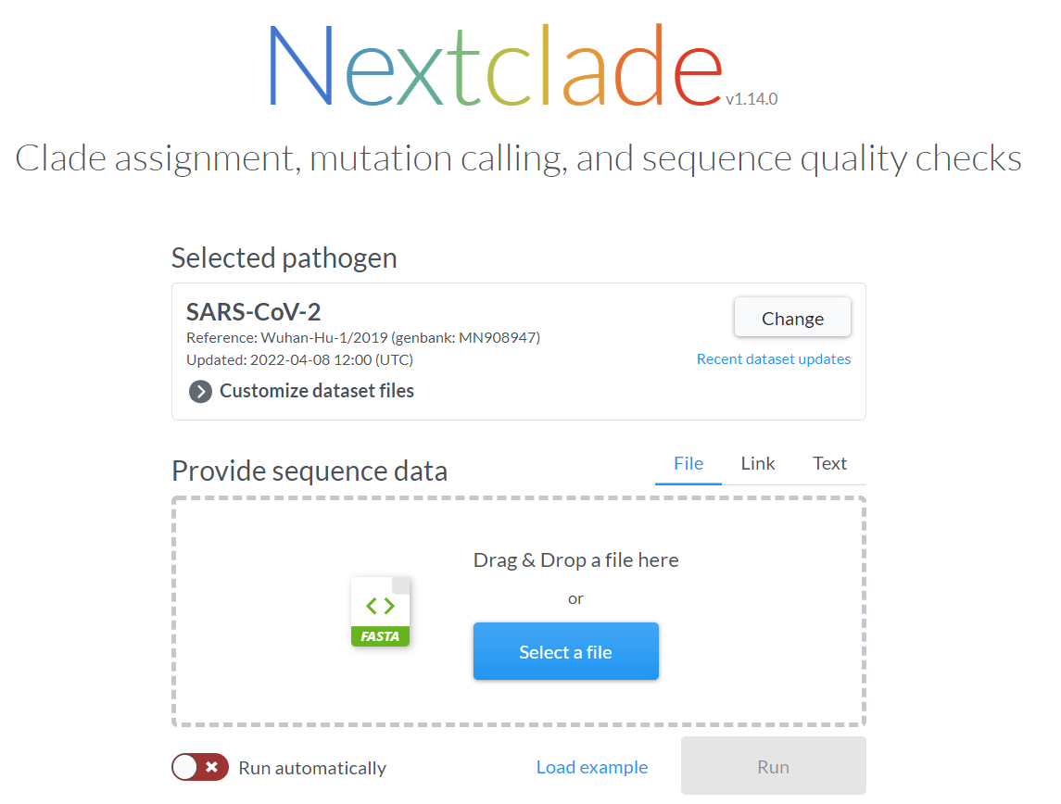
Nextclade: Identify putative recombinants
https://clades.nextstrain.org/
Select SARS-CoV-2
Upload data/sequences.fasta.
Click “Run”.

Slide 5
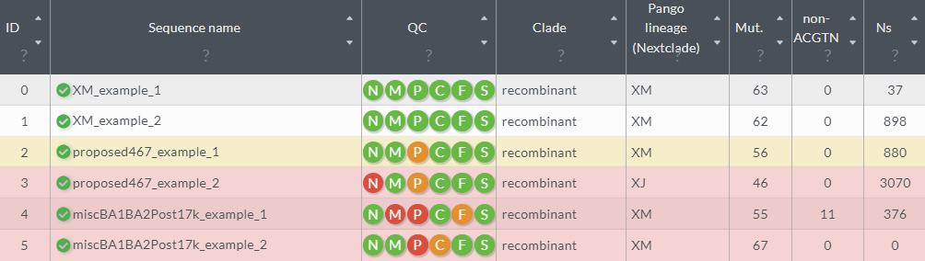

Nextclade: Identify putative recombinants
Note: Not the same method as pangolin!
Correct
Wrong
Private Mutations
Excess Ns
Use the download button in the top right to download the alignment
(nextclade.aligned.fasta) for a later step.

Slide 6
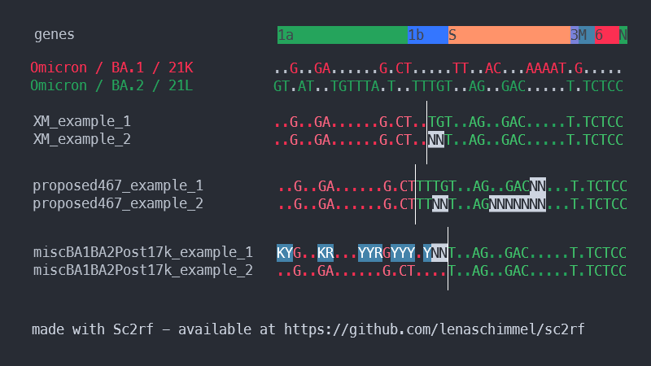
sc2rf: Plot recombination breakpoints
git clone https://github.com/lenaschimmel/sc2rf
cd sc2rf
pip install -r requirements.txt
INSTALL
RUN
./sc2rf.py results/nextclade.aligned.fasta --csvfile sc2rf.csv
OUTPUT

Slide 7
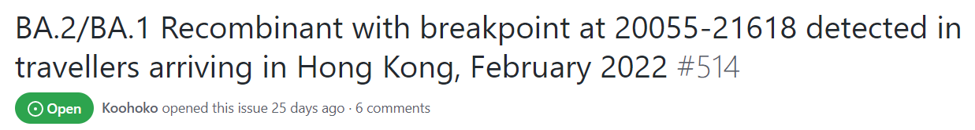
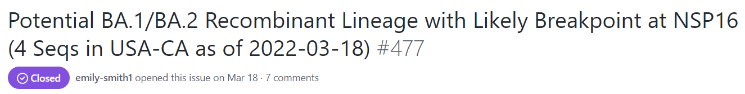
sc2rf: Plot recombination breakpoints
Compare the breakpoints to those in pango-designation repository issues.
Explore the breakpoints from sc2rf with the “breakpoints” column in:
resources/pango-designation_issues_update.tsv
Example
miscBA1BA2Post17k has a breakpoint between 20055 and 21618.
Matches breakpoints in Issue#477 and Issue#514.

Slide 8
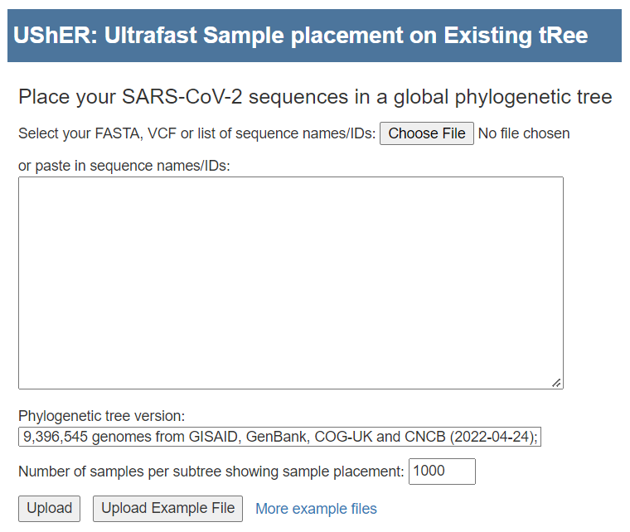
UShER: Refine lineage assignments
1a. Run on UCSC server: https://genome.ucsc.edu/cgi-bin/hgPhyloPlace
1b. Run on local machine: https://shusher.gi.ucsc.edu/
2. Upload data/sequences.fasta

Slide 9
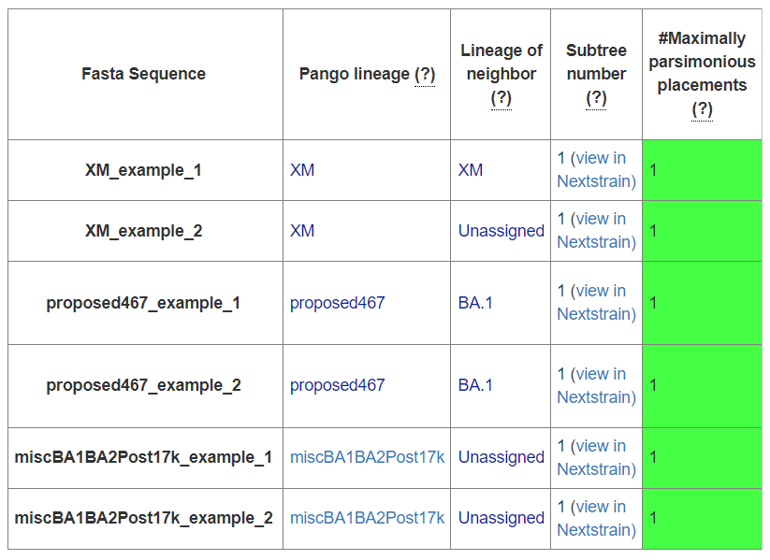
UShER: Refine lineage assignments
UShER
Assignment
pangolin
Assignment
Nextclade
Assignment
Lineages assignments by different algorithms currently differ more than they agree.
For pending or unpublished recombinants, UShER is the most accurate.
For designated recombinants, UShER and Nextclade are comparable.
Pangolin (PLEARN and PUSHER mode) is the most inaccurate.
Nextclade
Lineage
XM
XM
XM
XJ
XM
XM

Slide 10
BONUS Slides
Updating pango-designations metadata:
pip install click pandas numpy
resources/pango-designation_issues.py > issues.tsv
Running the tutorial with ncov-recombinant:
git clone --recursive https://github.com/ktmeaton/ncov-recombinant.git
cd ncov-recombinant
mamba env create -f workflow/envs/environment.yaml
conda activate ncov-recombinant
snakemake --profile profiles/tutorial

