Slide 1
Felony Disenfranchisement and Neighborhood Turnout
The Case of New York City
Kevin Morris
Brennan Center for Justice
Southern Political Science Association, 2020
Kevin Morris
Felony Disenfranchisement and Neighborhood Turnout

Slide 2
Outline
Introducing space into the conversation
Kevin Morris
Felony Disenfranchisement and Neighborhood Turnout

Slide 3
Introducing space into the conversation
Redefining “lost voters”
Outline
Kevin Morris
Felony Disenfranchisement and Neighborhood Turnout

Slide 4
Outline
Introducing space into the conversation
Redefining “lost voters”
Identifying neighborhoods with lost voters
Kevin Morris
Felony Disenfranchisement and Neighborhood Turnout

Slide 5
Outline
Introducing space into the conversation
Redefining “lost voters”
Identifying neighborhoods with lost voters Testing turnout effects
Kevin Morris
Felony Disenfranchisement and Neighborhood Turnout

Slide 6
Introducing Space
Most of the existing literature on felony disenfranchisement and indirect turnout effects looks for effects at the state level (Miles 2004; Bowers and Preuhs 2009; King and Erickson 2016)
Kevin Morris
Felony Disenfranchisement and Neighborhood Turnout

Slide 7
Introducing Space
Most of the existing literature on felony disenfranchisement and indirect turnout effects looks for effects at the state level (Miles 2004; Bowers and Preuhs 2009; King and Erickson 2016)
But we know that incarceration patterns aren’t uniformly distributed throughout a given state (see, for instance, Gelman, Fagan, and Kiss 2007)
Kevin Morris
Felony Disenfranchisement and Neighborhood Turnout

Slide 8
Introducing Space
Most of the existing literature on felony disenfranchisement and indirect turnout effects looks for effects at the state level (Miles 2004; Bowers and Preuhs 2009; King and Erickson 2016)
But we know that incarceration patterns aren’t uniformly distributed throughout a given state (see, for instance, Gelman, Fagan, and Kiss 2007)
Turnout effects are likely to be socially mediated - and therefore show up in the neighborhoods where disenfranchised individuals live (e.g. Foladare 1968; Huckfeldt 1979; Cho, Gimpel, and Dyck 2006)
Kevin Morris
Felony Disenfranchisement and Neighborhood Turnout

Slide 9
Redefining Lost Voters
Much of the existing literature cannot identify individuals who would have voted if not for their disenfranchisement (Burch 2013)
Kevin Morris
Felony Disenfranchisement and Neighborhood Turnout

Slide 10
Redefining Lost Voters
Much of the existing literature cannot identify individuals who would have voted if not for their disenfranchisement (Burch 2013)
This undermines our ability to distinguish the causal effects of incarceration / probation from the effects of disenfranchisement
Kevin Morris
Felony Disenfranchisement and Neighborhood Turnout

Slide 11
Redefining Lost Voters
Much of the existing literature cannot identify individuals who would have voted if not for their disenfranchisement (Burch 2013)
This undermines our ability to distinguish the causal effects of incarceration / probation from the effects of disenfranchisement
This is especially likely given the low turnout propensity among the formerly disenfranchised (e.g. Meredith and Morse 2015; Gerber et al. 2017; White 2019)
Kevin Morris
Felony Disenfranchisement and Neighborhood Turnout

Slide 12
This Project Addresses Both Problems
Administrative data from the NYS DOC allows us to conduct individual-level analysis
Kevin Morris
Felony Disenfranchisement and Neighborhood Turnout

Slide 13
This Project Addresses Both Problems
Administrative data from the NYS DOC allows us to conduct individual-level analysis
Purge records in the NYS voter file allow us to construct vote histories for disenfranchised individuals
Kevin Morris
Felony Disenfranchisement and Neighborhood Turnout

Slide 14
This Project Addresses Both Problems
Administrative data from the NYS DOC allows us to conduct individual-level analysis
Purge records in the NYS voter file allow us to construct vote histories for disenfranchised individuals
Lost voters are all formally disenfranchised individuals who have voted in the past 10 years
Kevin Morris
Felony Disenfranchisement and Neighborhood Turnout

Slide 15
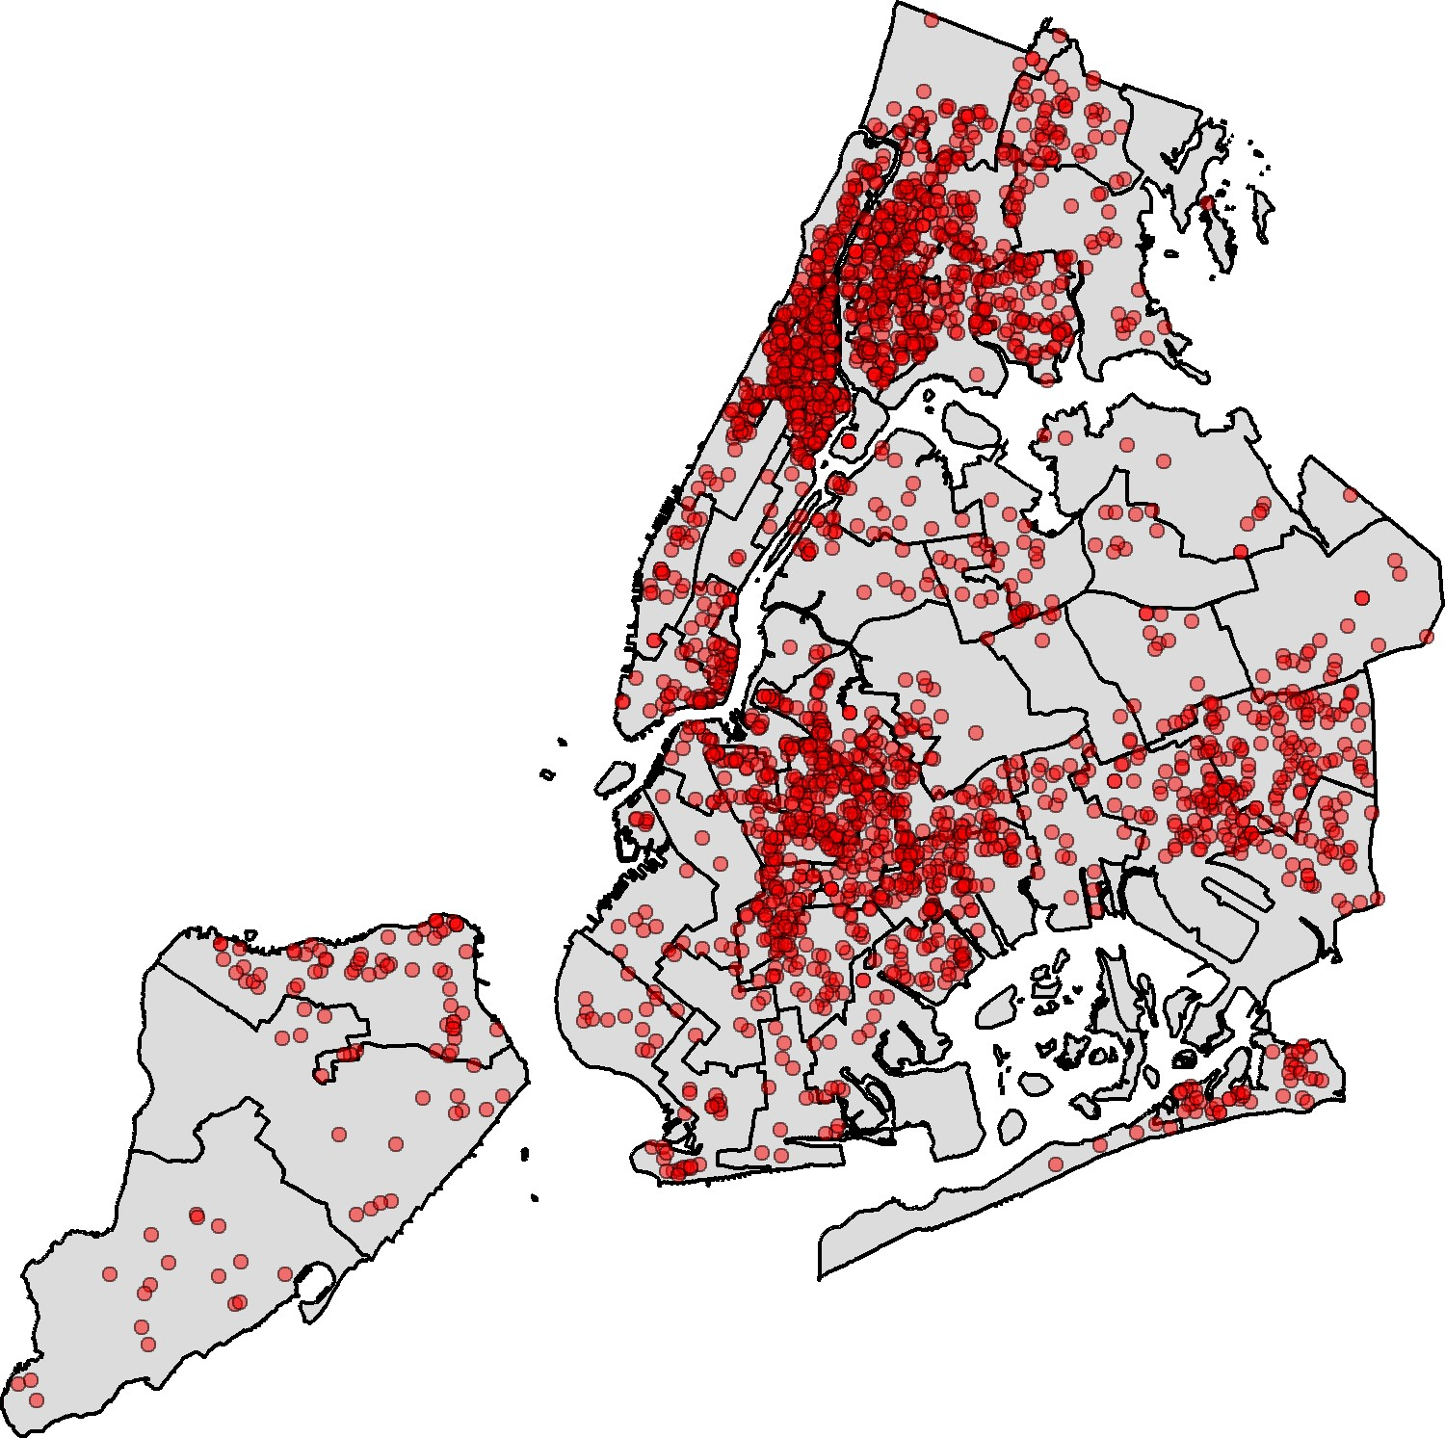
Identifying Neighborhoods with Lost Voters
Kevin Morris
Felony Disenfranchisement and Neighborhood Turnout

Slide 16
Methodology
A genetic match algorithm (Sekhon 2011) is used to match treated census block groups to untreated ones.
Each block group is matched to 30 untreated block groups; matches are done with replacement.
Kevin Morris
Felony Disenfranchisement and Neighborhood Turnout

Slide 17
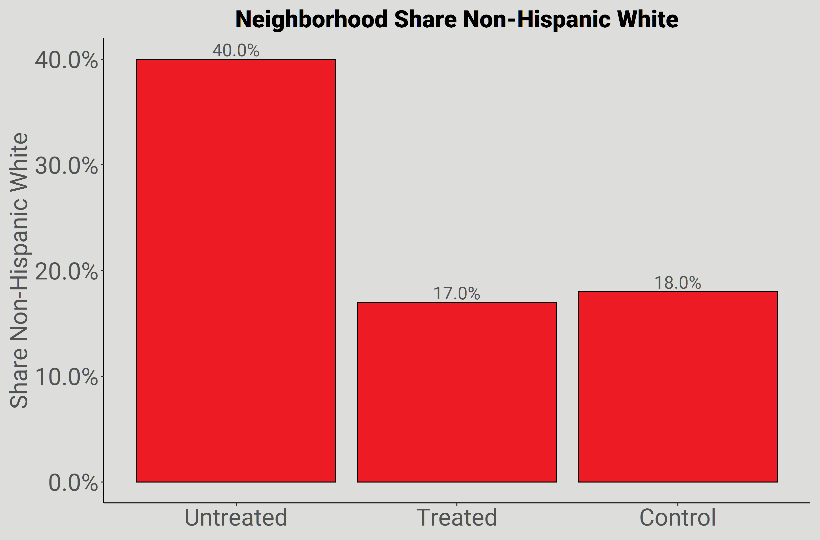
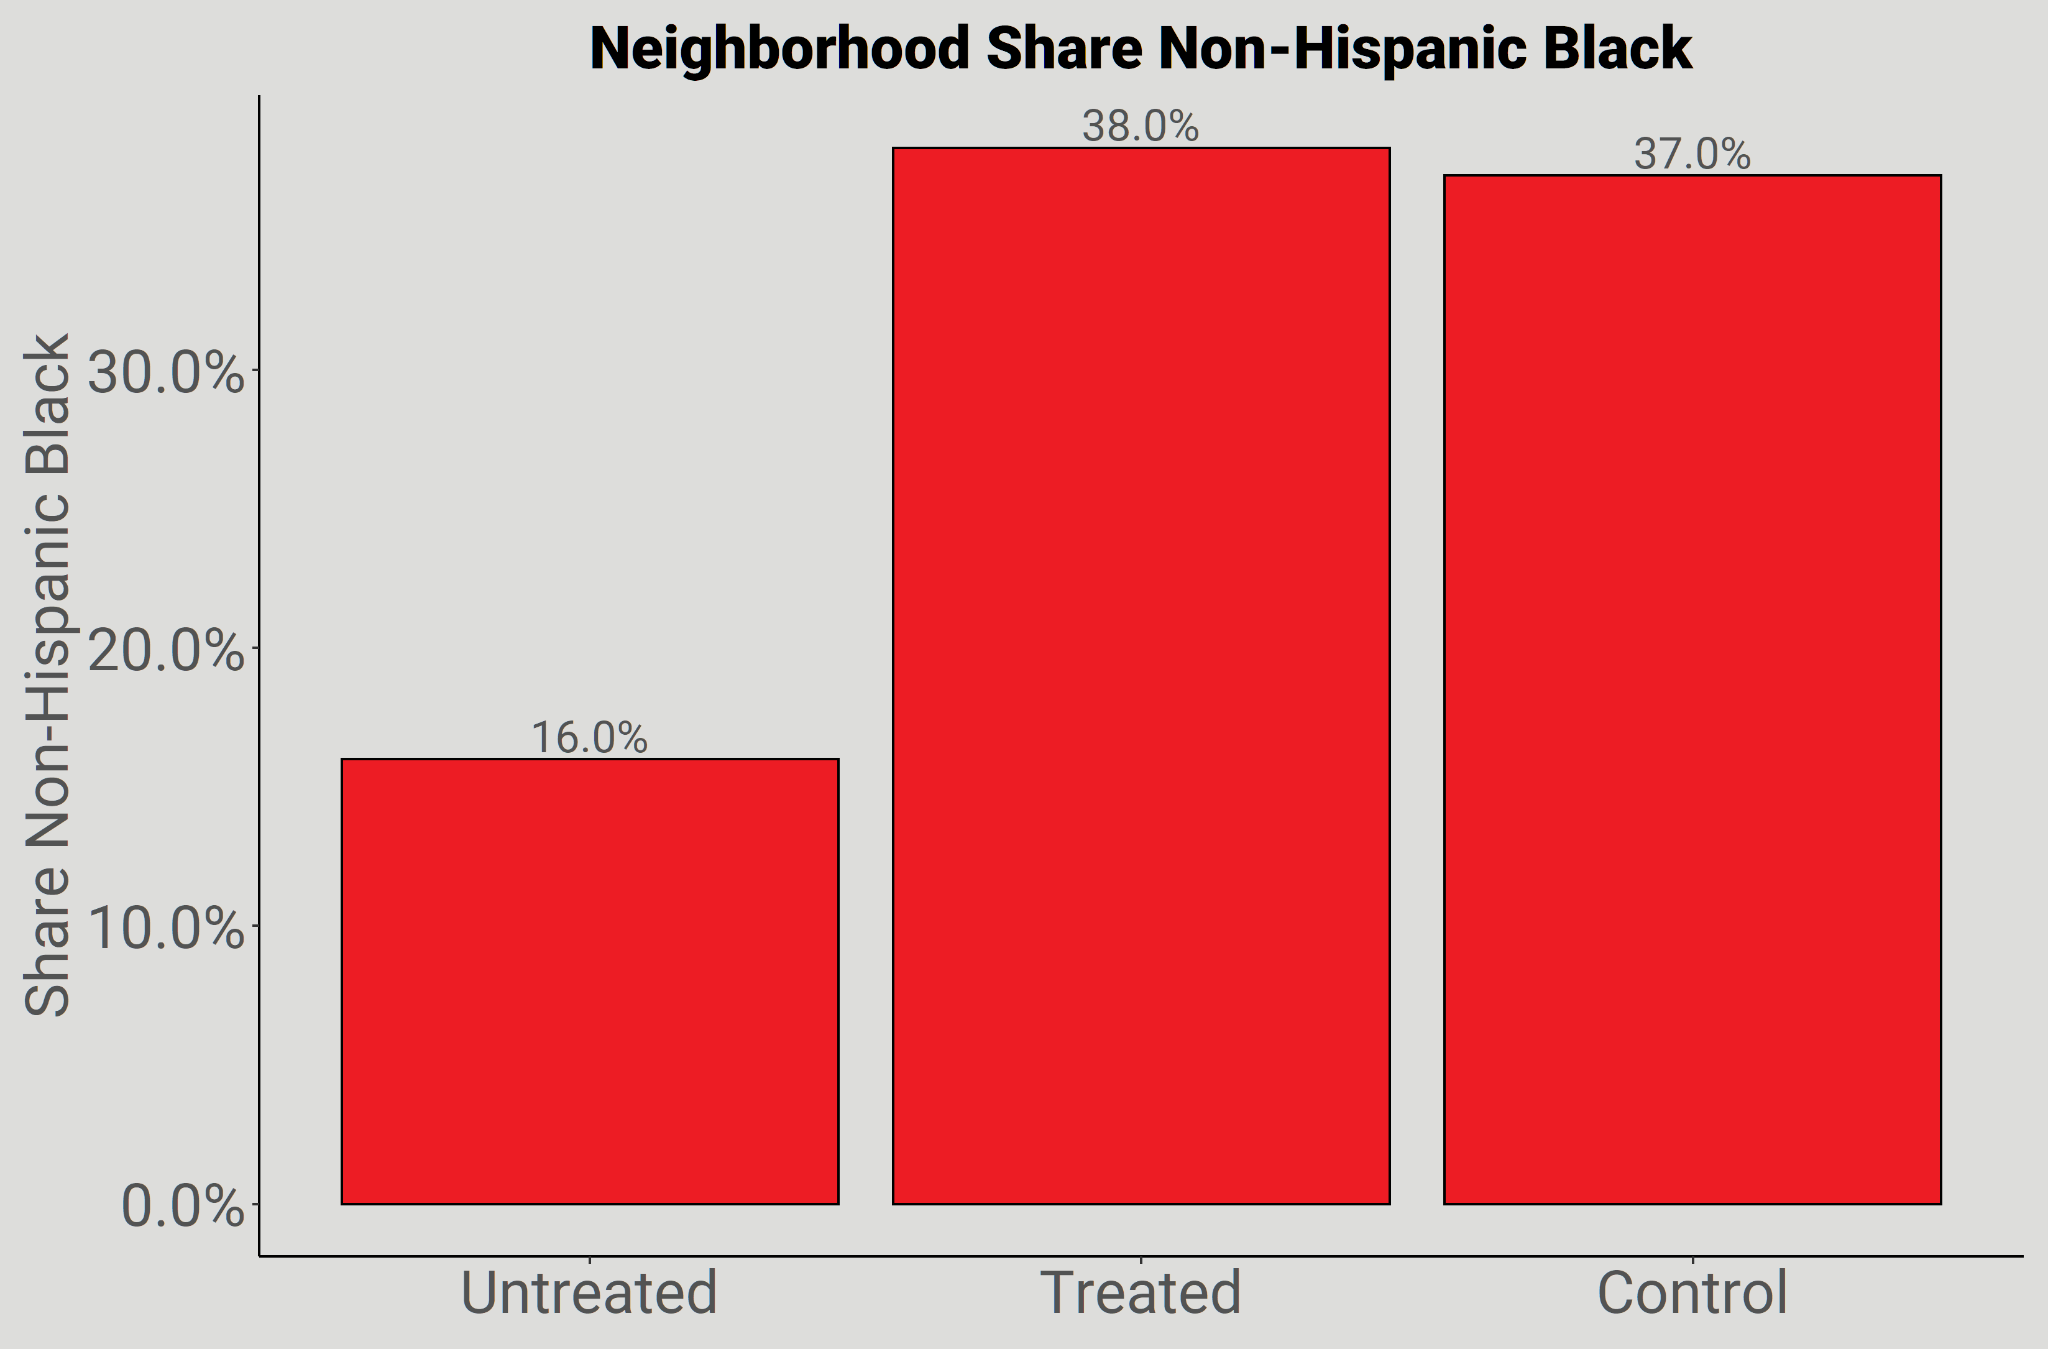
Matching Results
Kevin Morris
Felony Disenfranchisement and Neighborhood Turnout

Slide 18
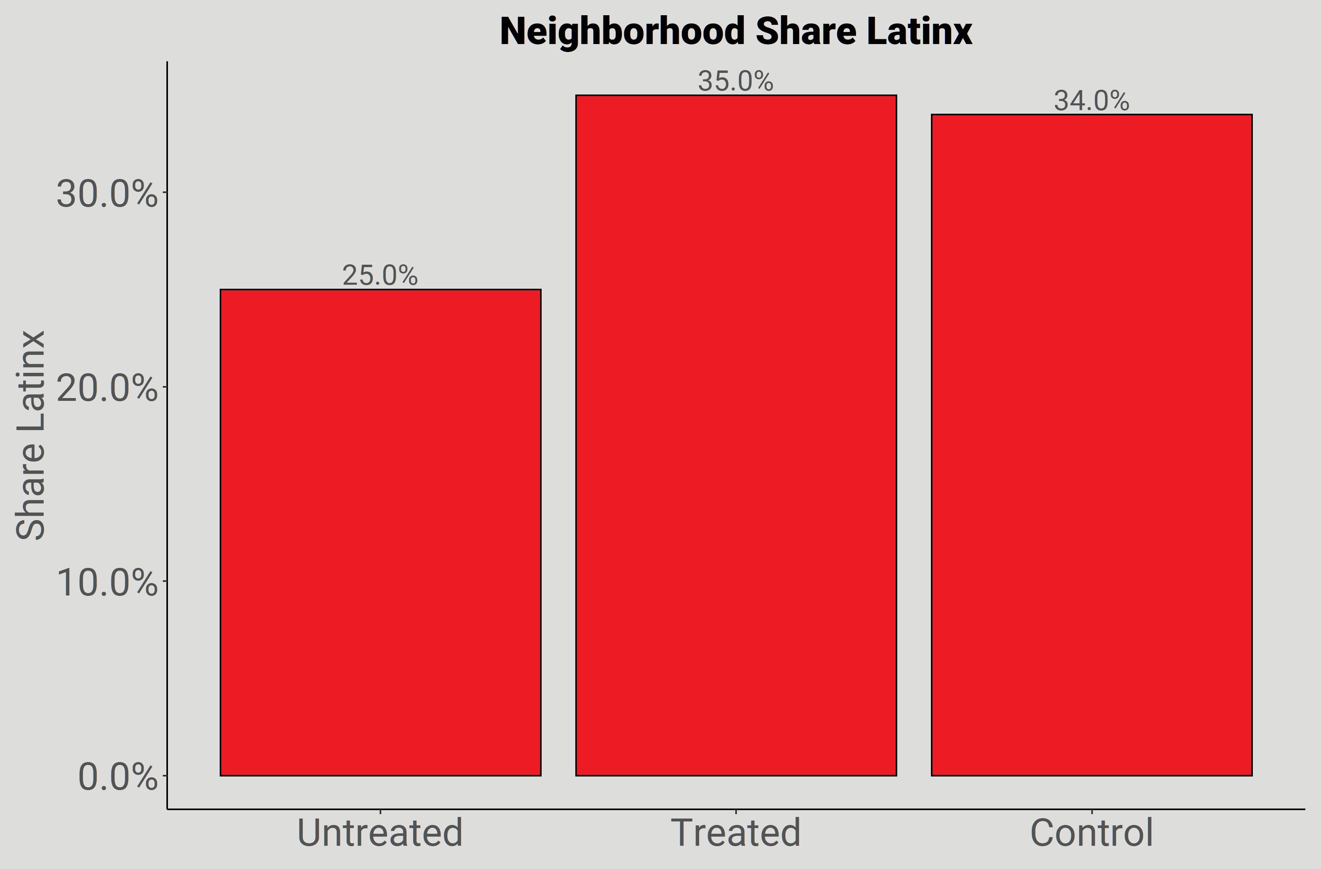
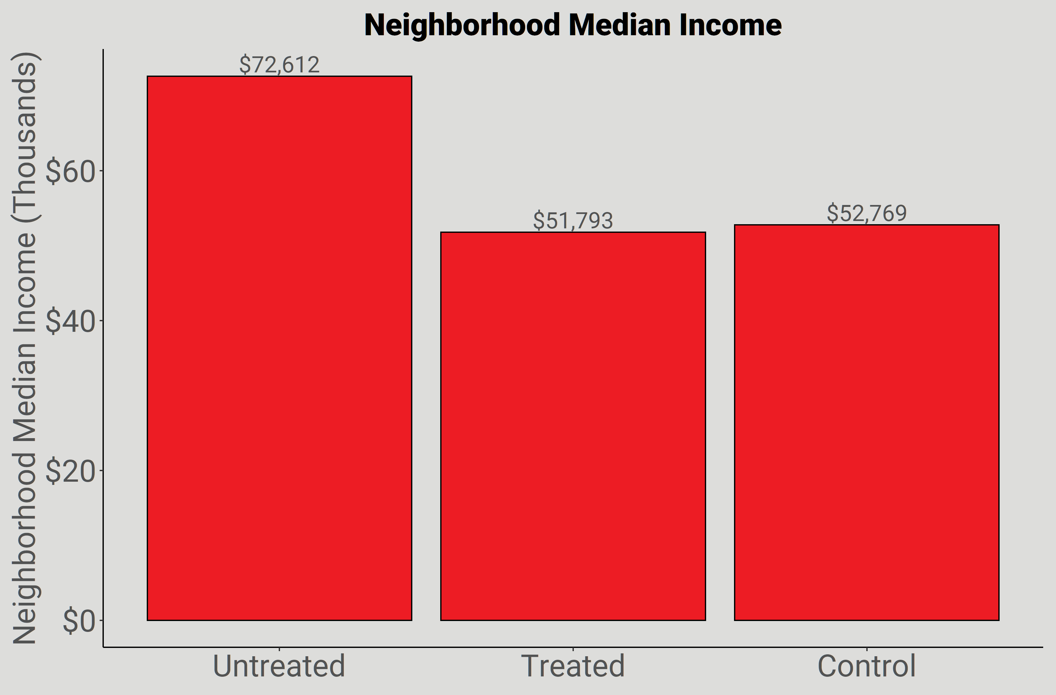
Matching Results
Kevin Morris
Felony Disenfranchisement and Neighborhood Turnout

Slide 19
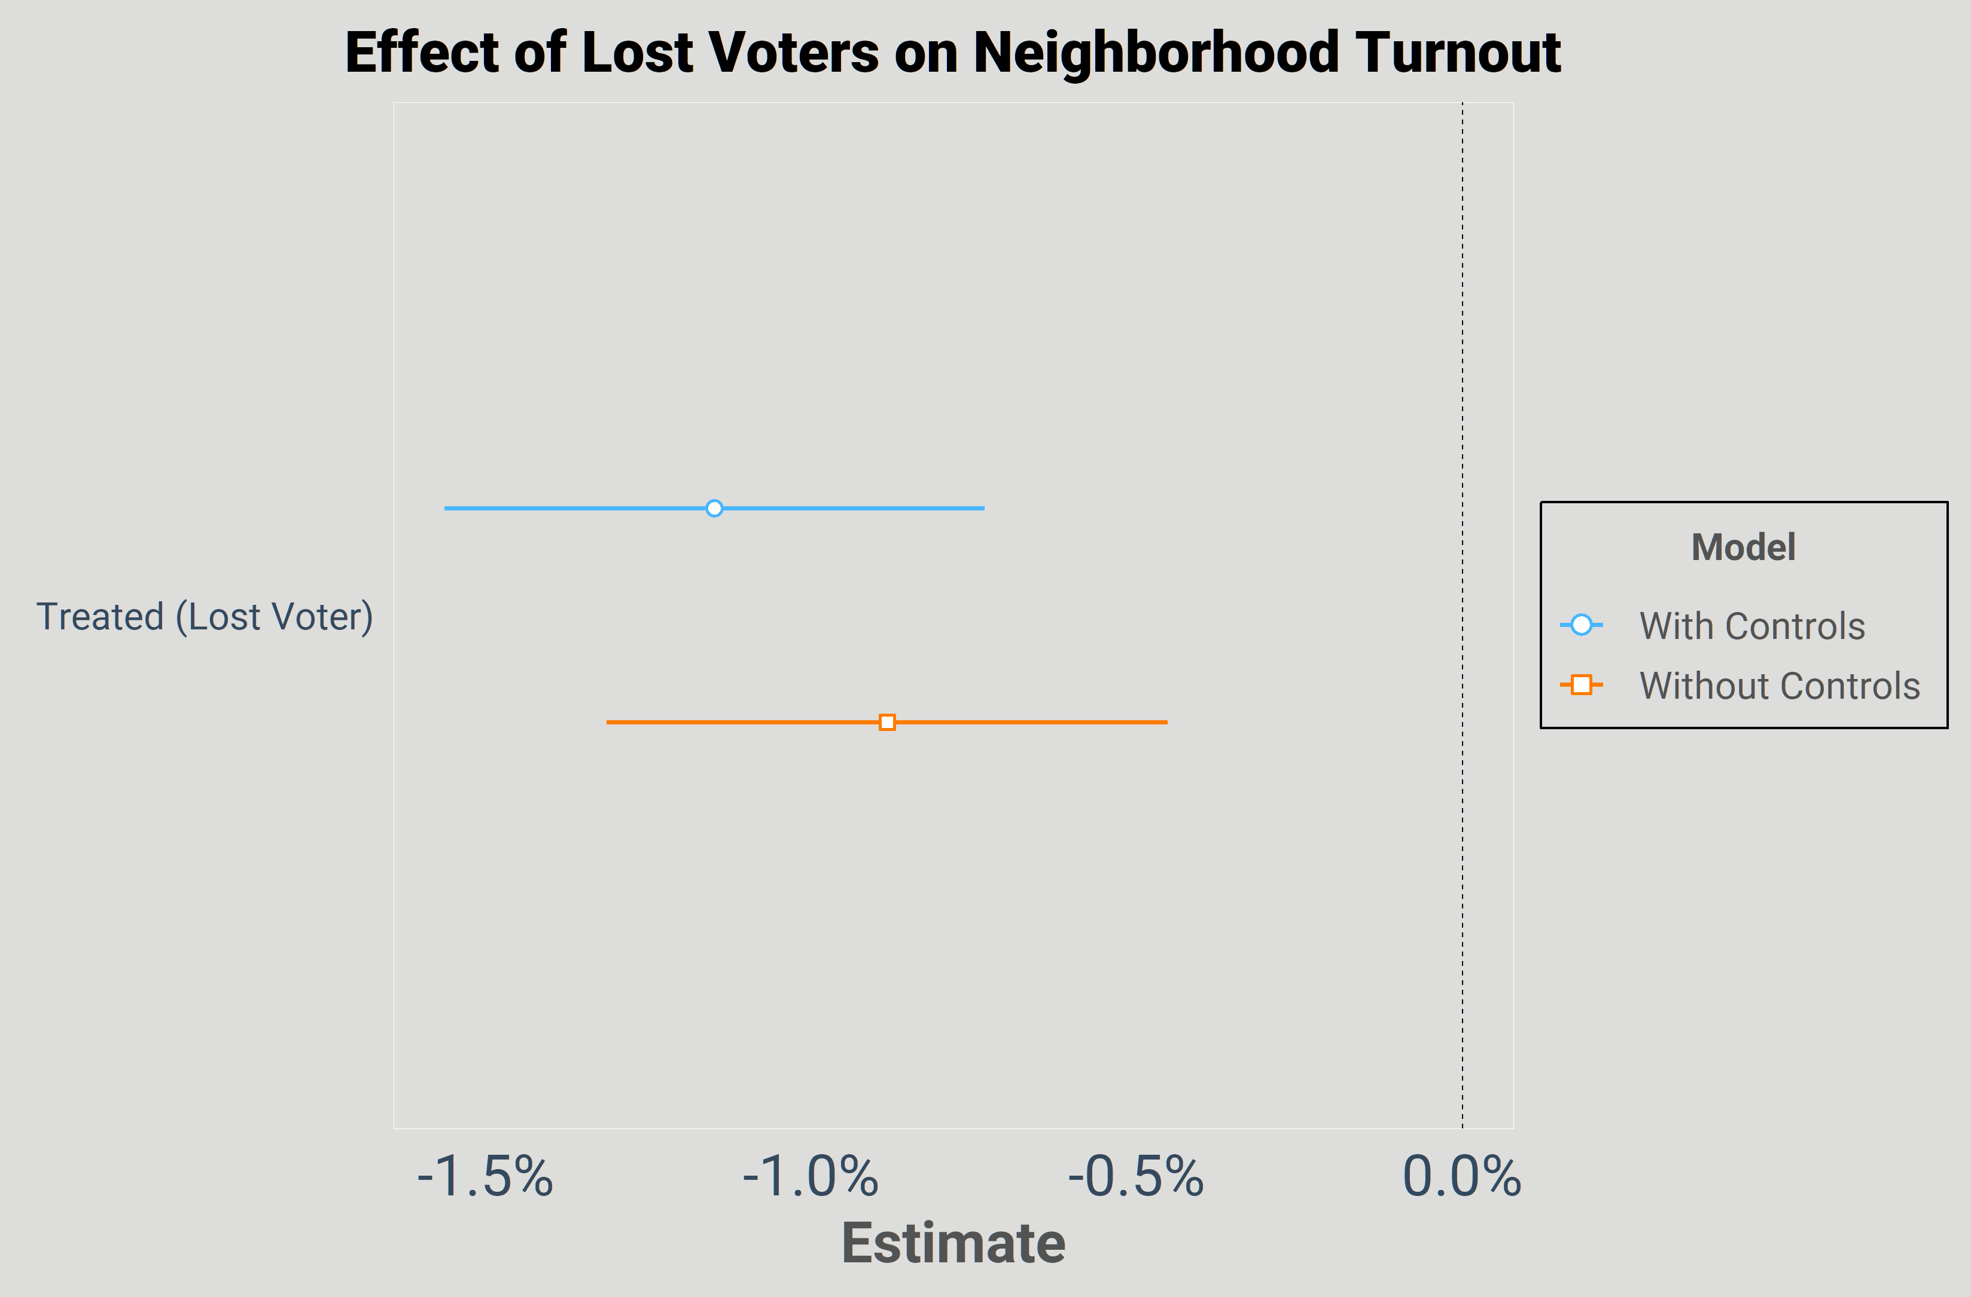
Testing Turnout Effects
Kevin Morris
Felony Disenfranchisement and Neighborhood Turnout

Slide 20
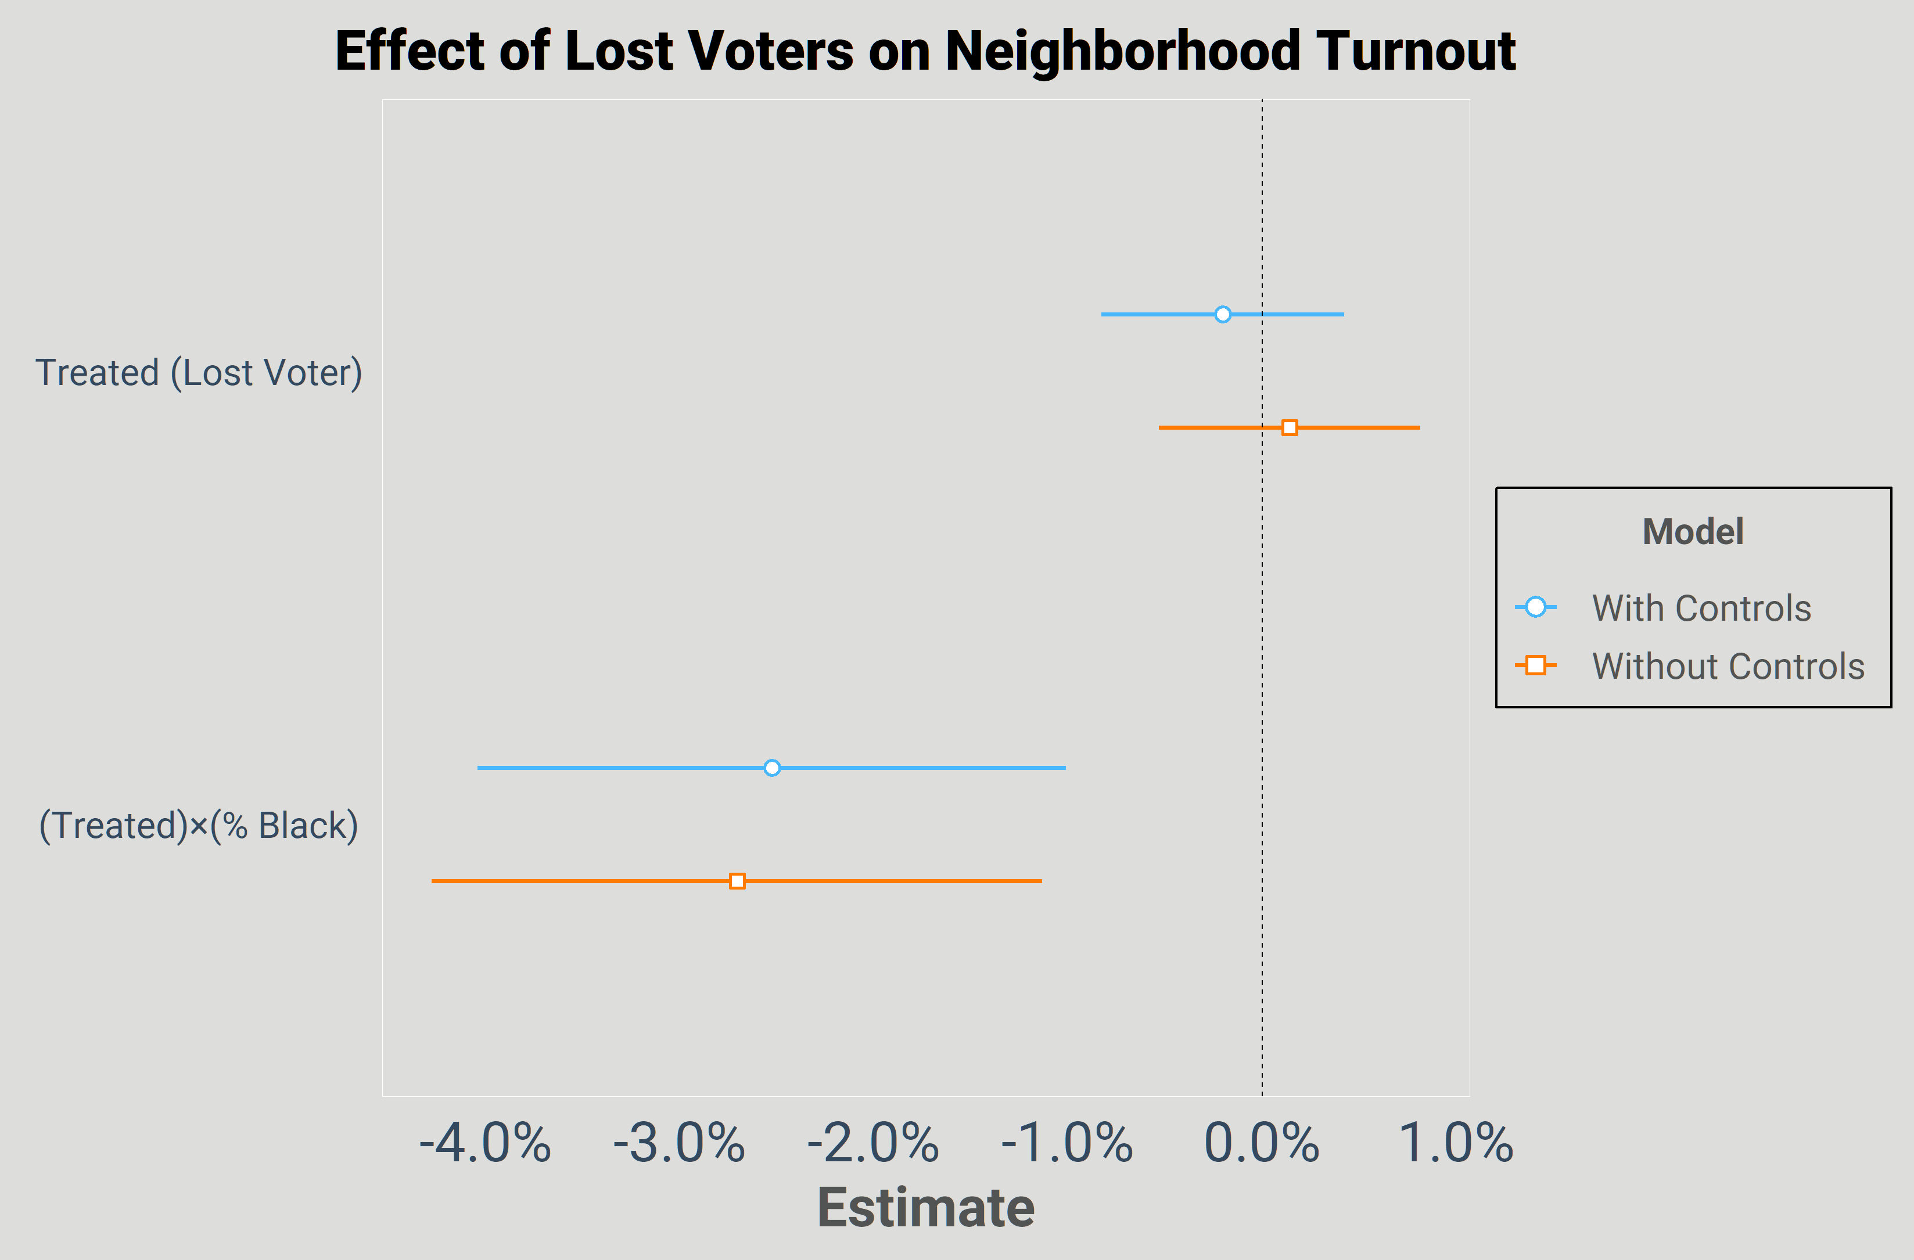
Testing Turnout Effects
Kevin Morris
Felony Disenfranchisement and Neighborhood Turnout

Slide 21
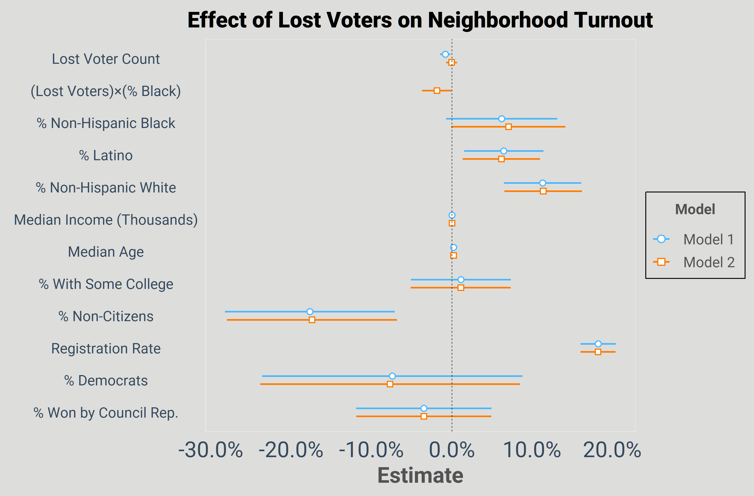
Testing Turnout Effects
Kevin Morris
Felony Disenfranchisement and Neighborhood Turnout

Slide 22
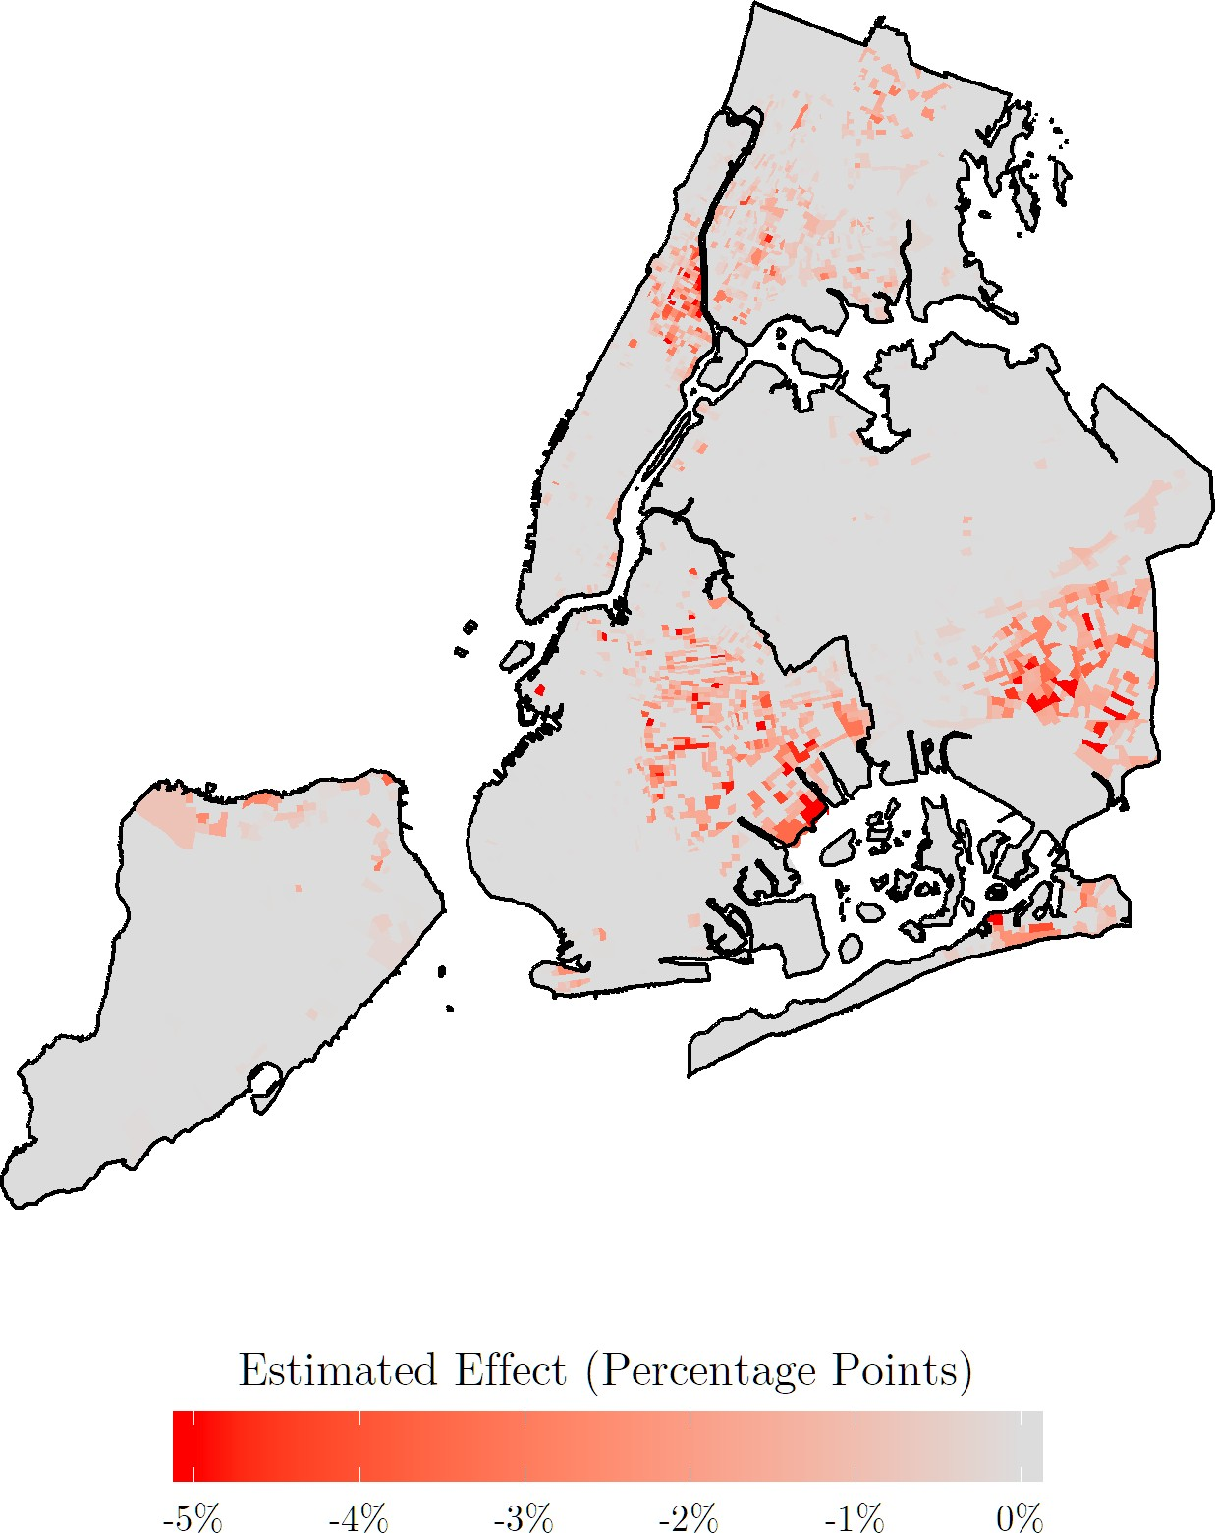
Testing Turnout Effects
Kevin Morris
Felony Disenfranchisement and Neighborhood Turnout

Slide 23
Conclusions
The indirect turnout effects identified in past research appear to be geographically concentrated where the lost voters live.
Kevin Morris
Felony Disenfranchisement and Neighborhood Turnout

Slide 24
Conclusions
The indirect turnout effects identified in past research appear to be geographically concentrated where the lost voters live.
Hajnal (2009) and others have demonstrated that turnout differentials can have real political implications, especially in low-turnout contests.
Kevin Morris
Felony Disenfranchisement and Neighborhood Turnout

Slide 25
Conclusions
The indirect turnout effects identified in past research appear to be geographically concentrated where the lost voters live.
Hajnal (2009) and others have demonstrated that turnout differentials can have real political implications, especially in low-turnout contests.
Felony disenfranchisement undermines Black political representation at the local level.
Kevin Morris
Felony Disenfranchisement and Neighborhood Turnout

Slide 26
Thanks! kevin.morris@nyu.edu
We Made It!
Kevin Morris
Felony Disenfranchisement and Neighborhood Turnout

Slide 27
References I
Bowers, Melanie, and Robert R. Preuhs. 2009. “Collateral Consequences of a Collateral Penalty: The Negative Effect of Felon Disenfranchisement Laws on the Political Participation of Nonfelons.” Social Science Quarterly 90 (3): 722–43. https://doi.org/10.1111/j.1540-6237.2009.00640.x.
Burch, Traci. 2013. “Effects of Imprisonment and Community Supervision on Neighborhood Political Participation in North Carolina.” Edited by Christopher Wildeman, Jacob S. Hacker, and Vesla M. Weaver. The ANNALS of the American Academy of Political and Social Science 651 (1): 184–201. https://doi.org/10.1177/0002716213503093.
Kevin Morris
Felony Disenfranchisement and Neighborhood Turnout

Slide 28
References II
Cho, Wendy K. Tam, James G. Gimpel, and Joshua J. Dyck. 2006. “Residential Concentration, Political Socialization, and Voter Turnout.” The Journal of Politics 68 (1): 156–67. https://doi.org/10.1111/j.1468-2508.2006.00377.x.
Foladare, Irving S. 1968. “The Effect of Neighborhood on Voting Behavior.” Political Science Quarterly 83 (4): 516. https://doi.org/10.2307/2146812.
Gelman, Andrew, Jeffrey Fagan, and Alex Kiss. 2007. “An Analysis of the New York City Police Departments
“Stop-and-Frisk” Policy in the Context of Claims of Racial Bias.” Journal of the American Statistical Association 102 (479): 813–23. https://doi.org/10.1198/016214506000001040.
Kevin Morris
Felony Disenfranchisement and Neighborhood Turnout

Slide 29
References III
Gerber, Alan S., Gregory A. Huber, Marc Meredith, Daniel R. Biggers, and David J. Hendry. 2017. “Does Incarceration Reduce Voting? Evidence About the Political Consequences of Spending Time in Prison.” The Journal of Politics 79 (4): 1130–46. https://doi.org/10.1086/692670.
Hajnal, Zoltan. 2009. America’s Uneven Democracy. Cambridge University Press. https://doi.org/10.1017/cbo9780511800535.
Huckfeldt, R. Robert. 1979. “Political Participation and the Neighborhood Social Context.” American Journal of Political Science 23 (3): 579. https://doi.org/10.2307/2111030.
Kevin Morris
Felony Disenfranchisement and Neighborhood Turnout

Slide 30
References IV
King, Bridgett A., and Laura Erickson. 2016. “Disenfranchising the Enfranchised.” Journal of Black Studies 47 (8): 799–821. https://doi.org/10.1177/0021934716659195.
Meredith, Marc, and Michael Morse. 2015. “The Politics of the Restoration of Ex-Felon Voting Rights: The Case of Iowa.” Quarterly Journal of Political Science 10 (1): 41–100. https://doi.org/10.1561/100.00013026.
Miles, Thomas J. 2004. “Felon Disenfranchisement and Voter Turnout.” The Journal of Legal Studies 33 (1): 85–129. https://doi.org/10.1086/381290.
Kevin Morris
Felony Disenfranchisement and Neighborhood Turnout

Slide 31
References V
Sekhon, Jasjeet S. 2011. “Multivariate and Propensity Score Matching Software with Automated Balance Optimization: The Matching Package for R.” Journal of Statistical Software 42 (7). https://doi.org/10.18637/jss.v042.i07.
White, Ariel. 2019. “Misdemeanor Disenfranchisement? The Demobilizing Effects of Brief Jail Spells on Potential Voters.” American Political Science Review 113 (2): 311–24. https://doi.org/10.1017/s000305541800093x.
Kevin Morris
Felony Disenfranchisement and Neighborhood Turnout

