Slide 1


Food 2 U Meal System
Brought to you by joseph garetson, sarah higgens, keeghan motquin, Samantha murphy, and Daniel zellmer

Slide 2



Our Motivation
Our system is based off a similar idea to a meal ordering service such as Blue Apron, Hello Fresh, and Schwan’s.
The main purpose of the system is to make it easier for consumers to cook meals by providing instructions and ingredients that can be ordered for them to cook their own meals.

Slide 3
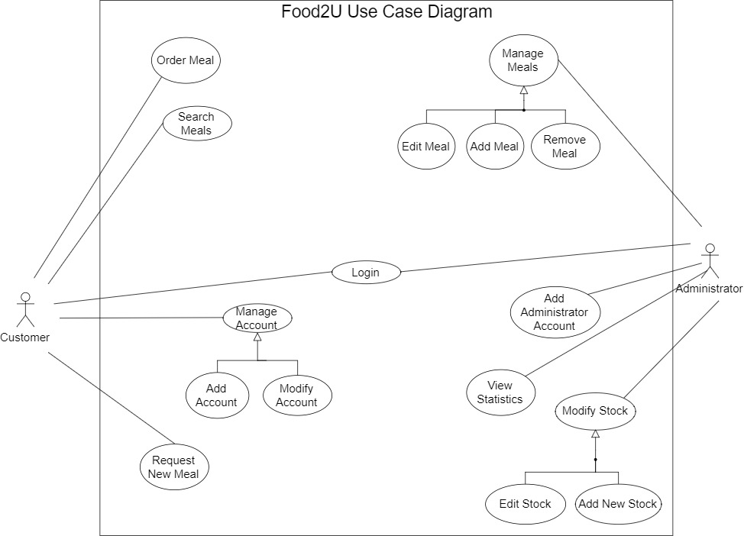
Use Case Diagram
Customer’s main use cases
Order Meal
Search Meals
Manage Account
Request New Meal
Administrator’s main use cases
Manage Meals
Add Admin Account
View Statistics
Modify Stock
Shared use cases
Login

Slide 4
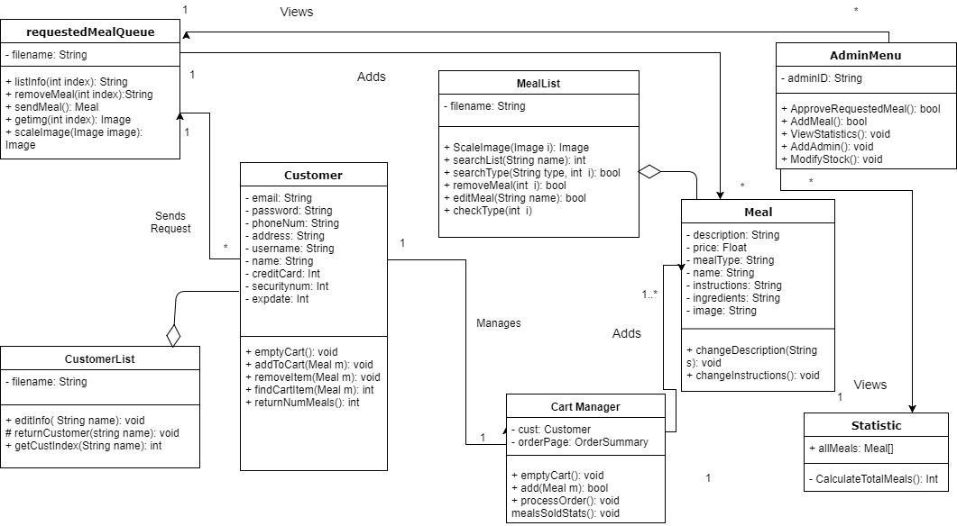
Class Diagram

Slide 5
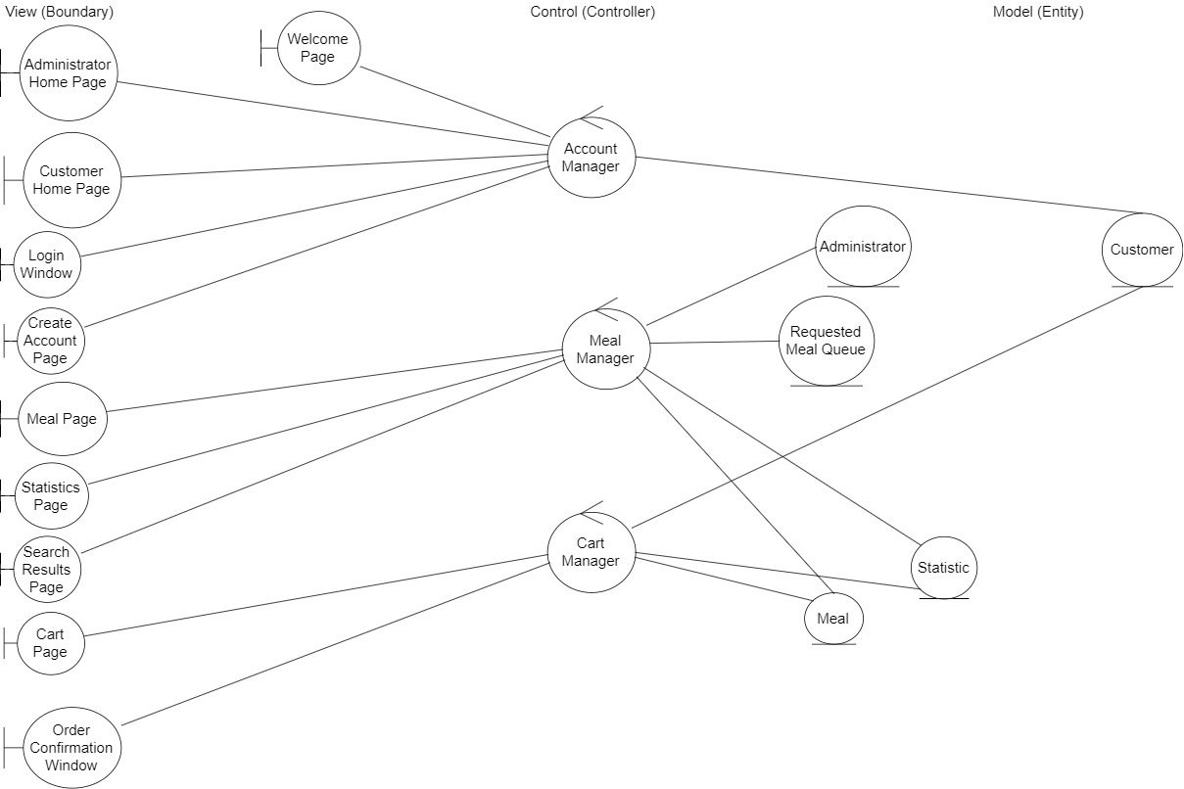
Robustness Diagram
Account Manager
Home pages
Customer
Meal Manager
Meal and Search pages
Meal information
Cart Manage
Cart page
Meals information

Slide 6
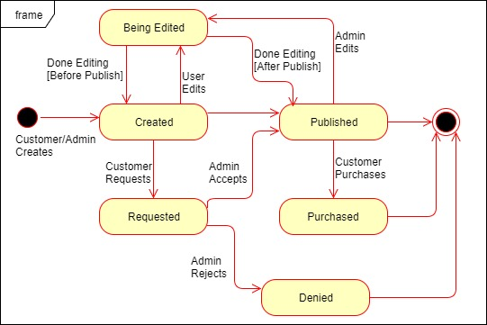
Meal State Chart

Slide 7
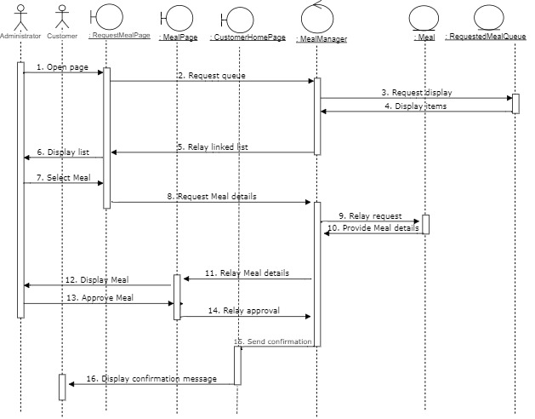
Sequence Diagram (Approve Requested Meal

Slide 8
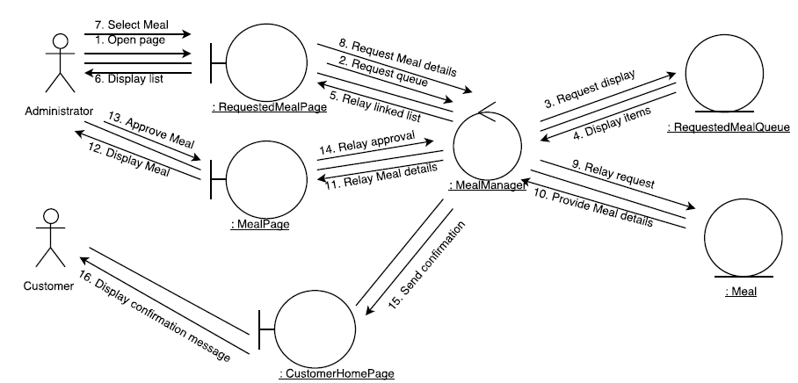
Collaboration Diagram (Approve Requested Meal)

Slide 9
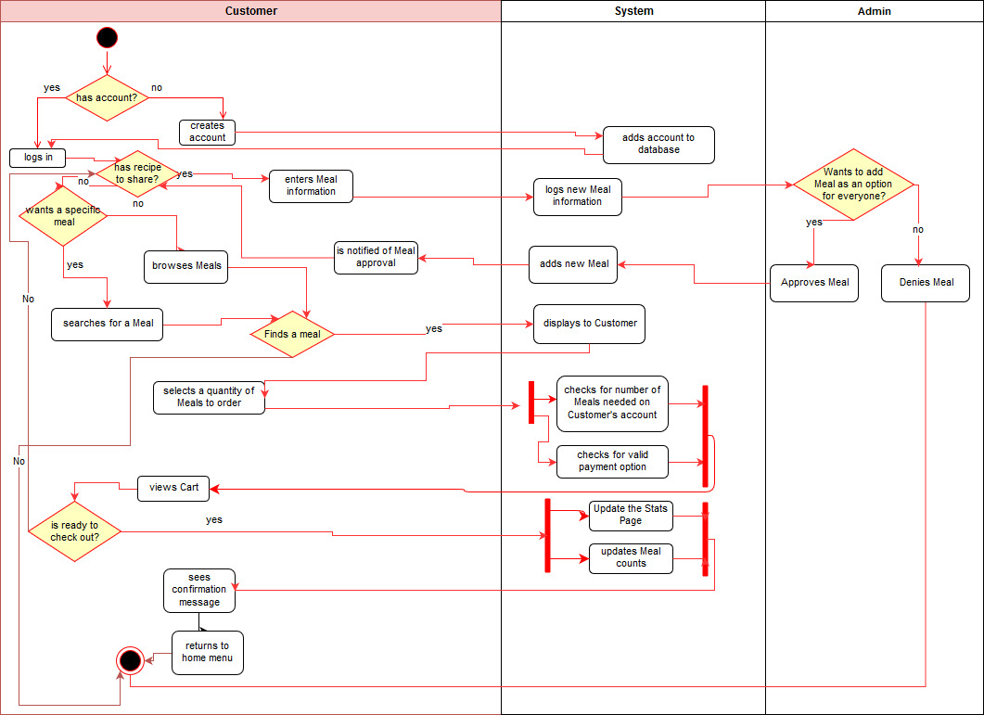
Activity Diagram

Slide 10
Now it’s time to see the product!

Slide 11
Questions??

