Slide 1
Important Factors in Human Development
Katie Harris
95-891
May 6, 2021

Slide 2
Summary
I used supervised learning techniques to find what factors are most important for human development as measured by HDI
The goal of this project would be to identify what factors are most important to development to guide policy makers in where to invest and what to invest in.
Notes:
I’m interested in Development ➔ Peace Corps

Slide 3
Input Data
Where did I start?

Slide 4
Data Sources
CIA: World Factbook
UN: HDI
IMF: Different Economic Metrics Over time
json
csv/xlsx
Pandas DF
Notes:
Used data from the CIA, the UN, and the IMF and transformed them into Pandas DF

Slide 5
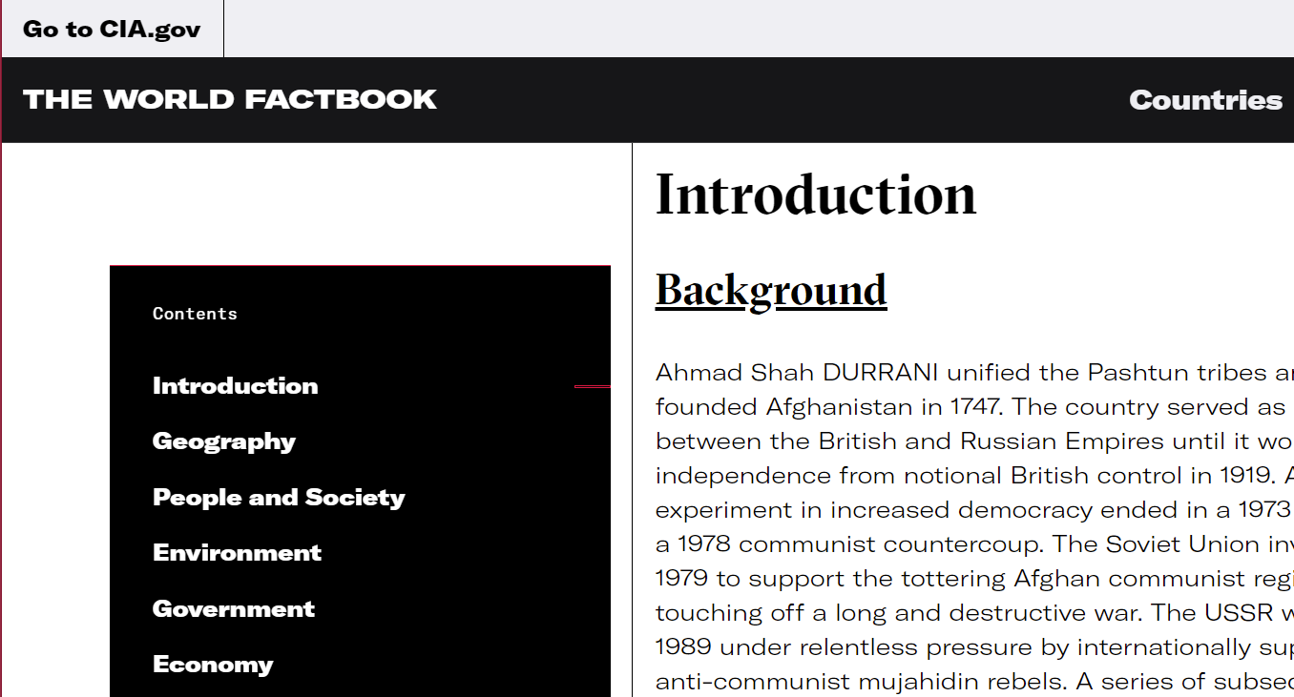
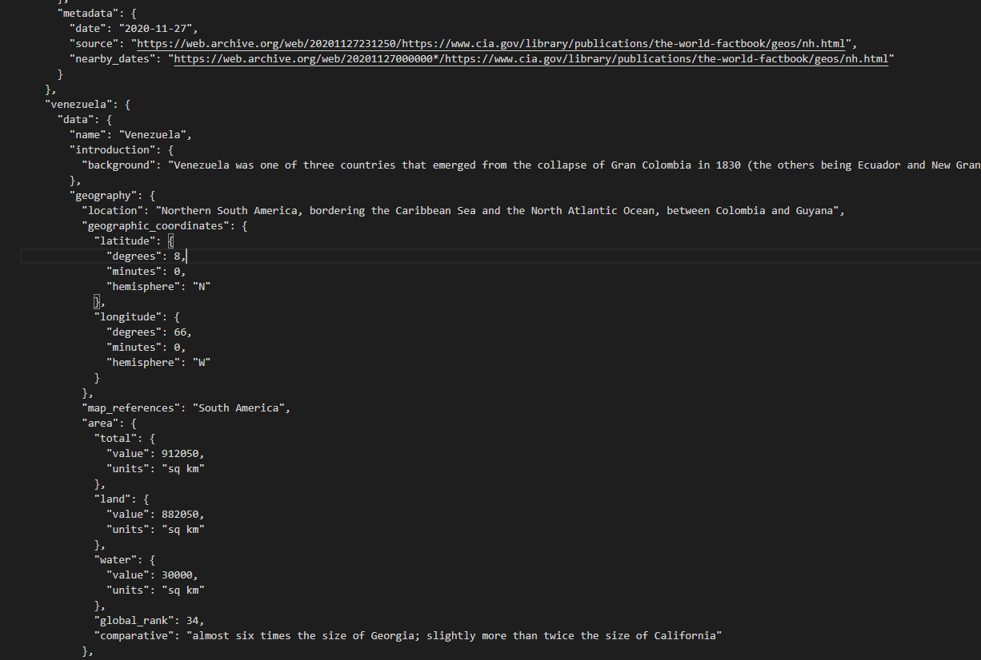
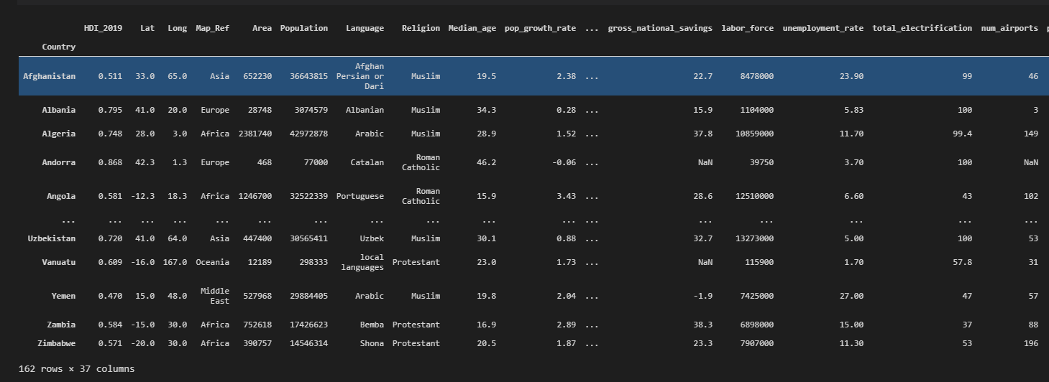
World Factbook
HTML
JSON
Data Frame
Notes:
The WF is very comprehensive has a lot of data → couldn’t use pandas library to import json because the json was so deep

Slide 6
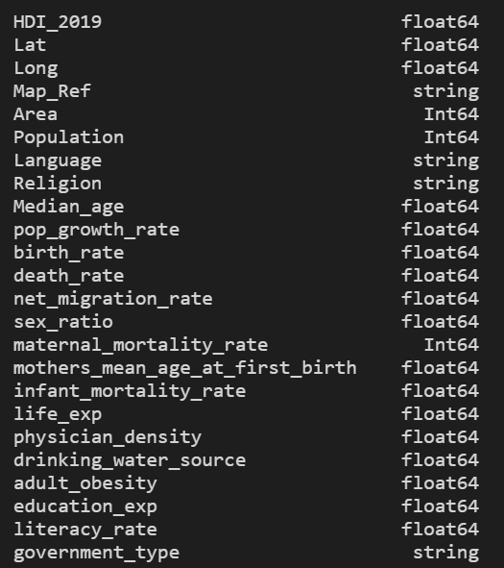
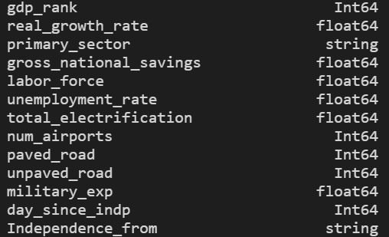
Notes:
These are the columns I chose from the WF. I left out info that was very country specific like border nations, background, current events.

Slide 7
UN and IMF
Data Frame
XLSX/CSV
Notes:
Very easy to take data and turn it into pandas DF via library methods but Problems– Missing and Inconsistent data

Slide 8
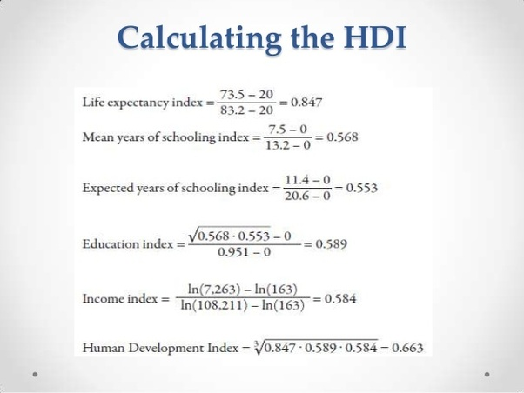
What is the HDI?
Notes:
Pros: Best and maybe only metric we have for HD but Cons: Doesn’t include social things like gender equity, or LGTB rights, etc.

Slide 9
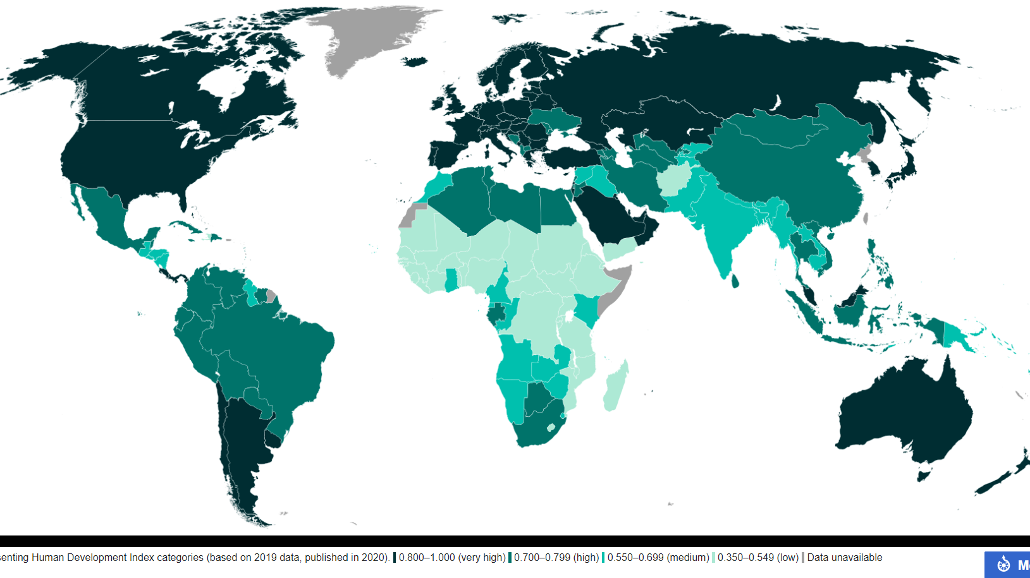
Notes:
Color coded map of Human Development → Darker means higher scores. Generally, what you would expect- Highest Developed Nations are in Europe, NA, and Australia

Slide 10
Notes:
HDI over time by Region . Generally, things are improving. But improvements are especially fast in Asia (most likely due to China) but Sub-Saharan Africa has seen strong improvement since 2000 too.

Slide 11
Methodology
What did I do?

Slide 12
Regression
Ran four different regression models
Basic Linear (Numeric Features Only)
Lasso
Random Forest
Gradient Boost
Notes:
I ran 4 different linear models to find feature importance. Basic Linear Model Lasso, RF, and GB were inclusive of categorical as well as numeric variables.

Slide 13
Goodness of Fit

Slide 14
Findings
What did I Find out?

Slide 15
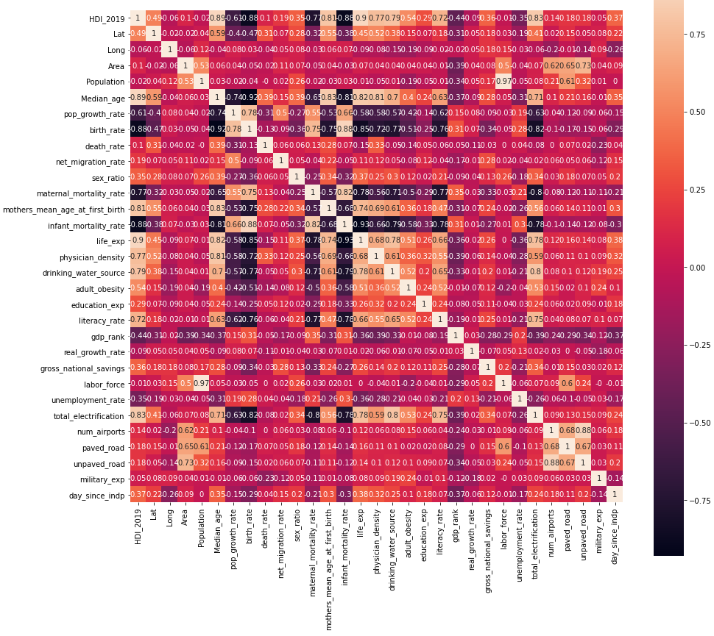

Correlation Matri
Notes:
Correlation matrix of all the numeric variables from the WF

Slide 16
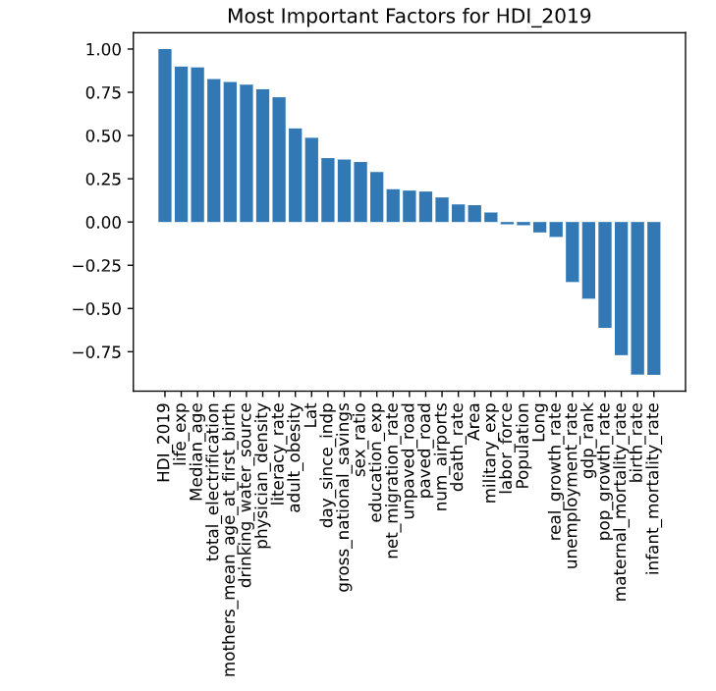
Notes:
More or less exactly what you would expect – Life expectancy, mortality rates, total electrification (what % of the population has access to electricity), drinking water source (what % of the population has access to clean water)

Slide 17
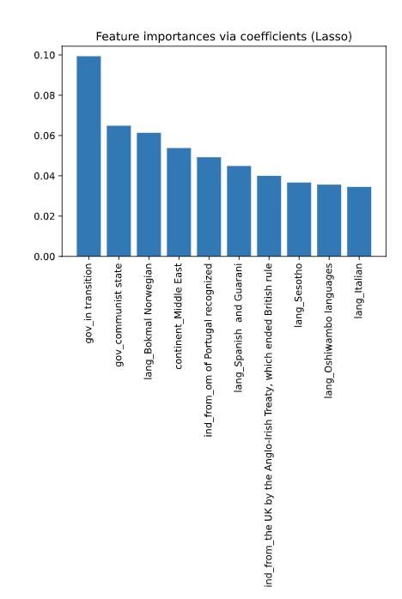
Notes:
Lasso is inclusive of Categorical features although some of these are kind of weird – like the languages

Slide 18
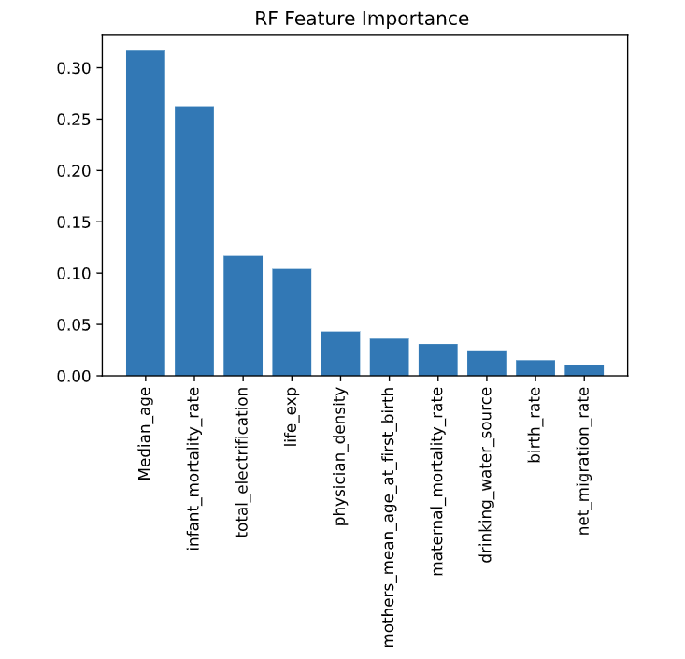
Notes:
RF Feature importance inclusive of both Numeric and Categorical but

Slide 19
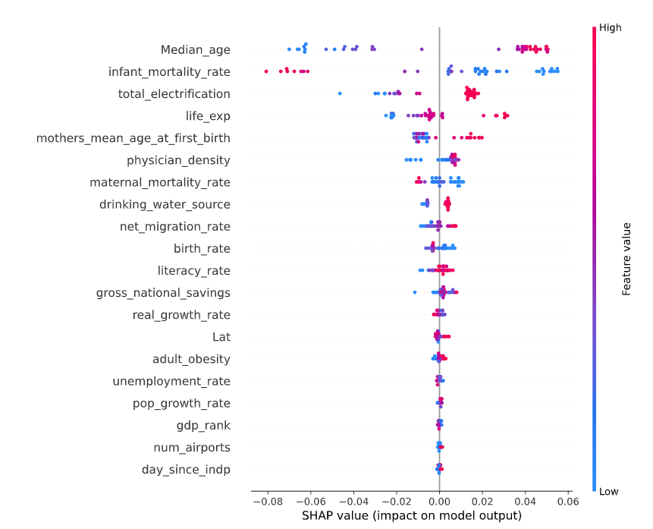
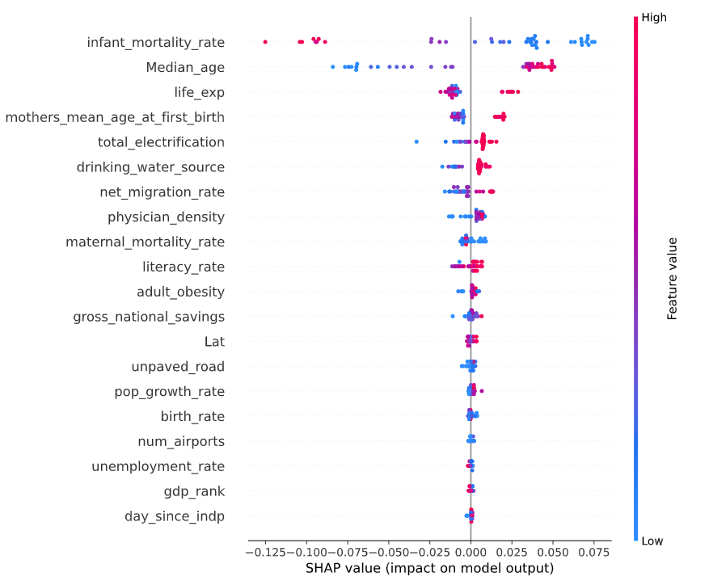
Random Forest VS Gradient Boost SHAP Values
Notes:
RF on Left and GB on the Right.
Not super different from what the other variables have shown us

Slide 20
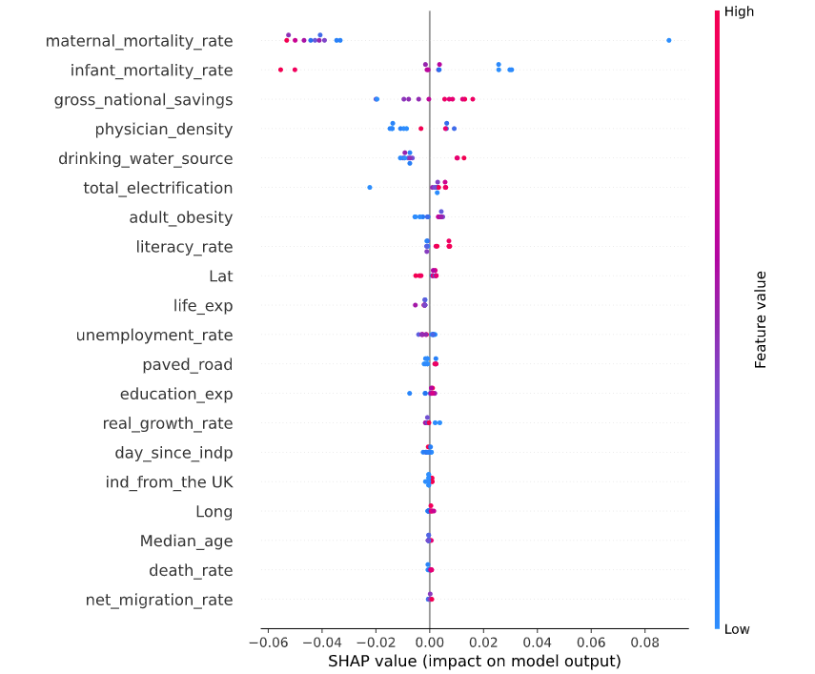
Africa SHAP Values
Notes:
Split by Region
What’s different in Africa = Gross National Savings

Slide 21
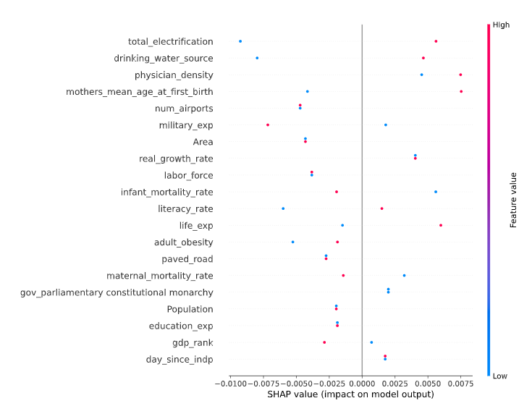
Southeast Asia SHAP Values
Notes:
Southeast Asia. Very small Sample so take it with a grain of salt but all of these look pretty familiar

Slide 22
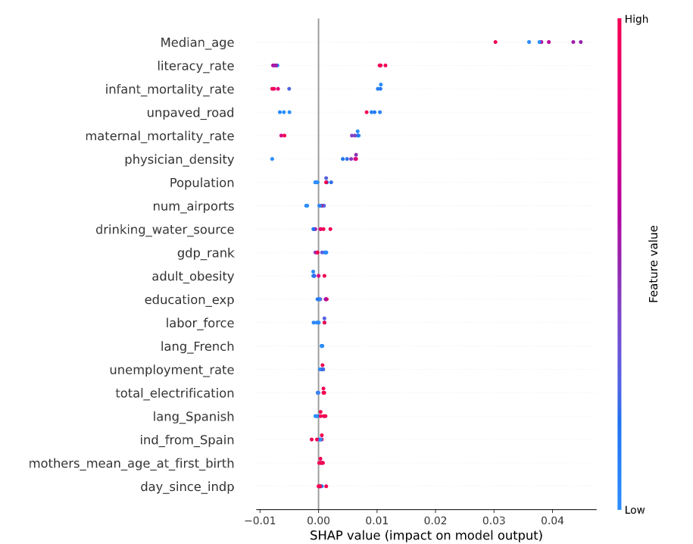
Latin America SHAP Values
Notes:
Again, all of these look familiar.

Slide 23
Economic Metrics
Notes:
Ran lasso and linear models for these too see how correlated they are with HDI. Noticeably CPI (Consumer Price Index) and Trade_value (Value of Exports) are most highly correlated with HDI. This makes sense in developed countries things cost more. Developed economies often export more too.

Slide 24
Conclusion, Lessons Learned, and Next Steps
The most common important factors for human development are related to mortality rates (infant, mother, etc.) and infrastructure like electric grids and drinking water sources.
Not Claiming a Causal Relationship just Associative
Worldbook data was python friendly but economic data would have better been handled in R or Stata
Using AI for Development purposes is difficult because a lack of data both in terms of quality and quantity
Panel Regression for the Economic Data

Slide 25
Questions?
Thank you For your Attention.

