Slide 1

Wolt’s
Takehome
Dataset
Analysis
by Artur Roos

Slide 2
The Dataset
Why this dataset?
1. Real™ data
2. Complex structure
3. Missing data
4. Averaged everything
What is it like?
30 columns
21983 rows
From 2019 to 2021
Registration Country
Amounts of different purchases
First/last purchase dates
Most popular hour/weekday
Device/Platform
Average delivery distance
More than 50% of most columns is missing.
What processing was done?
Only Finland.
Only people who purchased.
For each metric only columns with complete data were used.
No imputations.
Total ~5000 rows.

Slide 3
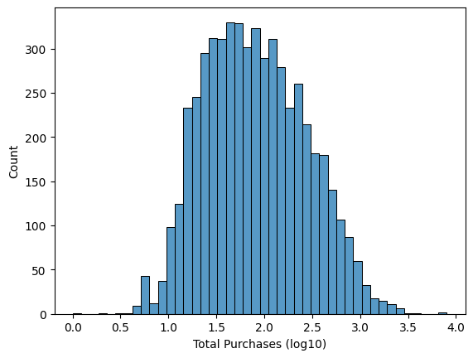
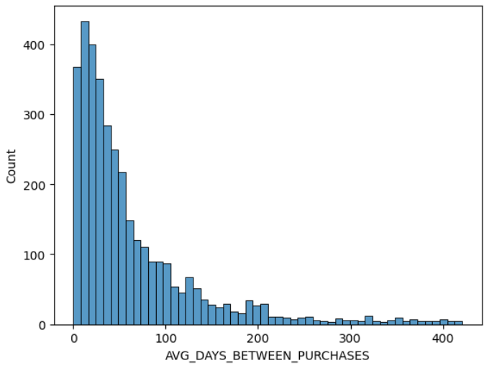
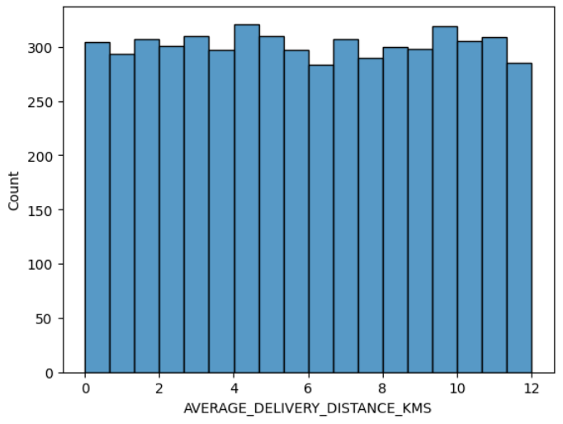
Distribution Shapes
How is the data?
All data is either uniform or with a strong tail, standard deviation mostly not applicable, but averages are very valuable.
What is the average customer like?
1. ~9 purchases totalling 260€.
2. Each purchase is ~30€.
3. Active for 8 months.
4. Orders takeaway every ~2 months.
5. Has tried around 4 places.
log-normal
uniform

Slide 4
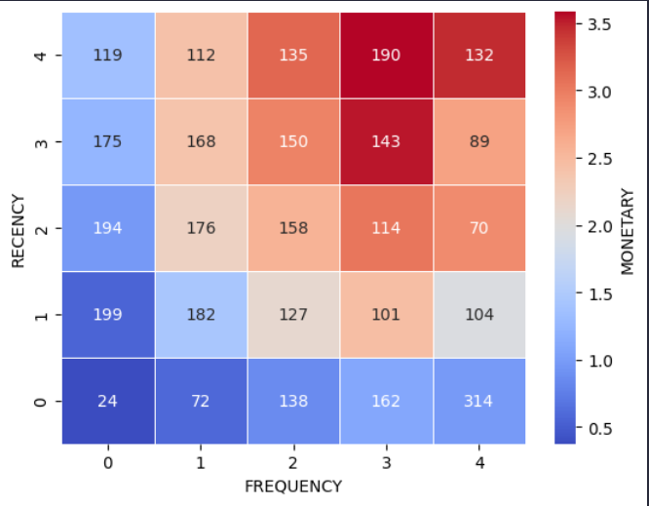
Recency, Frequency, Monetary
New Customers
Whales
What is RFM?
Customer’s activity is scored
on 3 axes and split into 4 cohorts.
Customer data over time needed
to estimate possible marketing
strategies for each group.
What does this mean?
1. Bulk of the revenue buy often and bought recently.
2. Frequency is important, possibly because of habit formation.
Whales
at Risk
RED = GOOD
Occasional Buyers

Slide 5
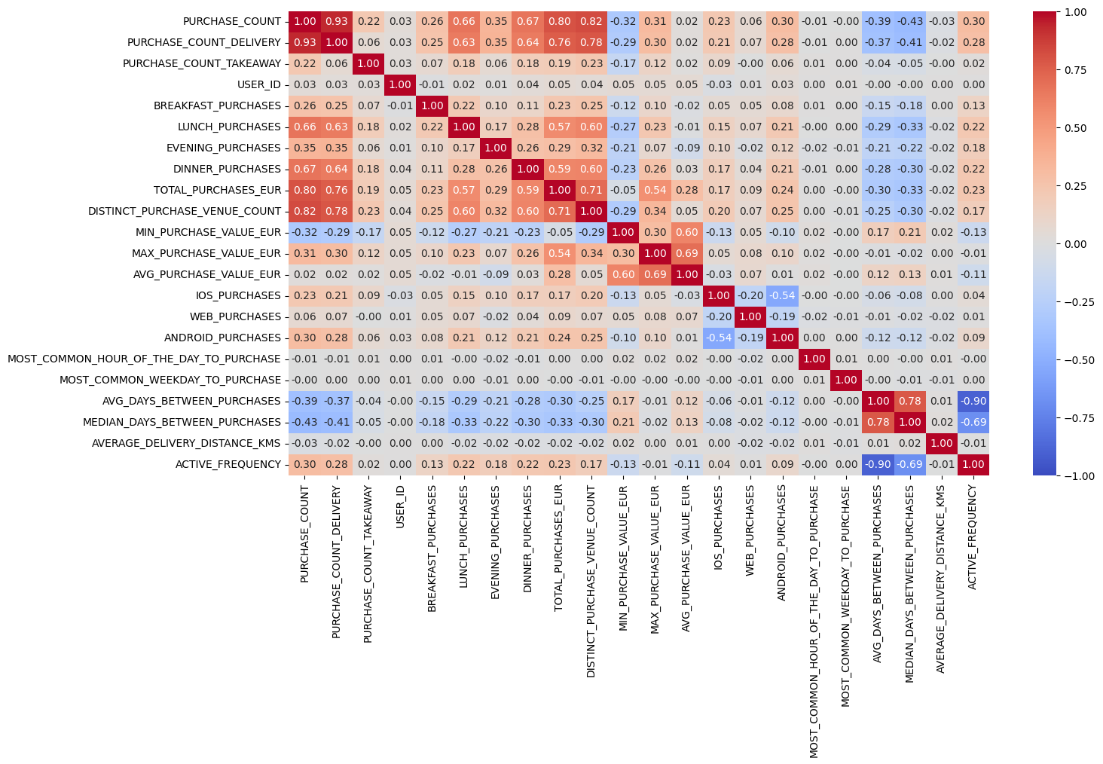
Relationships
Doesn’t make logical sense, so probably a fluke
What correlations exist?
1. Purchase count is basically equivalent to delivery count, most order take out.
2. Having a lot of purchases also correlates with having a lot of lunch dinner purchases, supporting the earlier conclusions.
3. More purchases = More venues
4. Averages correlate with minimum
and maximum, so customers have
a comfortable spending range
5. Platforms don’t give much information,except generally excluding each other
1
1
2
3
4
5
NB: Correlation is calculated using Kendall, so all monotonic relationships are preserved

Slide 6
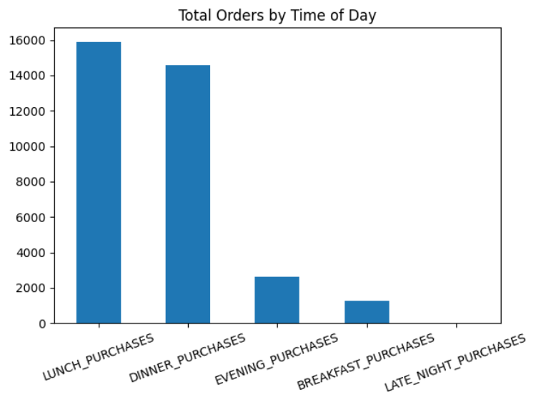
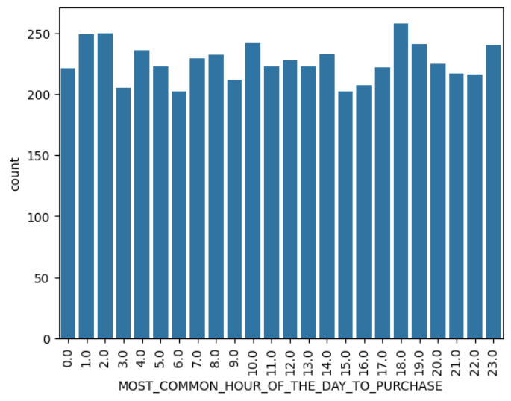
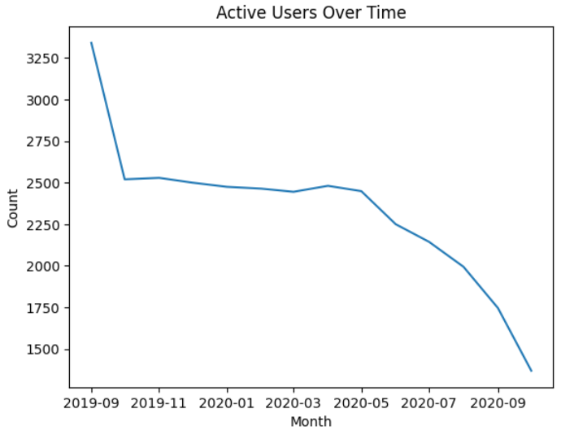
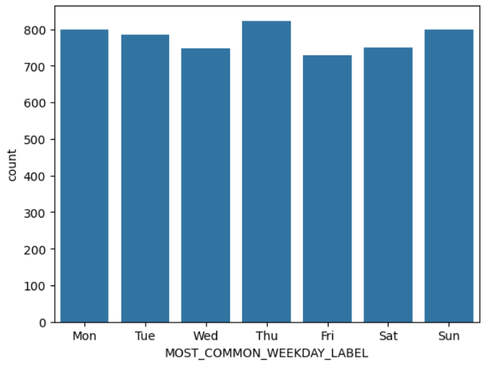
Temporal Patterns
What are the patterns?
Strong preference towards lunch and dinner order. 0 orders late at night.
The user count is continuously falling at an accelerating rate.
Most preferred hour of purchase is inconsistent across two different columns
Most common weekday looks similar, so it is also invalidated.
Inconsistent
COVID-19?

Slide 7

Conclusions
What are the key takeaways?
1. Frequency (habit formation) is very important for generating revenue.
2. Customers have a comfortable spending range the bounds of which are proportional to their average spending.
3. The amount of active users is declining, measures to increase conversion are needed.
4. Optimize for load during lunch and dinner times.
5. Different platforms are in use, all need to be supported.

Slide 8
References
Where were the images taken from?
1. https://explore.wolt.com/en/fin/about
2. https://wolt.com/en/fin/ruka/article/helsinki-welcome-to-wolt
Where is the code for this?
https://www.github.com/ktnlvr/wolt-takehome

