Slide 1



Senior Data and Analytics Engineer at Odido
As a Senior Data and Analytics Engineer at Odido, my focus is on creating, managing, and optimizing data pipelines, databases, and analytical frameworks. Utilizing SQL, Python, and BI tools like ThoughtSpot, as well as cloud platforms such as AWS, my goal is to empower data-driven decision-making and enhance business intelligence. Collaboration with diverse teams is essential to strategically leverage data, driving insights and innovation across the organization.
by Ketan Sahu

Slide 2
Business Intelligence Team at Odido
Data Migration and Transformation
Deep Domain Knowledge
The BI team at Odido manages data migration, ingestion, transformation, quality assurance, visualization, and documentation. It focuses on Finance, B2B, and B2C data, with multiple skilled analytics engineers collaborating to deliver top-notch results to internal stakeholders.
The team comprises individuals with deep domain knowledge in finance, mobile and fixed data for both B2B and B2C sectors. This expertise allows for seamless collaboration and the delivery of insightful analysis to stakeholders.

Slide 3
B2C Fixed Team Responsibilities
Data Ingestion
Data Transformation
Comprehensive Documentation
Utilizing tools like AWS DMS, Appflow, Lambda, and Sharepoint to ingest data from diverse sources.
Employing techniques such as data modeling, SQL, Python, and AWS Glue with AWS Redshift as the data warehouse.
Orchestrating data migration to the AWS cloud, implementing rigorous data quality checks, and comprehensively documenting all pipelines on Confluence.

Slide 4
B2C Fixed Team - Business Intelligence and Management
1
Business Intelligence
2
Team Management
3
Tele2 Reports
Leading as a developer within a scrum team, overseeing capacity and sprint planning for effective collaboration.
Leading the generation of B2C fixed data closing base reports for internal stakeholders post the Tele2 acquisition.
Leveraging ThoughtSpot as the primary BI tool, responsible for crafting and delivering actionable insights to stakeholders.

Slide 5
Data Pipelines Overview
1
Customer Lifecycle Status
The pipeline tracks how customers interact with Odido's services over time, aiding in decision-making to improve customer satisfaction and retention.
2
Case Ratio
Tracking customer interactions with Odido's customer care and issue resolution, providing insights for service enhancement.
3
Fiber Network Coverage
Understanding the availability of new fiber technology for internet access in various neighborhoods, enabling informed service expansion decisions.

Slide 6



Data Pipeline: Customer Lifecycle Status
New Connections
Tracking the number of customers requesting new connections.
Activated Orders
Monitoring the number of customers who have recently activated their orders.
In Contract Customers
Understanding the number of customers still under Odido's one-year contract.

Slide 7
Data Pipeline: Case Ratio
1
Customer Calls
2
Order/Product Stages
Monitoring customer calls to report problems with their orders or products.
Tracking calls occurring at different order/product stages for effective service evaluation and improvement.

Slide 8
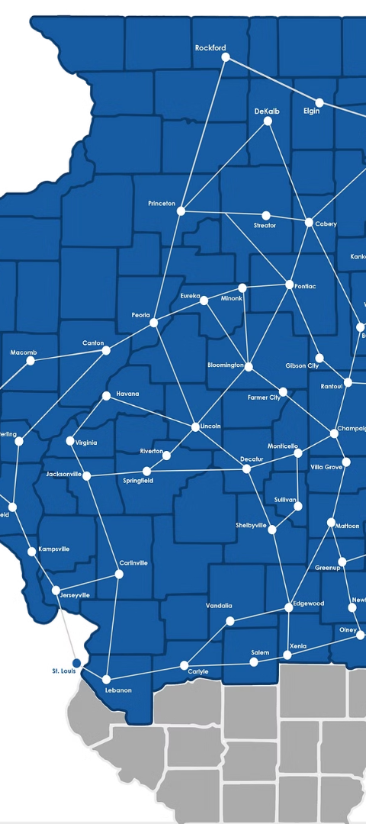
Data Pipeline: Fiber Network Coverage
Availability
Current Coverage
When fiber technology will be available in specific neighborhoods.
The number of homes currently covered by fiber technology.

Slide 9



Data Pipeline: Additional Pipelines
Recently Activated Customers Feedback Report
Fixed Sales Orders Pipeline
Fixed Churn Orders Pipeline
Efficient tracking of fixed sales orders for effective business planning and analysis.
Monitoring and analysis of fixed churn orders, providing insights for customer retention strategies.
Insight into feedback from recently activated customers, aiding in service enhancement and customer satisfaction.

Slide 10
Data Modeling Techniques
Truncate and Load
Upsert
SCD2
Efficient for full data loads
Effective for updating existing data records
For handling historical data changes

