Slide 1

Team: Aztech
Ketan Shah
Anuj Parmar

Slide 2
Problem Statement
Today many people use several social media platforms to market their product, blog or vlog to do business, but for getting most profit out of the work done or smart marketing work, all social media feed posted needed to be analyzed, but there on one single platform available for that. Were users can analysis posts across social media platform like Twitter, Instagram, Facebook, YouTube.

Slide 3
About TIFY
TIFY Scrapper is based on social media platform where it analyzes the statistics of the post selected by the user. It uses Twitter, Instagram, Facebook, Youtube (TIFY) application programming interfaces (APIs) for Social Scraping. On a single platform, the user can analyze all the social media’s mentioned above posts. The user can also get an insight into statistics of other user’s posts/updates which might be helpful for the user to know what kind of content is most desirable to his viewers and the data can then utilized to analyse and get insights into the kind of users and the type of content which should be delivered next to gain maximum views and popularity.

Slide 4
Why TIFY Scrapper?
TIFY scrapper is one of its kind platform where users can get analysis all of their posts posted across different social media platform(Twitter, Instagram, Facebook, YouTube),It save precious time of users and also helps to analyze same post across different platforms.

Slide 5
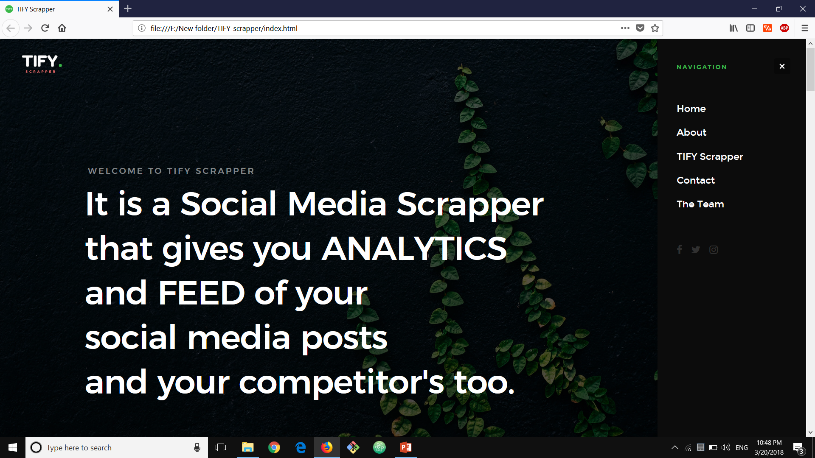
User Interface

Slide 6
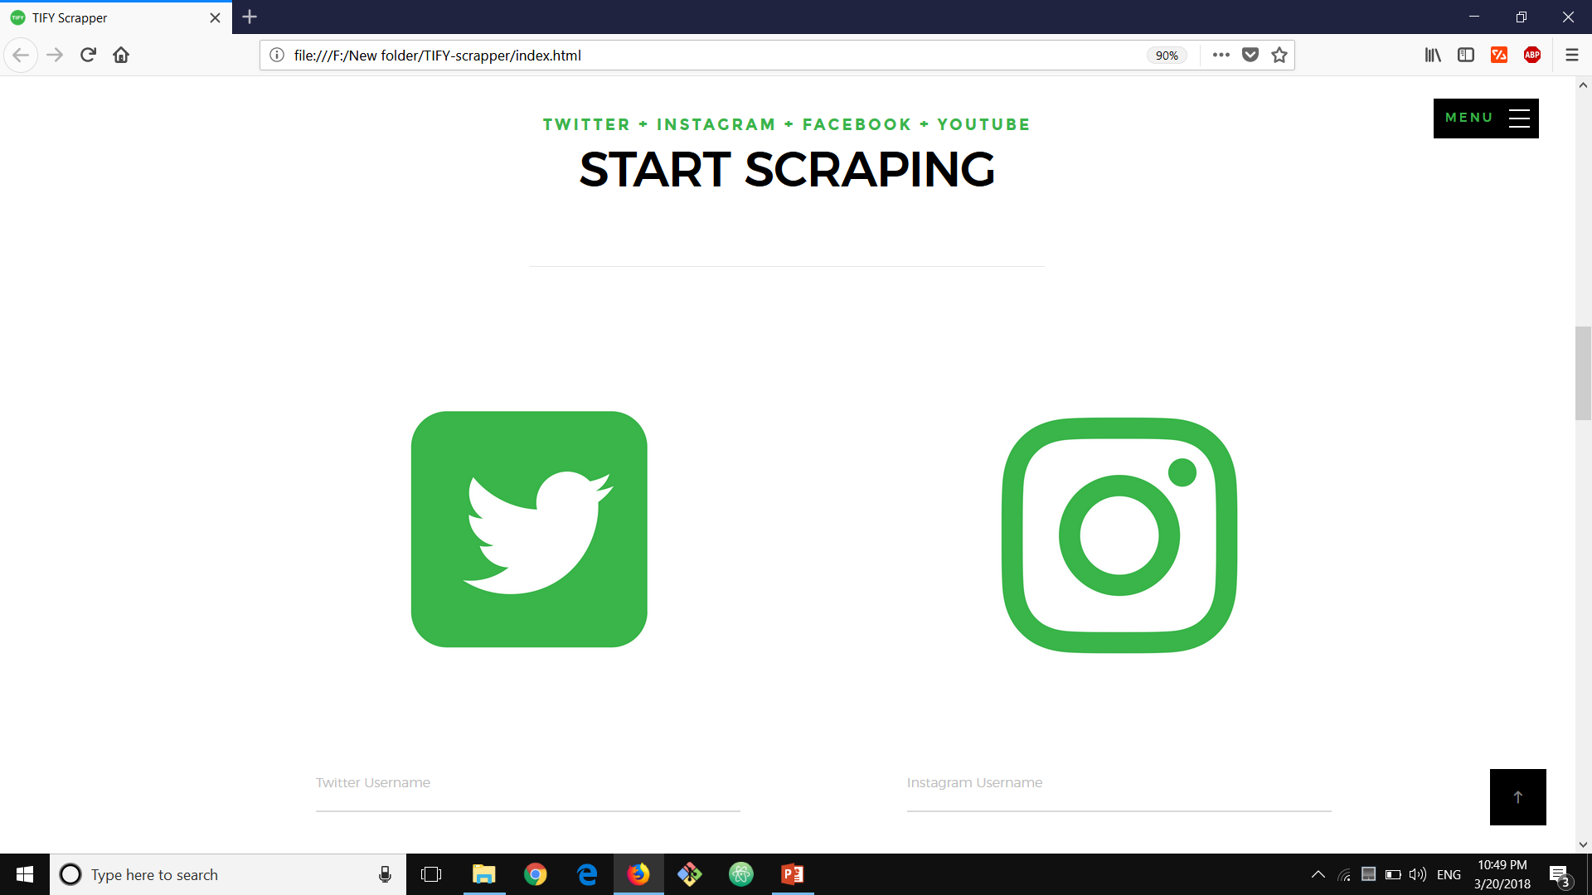

Slide 7
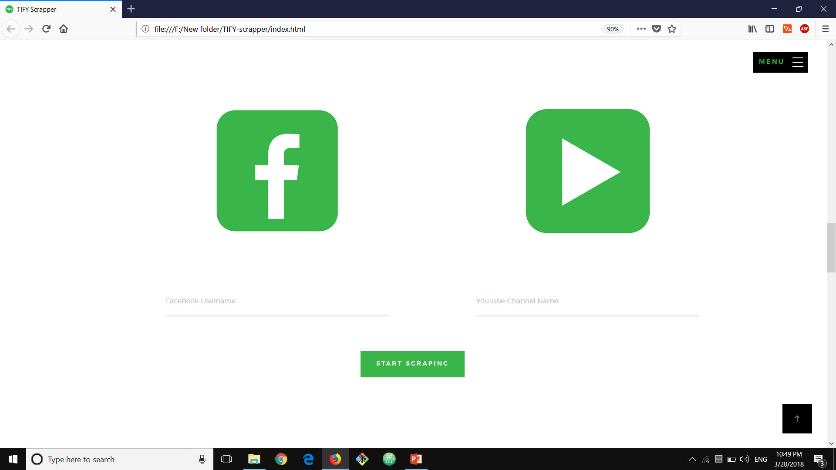

Slide 8
Thank You

