Slide 1
LLMs and Gen AI
From classification to language generation: embeddings, prompting, reasoning, tools and risks
Prof. Dr. Alexander Brandt
alexander.brandt@dhbw-stuttgart.de
Version of 21 October 2026

Slide 2
Contents
Language generation as classification
Word representations
Prompting
Reasoning
Tools and agents
Limitations and risks
Take-aways

Slide 3
Contents
Language generation as classification
Word representations
Prompting
Reasoning
Tools and agents
Limitations and risks
Take-aways

Slide 4
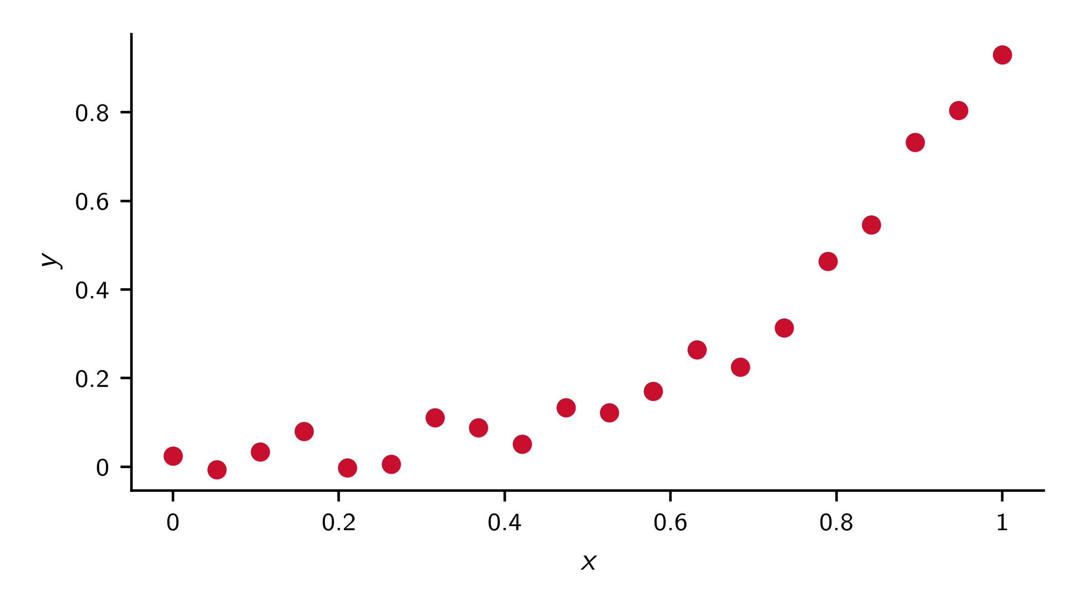
Regression

Slide 5
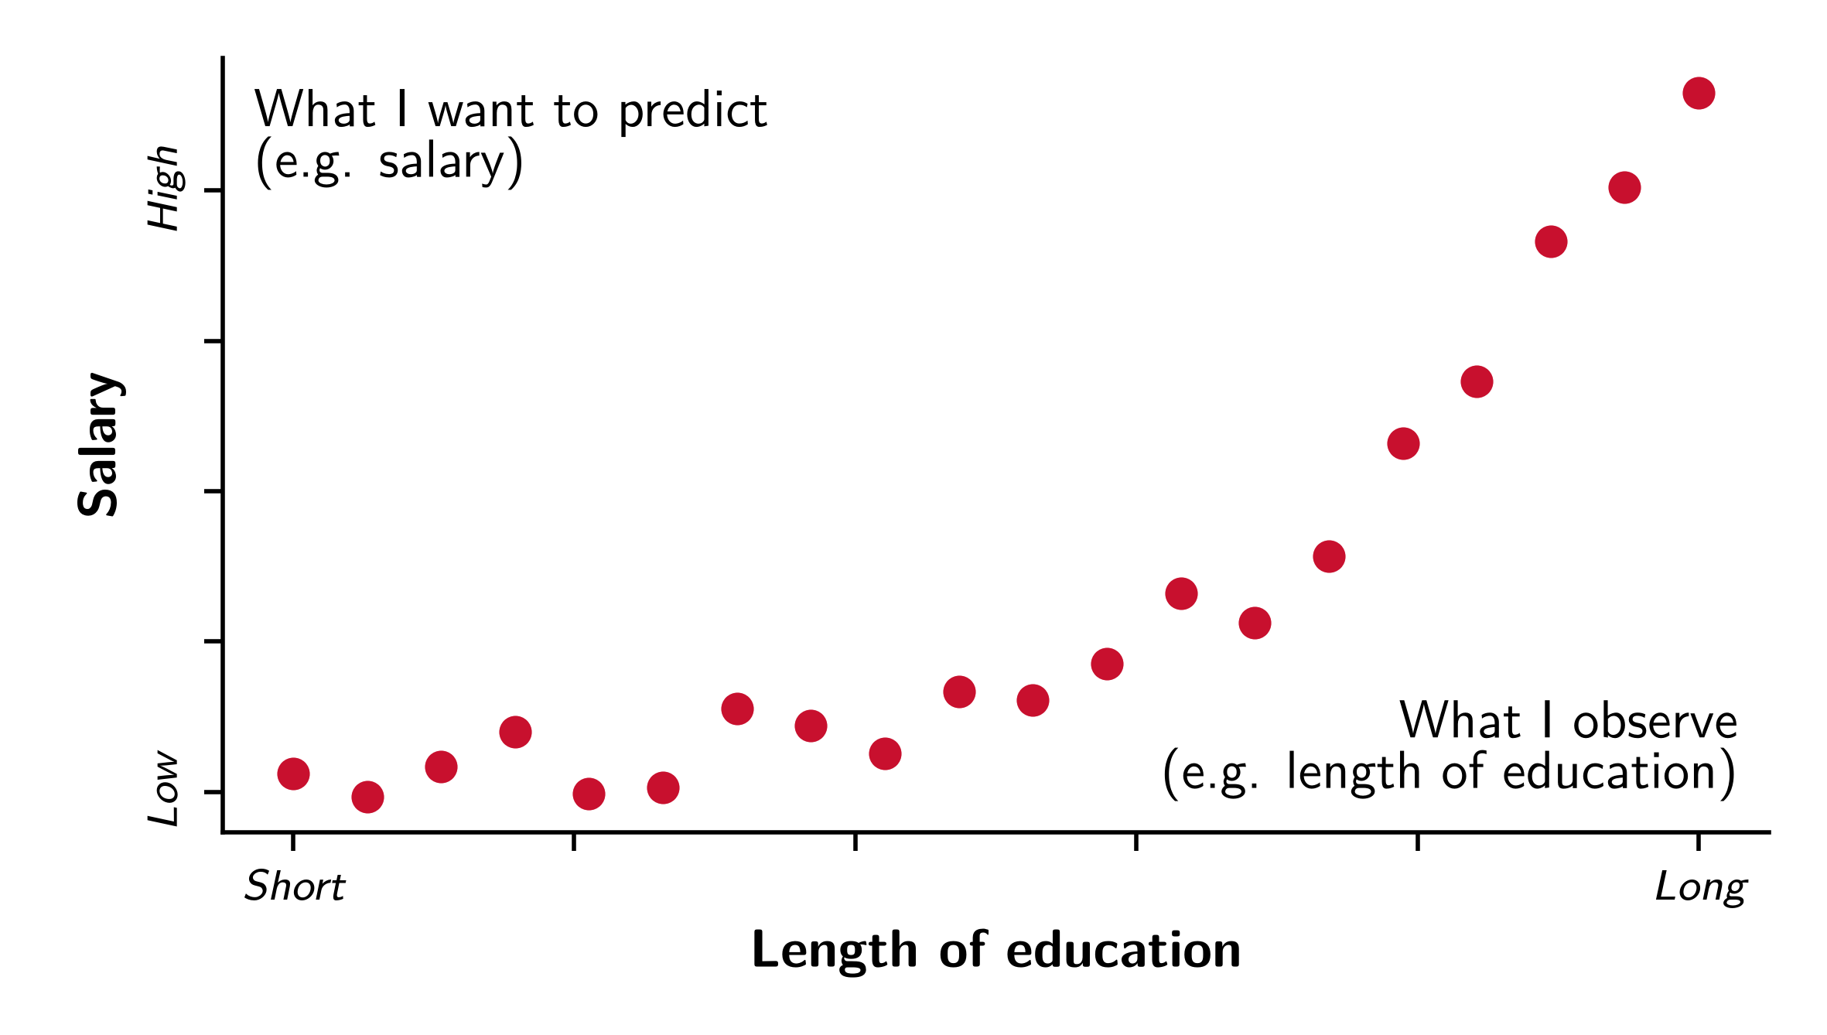
Regression

Slide 6
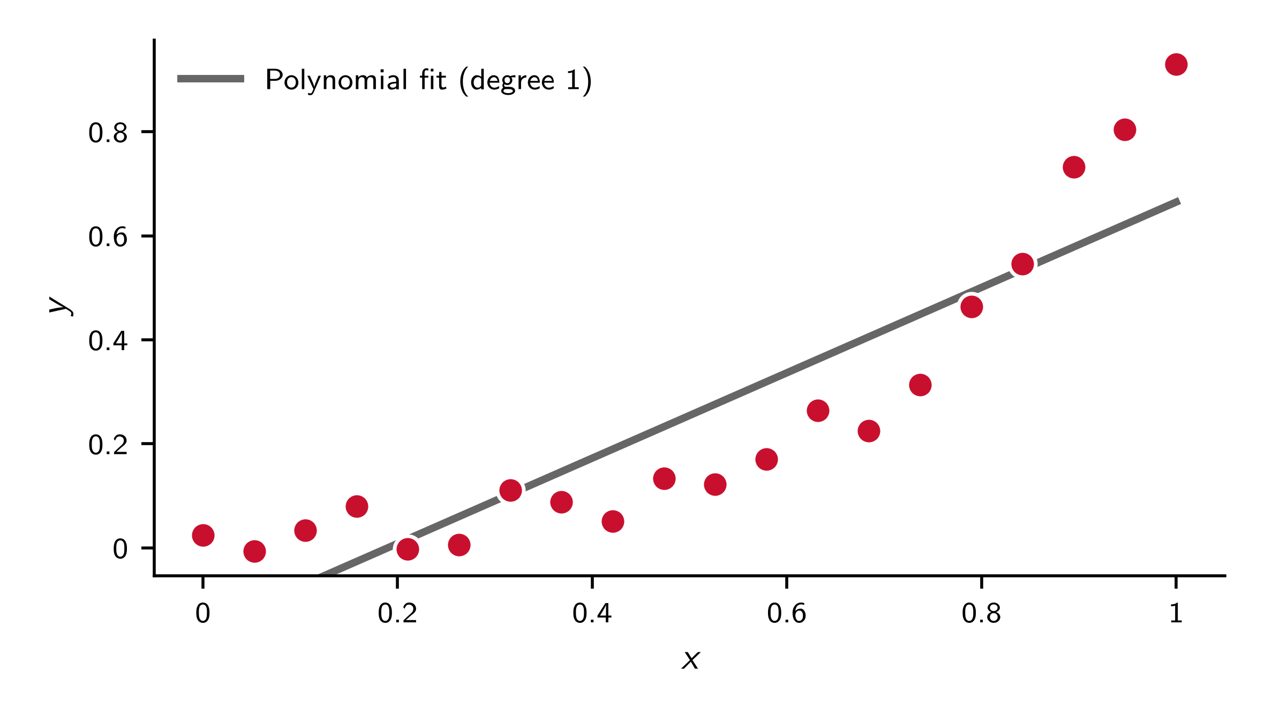
Linear model

Slide 7
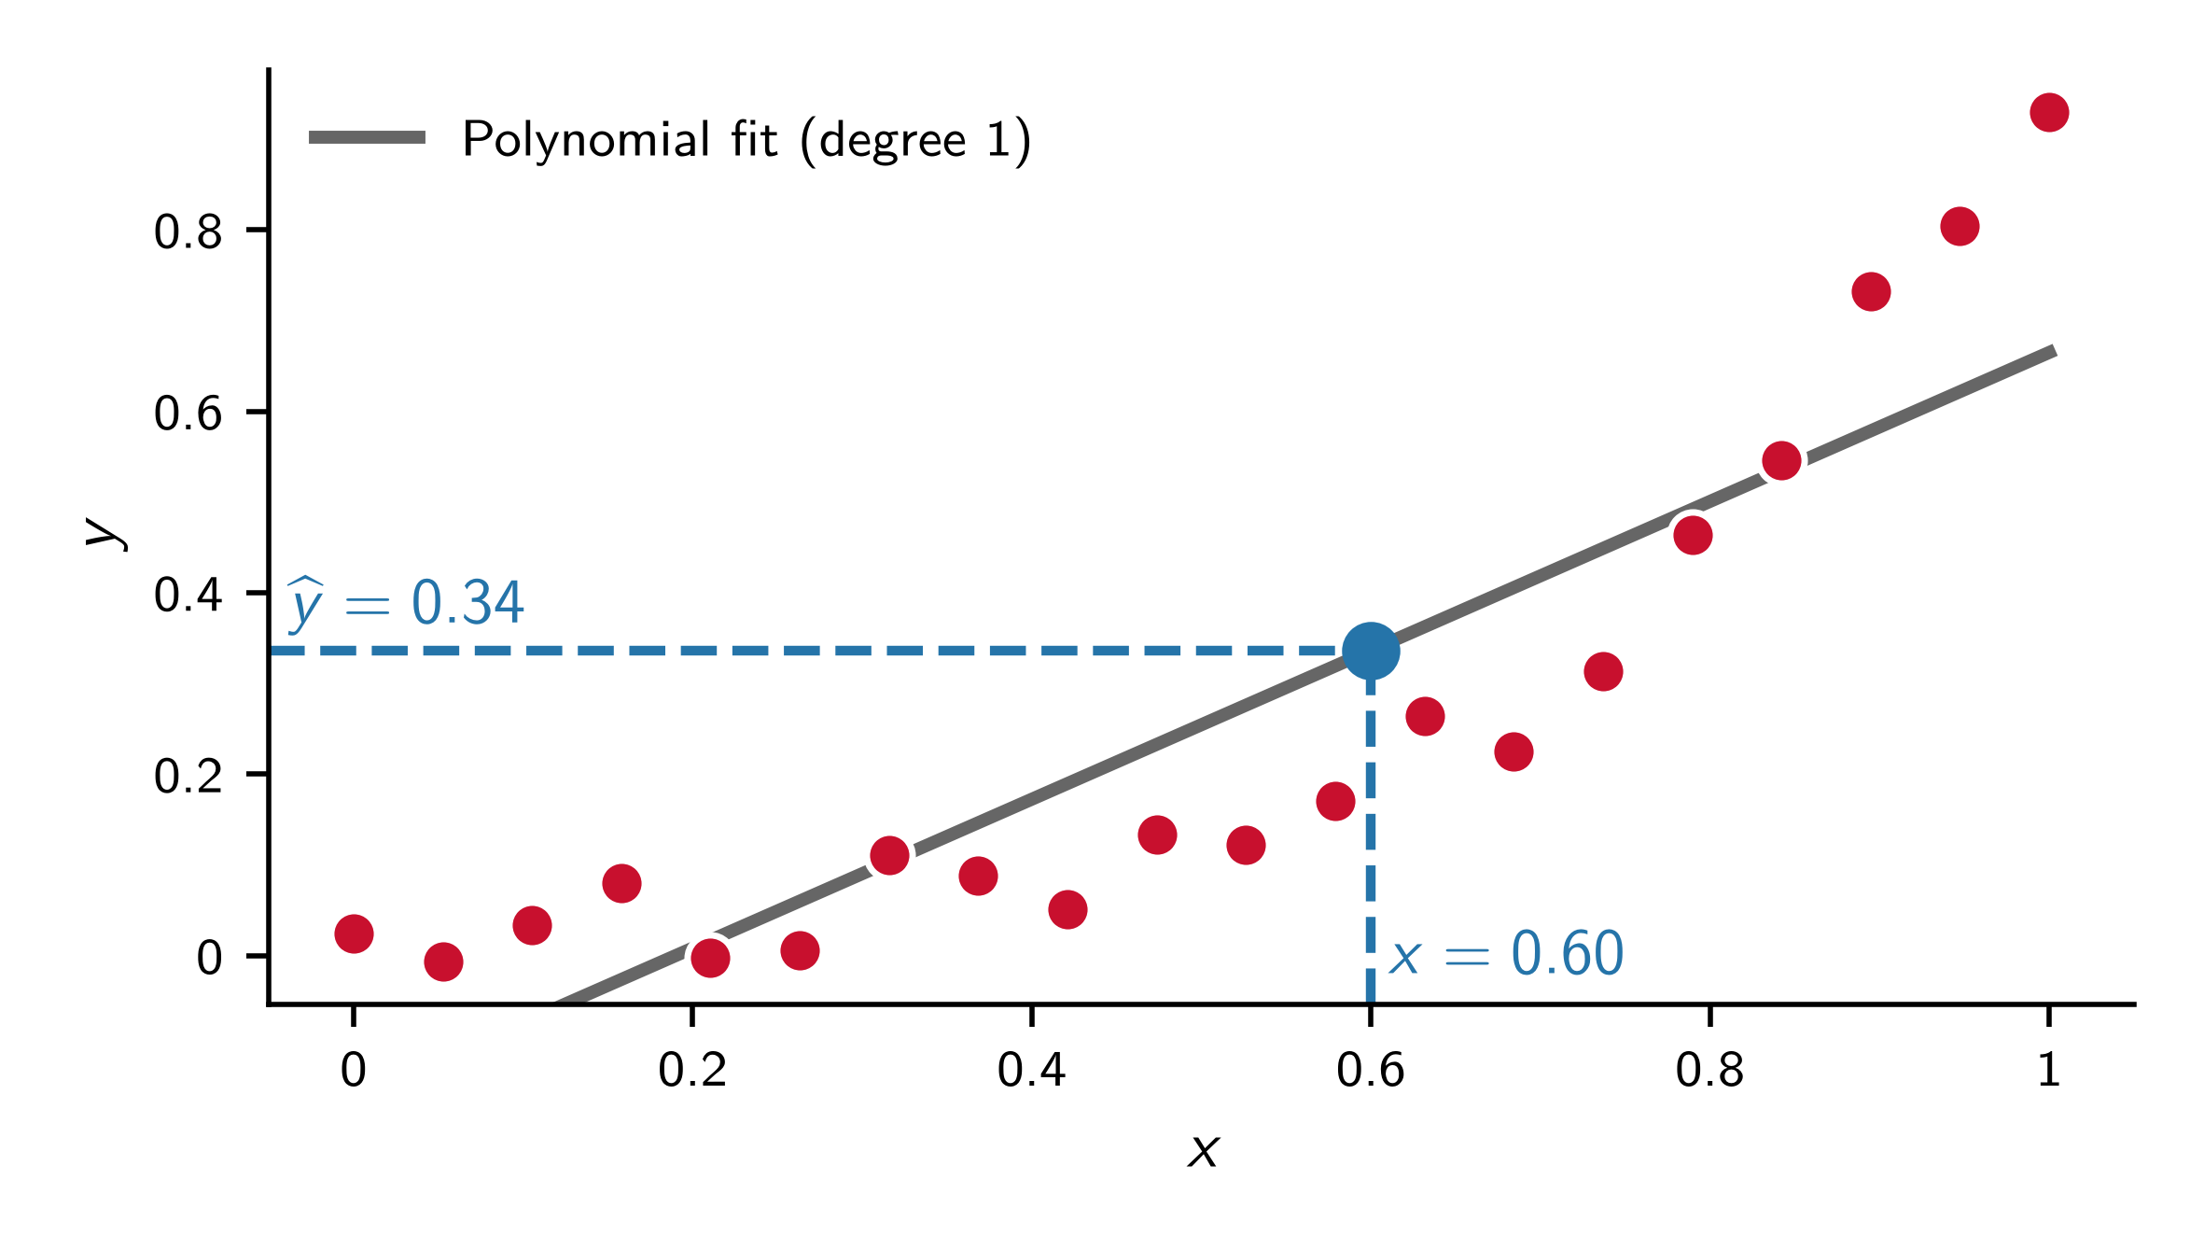
Prediction

Slide 8
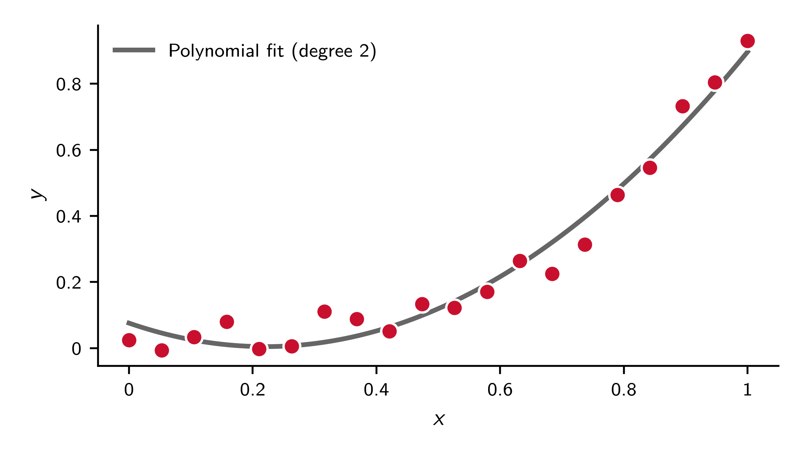
Second-degree polynomial (quadratic model)

Slide 9
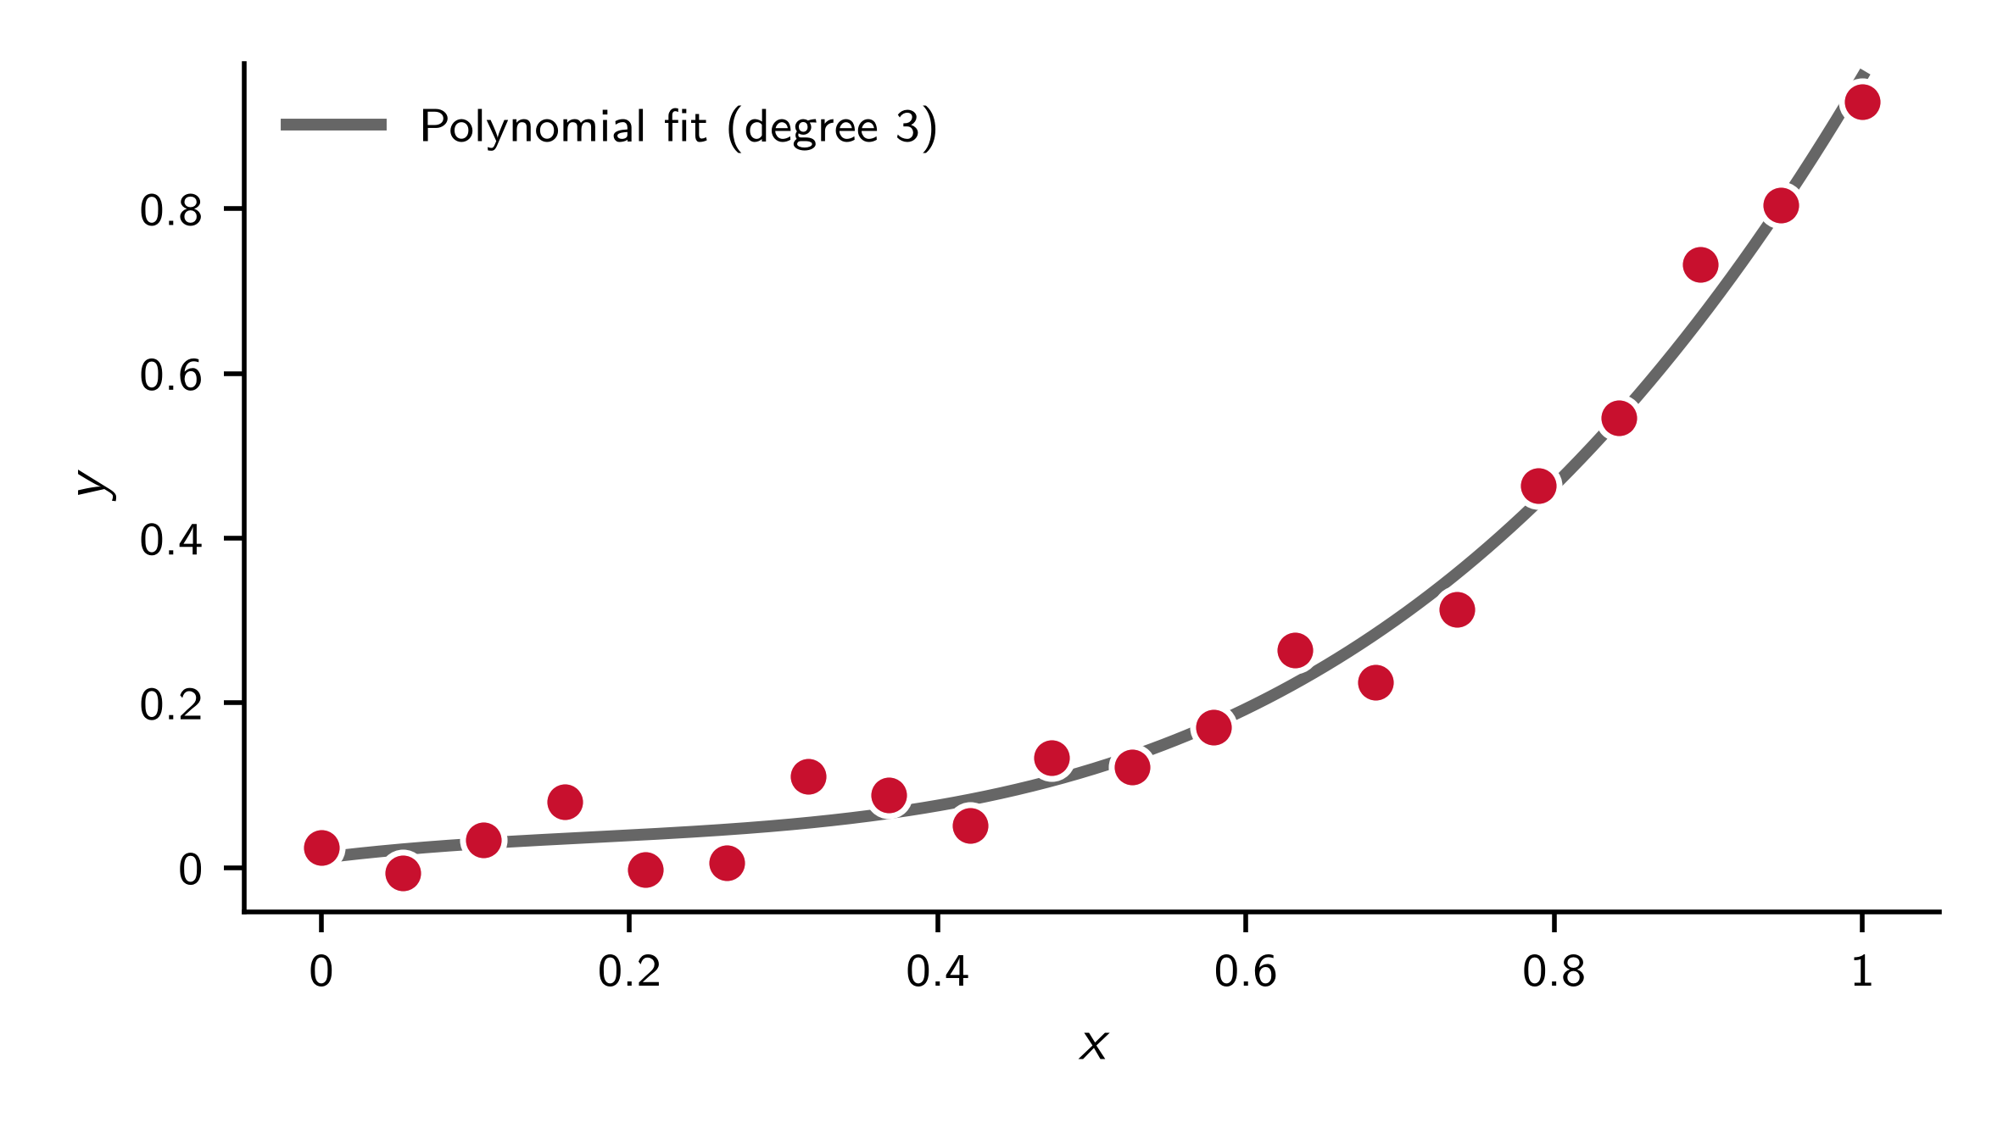
Third-degree polynomial

Slide 10
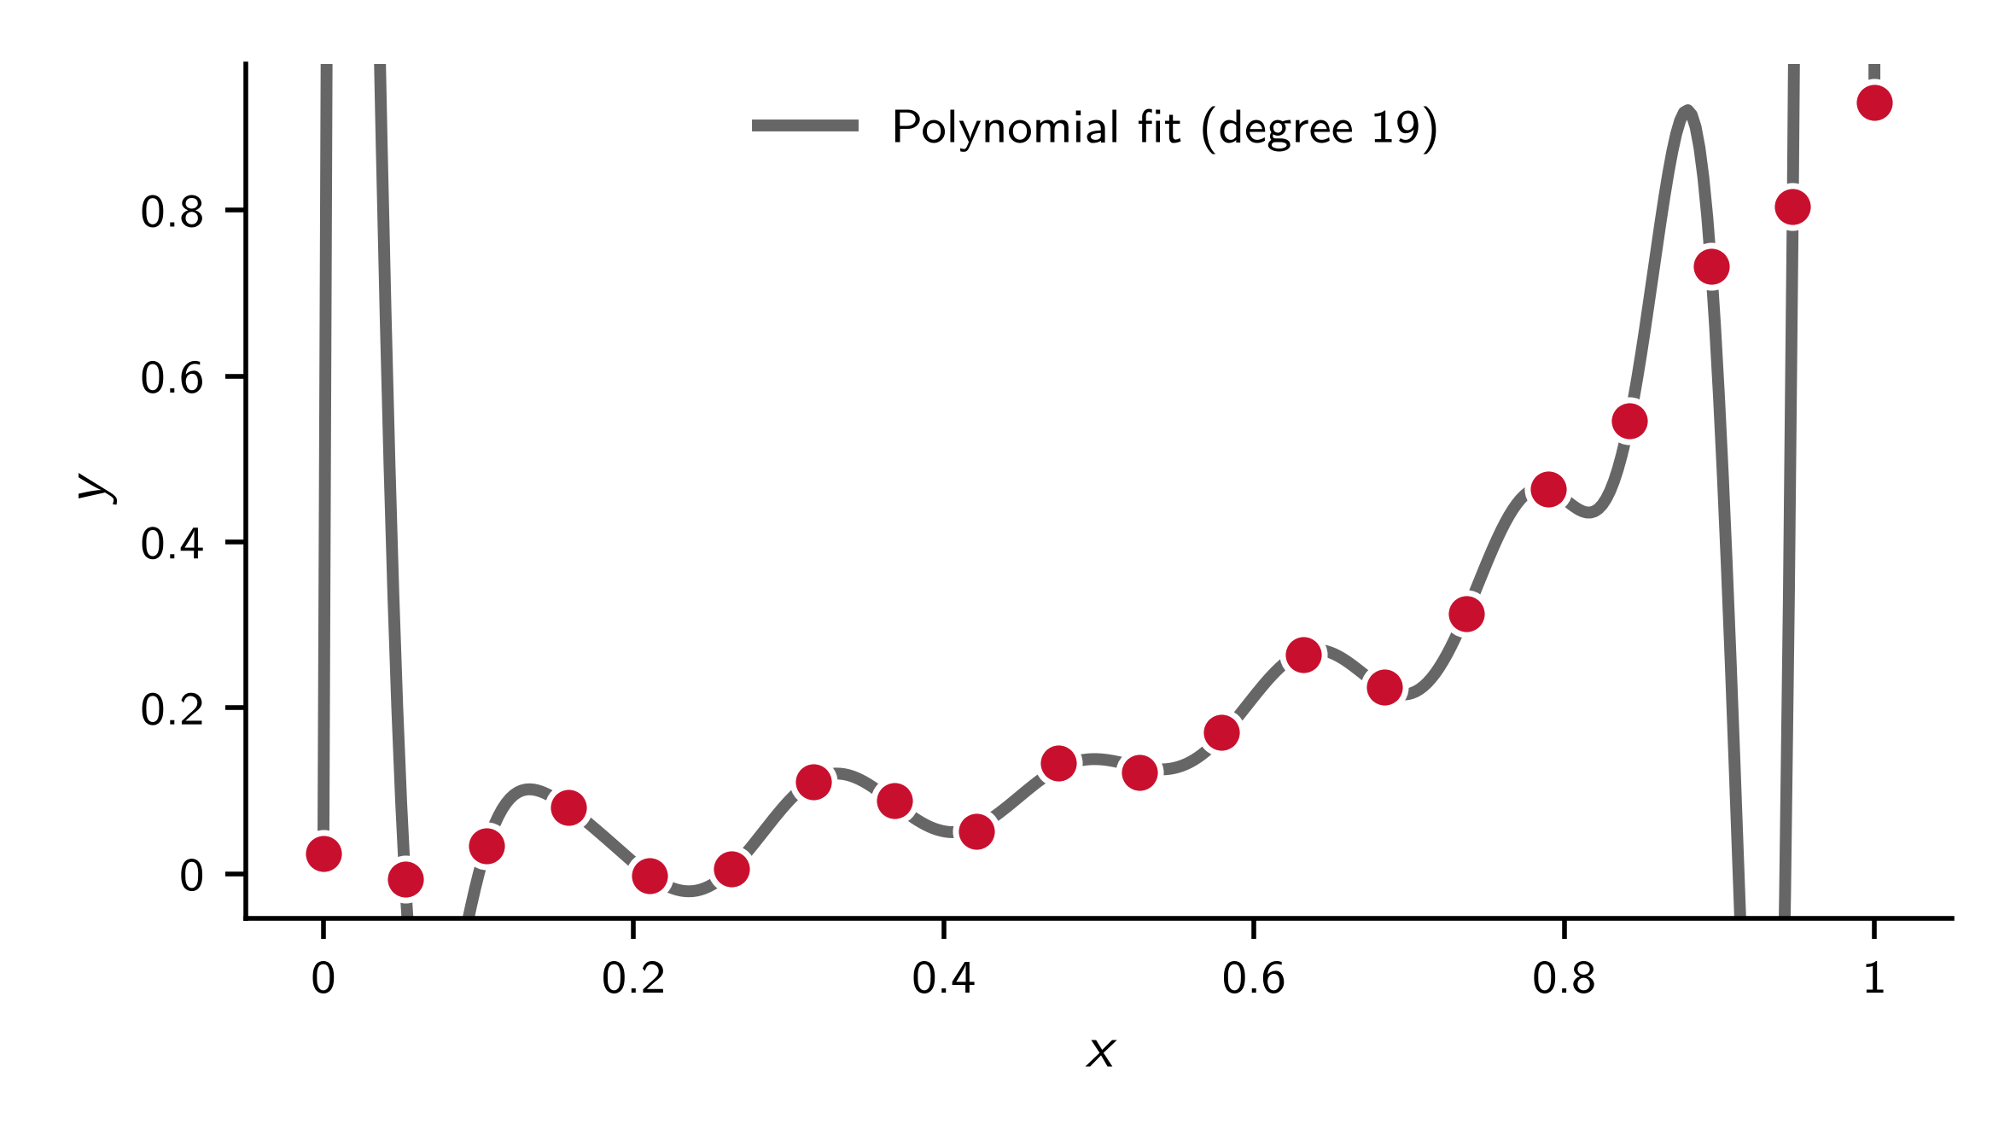
Learning from data

Slide 11
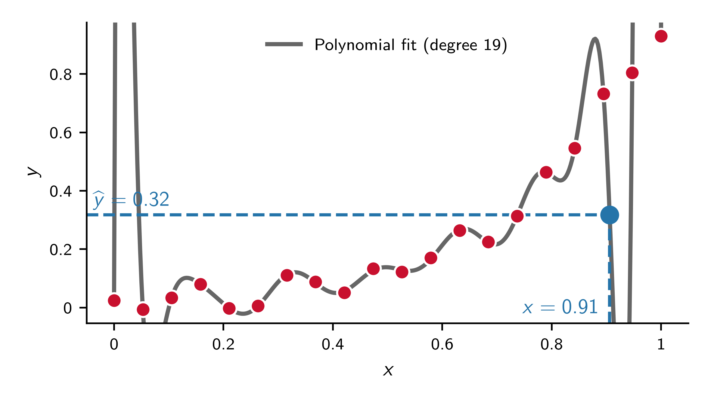
Learning from data

Slide 12
Regression
A regression problem consists of four components:
Data $𝒟=\left\{\left(x_{i},y_{i}\right)\right\}$
+ Model $f\left(x,θ\right)$ (e.g. $\sum_{j=0}^{d}{β_{j}x^{j}}$)
+ Loss $L\left(y,\hat{y}\right)$ (e.g. $\sum_{i}{{\left(y_{i}−{\hat{y}}_{i}\right)}^{2}}$)
+ Optimisation $\min_{θ}{L}$ (e.g. analytical)

Slide 13
Examples of regression problems
Motor insurance premium (average claim amount) from
driver/vehicle age, region, claims history, …
Average claim severity in residential building insurance from
building value, construction type, year of construction, region (flood/storm risk), roof type, heating type, …
Average processing time of a claim from
type of claim, documentation quality, claim amount, number of parties involved
Electricity instalment (average power consumption) from
living space, number of occupants, year of construction, heating type, …

Slide 14
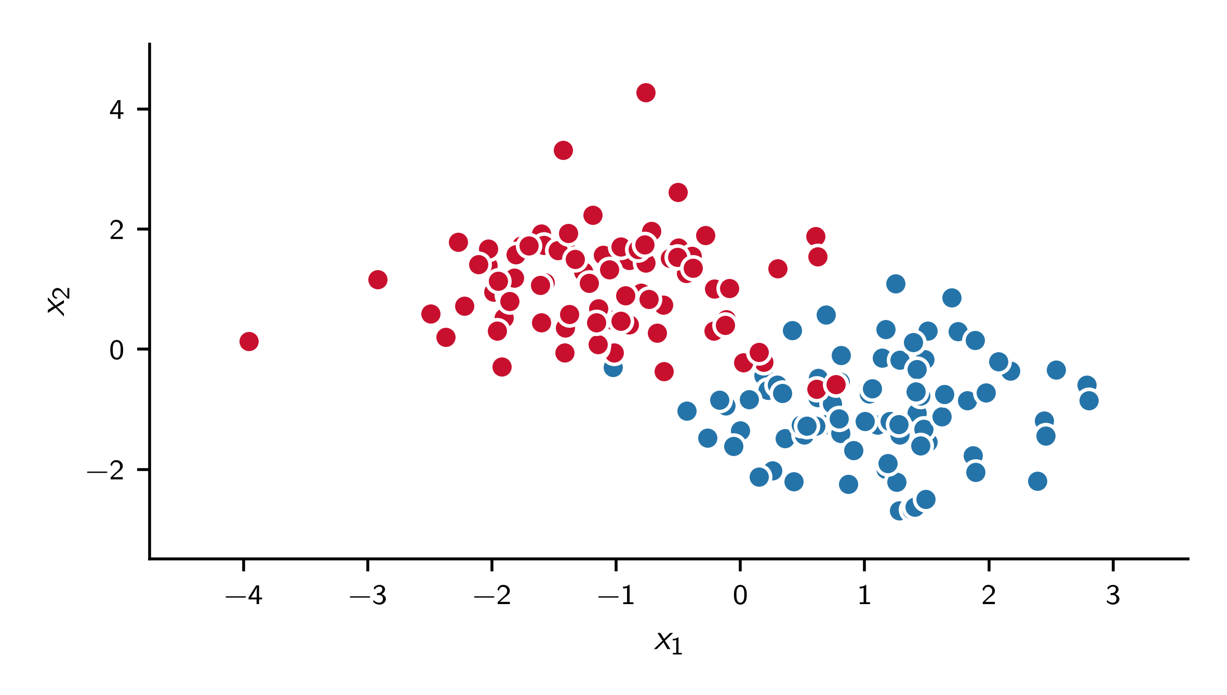
Classification

Slide 15
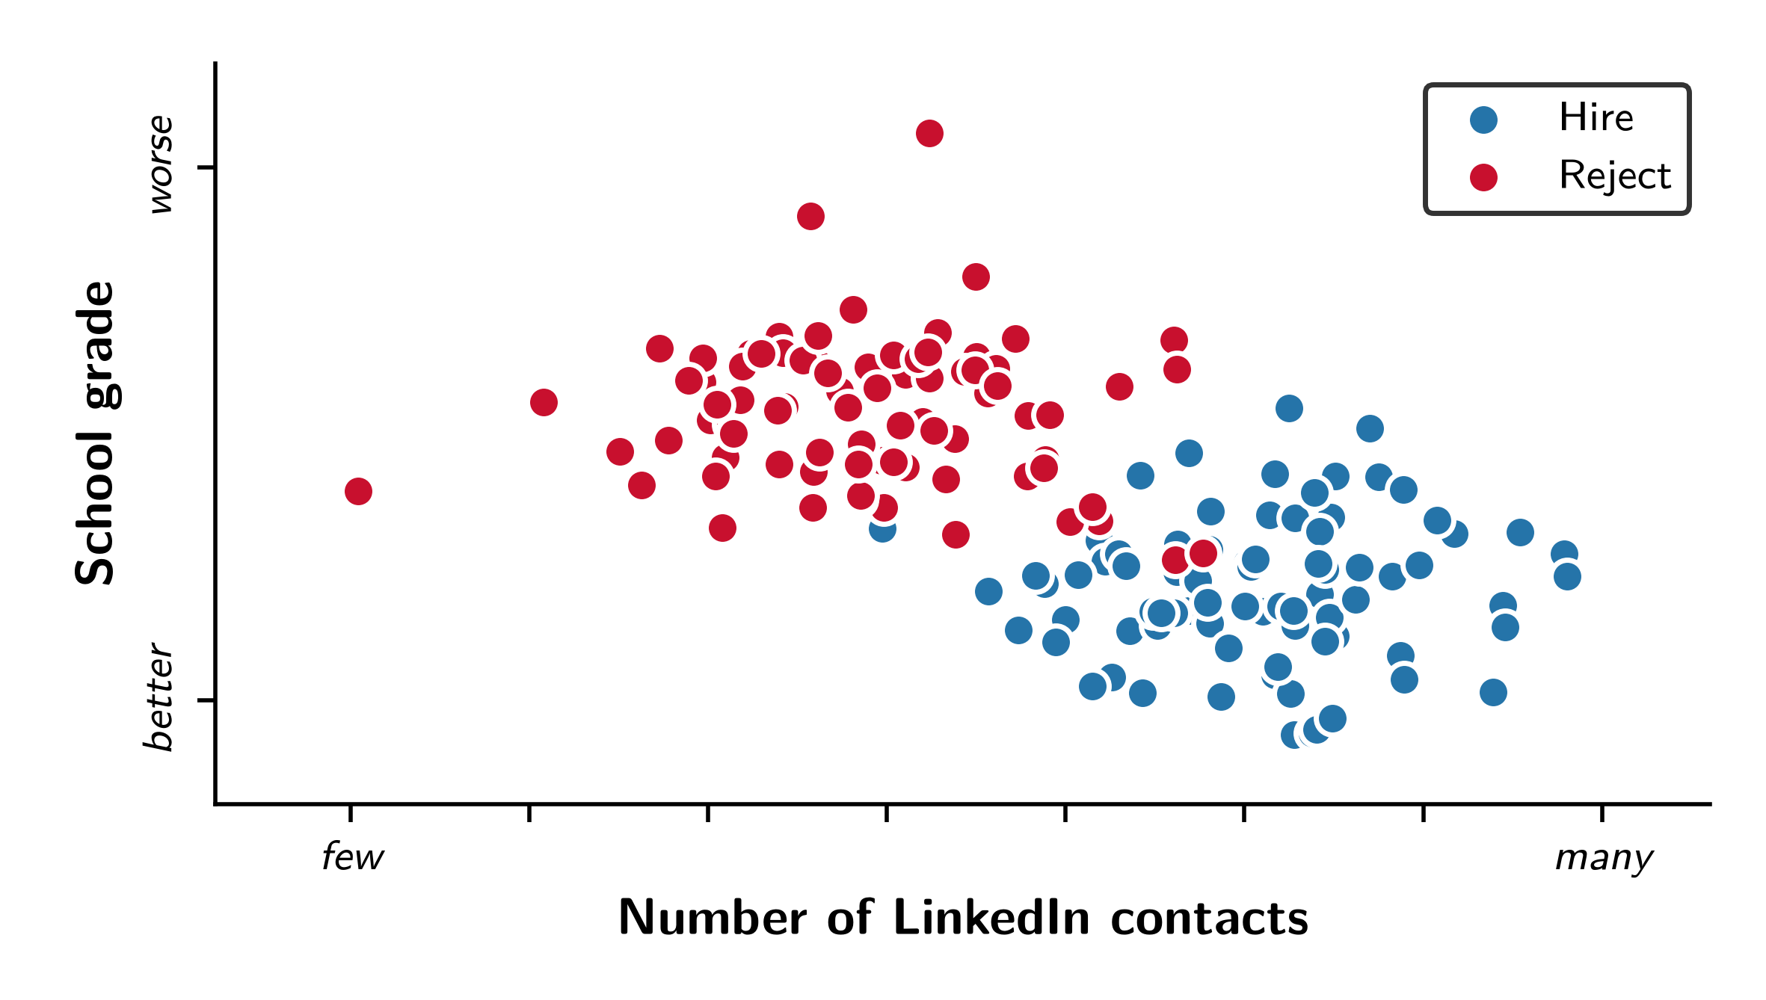
Classification

Slide 16
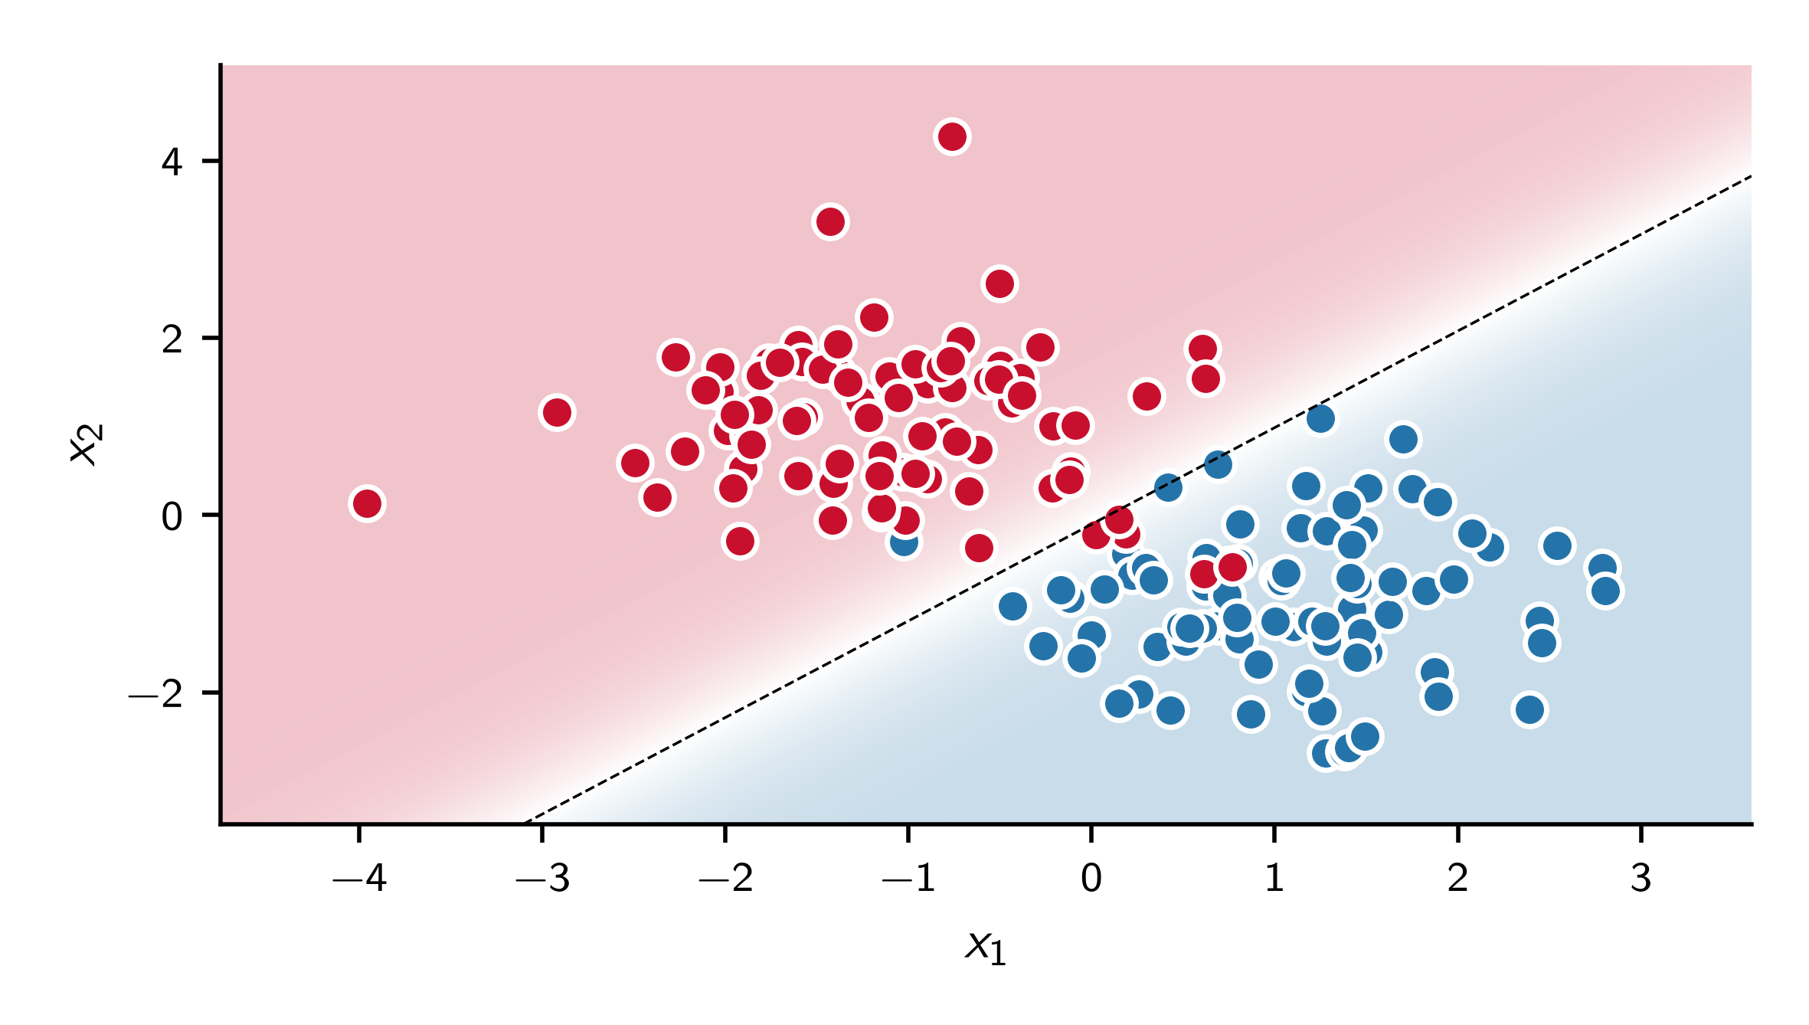
Logistic regression

Slide 17
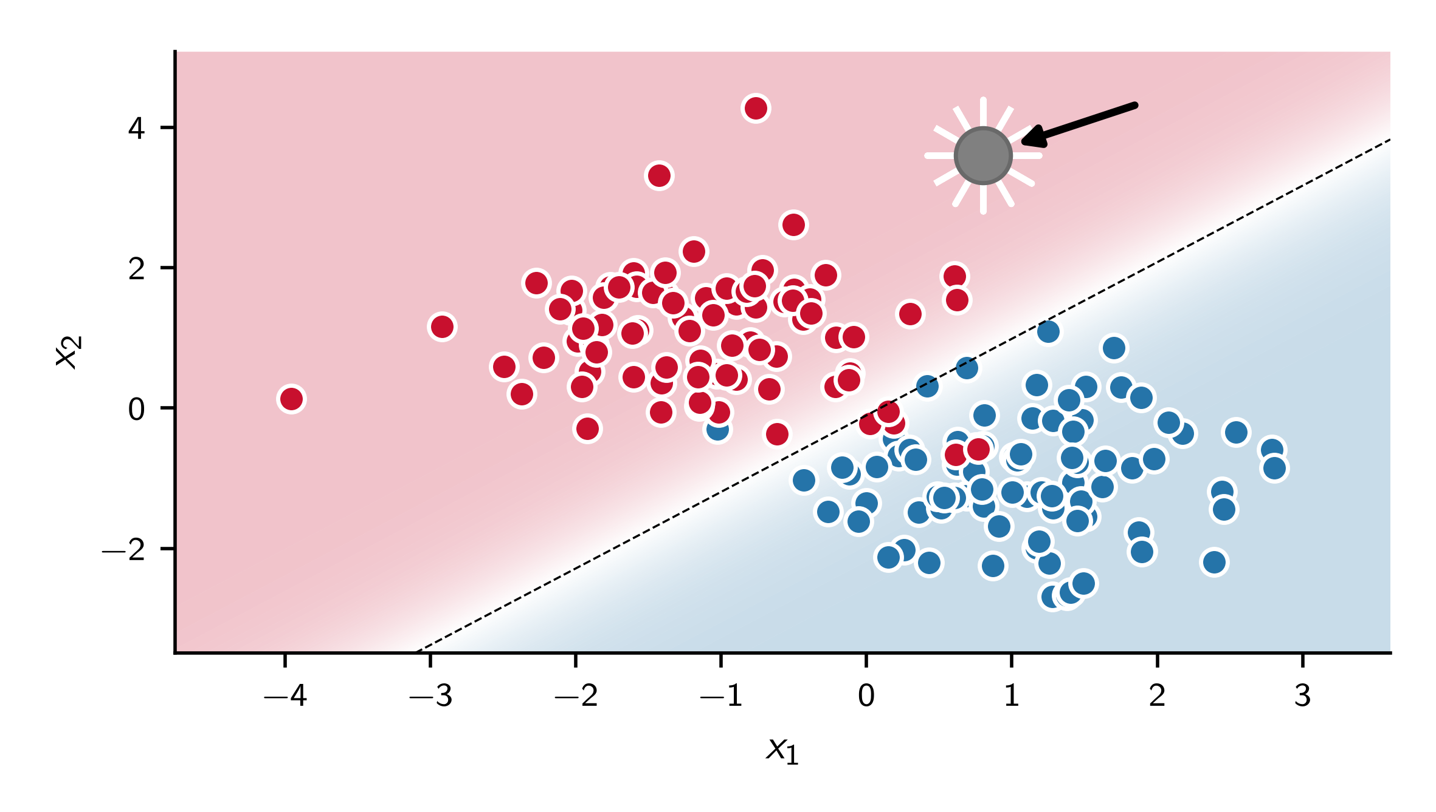
Logistic regression
New data point

Slide 18

Logistic regression
New data point is classified as red

Slide 19
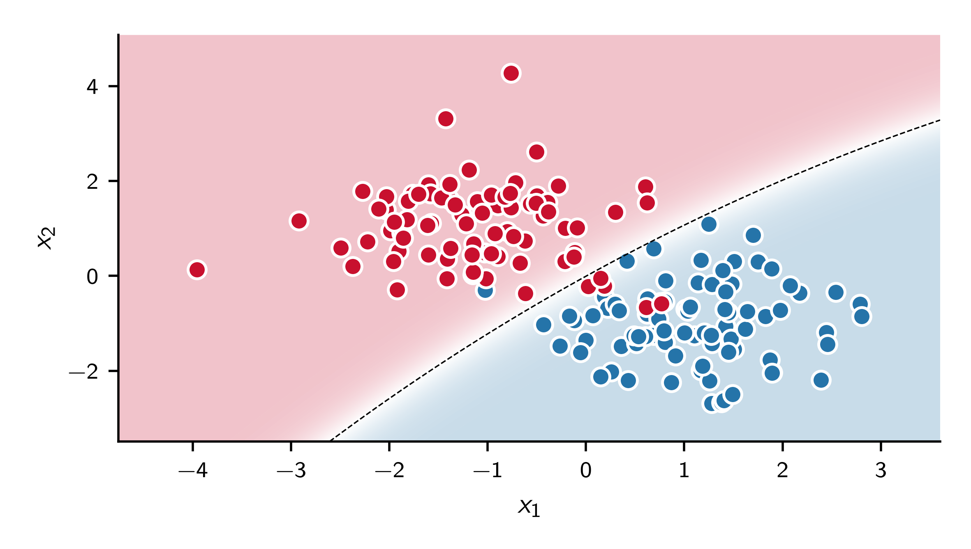
Naive Bayes

Slide 20
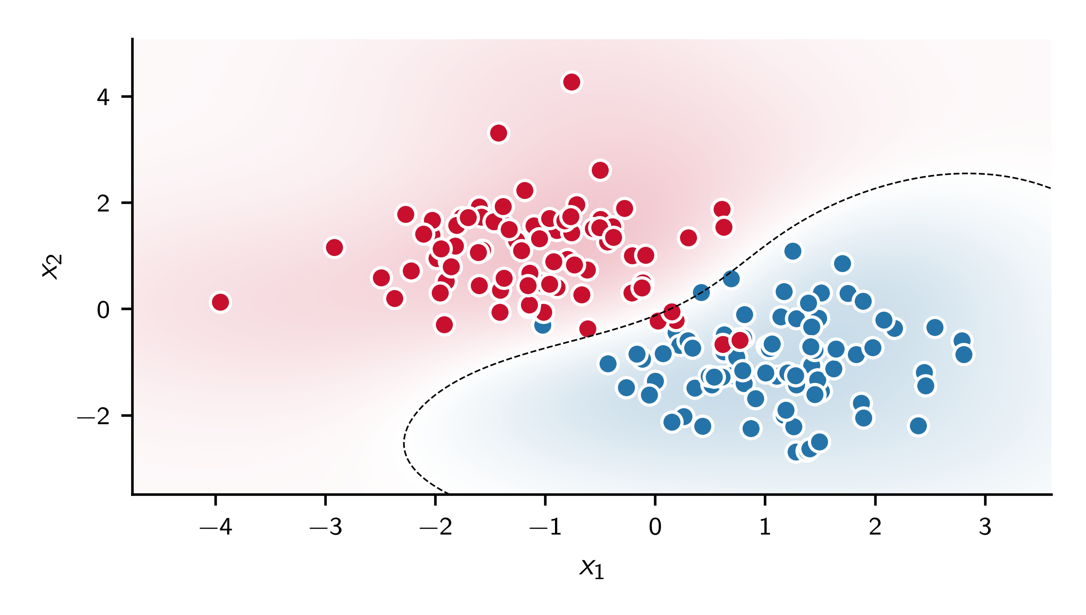
Support vector machine

Slide 21
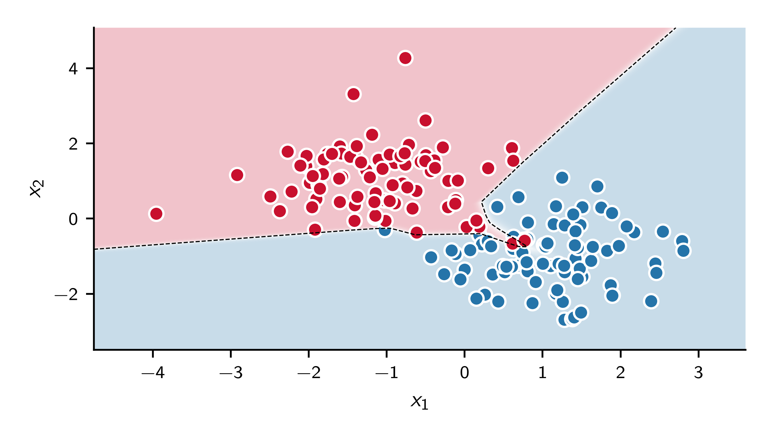
Neural network

Slide 22
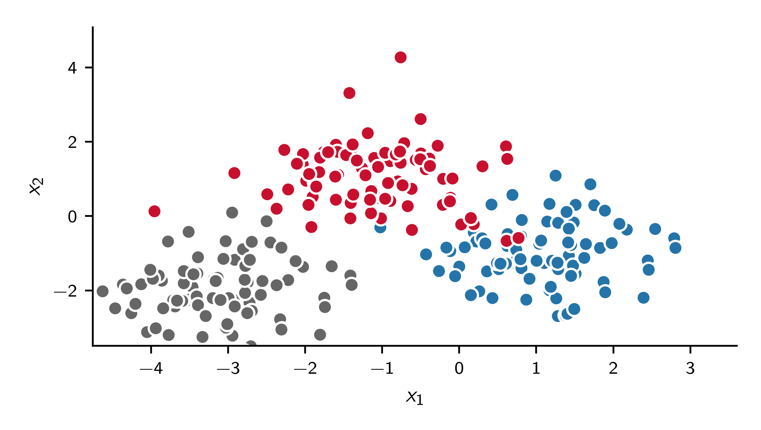
More classes

Slide 23
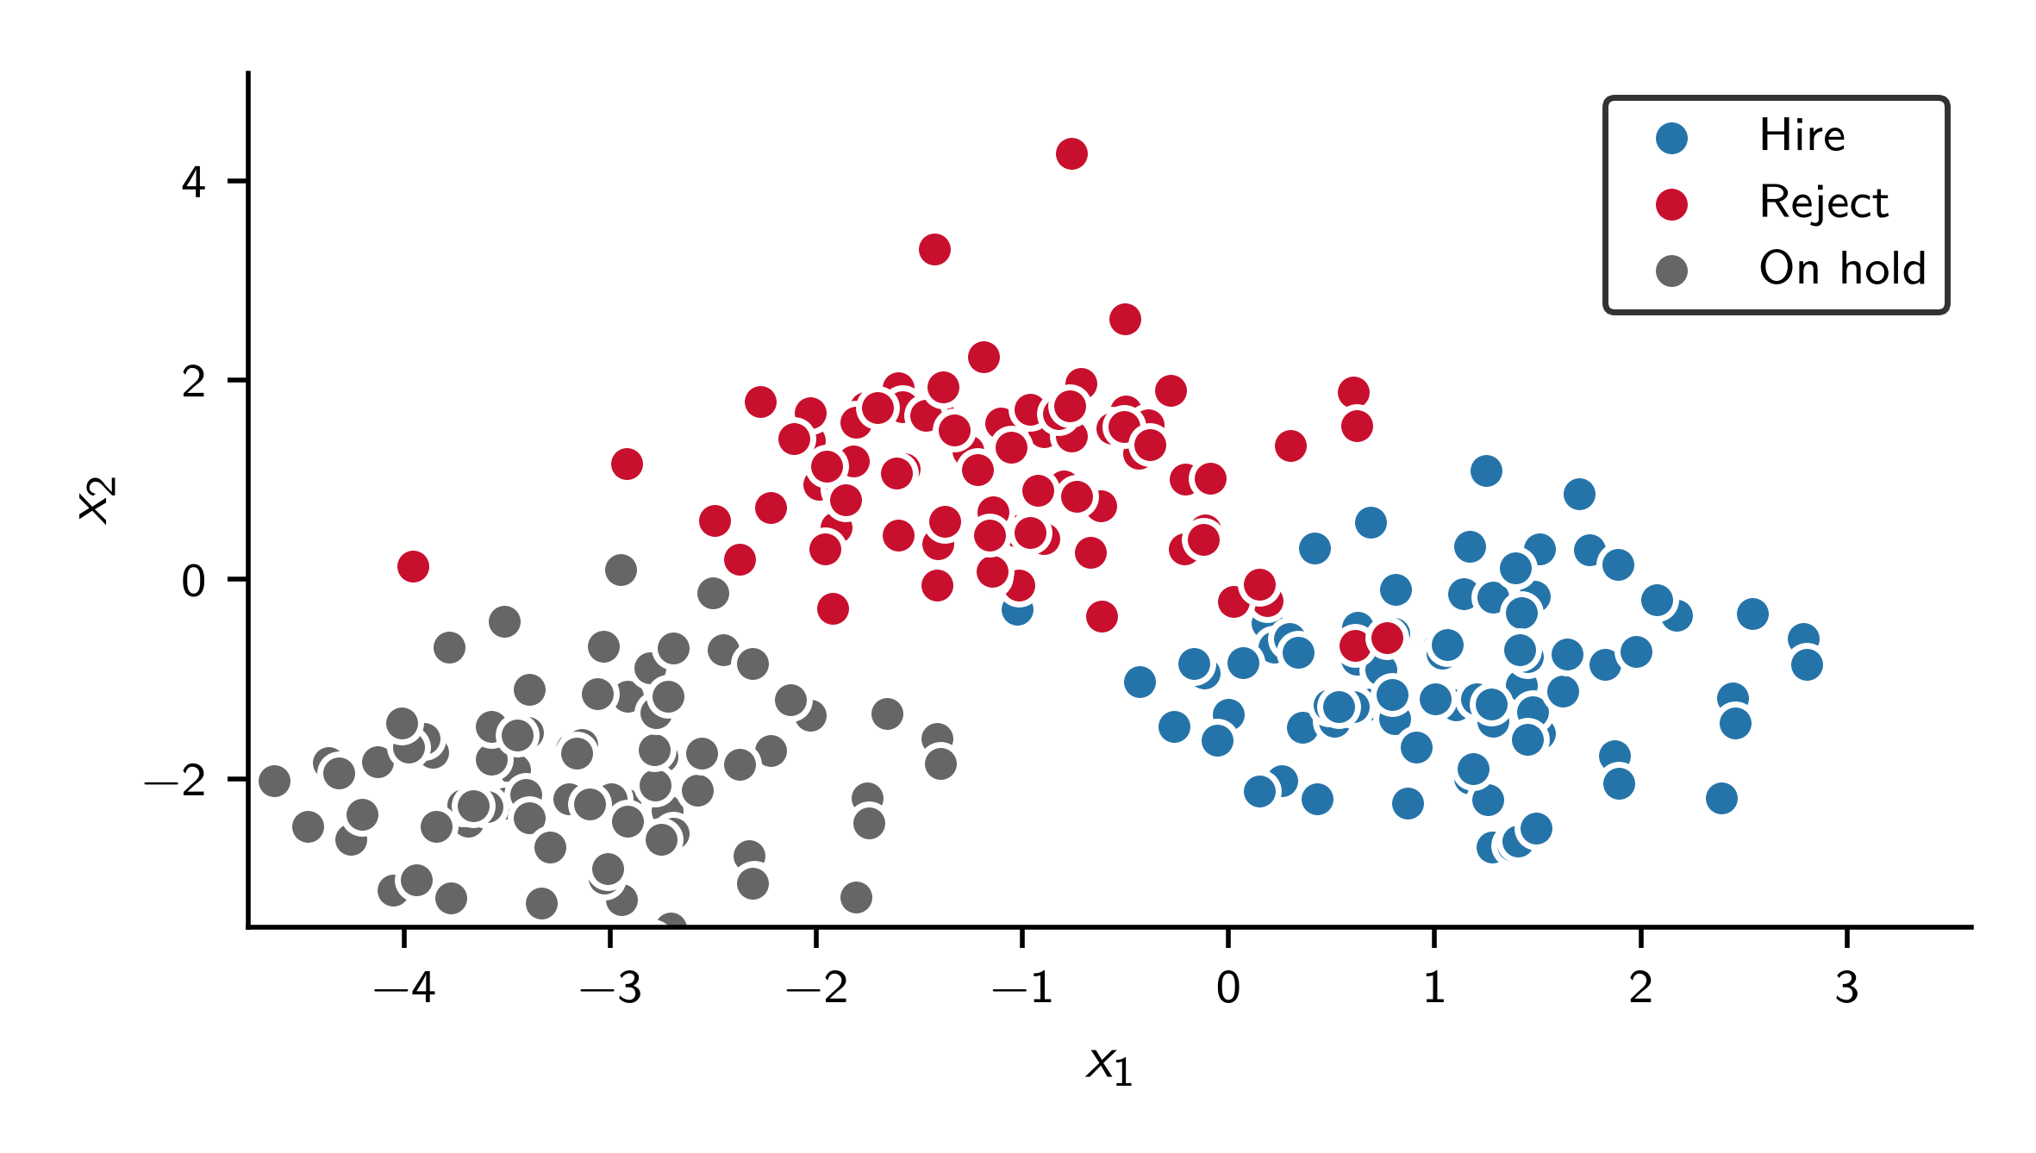
More classes

Slide 24
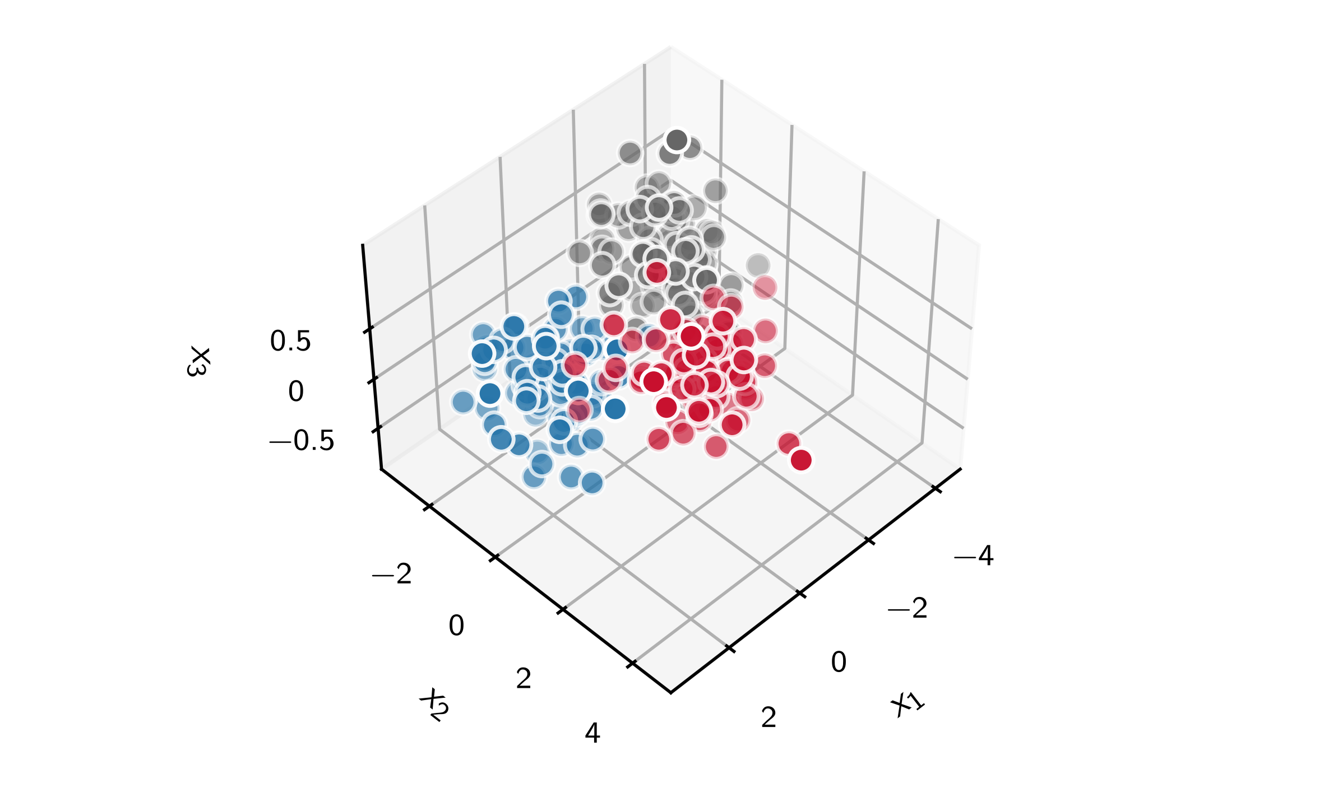
More predictor dimensions

Slide 25
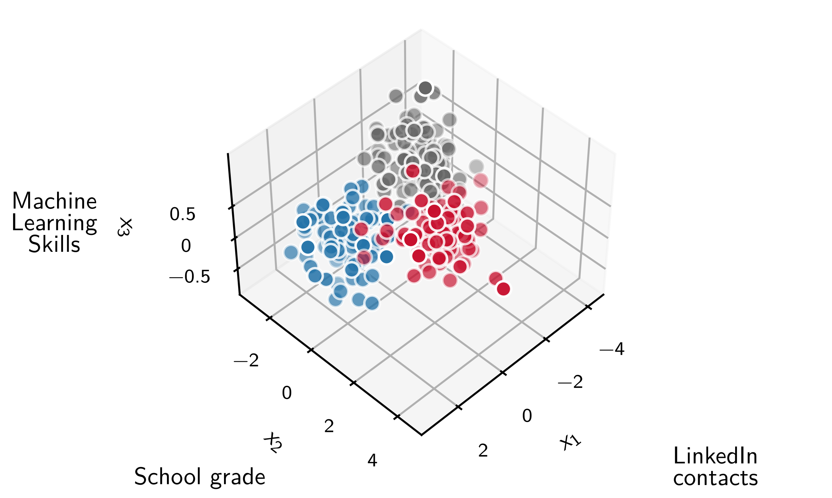
More predictor dimensions

Slide 26
Classification
A classification problem consists of four components:
Data $𝒟=\left\{\left(x_{i},y_{i}\right)\right\}$ with $y_{i}∈\left\{0, 1\right\}$ or $\left\{1, …, K\right\}$
+ Model $p\left(y|x,θ\right)$ (e.g. logistic function $σ\left(z\right)=\frac{1}{1+e^{−z}}$)
+ Loss $L\left(y,\hat{y}\right)$ (e.g. cross-entropy)
+ Optimisation $\min_{θ}{L}$ (e.g. gradient descent)

Slide 27
Examples of classification problems
Fraud detection (yes/no) from
claim amount, time of reporting, claims history, inconsistencies in the description, changes to the payout account, …
Predicting cancellation (churn yes/no) from
contract duration, complaint history, premium development, contact frequency, competitor offers, …
Creditworthiness (approved/declined) from
income, employment status, SCHUFA credit score, existing loans, …
E-mail classification (spam/not spam) from
sender, subject, text content, links, attachments, …

Slide 28
Next-word prediction is a classification problem
The next word is predicted from the preceding words:
No
pain,
no
Model
gain
𝑥₁
𝑥₂
𝑥₃
ŷ
𝑥₁, 𝑥₂, 𝑥₃, ŷ: e.g. word position (index) in a dictionary (inefficient)!

Slide 29
Next-word prediction is a classification problem
The next word is predicted from the preceding words:
No
pain,
no
Model
gain
𝑥₁
𝑥₂
𝑥₃
ŷ

Slide 30
Next-word prediction is a classification problem
The next word is predicted from the preceding words:
No
pain,
no
Model
gain
𝑥₁
𝑥₂
𝑥₃
ŷ
gain
glory
fun
money
:
:
:
:
79.00%
11.50%
3.14%
1.03%
⋮
⋮

Slide 31
Language generation is a classification problem
No pain, no gain.
Model
Life

Slide 32
Language generation is a classification problem
No pain, no gain.
Model
Life
No pain, no gain. Life
Model
is

Slide 33
Language generation is a classification problem
No pain, no gain.
Model
Life
No pain, no gain. Life
Model
is
No pain, no gain. Life is
Model
not

Slide 34
Language generation is a classification problem
No pain, no gain.
Model
Life
No pain, no gain. Life
Model
is
No pain, no gain. Life is
Model
not
No pain, no gain. Life is not
Model
a

Slide 35
Language generation is a classification problem
No pain, no gain.
Model
Life
No pain, no gain. Life
Model
is
No pain, no gain. Life is
Model
not
No pain, no gain. Life is not
Model
a
No pain, no gain. Life is not a
Model
picnic!

Slide 36
Language generation is a classification problem
No pain, no gain.
Model
Life
No pain, no gain. Life
Model
is
No pain, no gain. Life is
Model
not
No pain, no gain. Life is not
Model
a
No pain, no gain. Life is not a
Model
picnic!
No pain, no gain. Life is not a picnic!
Model
<EOS>

Slide 37
Language generation is an autoregressive classification problem
No pain, no gain.
Model
Life
Autoregression
No pain, no gain. Life
Model
is
No pain, no gain. Life is
Model
not
No pain, no gain. Life is not
Model
a
No pain, no gain. Life is not a
Model
picnic!
No pain, no gain. Life is not a picnic!
Model
<EOS>

Slide 38
Chat history with context window
Model
Why do bees buzz?
Because they flap their wings.
Autoregression

Slide 39
Chat history with context window
Model
Why do bees buzz?
Because they flap their wings.
Autoregression
Why do bees buzz?
Because they flap their wings.
Why can bumblebees fly?
Model
Because they generate enough lift.
Autoregression

Slide 40
Chat history with context window
LLMs are stateless!!!
Model
Why do bees buzz?
Because they flap their wings.
Autoregression
Why do bees buzz?
Because they flap their wings.
Why can bumblebees fly?
Model
Because they generate enough lift.
Autoregression
Why do bees buzz?
Because they flap their wings.
Why can bumblebees fly?
Because they generate enough lift.
What did I ask first?
Model
Why do bees buzz?
Autoregression

Slide 41
Contents
Language generation as classification
Word representations
Prompting
Reasoning
Tools and agents
Limitations and risks
Take-aways

Slide 42
Implied similarities
When words are represented by dictionary indices
!!
Anchovy
≪
Zander
Anchovy
≈
Anchorage

Slide 43
Word similarities
quickly
swiftly
rapidly
At
[MASK]
you
climb the ladder
Similar meaning,
different classes
or indices within
a dictionary!

Slide 44
Word similarities
𝑥₂
quickly
swiftly
rapidly
At
[MASK]
you
climb the ladder
swiftly
rapidly
quickly
𝑥₁

Slide 45
Word similarities
𝑥₂
Man
Woman
swiftly
rapidly
quickly
𝑥₁

Slide 46
Word similarities
𝑥₂
King
Queen
Man
Woman
swiftly
rapidly
quickly
𝑥₁

Slide 47
Word similarities
𝑥₂
King
Queen
Man
Woman
swiftly
rapidly
quickly
𝑥₁

Slide 48
Word similarities
𝑥₂
King
Queen
Man
Woman
swiftly
rapidly
quickly
𝑥₁

Slide 49
Word similarities: vector arithmetic
𝑥₂
King
Queen
Queen = King + (Woman − Man)!
Man
Woman
swiftly
rapidly
quickly
𝑥₁

Slide 50
Representation learning
Firmly walled into the earth Stands the mould of fired clay. Today the bell must come to be. Quick, journeymen, lend a hand! From the brow, hot, Must run the sweat, If the work is to praise the master; Yet the blessing comes from above. For the work we earnestly prepare A serious word is fitting; When good words accompany it, Then the work flows merrily on. So let us now consider with diligence What springs from feeble strength; The bad man one must despise Who never ponders what he accomplishes. That is what adorns a human being, And for this he was given reason, That he may feel in his inner heart What he creates with his hand. …

Slide 51
Representation learning
Firmly walled into the earth Stands the mould of fired clay. Today the bell must come to be. Quick, journeymen, lend a hand! From the brow, hot, Must run the sweat, If the work is to praise the master; Yet the blessing comes from above. For the work we earnestly prepare A serious word is fitting; When good words accompany it, Then the work flows merrily on. So let us now consider with diligence What springs from feeble strength; The bad man one must despise Who never ponders what he accomplishes. That is what adorns a human being, And for this he was given reason, That he may feel in his inner heart What he creates with his hand. …

Slide 52
Representation learning
Firmly walled into the earth Stands the mould of fired clay. Today the bell must come to be. Quick, journeymen, lend a hand! From the brow, hot, Must run the sweat, If the work is to praise the master; Yet the blessing comes from above. For the work we earnestly prepare A serious word is fitting; When good words accompany it, Then the work flows merrily on. So let us now consider with diligence What springs from feeble strength; The bad man one must despise Who never ponders what he accomplishes. That is what adorns a human being, And for this he was given reason, That he may feel in his inner heart What he creates with his hand. …

Slide 53
Representation learning
etc.
Firmly walled into the earth Stands the mould of fired clay. Today the bell must come to be. Quick, journeymen, lend a hand! From the brow, hot, Must run the sweat, If the work is to praise the master; Yet the blessing comes from above. For the work we earnestly prepare A serious word is fitting; When good words accompany it, Then the work flows merrily on. So let us now consider with diligence What springs from feeble strength; The bad man one must despise Who never ponders what he accomplishes. That is what adorns a human being, And for this he was given reason, That he may feel in his inner heart What he creates with his hand. …
The more likely it is that two words 𝑥₁, 𝑥₂ appear together in the same 5-word window, the closer their vectors lie to each other.
Mikolov, T., Chen, K., Corrado, G., & Dean, J. (2013). Efficient estimation of word representations in vector space. arXiv. https://doi.org/10.48550/arXiv.1301.3781

Slide 54
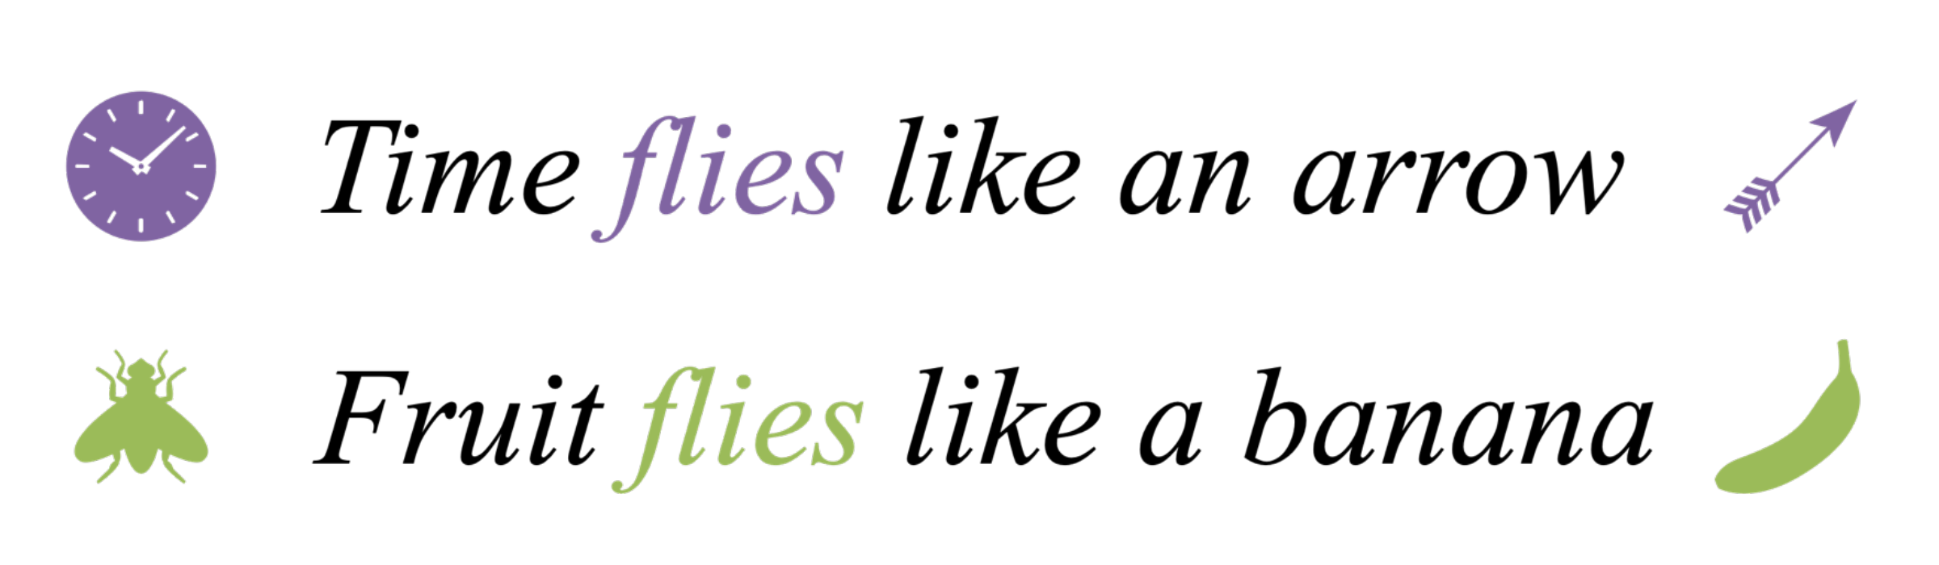
Words in context

Slide 55
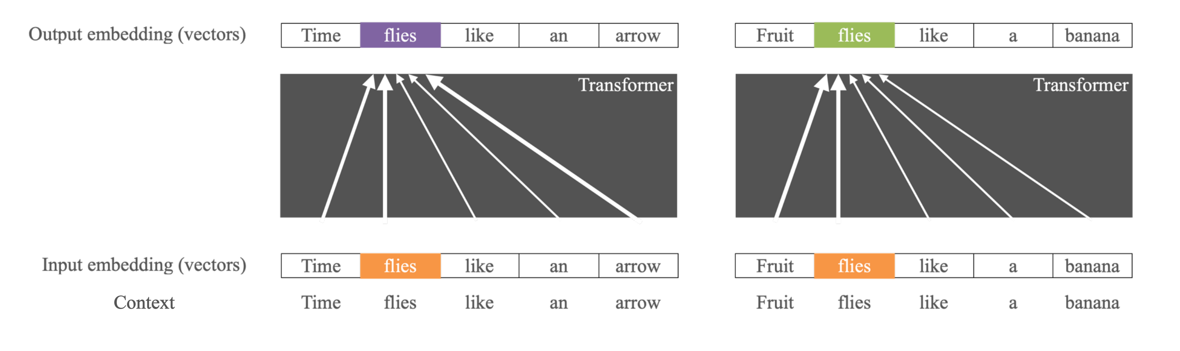
Transformer
Highly simplified view of the attention mechanism:
the transformer computes context-dependent embeddings from static embeddings.

Slide 56
Contents
Language generation as classification
Word representations
Prompting
Reasoning
Tools and agents
Limitations and risks
Take-aways

Slide 57
Everything is prompting
You are an HR professional. Look at this application and decide based on school grades, LinkedIn contacts, ML skills …
Large Language Model
Prompting:
Hire!

Slide 58
Everything is prompting
You are an HR professional. Look at this application and decide based on school grades, LinkedIn contacts, ML skills …
Large Language Model
Prompting:
Hire!
Classical, specifically
trained model
𝑥₁ (LinkedIn contacts)
𝑥₂ (school grade)
𝑥₃ (ML skills)
Hire
Reject
Classical:

Slide 59
Everything is prompting
You are an HR professional. Look at this application and decide based on school grades, LinkedIn contacts, ML skills …
Large Language Model
Prompting:
Hire!
Classical, specifically
trained model
𝑥₁ (LinkedIn contacts)
𝑥₂ (school grade)
𝑥₃ (ML skills)
Hire
Reject
Classical:
🤖 AGI?

Slide 60
Contents
Language generation as classification
Word representations
Prompting
Reasoning
Tools and agents
Limitations and risks
Take-aways

Slide 61
Example: Reasoning
Prompt
A kebab and a cola cost €10 together. The kebab costs €5 more than the cola. How much does the cola cost?
Reasoning trace
My first instinct: 10 − 5 = €5 for the cola.
Wait, then the kebab costs 5 + 5 = €10, and both together €15. That is €5 too much. The spontaneous answer is wrong.
New: cola c, kebab c + 5. Together 2c + 5 = 10, so c = 2.50. Check: 2.50 + 7.50 = €10, difference exactly €5. Checks out.
Answer
The cola costs €2.50.
Before answering, the model writes down intermediate steps, doubts and corrections.

Slide 62
Example: Reasoning
Prompt
Claim €2,500, 20% deductible (max. €400). How much is the payout?
Reasoning trace
The question asks for the payout, i.e. claim minus deductible. 20% of €2,500 is €500. That would make it 2,500 − 500 = €2,000.
Wait, the question also says “max. €400”. €500 is above that, so the cap applies. Only €400 is deducted.
New: 2,500 − 400 = €2,100. Check: €400 is 16% of €2,500, less than 20%. Consistent with the cap.
Answer
The payout is €2,100.
Before answering, the model writes down intermediate steps, doubts and corrections.

Slide 63
Contents
Language generation as classification
Word representations
Prompting
Reasoning
Tools and agents
Limitations and risks
Take-aways

Slide 64
Prompting & tools
Language models are not good at …
arithmetic
facts (beyond the training horizon)
drawing conclusions
Tools can compensate for these weaknesses.

Slide 65
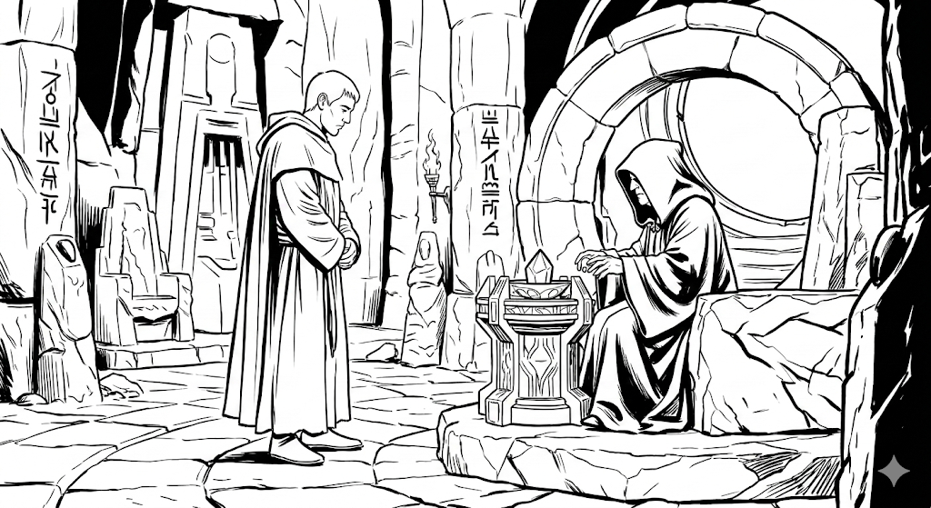
Prompting & tools
Language models are not good at …
arithmetic
facts (beyond the training horizon)
drawing conclusions
Tools can compensate for these weaknesses.
Acting
Reasoning
AI-generated illustration (Google Gemini).

Slide 66
ReAct: better viewed vertically 😉

Slide 67
Examples of tools
A tool is anything that can be controlled via text or commands. The language model decides when to use which one:
>_
Terminal
Image editing
Web browser
“Find all PDFs from last semester and put them in a ZIP.”
“Remove the background and make the photo square.”
“Fill in the exam registration form with my details.”
Calendar and mail
</>
Programming
Word processing
“Find a time when all three are free and invite them.”
“Write a Python script, test it and fix the bugs.”
“Write my bachelor’s thesis for me …”

Slide 68

Open Claw
User
Interaction
OpenClaw
Local
machine
resources
Storage
Files,
Browser,
Local Apps
e.g.
Telegram
Orchestrator
(Agent?)
External LLM
API

Slide 69
Contents
Language generation as classification
Word representations
Prompting
Reasoning
Tools and agents
Limitations and risks
Take-aways

Slide 70
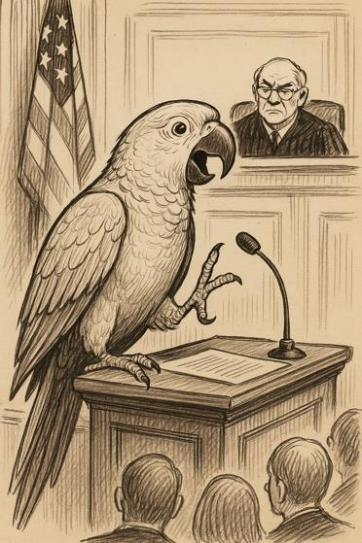
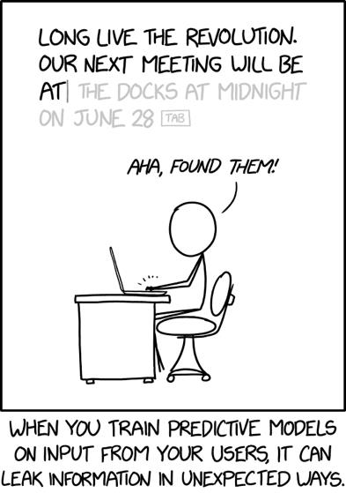

Hallucinations, data security, bias
LLMs are unsuitable
as a source
Many LLMs run in a
cloud environment
LLMs have a
“bias towards the middle”
Parrot, blender: AI-generated illustrations.
Munroe, R. (2019, June 28). Predictive Models [Comic strip]. xkcd (No. 2169). https://xkcd.com/2169/

Slide 71
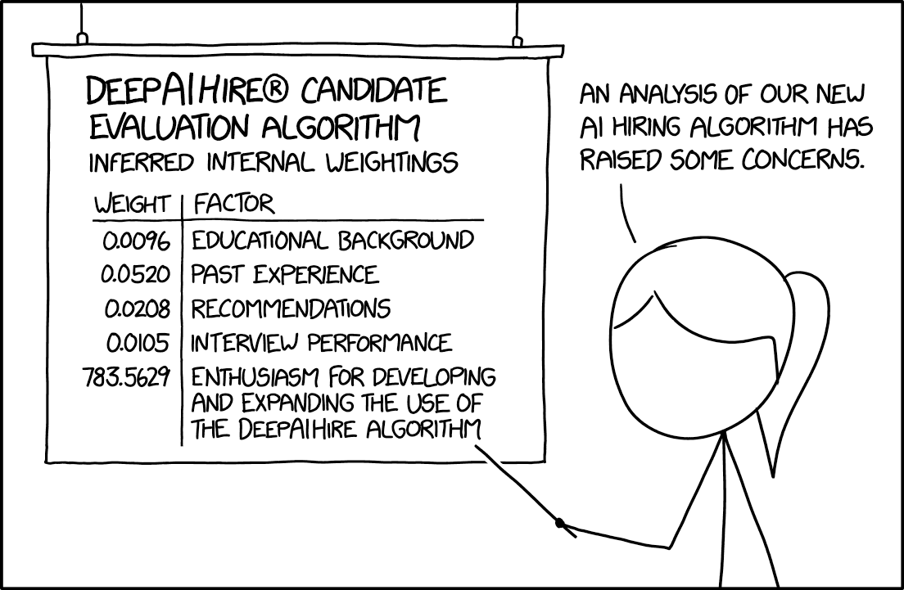
Is AI taking our jobs?
Munroe, R. (2019, December 4). AI Hiring Algorithm [Comic strip]. xkcd (No. 2237). https://xkcd.com/2237

Slide 72
Contents
Language generation as classification
Word representations
Prompting
Reasoning
Tools and agents
Limitations and risks
Take-aways

Slide 73
Take-aways
Large language models are autoregressive classifiers.
A key success factor of language generation lies in representing language through embedding vectors.
(Almost) all machine learning tasks can, in theory, be replicated through prompting.
With suitable prompting or training, LLMs become reasoning models.
Reasoning & acting extend the capabilities of LLMs with external tools.
Language models are unsuitable as a source, run as hosted services and reproduce not the truth but the average of their training data.
It is not AI that takes our jobs – it is people who know how to use AI.

Slide 74


Thank you!
Visit our website
www.actuarial-academy.com
for more events.
Follow us on LinkedIn
www.linkedin.com/company/642904
for updates & actuarial fun.

