Slide 1
Stellar Dynamics in Spiral Galaxies
Orbits · Phase Space · Chaos · Secular Evolution
45-minute lecture | 22 slides
Based on Binney & Tremaine, Galactic Dynamics (2nd ed.)
1 / 22

Slide 2
Outline
1. Hierarchical structure of the Universe
2. What is a galaxy? Main components
3. Galaxy classification – the Hubble fork
4. Orbits in spherical & axisymmetric potentials
5. Phase space – surfaces of section
6. Orbits in non-axisymmetric potentials
7. Action–angle variables and orbital tori
8. Adiabatic invariance of actions
9. Hamiltonian perturbation theory & KAM theorem
10. Poincaré sections – mixed phase space
11. Lyapunov exponents & frequency analysis
12. Summary and outlook
2 / 22

Slide 3
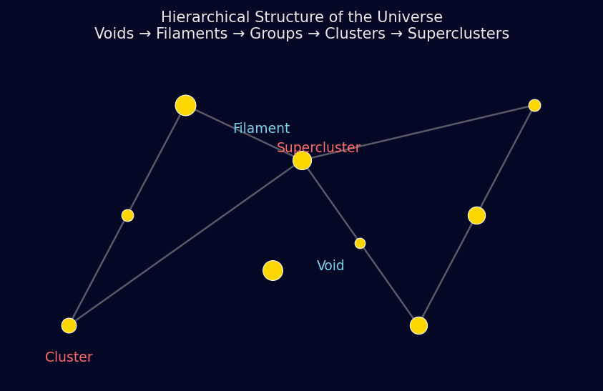
Hierarchical Structure of the Universe
From quantum fluctuations to the cosmic web
• Planets / Stars: 10⁻³ – 10³ AU
• Star clusters: 1 – 100 pc
• Galaxies: 1 – 100 kpc
• Galaxy groups: 1 – 3 Mpc
• Galaxy clusters: 1 – 10 Mpc
• Superclusters / Filaments: 10 – 100 Mpc
• Observable Universe: ~ 28 Gpc
•
• Dark matter drives structure growth
• ΛCDM: P(k) ∝ kⁿ·T²(k), n ≈ 0.96
3 / 22

Slide 4
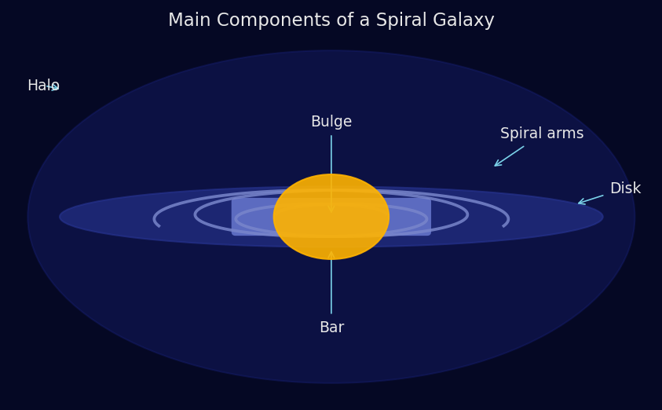
What is a Galaxy? Main Components
Bulge · Disk · Bar · Spiral Arms · Halo
• Disk: M_disk ~ 5×10¹⁰ M☉
• Exponential profile: Σ(R) = Σ₀ exp(-R/h_R)
• h_R ≈ 2–4 kpc (Milky Way: h_R ≈ 2.6 kpc)
•
• Bulge: r_eff ~ 1–2 kpc, Sérsic n≈4
•
• Bar: ℓ_bar ~ 3–5 kpc, pattern speed Ωₚ ~ 30–60 km/s/kpc
•
• DM Halo: M_halo ~ 10¹² M☉, r_vir ~ 200 kpc
• NFW profile: ρ(r) = ρ_s / [(r/r_s)(1+r/r_s)²]
•
• Total luminosity: L ~ 10⁹ – 10¹¹ L☉
• Typical T_eff (stars): 3,000 – 50,000 K
4 / 22

Slide 5
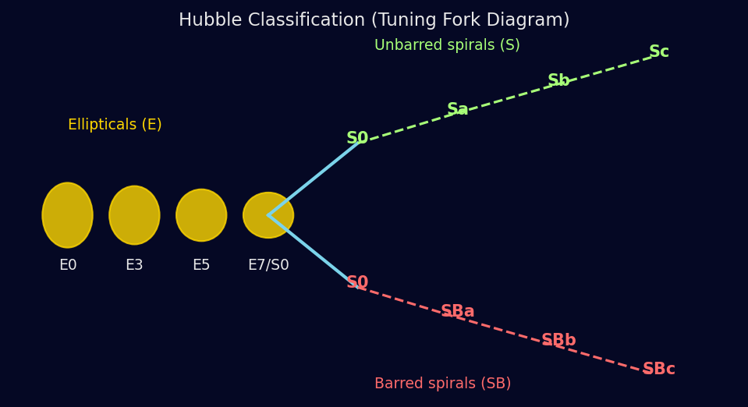
Galaxy Classification: The Hubble Tuning Fork
Morphological sequence from ellipticals to late spirals
• Ellipticals (E0–E7):
• Spheroidal, old red stars, little gas
• M_* up to ~ 10¹³ M☉ (cD giants)
•
• Lenticulars (S0):
• Disk without spiral arms
•
• Spirals (Sa→Sc / SBa→SBc):
• Increasing arm openness, gas fraction,
• and star formation rate along sequence
•
• Irregulars (Irr): disturbed, star-forming
•
• ★ de Vaucouleurs (1959) extended to RC3
5 / 22

Slide 6
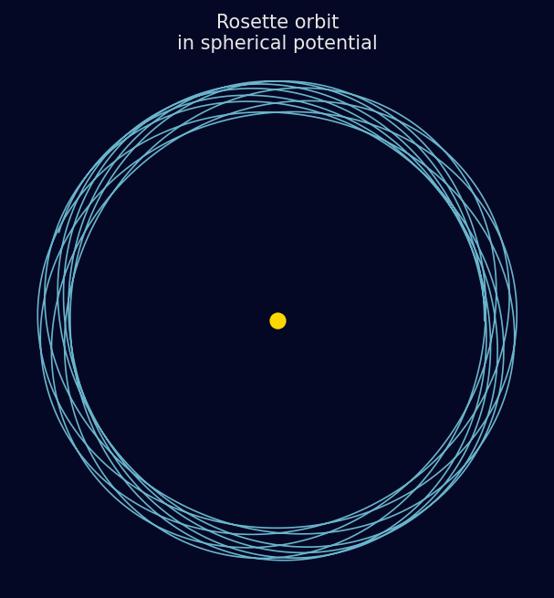
Orbits in Static Spherical Potentials
Conservation of energy E and angular momentum L
Effective potential: Φ_eff(r) = Φ(r) + L²/(2r²) Radial equation: r̈ = −dΦ_eff/dr Apsidal angle: Δφ = π ⟹ closed orbit Δφ ≠ π ⟹ rosette orbit
• Isochrone potential: all bound orbits are closed
• Logarithmic: V_c = const → flat rotation curve
• Φ(r) = V_c² ln(r) + const
• Hernquist/NFW: closed only for circular & radial
•
• Two integrals of motion: E, Lz (3rd may exist)
• Orbit families: loop, box (radial), tube
6 / 22

Slide 7
Orbits in Axisymmetric Potentials
Meridional plane, third integral, epicycle theory
Φ(R,z) ⟹ Integrals: E, Lz, (I₃ approximate) Meridional plane: R̈ = −∂Φ_eff/∂R, z̈ = −∂Φ/∂z Φ_eff(R,z) = Φ(R,z) + Lz²/(2R²) Epicycle approximation (R ≈ R_g + x, |x|≪R_g): ẍ = −κ²x, z̈ = −ν²z κ² = R dΩ²/dR + 4Ω² (epicycle freq.) ν² = ∂²Φ/∂z²|_z=0 (vertical freq.) For flat rotation curve: κ = √2 Ω
• Lindblad resonances:
• ILR: Ω − κ/m = Ωₚ
• OLR: Ω + κ/m = Ωₚ
• CR: Ω = Ωₚ (corotation)
•
• Stars near corotation trapped
• in horseshoe orbits
•
• 3rd integral I₃ ≈ action Jz
• (Stäckel potentials exact)
•
• ► Oort constants A, B
• A = −½(dv_c/dR)R
• B = −Ω − A
⚡ Animation: orbit in (R,z) meridional plane
7 / 22

Slide 8
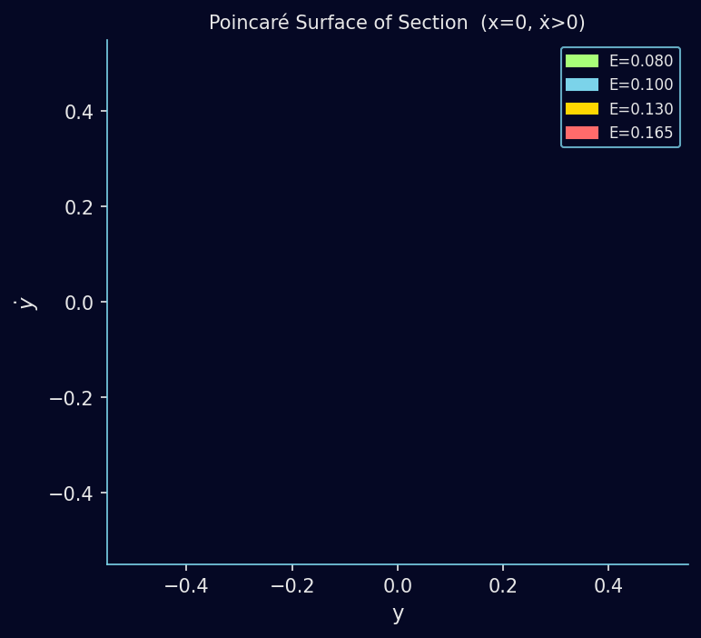
Phase Space and Surfaces of Section
Reducing dimensionality by 2 — Poincaré map
• 2-DOF Hamiltonian: 4D phase space
• Energy surface: 3D
• Poincaré section (x=0, ṗₓ>0): 2D map
•
• Regular orbits → closed curves (KAM tori)
• Resonant orbits → finite point sets
• Chaotic orbits → scattered points
•
• Example: Hénon–Heiles potential
• H = ½(px²+py²) + ½(x²+y²)
• + x²y − ⅓y³
•
• At low E: mostly regular
• At E → E_escape: mostly chaotic
•
• ★ Key diagnostic for galactic dynamics
8 / 22

Slide 9
Orbits in Non-Axisymmetric Potentials
Bars, triaxial ellipsoids, spiral perturbations
Rotating frame (pattern speed Ωₚ): H = ½|v|² + Φ(x,y) − Ωₚ Lz = EJ (Jacobi integral) Barred potential (bisymmetric): Φ_bar(R,φ) = Φ_0(R) + Φ_2(R) cos(2φ) Orbit families in a bar: x₁ – backbone, elongated along bar (stable) x₂, x₃ – perpendicular to bar x₄ – retrograde Spiral arms: transient density waves Lin–Shu dispersion relation: (ω−mΩ)² = κ² − 2πGΣ|k|
• Corotation radius R_CR:
• Ω(R_CR) = Ωₚ
•
• Bar resonances drive
• secular angular momentum
• exchange with halo
•
• Manifold theory:
• unstable manifolds of L₁, L₂
• trace spiral arms
•
• ⚡ Animation: x₁ family in
• rotating bar potential
9 / 22

Slide 10
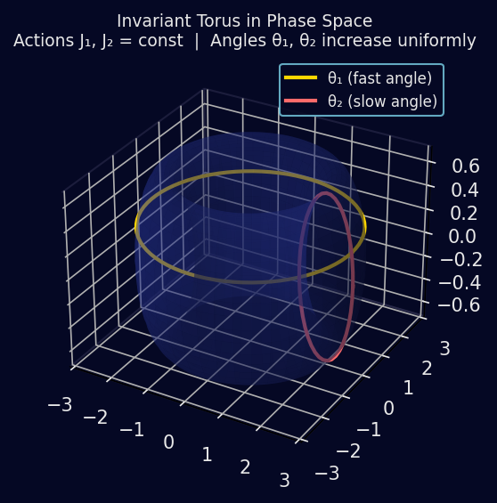
Action–Angle Variables & Orbital Tori
The natural coordinates for integrable systems
Actions (adiabatic invariants): Jᵢ = (1/2π) ∮ pᵢ dqᵢ Angles (conjugate variables): θ̇ᵢ = ∂H/∂Jᵢ = Ωᵢ(J) = const θᵢ(t) = θᵢ(0) + Ωᵢ t Torus T² = {(θ₁,θ₂) ∈ [0,2π)²} For axisymmetric disk: J = (Jr, Lz, Jz) Ω = (κ, Ω_φ, ν)
• Torus construction (McGill & Binney 1990)
• Stäckel fudge (Binney 2012)
• fast approximation for disk potentials
•
• Actions are constants of motion
• → label orbit families
• → natural basis for DFs
• f = f(Jr, Lz, Jz)
10 / 22

Slide 11
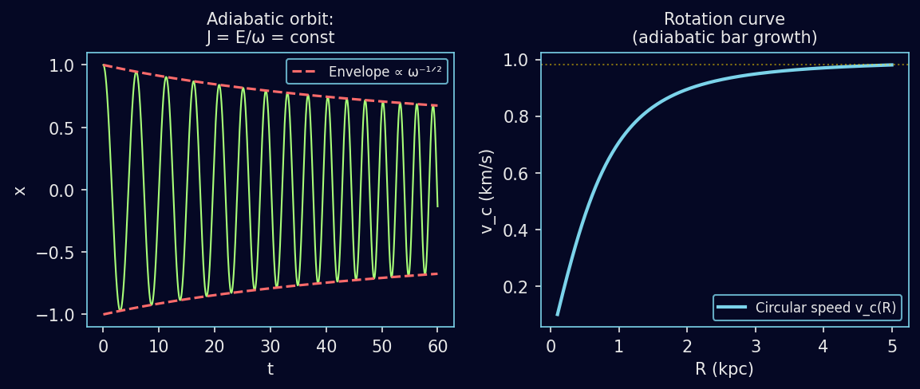
Slowly Varying Potentials & Adiabatic Invariance
Actions frozen when Φ changes on timescale τ ≫ T_orbit
Adiabatic invariant: J = ∮ p dq / (2π) = const Simple harmonic: J = E / ω → E ∝ ω as ω changes slowly Action change: ΔJ / J ~ exp(−ωτ) ≪ 1 (exponentially small)
• Eccentric orbits in a growing disk:
• Jz adiabatically frozen as disk mass increases
• → 'heating' by non-adiabatic perturbations required
•
• Transient spiral perturbation:
• If τ_spiral ≫ T_orbit: actions conserved → no net heating
• If τ_spiral ~ T_orbit: stochastic heating (resonance)
•
• Slow growth of a central black hole:
• MBH grows on Gyr timescale → Jr, Jz adiabatically conserved
• Orbits shrink: Ω_r, Ω_z ↑ while J = const
11 / 22

Slide 12
Hamiltonian Perturbation Theory
Canonical perturbation theory in action–angle coordinates
H(θ,J) = H₀(J) + εH₁(θ,J) Generating function S(θ,J') = θ·J' + εS₁(θ,J') + … New Hamiltonian: H'(J') = H₀(J') + ε⟨H₁⟩ + O(ε²) Resonance condition: n·Ω(J) = 0 (small divisor problem) Secular terms: ΔJ ∝ ε at resonance → libration islands
• Spiral arm perturbation:
• H₁ = −Φ_s(R) cos(mφ − ωt)
• Corotation resonance: most important
• ILR, OLR: wave reflection/transmission
•
• Bar perturbation (steady, m=2):
• n·Ω = 0 ↔ ℓκ + mΩφ = mΩₚ
• Resonances drive secular evolution
•
• Perturbation theory breaks down:
• when ε is not small, OR
• when resonances overlap (Chirikov)
•
• → KAM theorem gives conditions
• for persistence of tori
12 / 22

Slide 13
KAM Theory
Kolmogorov–Arnold–Moser: survival of invariant tori
KAM theorem (1954–1963): If H = H₀(J) + εH₁(θ,J), H₀ non-degenerate, and the frequency vector Ω(J) satisfies |n · Ω(J)| > γ / |n|^τ for all n ∈ ℤ^N\{0} (Diophantine condition, γ>0, τ>N−1) then for ε < ε_crit(γ,τ), the invariant torus survives.
• Most (positive-measure) tori survive small perturbations
• Resonant tori (n·Ω = 0) are destroyed → replaced by island chains + thin chaotic layers (Birkhoff–Poincaré)
• As ε increases, more tori break: Aubry–Mather theory (cantori)
• Last KAM torus at ε = ε_crit separates inner regular from outer chaotic region
• Nekhoroshev theorem: action diffusion exponentially slow for non-resonant orbits
• Galactic application: disk stars mostly on KAM tori; bar pushes orbits toward chaos
13 / 22

Slide 14
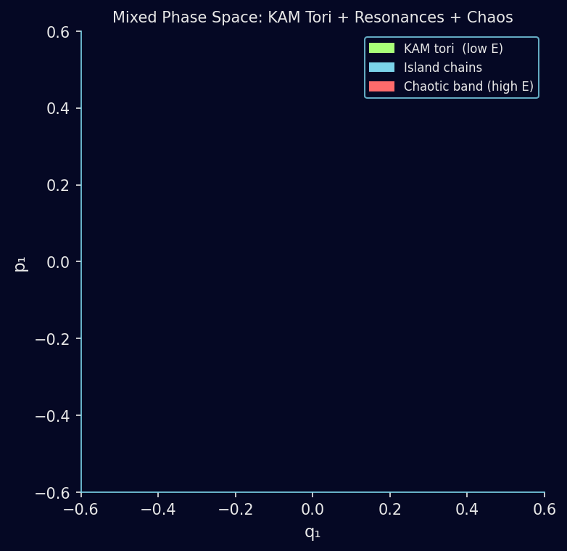
Poincaré Sections: Mixed Phase Space
KAM tori · Resonance islands · Chaotic layers
• As energy E → E_escape:
• Regular ↔ Resonance island chains ↔ Chaotic sea
•
• Island chains (Birkhoff chains):
• p:q resonance → p stable + p unstable fixed pts
• Each stable pt surrounded by sub-islands (self-similar)
•
• Chaotic bands:
• Thin near separatrices of resonances
• Merge at high E → large chaotic sea
•
• Arnold diffusion (N≥3 DOF):
• Slow drift along resonance web
• Timescale ~ exp(1/ε)
•
• Galaxy implications:
• Chaotic orbits → box-orbit heating
• → affect bar slow-down, disk thickening
14 / 22

Slide 15
Chaotic Orbits in Barred Galaxies
Sticky orbits, stochastic heating, and secular evolution
Jacobi energy: EJ = ½v² + Φ_eff − ΩₚLz = const (rotating frame) Zero-velocity curve: EJ = Φ_eff(R,φ) Lagrange points L₁, L₂, L₃, L₄, L₅ Orbits with EJ > Φ(L₁,₂) can escape bar region → 'Sticky' chaotic orbits linger near remnants of KAM tori
• Sticky orbits: chaotic but quasi-regular for ~ Gyr
• Mimic regular x₁ family → populate bar
•
• Bar slow-down via halo resonance:
• Trapped orbits exchange angular momentum
• dL/dt ∝ ∂f/∂E at resonance (Tremaine–Weinberg)
•
• SALI / GALI indicators (Skokos 2001, 2007):
• Quickly distinguish regular from chaotic
• SALI → 0 exponentially for chaotic orbits
• SALI → const > 0 for regular orbits
•
• N-body simulations confirm ~20% chaotic orbits in bar
15 / 22

Slide 16
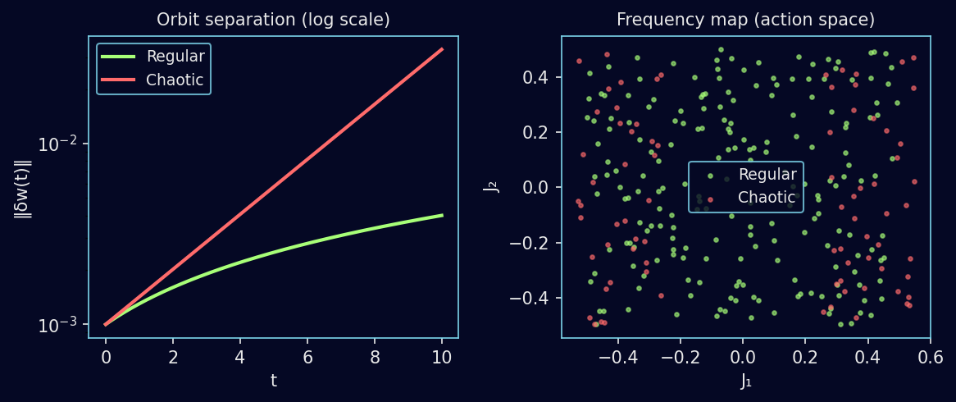
Lyapunov Exponents
Quantifying sensitivity to initial conditions
Maximal Lyapunov exponent (MLE): λ₁ = lim_{t→∞} (1/t) ln ‖δw(t)‖ / ‖δw(0)‖ Regular orbit: λ₁ = 0 (power-law divergence) Chaotic orbit: λ₁ > 0 (exponential divergence) Full spectrum: λ₁ ≥ λ₂ ≥ … ≥ λ_{2N} Σ λᵢ = 0 (Hamiltonian, Liouville)
• Numerical methods: tangent map integration alongside orbit
• Typical values: λ₁ ~ 0.1–1 Gyr⁻¹ for chaotic galactic orbits
• Lyapunov time: t_L = 1/λ₁ ~ 1–10 Gyr (comparable to Hubble time!)
16 / 22

Slide 17
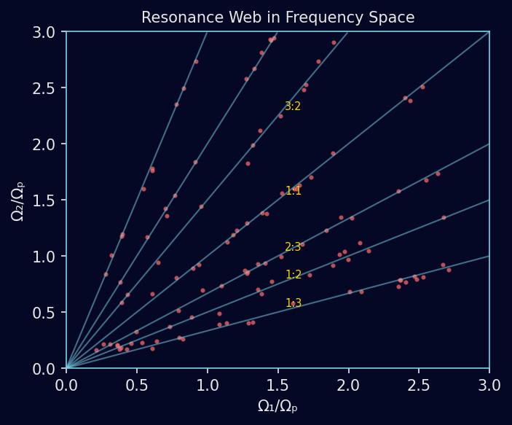
Frequency Analysis Methods
Laskar's NAFF, frequency maps, and the web of resonances
NAFF – Numerical Analysis of Fundamental Frequencies (Laskar 1990, 1993): From time series x(t), find dominant frequency ω₁ s.t. ∫₀ᵀ x(t) e^{−iω₁t} χ(t) dt is maximised Repeat on residual to get ω₂, ω₃, … Diffusion rate: σ = |Ω(t₁) − Ω(t₂)| / T → 0 for regular
• Frequency map: plot (Ω₁/Ωₚ, Ω₂/Ωₚ) for ensemble
• Regular orbits → sharp curves
• Chaotic orbits → diffuse scatter
•
• Identifies resonances as dense lines
• n₁Ω₁ + n₂Ω₂ + n₃Ωₚ = 0
•
• Applied to: triaxial ellipticals (Valluri),
• barred disk galaxies (Quillen, Minchev)
• N-body simulations (Voglis, Contopoulos)
17 / 22

Slide 18
Self-Consistent Models & Distribution Functions
Closing the loop: orbits ↔ potential ↔ density
Collisionless Boltzmann equation (CBE): ∂f/∂t + v·∇f − ∇Φ·∂f/∂v = 0 Jeans theorem: any function of integrals of motion solves CBE f = f(E, Lz, I₃) for axisymmetric system Self-consistency: ρ(x) = ∫ f dv³ → ∇²Φ = 4πGρ Action-based DFs: f = f(Jr, Lz, Jz) (Binney & McMillan 2011)
• Dehnen–Binney (1998): f(E, Lz) for disk + bulge + halo
• Posti et al. (2015): action DF for NFW halo
• Bovy et al. (2013): mono-abundance populations → disk DFs
•
• Jeans equations: ∂(ρ⟨vᵢvⱼ⟩)/∂xⱼ = −ρ ∂Φ/∂xᵢ
• Used in mass modelling (Gaia + spectroscopy)
•
• ★ Observable: proper motions (Gaia DR3), RVS radial velocities
• → test action-based DFs directly
18 / 22

Slide 19
Observational Diagnostics
Connecting theory to data: Gaia, APOGEE, IFU surveys
• Gaia DR3 (2022):
• 1.5 × 10⁹ stars with 5-6D phase space
• Reveals: moving groups, phase spirals,
• bar resonances in velocity space
•
• APOGEE / GALAH surveys:
• Chemical abundances → chemodynamical DF
•
• IFU spectroscopy (MaNGA, SAMI, MUSE):
• Velocity fields of external galaxies
• Bar pattern speeds via Tremaine–Weinberg method:
• Ωₚ sin i = ∫ Σ V dx / ∫ Σ x dx
• N-body + SPH simulations:
• GADGET-4, AREPO, AGORA
• Track orbit families over Gyr
•
• Frequency analysis of N-body:
• Identify resonance trapping
• Bar slow-down rate
•
• Chaos fraction vs galaxy type:
• Strongly barred → more chaos
• Merger remnants → triaxial, chaotic
•
• ★ Phase spiral (Antoja 2018):
• Incomplete phase-mixing → GMC/Sgr?
19 / 22

Slide 20
Open Questions & Current Frontiers
Where stellar dynamics meets cosmology
❯ 1. Origin of the Milky Way's long bar and its current pattern speed (~ 39 km/s/kpc)
❯ 2. Role of chaotic orbits in bar slow-down: N-body vs. secular theory
❯ 3. Dark matter substructure: granular potential fluctuations → heating & diffusion
❯ 4. Phase-space spirals (Gaia): quantifying timescale of perturbation
❯ 5. Action diffusion across resonances: Fokker–Planck approach
❯ 6. Torus construction beyond integrable backgrounds (angle maps in N-body)
❯ 7. Machine-learning orbit classification (Neural network surrogates for NAFF)
❯ 8. Connecting stellar dynamics to chemical evolution (chemodynamical torus models)
❯ 9. Stellar streams as dynamical tracers of the DM halo shape
❯ 10. Relativistic corrections near the central black hole: post-Newtonian dynamics
20 / 22

Slide 21
Summary
Key take-home messages
• Galaxies are hierarchical structures: bulge, disk, bar, halo each with distinct dynamics
• Orbits in integrable potentials are confined to invariant tori characterised by actions J
• Action–angle variables are the natural language for Hamiltonian dynamics in galaxies
• Adiabatic invariance: slowly-evolving potentials preserve actions → secular evolution
• KAM theorem: most invariant tori survive small perturbations; resonant ones break
• Poincaré sections reveal the mixed phase space: regular islands ↔ chaotic sea
• Lyapunov exponents and frequency analysis quantify and classify orbital chaos
• Gaia + IFU surveys provide unprecedented tests of theoretical orbit models
Recommended reading: • Binney & Tremaine, Galactic Dynamics (2008) • Contopoulos, Order and Chaos in Dynamical Astronomy (2002) • Laskar, Icarus 88 (1990) • Skokos, Lecture Notes in Physics 790 (2010)
21 / 22

Slide 22
Thank You
Questions & Discussion
"The most beautiful thing we can experience is the mysterious. It is the source of all true art and science." — Albert Einstein
22 / 22

