Slide 1

Predicting Employee Attrition Using Data Science for Frito-Lay DDSAnalytics Katrina Tompkins 6/30/2024

Slide 2
Project analysis slide 2
Introduction
What is DDSAnalytics?
Focused vision of visualizing and analyzing data by way of data science
Specialize in talent management solutions for Fortune 100 companies.
Maintain a stable and engaged workforce
Project objectives
Leveraging data science to predict employee turnover
Identify the top three factors that contribute to turnover
Learn about any job role specific trends that may exist in the provided data set
Assumptions of the analysis project
Provided employee data set of total 69000 at Frito Lay in North America
Attrition and turnover are used interchangeably in this dataset

Slide 3
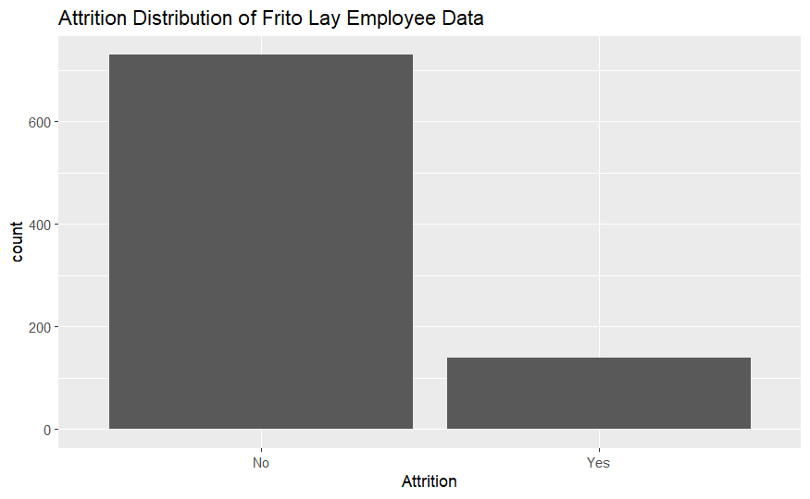
Project analysis slide 2
Employee Attrition Distribution
General rule of thumb for attrition distribution is less than 10%
For provided dataset of 870 Frito-Lay employees is 19.2%
730
140

Slide 4
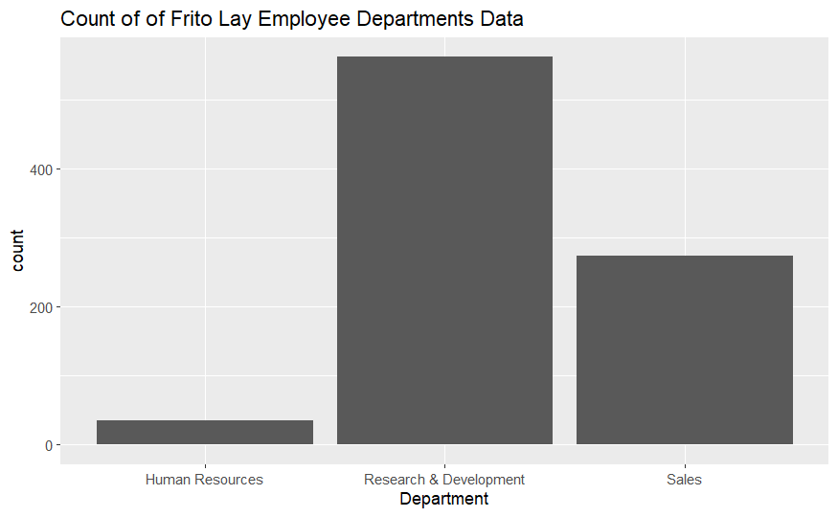
Project analysis slide 2
Dataset Overview
36 Features/variables
Attrition
0 = No
1 = Yes
Job Satisfaction
1 – Low
2 – Medium
3 – High
4 - Very High
Data preprocessing steps
Handling missing values
Scaling numerical features
Top 3 contributing factors by department

Slide 5
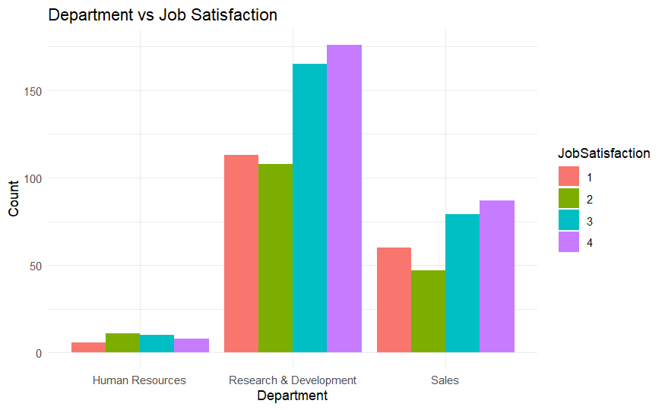
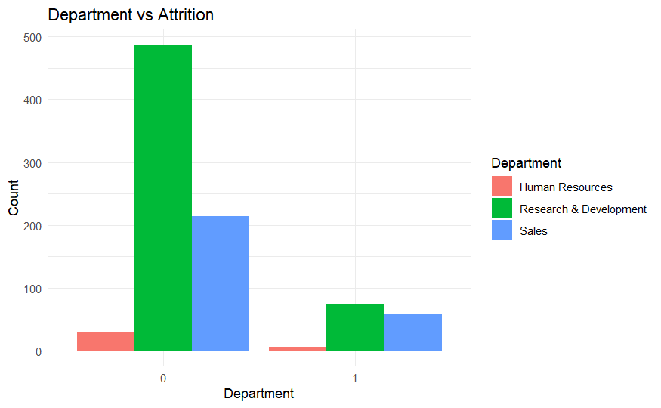
Project analysis slide 2
Trend Analysis
Significant trends
High attrition in Research and Development and Sales Departments
Job Satisfaction
1 – Low
2 – Medium
3 – High
4 - Very High
Attrition
0 = No
1 = Yes

Slide 6
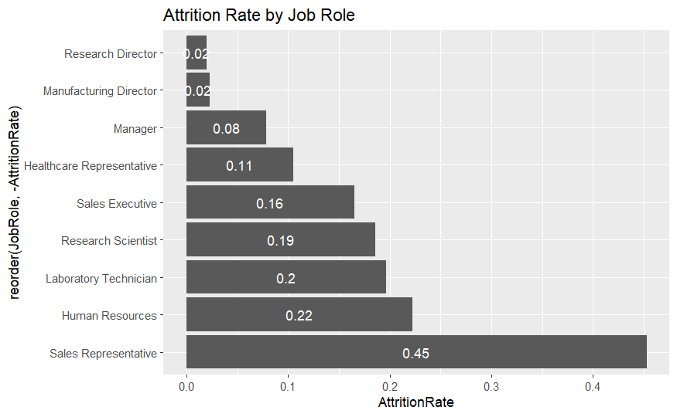
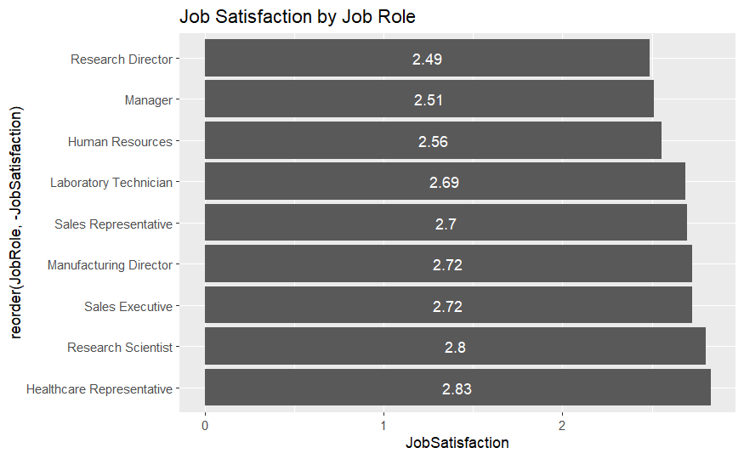
Project analysis slide 2
Trend Analysis
Significant trends
Correlation between job satisfaction and attrition
Job Satisfaction
1 – Low
2 – Medium
3 – High
4 - Very High
Sales Representative job role contained highest (45%) attrition rate in the sales department
Human resources role contained 22% attrition rate

Slide 7
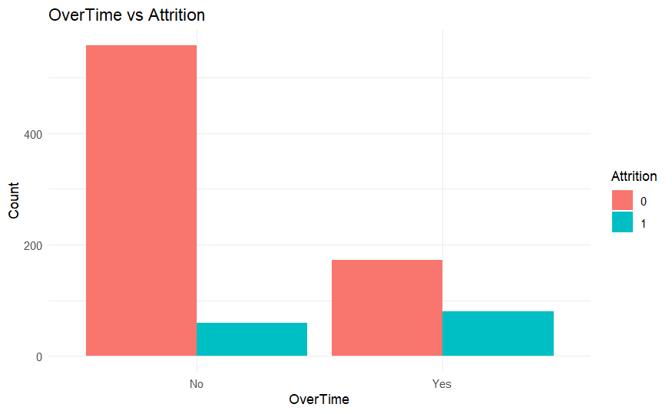
Project analysis slide 2
Overtime vs Attrition
Based on the provided dataset of 870 employees the attrition count for both hourly and salaried employees were significantly low. Based on the low count, one could assume that attrition is not a significant factor for salaried versus hourly employees
Overtime
Yes = Hourly
No = Salary
Attrition
0 = No
1 = Yes

Slide 8
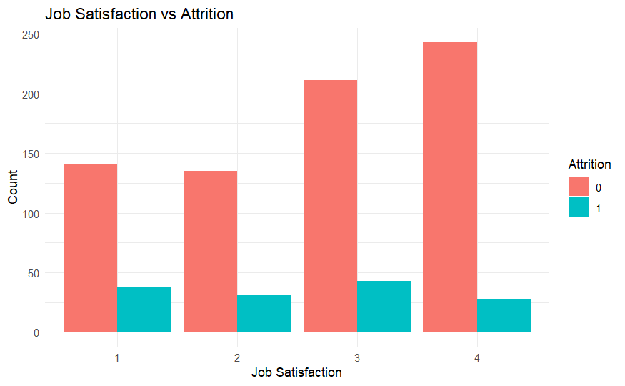
Project analysis slide 2
Prediction Analysis

Slide 9
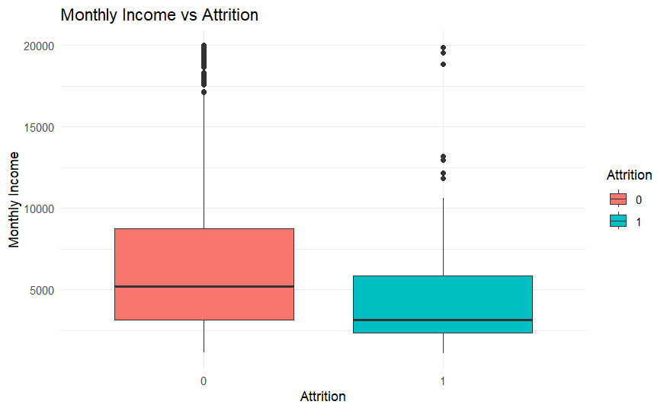
Project analysis slide 2
Monthly Income vs Attrition
Lower monthly income for employees with attrition below $5000
Attrition
0 = No
1 = Yes

Slide 10
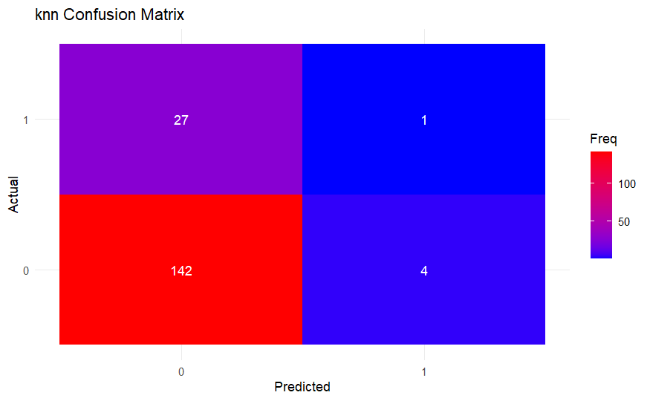
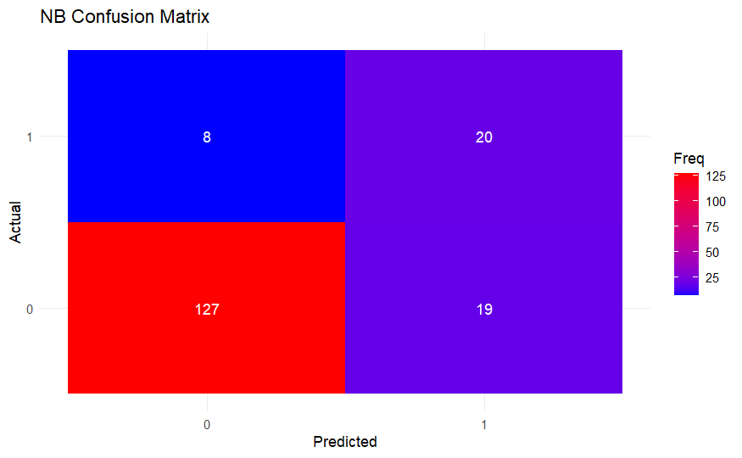
Project analysis slide 2
Predictive Model Analysis using k-nn and NB
Accuracy : 0.8218 for 7 Nearest Neighbors
Sensitivity : 0.8699
Specificity : 0.7143
Accuracy : 0.8448
Sensitivity : 0.97260
Specificity : 0.03571
Although the NB accuracy and sensitivity was higher than K-nn accuracy, the combined frequency of this k-NN predictive model for attrition provided a better accuracy to identify the presence of an actual deficit, condition, or disorder—a true positive result and to identify the absence of an actual deficit, condition, or disorder—a true negative result.

Slide 11
Project analysis slide 2
Conclusion and Recommendations
Summary of key findings.
All analysis and conclusions in the Project are circumstantial and confined to only the provided data.
Job Satisfaction has no significant impacts on attrition
Hourly versus salaried positions did not seem to have any impact on the attrition rate
Top 3 factors contributors to attrition
Research & Development (R&D), Sales and Human Resources departments
Job Role
Monthly Income
Recommendations for Frito Lay:
Deep dive analysis into top contributors
Next steps:
Implement/Review the predictive model in the HR process, further data collection and analysis
Segmentation
Time Period
Statistical Power

Slide 12
Thank You

