Slide 1
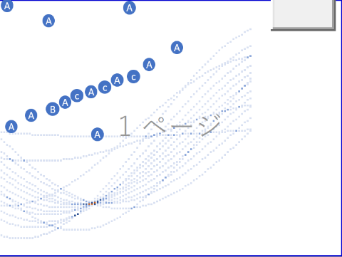







$$θ_{1}$$
$$θ_{2}$$
仮想の直線2
$$ρ_{1}$$
$$ρ_{2}$$
仮想の直線1
$$θ_{2}$$
$$θ_{2}$$
$$ρ_{2}$$
(x, y)

