Slide 1
GDD for GWJ67 - Parasite
I'm gona try using this as a GDD.
Hopefully I'll actually use a GDD this time, rather than creating it at the start and winging it afterwards.

Slide 2
The theme
The theme is "Parasite" - the axioms of this theme are as follows:
There needs to be one or more entities that infest something in the game.
The player plays the role of the parasite OR the parasite is the primary antagonist
So far I'm leaning towards the player acting as a defender of a space ship or base that is attacked by infested enemies.

Slide 3
Game idea
After talking with my brother I've decided to go with something akin to Papers Please.
The player takes the role of a cargo hold inspector on a space ship that makes regular trips between space stations.
There are multiple containers (barrels, crates, etc.) with stuff.
The player needs to use tools to detect if cargo is infested.
There are tools that purify or destroy cargo.

Slide 4
Game idea
Each mission has a time limit defined by the amount of time it takes for the cargo ship to arrive at it's destination.
Cargo destroyed or damaged in transit lowers the players pay out (and might trigger a sudden death if the player does enough damage).
Infested cargo will start showing visible symptoms and spreading after some time.

Slide 5
Game vibe
What story would I like to tell with this game?
Goofy comedy. Drag stuff into stuff to do things.
Everything might be infested. Constant fear and paranoia.
In space, space travel, space ship.

Slide 6
Game vibe
Rather than designing a game up-front and creating a detailed plan I would like to focus on 2 things:
Making things that are self-contained
Focus on how I want the player to feel while playing the game - design around how the player experiences the game, one step at a time

Slide 7
World building questions
Why cargo is checked in transport?
It's a shady operation and it's faster this way.
Why player needs to perform mini-games?
Machines on ship are of poor quality and brake often.
Why not burn all cargo just in case?
Player gets cash depending on how much cargo reaches it's destination - regardless of infestation.

Slide 8
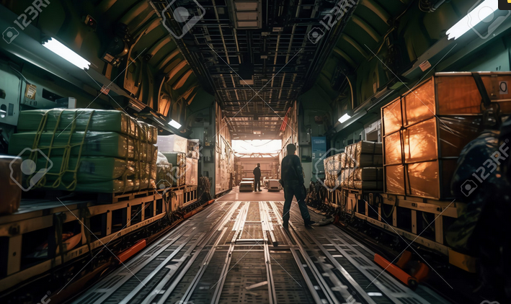
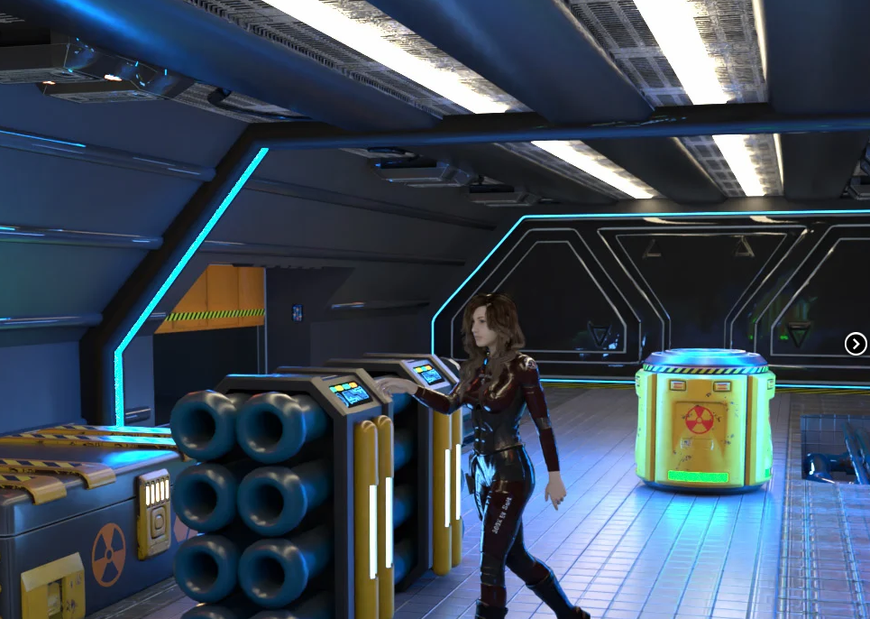
Where the game takes place
On the cargo hold of an old and shoddy space ship

Slide 9
What I want to make?
These are the things I would like to give a shot in this game jam:
Low poly stuff with pixel art textures
2D Shader VFX
Mini games
Static camera with multiple rooms
Voice acting

Slide 10
Voice acting
I see myself as a narrator that speaks to the player.
Primarily as someone telling the player what to do - so either the ship captain or a taskmaster supervising the player.
Probably a greedy alien that speaks down to the player who is a new hire.

Slide 11
Mini games
What is their purpose?
Time wasters - player has limited time and mini games cost time.
They work as an additional skill check.
Brakes game peace.

Slide 12
Machine ideas
Biodetector - scans things to detect if there is life inside. Early in game if thing is marked as dead stuff and has parasites it will be detected. Later contraband might have live things but bee marked as dead stuff.
Airlock - for dumping stuff into space.
Incinerator - destroys delicate bio stuff but dead stuff is only burnt.
Radiation hold - uses radiation to kill parasites. Unlocked much later?

Slide 13
Machine ideas
Light switch – parasites hide in light, so player can turn off light so that they show up
Elevator – moves stuff up or down, player operated

Slide 14
Game loop
Info screen showing what’s in the cargo hold
Screen goes to cargo hold with a progress bar showing time to arrival
Player can now interact with stuff (move, press, toss, etc.)
Progress bar slowly loads
Player can skip to arrival
Once progress bar is loaded game switches to result screen showing if player won / lost

Slide 15
Level description
1 - Player gets a welcome and is instructed to scan a small cargo of rocks for bio-signs. There are no parasites. Welcome screen has a solo scanning segment.
2 - There is more stuff in cargo. One container is infested. Welcome screen has a solo air-lock segment.
3 - A lower cargo level is unlocked, and an elevator shows up. Welcome screen explains elevator.

Slide 16
Level design
4 - Mid transit lights go out and stuff gets sent flying, making it hard to keep track of things.
5 - Incinerator is introduced as alternative to air lock. Different types of cargo are presented.

