Slide 1
Level Design
What I made for the Jam
What I don't like about it
What I would like to have

Slide 2
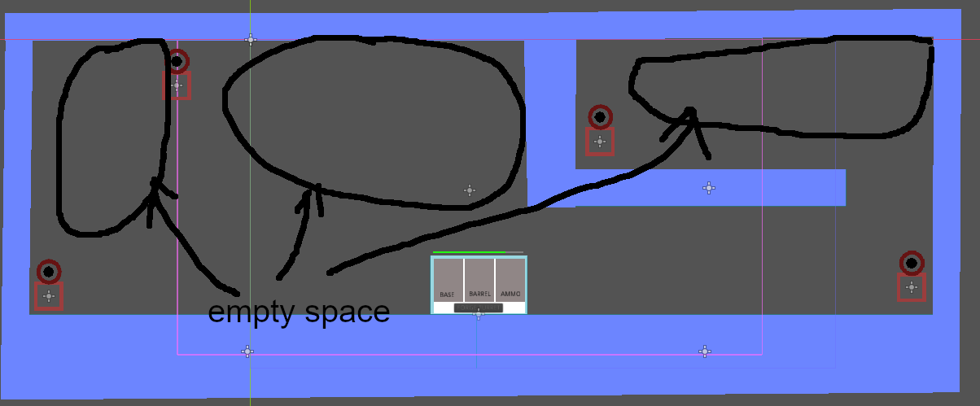
What I made for the Jam
A single basic level with loads of unused space
Enemies moved from a variety of spawn points to the center
Enemies moved along predetermined paths
Level too big to fit on screen created a need for a moving camera

Slide 3
What I don't like about it
Turrets with 360 degree aim in a side-view 2D game (looks ugly and adds loads of complexity from targeting)
Simple paths from spawn to target

Slide 4
What I would like to have
Multiple targets for enemies to attack - but in a way that is predictable / telegraphed to the player

