Slide 1
Title: TBD
An HMI themed point-and-click game

Slide 2
Original goals
This was meant to be a submission for Godot Wild Jam 71
The theme was: Unintended Consequences
I wanted to make a simple point-and-click game that takes place in an unspecified factory and looks authentic
The game would throw various obstacles and challenges towards the player
The player gets a variety of buttons / switches / items that once used progress the story forward - but often create new problems
Create multiple branching paths that the story can follow
Also create multiple endings - each one the result of some kind of critical failure caused by the player

Slide 3
Key parts
Pop up windows - the game takes place in a variety of sub-screens
Text Terminal - the main window, sends updates, prompts player into moving the story forward
"Rough" interface with an authentic factory look
Dragging and dropping things - like access cards or tools
Loads of buttons to press and flick

Slide 4
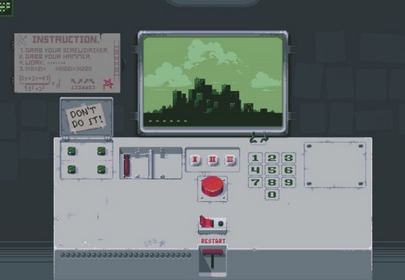
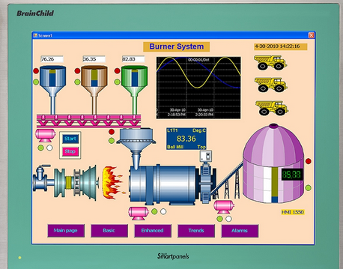
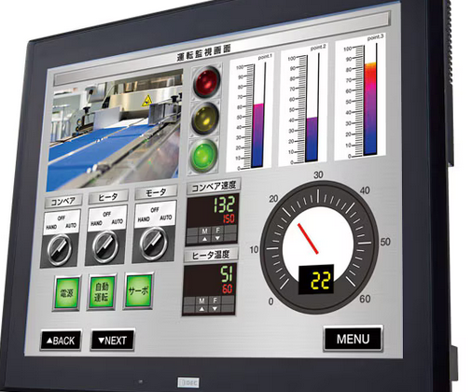
Inspiration
Please, Don't Touch Anything
Human Machine Interface (HMI) style terminals

Slide 5
Game sections
Hard reset - introduces basic

Slide 6
Hard reset
A terminal shows up on screen and starts printing various boot related messages.
An empty inventory window is introduced
Player is notified that a hard reset is necessary
The emergency reset window shows up with a button and a removable card
Once the reset is complete and the card removed and placed in inventory the emergency reset window disappears
Emergency power generator is now back online

