Slide 1
Post GWJ 77 assessment
Goals:
Go through feedback
Make a list of features I liked in other games
Make a list of features I added to my game
What features I didn't add - but wanted to

Slide 2

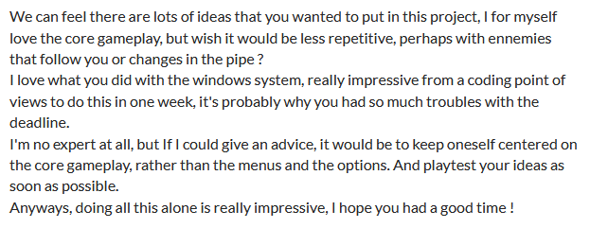
Jam feedback
Trippy exploration vibes - ok
Reminiscent of
Cruelty Squad - don't like this :S
Gameplay wasn't great - agree
Windows XP / dream core style - kinda what I was going for
Core gameplay feels repetitive - agree
Suggested enemies - not a fan of that idea

Slide 3
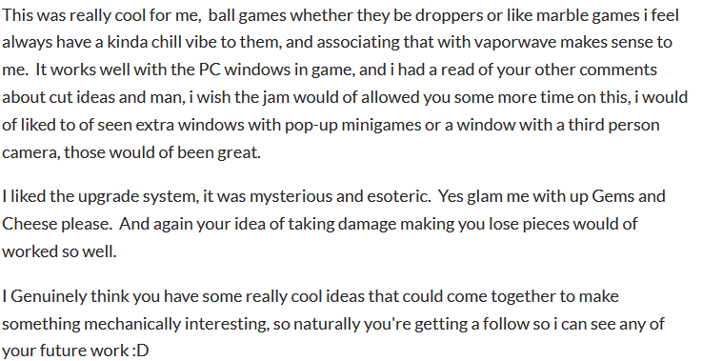
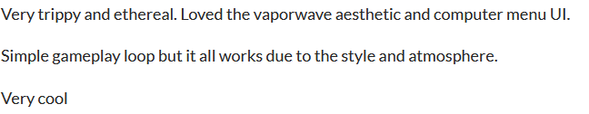
More feedback
Ball game works with vaporwave theme - agree
Extra features mentioned sound cool - agree
Upgrade system felt "esoteric" - not intended (or desired)
Intended damage mechanic sounds cool - agree
Trippy and ethereal - agree
Aesthetic and menu UI was cool - agree

Slide 4
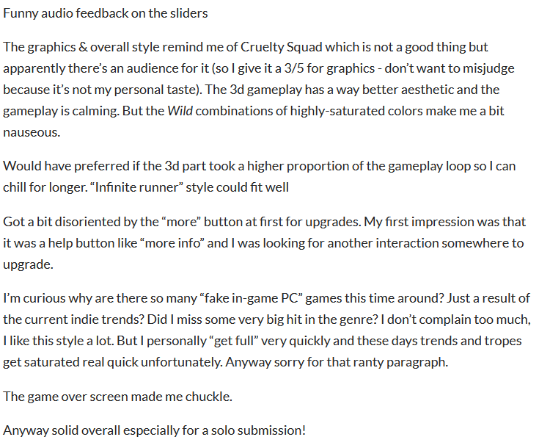
Even more feedback
Once again compared to Cruelty Squad - I find this most worrying
Highly-saturated colors - need to cut down on those
The falling part should last longer - fully agree
Upgrade system was confusing - agree

Slide 5
Last of feedback
Trippy experience - agree
Windows in-game were cool
Check-board room was confusing - yes, need to cut down that texture
Third person view would have been nice - agree
Feels like Minecraft dropper - yes, that was the intended experience

Slide 6
List of game features
"Animated intro" - simple, could be replaced by a more complex one
Window system - mostly fine, but minimizing was done outside, making it very scuffed, also need to figure out how to add more buttons, since I cannibalized the escape button as a tutorial button
Settings window - audio level adjustment works, needs to allow for key re-binding, could use a bit touch up
In game notification / progression system - needs a re-work, it's very scuffed and horrible
Core gameplay - works, but does not align well with the original vision
Time mechanic - source of a fail state, since I skipped the original damage system, needs to be cut out

Slide 7
Game features - continued
Player controls - basic, work
Level generation - basic, bland, repetitive - a tunnel with floors with 2 features - definitely needs improvement
Feature system - 3 items total, they work, but the goal was to have a large pool of items, and to have them themed
Loot collection system - basic, works
Music - got only 1 very long track, could use more variety, and better delivery
Wall textures - got a bunch, and they work, but they aren't very pretty (at least most of them)
Skill point system - ended up very flat, just unlock for items with no gameplay impact, but works, could use a re-work
Skill point spending system - works, but doesn't do much and the it's presented is quite confusing

Slide 8
Game features - last slide
Morphing system - feels weak, both visually and game-play wise
Part system - player can see the collected loot, presented as parts, works ok, but could be bugged in unexpected ways
Upgrade system - player can slap parts on to the main character, works, kinda hilarious, needs a re-work since it's very scuffed
Game balancing - basically non-existent, needs to be addressed once other re-works are done
Level selection system - terrible, very little choice, needs a re-work
Minimizing system - very scuffed, the logic needs to be placed into the Window code rather than outside

