Slide 1

Level design
What I want
References
How to make it
How to add variety

Slide 2
What I want
Tunnel through which player falls
Infinite level generation
Vaporwave vibes
Empty shopping center vibes
Driving through a dessert vibes
Random pre-scripted stuff that sometimes happens in the background

Slide 3
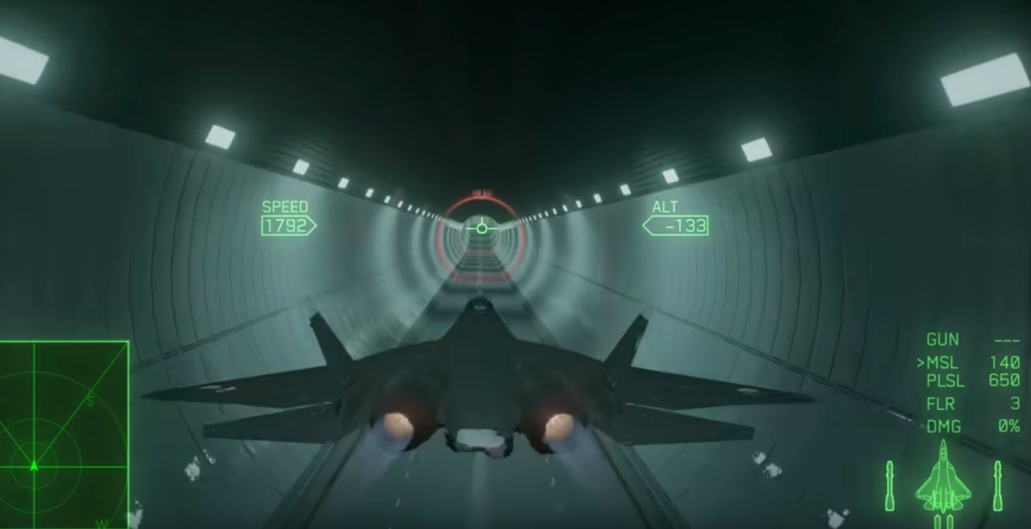
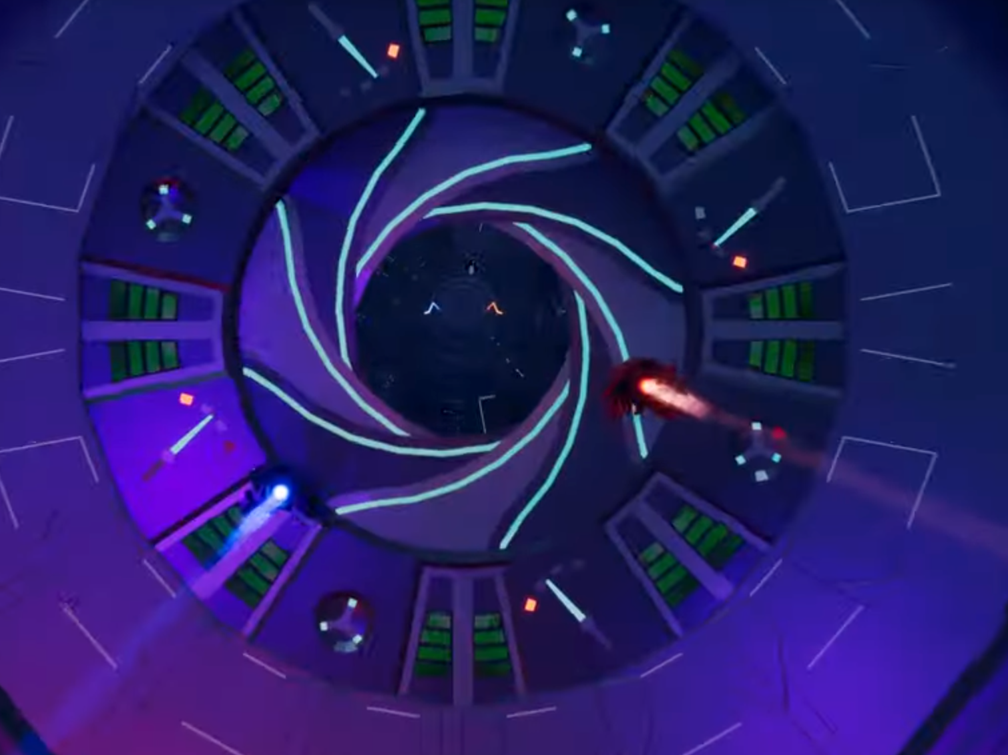
References
This shot of a plane flying though a tunnel is a good representation of what I want
So is this shot taken from an Aaero2 trailer.

Slide 4
How to make it
Design by hand - loads of work, me no like
Wave Function Collapse (WFC) - loads of initial work and investment, but once setup it could make infinite levels
Bit of both - what I like most right now, make sections, and stitch them together using WFC

Slide 5
How to add variety
Preferably via a feature system
Spread out features appropriate to a given "biome"
Using a second pass WFC system (where the first pass is generating the walls of the tunnel

Slide 6
Level flow
I want the game to have a constant flow most of the time
But I also want the game to stop sometime, because of pit stops or events
Special stopping areas could be added that are visible but mostly see through
Kinda like a web that catches the player, but only for a set period of time
A railway crossing of sorts

Slide 7
Update – 10 February
I got WFC working, which is very cool
I got to figure out what to do with long tunnels made out of 4x2 tiles, each wall of the tunnel 4 tiles wide
I also need to figure out how to connect segments
Also need to make segments

Slide 8
Ideas
Feature idea – wall of ice, the player either breaks the ice and goes through, or stops on the ice, which then slowly cracks and shatters after a brief pause

Slide 9
More ideas
Train x-ing – the player is stopped in a force filed of sorts while stuff happens in front. Once stuff ends falling resumes.

Slide 10
Super Market Alley
Shelves on both sides with products
Lamps on top
Floor on bottom – possible checker pattern
Cardboard “sale” signs spread out next to shelves
Shopping trolleys on floor / in the way

