Slide 1
CpG Island Finder
Gray Gwizdz
Sean Fisk

Slide 2

Download
Windows / Mac OS X
tinyurl.com/cpgislands

Slide 3

CpG Islands
CpG islands are portions of genomes that contain a high frequency of CpG sites
CpG islands are present in the promoter regions of approximately 40% of mammalian genes
Main factors in determining CpG islands are window length, GC ratio and observed to expected ratio

Slide 4
Example: Finding CpG islands
Window Length: 5 bases
GC Ratio: 0.5
Observed to expected: 0.6
Sequence: ATCGCAGCTGCAGC

Slide 5
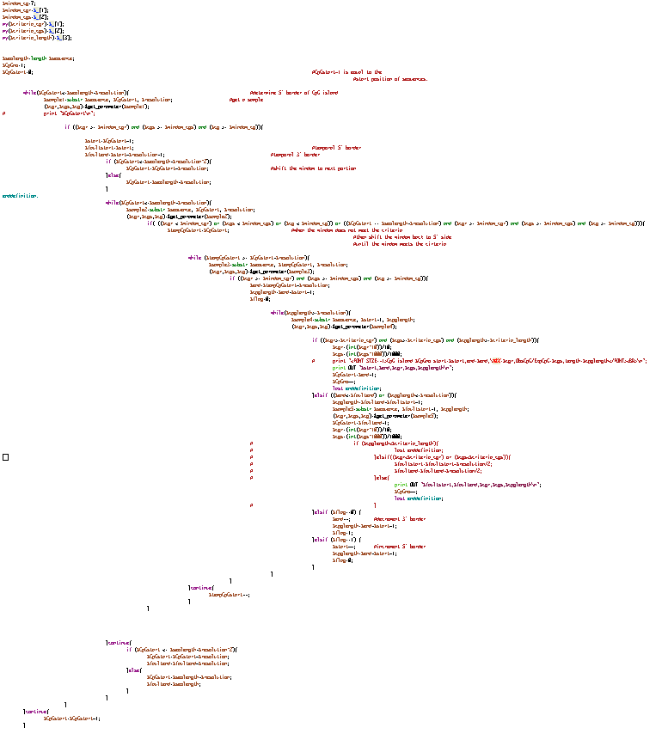
Algorithm
Sequence Manipulation Suite 2 (SMS2)
European Molecular Biology Open Software Suite (EMBOSS)
Takai-Jones Perl script

Slide 6
Implementing Best Practices
Test-Driven Development
Presenter-First
Minimal code
Maintainable code
Reliable results
Continuous integration
Separation of responsibilities
Maintainable code
Flexibility
CLEAN CODE!

Slide 7
Tools
Python
Other
Biopython
PySide
pytest
flake8
Sphinx
Qt
git
GitHub
Travis-CI
Read the Docs

Slide 8

Demo Time

Slide 9
Questions?

