Slide 1

Feature Comparison Demo for SAP & ZOHO

Slide 2
Naming nomenclature in the ZOHO context
LEAD = Unexplored Opportunity
POTENTIAL = Genuine Sales Opportunity
ACCOUNT = Company E.g. J&J Account
CONTACT = Point of Contact within the company

Slide 3
Customer lifecycle in ZOHO CRM
Leads
They are *new* sales opportunities gathered via various methods like cold calls, directories, trade Shows etc but not acted upon
Contact
A Contact & Account gets generated when LEAD becomes a POTENTIAL
LEAD becomes POTENTIAL once he is contacted and a genuine sales opportunity is identified.
Potentials
Account
Repeat Customer or repeat order process starts from POTENTIAL
POTENTIAL becomes CUSTOMER once it is indicated in the system that a “customer is won”
Customer
LEAD = Unexplored Opportunity
POTENTIAL = Genuine Sales Opportunity
ACCOUNT = COMPANY
CONTACT = Point of Contact within the Co.

Slide 4
SAP
 | Merits | Demerits
SAP | The inquiry module will be integrated with SAP. All historical data can be brought forward when dealing with a repeat customer. With a new customer there is no advantage as such. Reports that range from customer acquisition upto billing can be made. It is free since it’s a development within SAP, but to the extent that all users who use this module are “professional Users”. | No Mobile Access No built in analytics or dashboards Is not a true CRM solution. Professional Users costs : Out of the 5 users, 3 users are professional. Consider 1 View only license We will have to procure 3 more licenses. ( i.e. 3 X 75000 = 225000/- & 20% AMC – 45,000 per year) = Singapore requirement : 2 licenses ( 150000 + 30K AMC)

Slide 5
ZOHO CRM
 | Merits | Demerits
ZOHO | ZOHO CRM is an end to end CRM solution and can be used up to Proforma Invoice which is presently done in Excel There is a completely free version up to 10 users with limitations like no additional fields can be created Products cannot be added Quotations cannot be made Proforma invoice cannot be made. Custom reports and Dashboards not possible Is user friendly and can be used on the smartphone as a app. Can be extended to other divisions on the fly Built in Dashboards and analytics | No direct interface with SAP. There is a work around for existing customers by adding SAP customer code in ZOHO and taking reports but is an offline process. No internal developer resource. The present version is configured by me. The support if required from ZOHO Corp is not considered right now. To make it relevant for our business (i.e. add new fields and add products) we need to go for the professional version which costs Rs 1200/- (non-negotiated) per user per month. User : Entry Users = 5 View Users = 1 Singapore Users = 2 ( 1 entry and 1 view) Therefore 8 X 1200 X 12= 115200/- per year

Slide 6
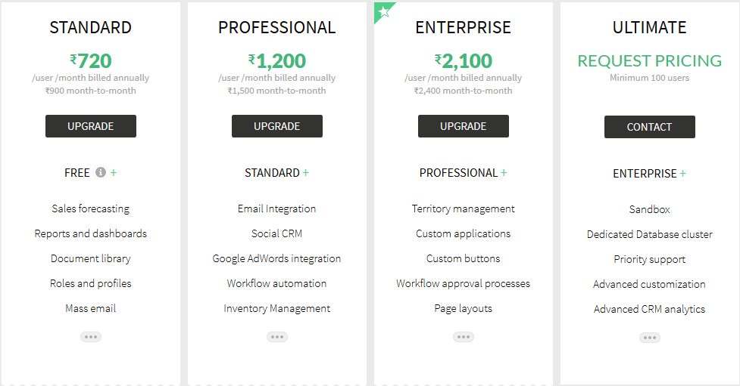
PAID CRM Version

Slide 7
Thank You

