Slide 1
IDP Project 2016-17 Finding Fatty Alcohol derivatives
Fatty alcohol ethoxylates (FAE)
By Mr. Anandrao, Rajan, Pratik

Slide 2
Content
SR NO | TOPIC | PAGE NO
0 | Study Objective | 3
1 | Basics of Alcohol Ethoxylates | 4
2 | Uses of Alcohol Ethoxylates | 6
3 | Market size: Surfactant & Alcohol Ethoxylates | 8
4 | Per Capita Consumption | 12
5 | Market Players | 13
6 | Recent & Planned Downstream Investment | 16
7 | Value Chain | 17
8 | Technology | 19
9 | Opportunity for VVF | 23
10 | Capability gap analysis | 24
11 | Conclusions | 25
12 | Learning's from the Project | 26

Slide 3
0) Study objective
Finding of Value added alcohol derivatives and to recommend two products for implementation.
This study will help participants & provide----
Exposure to alcohol derivatives market.
Familiarization of fatty alcohols and oleo chemical language.
Manufacturing processes.
Developing business case.
Project/ product costing.
Toll processors information.

Slide 4
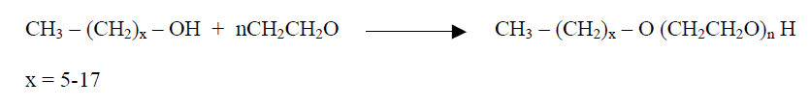
1) Basics of Alcohol Ethoxylates
Ethoxylates are Non ionic surfactant (The term non-ionic surfactant will be defined in next slide)
Alcohol Ethoxylates are produced by reaction called “Ethoxylation”.
This is a chemical reaction in which Ethylene oxide reacts with Fatty Alcohol in presence of catalyst & heat.
Alcohol ethoxlates are Surfactants and directly used in Detergent formulation or often converted to related species called ethoxysulfates by reacting with Sulphur trioxide.
Chemical Reaction:

Slide 5
1) Basics of Alcohol Ethoxylates Contd…
Surfactants ??
Classification:
(1) Anionics : In these surfactants the hydrophilic group is negatively charged. They are the most widely used type of surfactants for laundering, dishwashing liquids and shampoos. They are particularly good at keeping the dirt, once dislodged, away from fabrics.
Four anionic surfactants are used:
a) alkylbenzene sulfonates (b) alkyl sulfates (c) alkyl ether sulfates (d) soaps
(2) Cationics: With these surfactants, the hydrophilic head is positively charged.
Although they are produced in much smaller quantities than the anionics, there are several types, each used for a specific purpose.
(a) Mono alkyl quaternary systems (b) Esterquats
(3) Nonionics: These surfactants do not bear an electrical charge and are often used together with anionic surfactants. An advantage is that they do not interact with calcium and magnesium ions in hard water.
They account for nearly 50% of surfactant production (excluding soap). The major group of nonionics are the ethoxylates made by condensing long chain alcohols with ethylene oxide to form ethers.
(4) Amphoterics: Amphoteric (or zwitterionic) surfactants are so called because the head-group carries both a negative and positive charge. A range of methods is used to produce such materials, almost all of which contain a quaternary ammonium ion (a cation). The negatively charged group can be carboxylate, -CO₂⁻, sulfate, -OSO₃⁻ or sulfonate, -SO₃⁻. One such well-used class is the alkyl betaines which have a carboxyl group. A long-chain carboxylic acid reacts with a diamine to form a tertiary amine. On further reaction with sodium chloroethanoate, a quaternary salt is formed.

Slide 6
2) Uses of Alcohol Ethoxylates
Ethoxylates are basically used as Non ionic surfactant
Normal use levels: 1- 6% in most detergent formulations
Ethoxylates are used for making Anionic surfactants like Sodium Laureth Sulphate.
Ethoxylates are used as thickener in cosmetic surfactant preparations like shampoos, shower preparations and foam baths.
Ethoxylates are used in various cosmetics and toiletries such as conditioners, bath oils, creams, lotions, and shaving products. Builds good viscosity, structures in surfactant solutions in combination with sodium chloride.
They provide moderate, stable foam and high detergency for use in laundry products, consumer and hard surface cleaners.

Slide 7
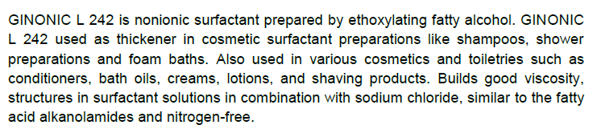
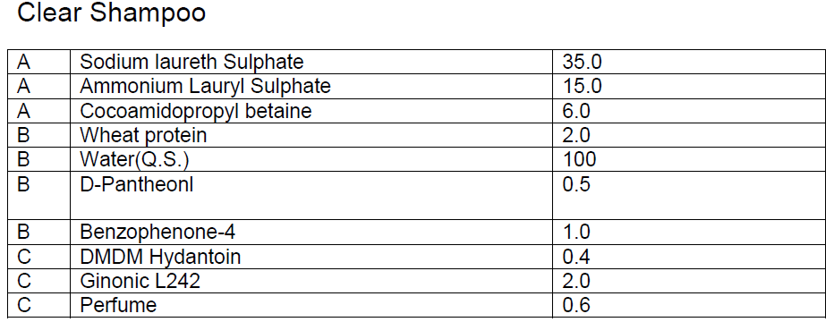
2) Uses of Alcohol Ethoxylates Contd…
Typical formulation where Alcohol Ethoxylates are used as Non ionic surfactant
Godrej Industries makes “GINONIC L242” and uses in below formulation:-
%

Slide 8
3) Market Size of Alcohol Ethoxylates
Today, more than 6 million metric tons per year of nonionic surfactants are produced worldwide by some over 200 different ethoxylators.
The annual growth of ethoxylates varies around the different regions in the world reaching yearly growths up to 4 to 5 %.
Overall worldwide growth is in the region of 2 %.
The global alcohol ethoxylate market was valued at $5,124.8 million in 2014 and is projected to grow at a CAGR of 3.5% during the forecast period from 2014 to 2019.
The market, by application, was led by the house hold and personal care segment in 2014, with a 49.6% share. Europe is a key market for alcohol ethoxylate.

Slide 9
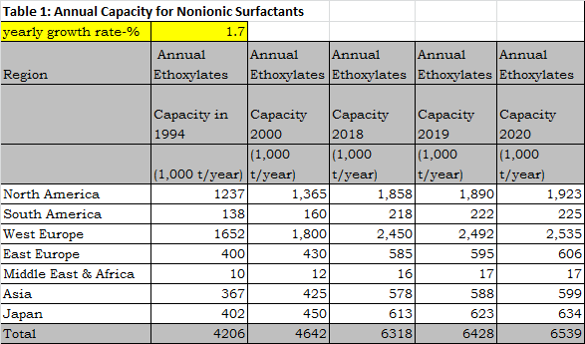
3) Market Size of Alcohol Ethoxylates Contd…
Region wise
The current demand for non-ionic ethoxylates in Asia region is about 5,78,000 MT per annum.

Slide 10
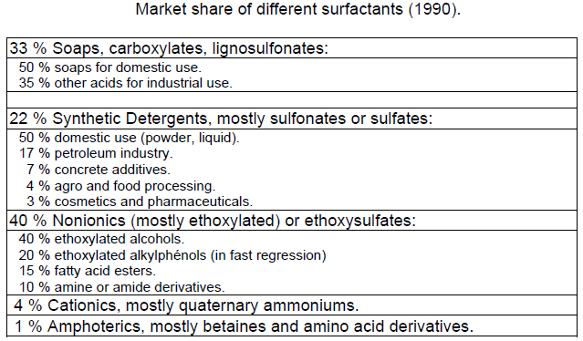
3) Market Size of Alcohol Ethoxylates Contd..
During the last 35 years, nonionic surfactants have increased their market share, to reach about 40 % of the total surfactant production worldwide.

Slide 11
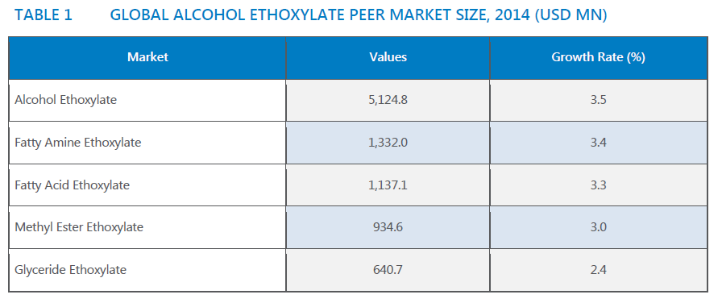
3) Market Size of Alcohol Ethoxylates Contd..

Slide 12
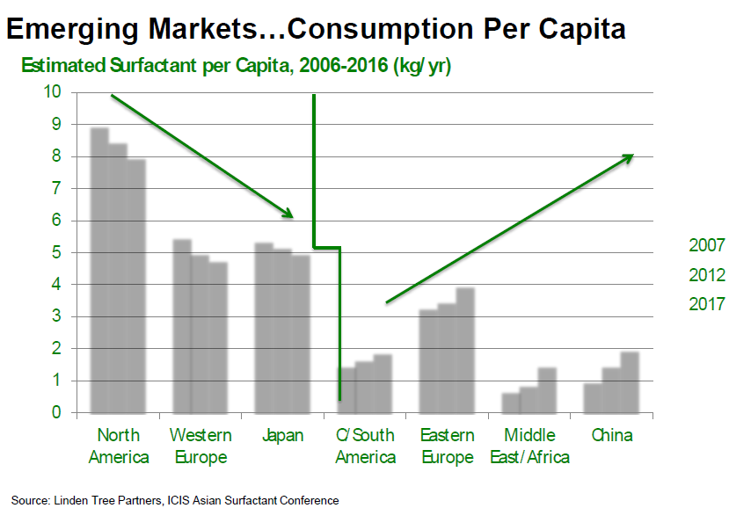
4) Per Capita consumption

Slide 13
5) Market Players
GLOBAL:
1) BASF SE (Germany),
2) Huntsman Corporation (U.S.)
3) Clariant AG (Switzerland)
4) Stepan Company (Illinois)
5) Shell Chemicals (Netherlands)
6) Sasol Ltd (South Africa)
7) Ineos Group (Switzerland)
8) India Glycols (India)
9) The Dow Chemical Company (U.S.)
INDIAN:
Rimpro India
VENUS Goa
Galaxy surfactants
Core chemicals
Saibaba surfactants
Aarti surfactants
Unitop chemicals

Slide 14
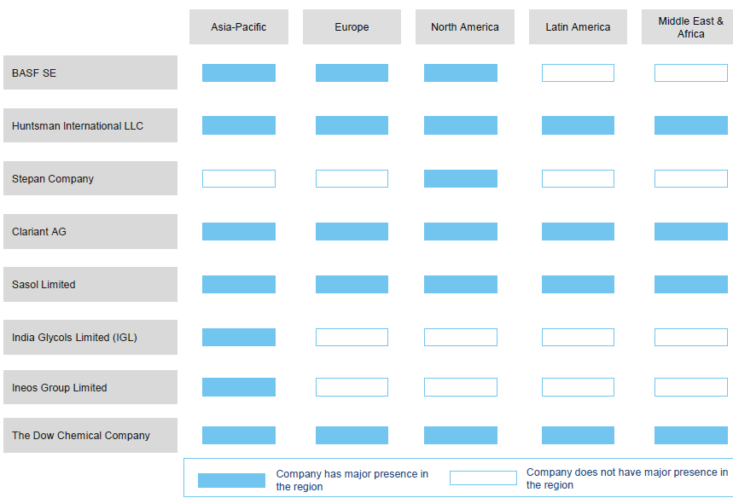
5) Market Players Contd…
Geography wise presence

Slide 15
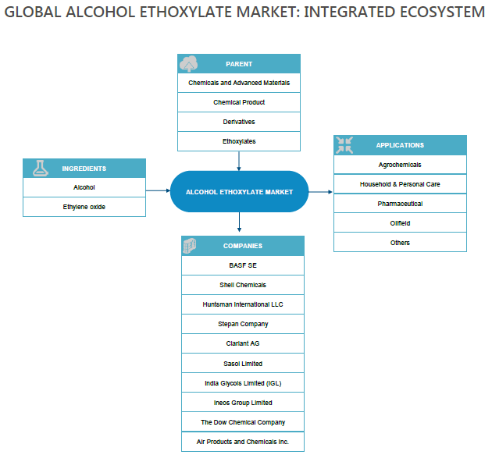
5) Market Players Contd…

Slide 16
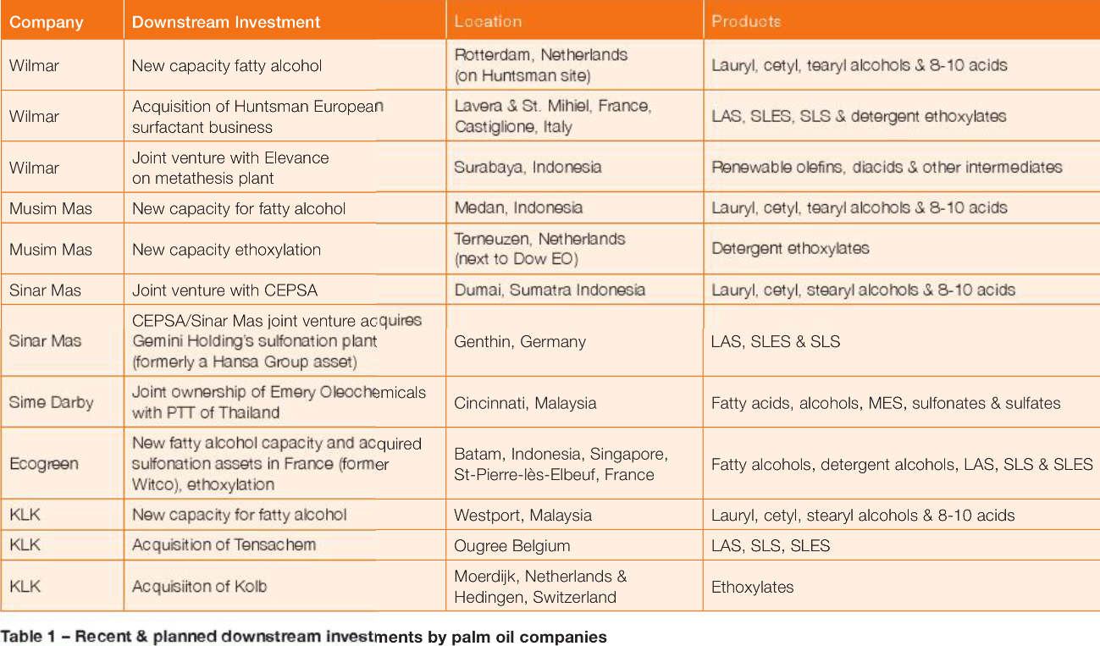
6) Recent & Planned Downstream Investment in FAEs

Slide 17
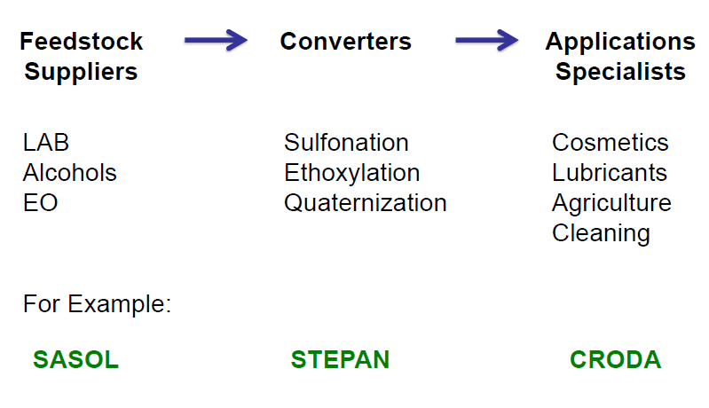
7) Value Chain

Slide 18
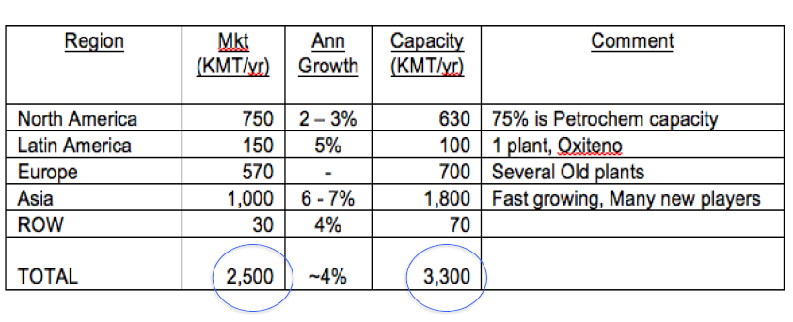
7.1) Fatty Alcohol Market Snapshot
There is excess capacity of Fatty Alcohol worldwide, this favors converting it into Fatty Alcohol Ethoxylates/end use chemicals

Slide 19
8) Technology
Many plants have been designed and operated on a batch system with various stirring systems and recirculation loops since the early 1950s but the latest thinking for bulk production is probably the plants that Davy Process Technology has developed for alkoxylation. This is Buss Loop Reactor technology.
At least 10 plants of its design have been put into beneficial operation since they were first introduced in 1990 and are based on the Buss Loop Reactor technology.
Technologies:-
Batch system
Batch/Continuous system

Slide 20
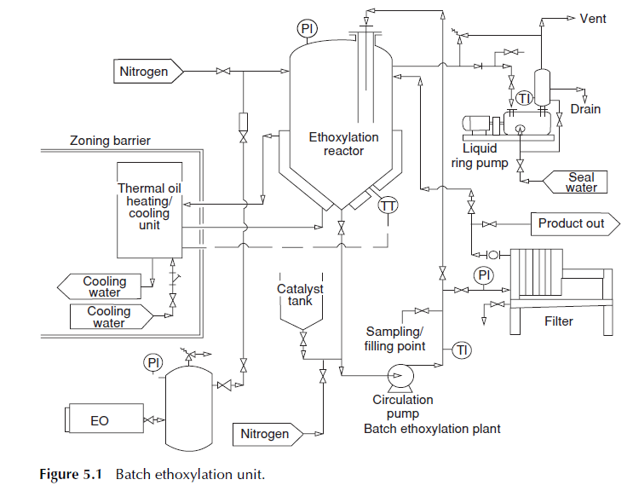
8) Technology Contd…
1. Batch system

Slide 21
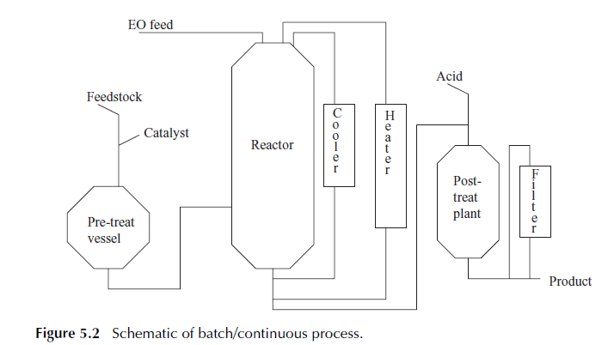
8) Technology Contd…
2. Batch/Continuous system

Slide 22
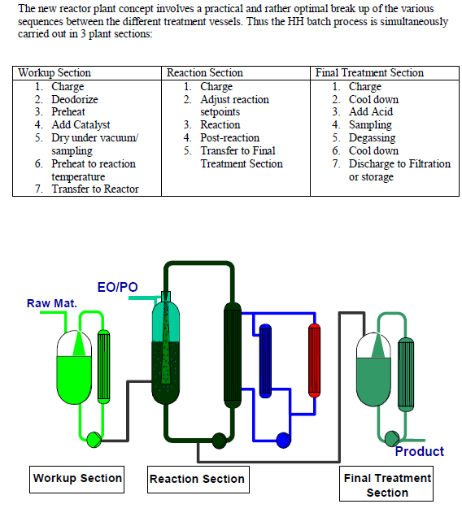
8) Technology Contd…

Slide 23
9) Opportunity for VVF
Global demand for FAE’s in 2018 would be about 6,318,000 MT/year.
If VVF targets 0.5% market share, the opportunity would be about 31590 MT/year
At present VVF toll manufacturers FAE’s about 6000 MT/year and markets the same.
So, 25590 MT/year FAE’s potential is available.

Slide 24
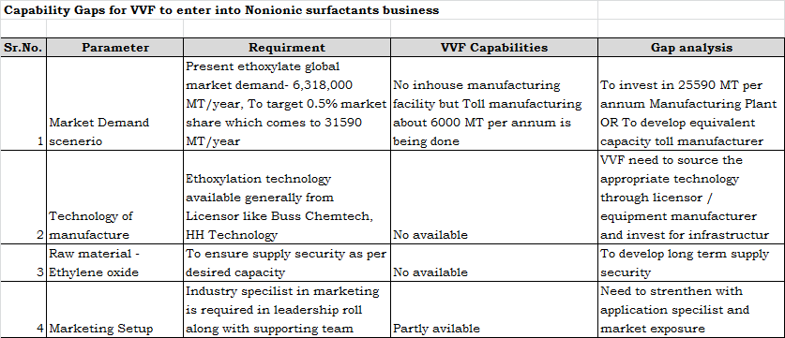
10) Capability Gaps analysis

Slide 25
11) Conclusions
FAE can continue to support VVF through increased Tolling or new plant infrastructure
On global scenerio, companies like Wilmar, KLK, Musim mas are integrating vertically and investing into downstream processing capacity .
For fatty alcohol ethoxylation, the concern will be securing EO supply on longterm basis.

Slide 26
12) Learning's from Project
Fatty alcohol ethoxylate market insight & global players
The learning about technology
Capability gap analysis

Slide 27
Thank you
References:
1. Chemistry & technology of surfactants – Richard J. Farm (Consultant and former Director of the British Association for Chemical Specialities)
2. New alkoxylation technologies- Urs Geser & Rich Malone (HH Technology corp USA)
3. http://www.prnewswire.com/news-releases/surfactants-market-type--substrate-to-hit-54-cagr-to-2021-led-by-non-ionic-surfactants-597553151.html
4. The Changing face of the surfactant supply chain- Neil A. Burns. (www.specchemonline.com)

