Slide 1
VVF (India) Limited Bacter Shield IDP
Team Lead – Jaijee
Team Members – Amit, Subrata, Rajesh, Vishal, Luis & Bijendra.
Notes:
Change logo (top right) and page number (bottom right) placement across.

Slide 2
TASK
Develop a improved Bacter Shield Soap
Develop a soap which has better sensorials (all aspects)
LB benchmarked for performance
Identify possible extensions going forward
Reponsibility
Bijendra/Rajesh – SKU size, MRPs, variants, schemes, offers, product samples & all other in market data from GT/chemist/MTO.
Luis/ Vishal – secondary data for sales data like Nielsen, data available on net, etc
Jaijee – advertising spends, TV/print ads, ad claims.
Amit – Formulation checks
Subrata – indicate costs (if we have something similar)

Slide 3
PART 1 – Soap development
Product developed & tested among consumers.
Developed product passes in sensorials & have been finalised.
Packaging development completed.
Commercial production to be taken in March 2017.

Slide 4

PART 2– New Category Identification
Scan done to identify all possible extensions for the brand.
The identified products grouped as under
Face
Shaving Foam, shaving round,
anti-acne cream
Body
Shower Gel, Perfumes, Deos, Roll On, Wipes, liquid, powder
Hand & Foot
Anti-crack, band-aid
Mouth
Washes, tooth paste, ulcer pastes
Head
Anti-dandruff shampoo
Institution & House holds
Anti-septic liquid, surface cleaner, glass cleaner, floor cleaners

Slide 5
ANTISEPTIC LIQUID
Source : www.slideshare.net/Arunkhedwal/1-market-research

Slide 6
SUTHOL Antiseptic Skin Liquid
Suthol, which was launched in 2003, is fast gaining traction, and now accounts for about 30% of Co’s Total revenue of 150Cr.
Suthol sales are growing 20% year-on-year.
65% of the Co’s revenue comes from out of West Bengal.
Suthol comes in 4 Variants – Natural, Chandan, Fresh and Plus. 100ml Pack size.
Suthol Antiseptic Skin Liquid is a smarter way to fight against Prickly Heat, Itches and Skin Rashes. Being liquid Suthol penetrates deep within skin carrying its healing and protective ingredients to provide with the best protection and relief against skin problem. First of its kind in liquid form in liquid form.
Source The Mint Oct13 2016

Slide 7
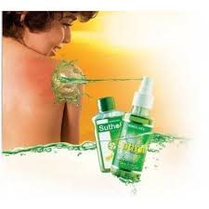
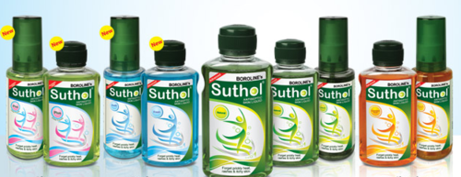
Antiseptic Liquids - Suthol
Available in three variant :- Natural, Fresh, Plus and Chandan ( Natural is the lead variant)
Available in following Packs Size and MRP :-
100ml :- Rs 33/-
100ml Spray :- Rs 45/-
200ml (only in Natural Varient) :- Rs 60/-
Source :General trade and online stores

Slide 8
Dettol Antiseptic Liquid.
Dettol liquid hold almost 86% of the 200+Cr antiseptic liquid market share. (Reckitt Benckiser)
Postioned as a “100% germ fighter”. Tagline – “Be 100% Sure”. Campaign – “Banega Swachh India”
Available in 60ml, 110ml, 200ml, 500ml & 5Ltrs. Scents – Pine.
Used for First Aid, Personal Hygiene, Household cleaning and laundry. Anti-bacterial segment – has become an inevitable parts of Hospitals and Clinics extra hygiene. Target Consumers – entire section of consumers, irrespective of their age. Has become part of lifestyle – be it cuts or wounds or daily household use.

Slide 9
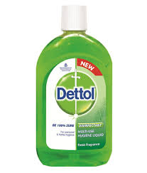
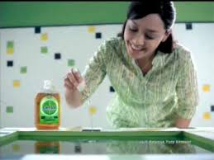
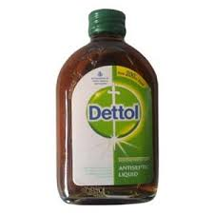
Antiseptic Liquids - Dettol
Available in Glass and Plastic bottel :- Original is the lead the variant)
Available in following Packs Size and MRP :-
60ml :- Rs 22/-
110ml Spray :- Rs 33/-
200ml :- Rs 58/-
500ml :- Rs 129/-
Source :General trade and online stores

Slide 10
SAVLON - Antiseptic Liquid.
Savlon liquid hold 8% of the 200+Cr antiseptic liquid market share. This brand has be bought by ITC from Johnson.
Postioned as a “An antiseptic that does not hurt while healing”.
Available in 50ml, 100ml, 500ml,1000ml.
Clinically proven to be effective germ killer. Better scent and non-stinging properties.
Popular in institutional market, Tie-ups with hospitals, clinics, sports clubs etc.

Slide 11
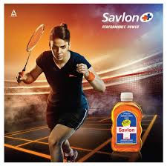
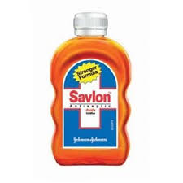
Antiseptic Liquids - Savlon
Available in Plastic bottel
Available in following Packs Size and MRP :-
50ml :- Rs 17/-
100ml Spray :- Rs 30/-
200ml :- Rs 58/-
500ml :- Rs 118/-
Source :General trade and online stores

Slide 12
Brand Spends
Category | Brands | TV | Print | Radio | Total Spends | SOE%
Antiseptic Creams/liquids | Dettol Antiseptic Liquid | 2075 |  |  | 2075 | 35
 | Savlon Antiseptic Liquid | 1900 |  |  | 1900 | 32
 | Heal O Kind Nanofine Gel | 276 | 448 |  | 725 | 12
 | Suthol | 517 |  |  | 517 | 9
 | Boroline Ultra Smooth | 306 |  |  | 306 | 5
 | Boroplus | 118 | 181 |  | 299 | 5
 | Boroline |  | 11 |  | 11 | 0
 | Vi-john Boro Shield |  | 8 |  | 8 | 0
 | Lookmane Hayat Tel |  | 6 |  | 6 | 0
Category Total |  | 5208 | 660 |  | 5868 | 100
Spends Jan to Oct 2016. Rs in Crs – source TAM

Slide 13
PRICKLY HEAT POWDER
http://www.business-standard.com/article/management/prickly-competition-to-beat-the-heat-110053100061_1.html

Slide 14
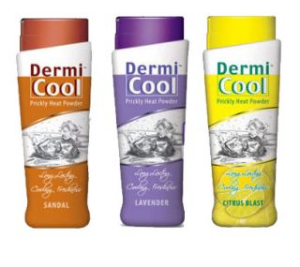

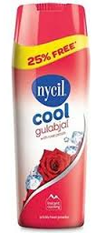
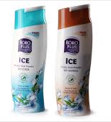
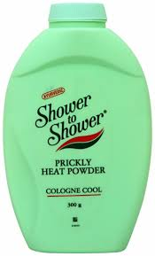
Prickly Heat Powder
Products | Available Sizes | Variant | MRP
Nycil | 150g + 25% Free | Classic, Cool Herbal, | 82
Dermi Cool | 150g | Regular, Sandal, Lavendar | 84
Boro Plus | 150g | Ice Cool | 77
Shower to Shower | 150g | Classic and Sandal | 82
Hula Hula | 150g | Lavender | 199
Source :General trade and online stores

Slide 15
Nycil – (Heinz)
Nycil is the leader in the prickly heat category with almost 37% market share.
Tagline - India ka no. 1 Ghamorinaashak powder
USP Provides a cooling effect removing irritation
Available variant in Cool Classic Methol, Cool Chandan, Lavender, Nycil Classic, Cool Gulabjal, Cool Herbal & Nycil Sandal.
Available in 400gms and 150gm at MRP 140/- & 82/- respectively.
Seasonal products. Absorbs heat, Soothing relief to skin keeping it dry, antibacterial and anti fungal agent.

Slide 16
Dermicool
Dermicool holds almost 30% of market share in the prickly heat category.
Tagline - Aaya mausam thande thande Dermicool ka, Ghamoriyaan chhoomantar
USP Dual action – Bacteriostatic formula plus cooling effect
Available variant in Sandal, Regular, Citrus blast and Lavender.
Available in 150gm at MRP Rs 84/-.
Its Bacteriostatic Formula cures prickly heat while cooling properties provide instant relief from burning discomfort.

Slide 17
Boroplus Ice Cool
Boroplus holds almost 23% market share in the prickly heat category.
Covers distributions with 28 depots across India with 2500+ distributors.
Advt & Promotional budget of 10+ Cr of Boroplus Ice.
Tagline All iz well
USP - 5 power formula keeps the skin healthy and active even during pricking summer at the same time giving a lingering Icy Cool touch.
www.scribd.com/doc/57296543/Marketing-Research-on-boric-Heat-powder-dermicool.

Slide 18
Brand Spends
Category | Brands | TV | Print | Radio | Total Spends | SOE%
Prickly Heat Powders/lotions | Dermi Cool | 20.1 |  | 0.8 | 20.9 | 57
 | Nycil Cool | 10.3 |  |  | 10.3 | 28
 | Boroplus Ice | 0.70 | 4.3 |  | 5.1 | 14
 | Tulsi Ayurvedic Cool Talc |  | 0.4 |  | 0.4
Category Total |  | 31.1 | 4.7 | 0.8 | 36.6 | 100
Spends Jan to Oct 2016. Rs in Crs – source TAM

Slide 19
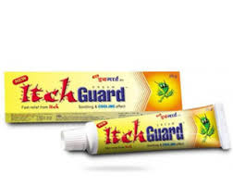
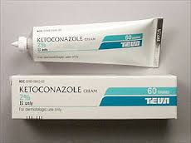
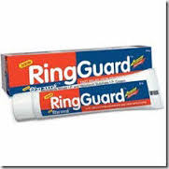
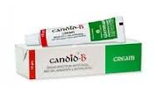
Anti-itch cream
Products | Available Sizes | MRP
Itch guard Cream | 15g | 50
Itch guard Cream | 25gm | 64
Ring Gurad | 20g | 66
Candid | 10g | 72
Ketoconazole | 30g | 174
Source :General trade and online stores

Slide 20
Brand Spends
Category | Brands | TV | Print | Radio | Total Spends | SOE%
Medicated Skin Treatment | Itch Guard Cream | 17.4 |  |  | 17.3 | 15
 | Ring Guard Cream | 14.9 |  |  | 14.9 | 13
 | V Wash Plus | 8.6 | 5.3 |  | 13.9 | 12
 | Candid Dusting Powder | 10.7 |  |  | 10.7 | 9
 | Zalim Lotion |  | 10.5 |  | 10.5 | 9
 | Krack Heel Repair Cream | 9.6 |  |  | 9.6 | 8
 | B Tex Malam | 1.7 | 6.2 |  | 7.8 | 7
 | Kailash Jeevan Ayurvedic Cream | 0.2 | 7.3 |  | 7.5 | 6
 | Clean And Dry | 4.5 |  |  | 4.5 | 4
 | B Tex Super | 0.8 | 2.2 | 0.1 | 2.9 | 2
Category Total |  | 76.1 | 41.9 | 0.1 | 118.1 | 100
Spends Jan to Oct 2016. Rs in Crs – source TAM

Slide 21
STATUS – Extensions
Categories identified as potential extensions
Anti-septic liquid – Suthol type.
Prickly heat powder – Nycil, Boroplus & Dermicool
Anti-itch cream/spray – Itch guard, Candid, Ring Guard, KZ.

Slide 22
Costings
BACTERSHIELD | Anti-itch cream | Anti-septic liquid | Prickly Heat Powder
MRP* | 50.00 | 33.00 | 80.00
GM/ML | 20 | 100 | 150
Total COGs / MT | 2,11,750 | 1,17,362 | 1,77,031
Ex- Plant Baddi | 3,25,250 | 1,46,501 | 2,23,697
Realisation | 8,88,000 | 1,81,600 | 3,71,500
Gross Cont | 5,62,750 | 35,099 | 1,47,803
% | 63.4% | 19.3% | 39.8%
Anti-itch cream is treated as an OTC product & hence the margins are 10% (distributor) & 20% (retail).
Trade Margins in powder & anti-septic liquid taken at 6% (distributor) & 10% (retail).
Scheme is inbuilt in the pricing @ 100% for anti-itch, @35% Anti-septic liquid & 60% for powder.

Slide 23

Thank you.
Thank You!

