Slide 1
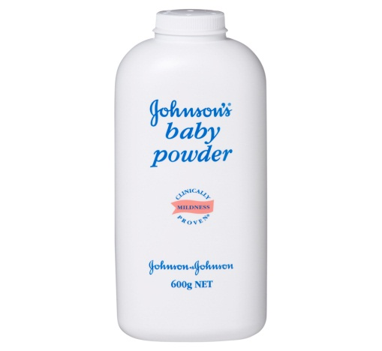

Quality Control. Project Owner CMB Head
J and J Talcum Powder reported without fragrance.
Routine cross examine of talcum powder # BV60195,dated 17/03/2016 found no fragrance.
Inform to Baddi Olfactory team, material already dispatched.
Asked for control sample , control sample found Acceptable.
Both the samples “control” and “routine test sample” shown to CMB Head Mr. Pratyaya Chakrabarti and Mr. Sunil Sing

Slide 2
Quality Control. Project Owner Baddi team
PKFAD consignment reported failure in olfactory specification.
Routine cross examine of PKFAD, dated 23/05/2016 found charred note.
Total quantity received at different interval of Time 48+28+42 mt.
Inform to Baddi Olfactory team.
Baddi team confirm that this material is from new supplier
& finely they stop the purchase from the same.

Slide 3
Quality Control. Project Owner Baddi team
Vitawon W noodles batches reported failure in olfactory specification.
Routine cross examine of Vitawon w ,dated 25/11/16 found charred note.
Inform to baddi team.
B111600408 VITAVON W Total profile change observed— enhance charred note —Rejected.
B111600410 VITAVON W Total profile change observed—enhance charred note—Rejected.
B111600413 VITAVON M Total profile change observed—enhance charred note—Rejected.
B111600409 Translucent Partial change in profile observed. --- Just Acceptable.
B111600407 VITAVON W Partial change in profile observed. ---Just Acceptable.
B111600411 Translucent Partial change in profile observed. ---Just Acceptable.
Done the backward integration
DFA 1214 found main culprit , received from Taloja.

Slide 4
Quality Control. Project Owner Taloja team
DFA 1214 Odor optimization.
Different experimental online samples received from Taloja.
Timely communicated the odor profile with plant head and with QC department.
After some trial and error , promising odor profile observed in 1214.
Given both the ‘rejected” and “acceptable” odor profile 1214 to baddi team , for their odor assessment.
And hence issue resolve.

Slide 5
Conclusion
• PKFAD consignment reported failure in olfactory specification, Reported / action / correction.
Observed olfactory failure in different consignment , of Noodles backward integration and their optimization.
DFA 1214 Odor optimization.
J and J Talcum Powder reported without fragrance.

Slide 6



Thank
You!!!
30

