Slide 1
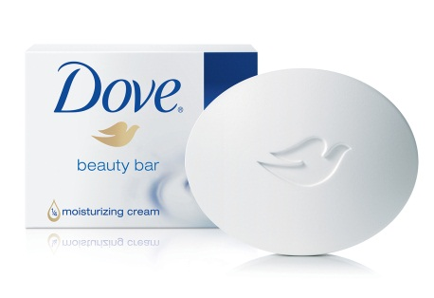

Achievements. Project Owner Ms. Delna
Cracking of Dove fragrance.
We failed 1st consumer trail against Dove by one side.
Before placing second consumer trail following steps taken.
Closely evaluated the bench mark DOVE, profile mapping and performance.
Communicated to each fragrance house in perfumery language.
Brief open to 4 fragrance house. IFF /GFL/Firminich /MANE
Given feedback after every submission. MANE has noted each point very silently,23rd modification comes out promising.
Closely evaluated the 23rd mod for, dry sniff-Bloom-retention with bench mark.
After doubly sure, place the option for consumer trial.
Not clearly won the battle against DOVE, but given very tough fight.
Started to close fine loopholes, expecting one side win.

