Slide 1
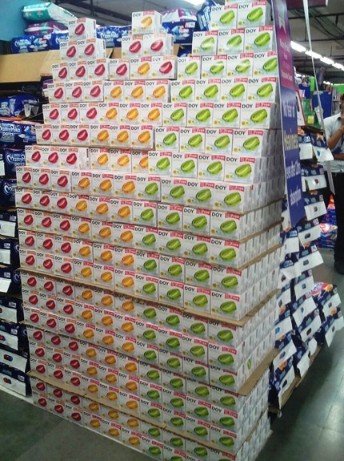
Activity –
“Sugar Free” Activity in Big Bazaar helps us to BUILD high volume and visibility in UP and Punjab stores
Big bazaar Lucknow

Slide 2
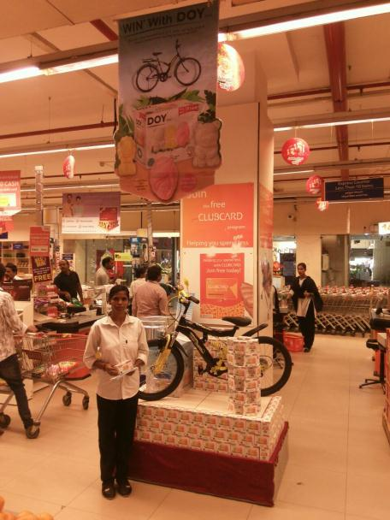
Activity –
Did a “Lucky Draw Contest in FIVE Star Bazaar “stores which help to generate huge unpaid visibility of Doy Kids
(All Sales Value in Rs. Laces)

