Slide 1
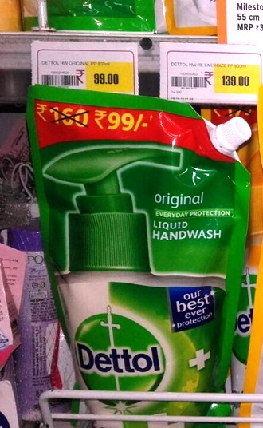
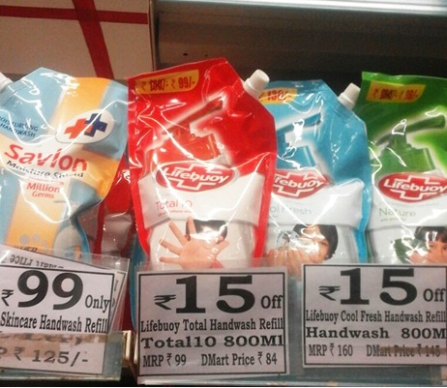
What didn't work well–
Lifebuoy & Dettol Hand Wash 800ml @ Rs 99/- in all the MTOs stores and Rs 84/- in D Mart stores

Slide 2
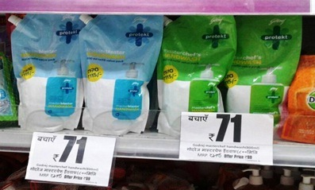
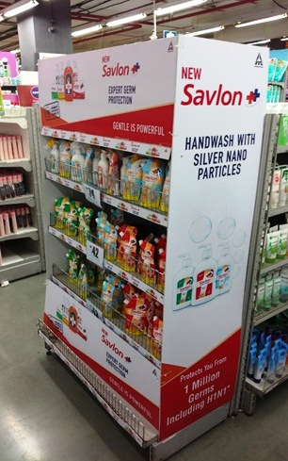
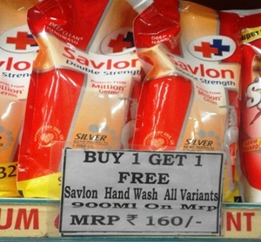
What didn't work well–
Godrej Protekt Hand Wash 800ml @ 99 in FB and @ 75 in D Mart stores
Savlon 900ml @ BOGO offer

Slide 3
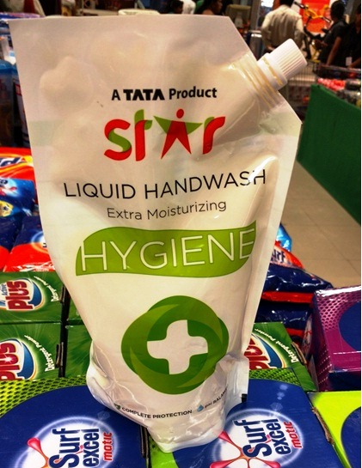
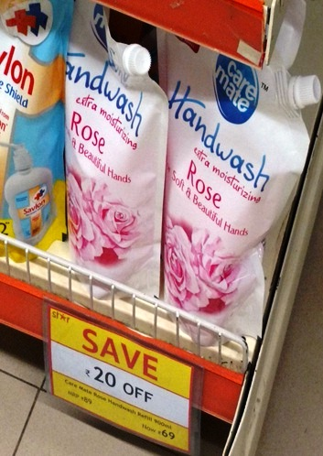
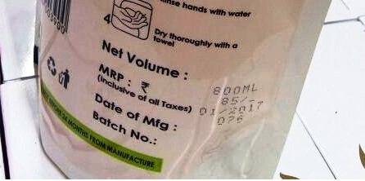
What didn't work well–

