Slide 1
Engineering Purchase …the way forward
Notes:
Change logo (top right) and page number (bottom right) placement across.

Slide 2
Content
Engineering Purchase – Scope – A perspective
What was done in past?
What have been done till now?
What are the critical issues need to addressed?
Best Practices
Management Support requirement

Slide 3
Engineering Purchase - Scope
1) Procurement of Material and Services for Oleo Chemical Business:
a) Raw Material (Except Oil procurement):
Polysorbate-60, Cetherate-20, Hydrated Lime, Liquid Nitrogen, Hydrogen
b) Packing Material:
Primary Packaging: HDPE Drum, HDPE Bags, Paper Bags, 5 Layer Poly
Bags, Flexitanks, Liners
Secondary & Tertiary Packaging: Wooden Pallets, Stretch Film, Labels,
Stickers
c) Catalyst & Support: Copper & Nickel Catalyst & Packing for Columns
d) Production consumables like Filters
e) Storage tank Cleaning Services and Consumables

Slide 4
Engineering Purchase - Scope
2) Indirect Procurement for VVF Group (Except Logistic)
Project & Capital Procurement (Equipment & Systems, Services)
MRO (Maintenance, Repair & Operation) item categories listed below (Partial list)

Slide 5
Engineering Purchase - Scope
3) Fuel Procurement for All Plants in India which includes Natural Gas, Coal, Petcoke and Furnace Oil
4) Information Technology Procurement for entire Group
4) Contract Management
5) Estimation support for new project proposal
6) Vendor development and new Sourcing support
7) Procurement in compliance with Kosher and Halal approval
8) Complying ISO requirement
9) Complying SOP and Delegation of Authority
10) Audit Compliance

Slide 6
Engineering Purchase - Scope
Past Procurement Value and line count (Material & Services) (Value in lakhs)
Current Material Master is having almost 1 lakh material code covering Engineering, Quality Control, R&D, Administration items
In last 4 years, we have placed order for 9619 nos material out of which 5799 nos materials are only ordered once having value of INR 42.4 Crores
Currently Service procurement is being done with Service code which is more complicated in terms variations is scope, location specific cost, level of service provider etc. (At least 25 informal Service Contract in place today)
Total 1200+ active vendors and still counting
Total more than 50+ internal customer to service and support

Slide 7
Engineering Purchase - Scope
Past Procurement Value and line count (buyer wise) (Value in lakhs)
Up to FY 14-15, 5 buyers were there as per above table plus additionally Mr. Varghese and Mr. Tushar were also there.
Average 15 items to be procured per person per day (Annual 11977 transactions between 4 buyers) which need to be followed by multiple deliveries

Slide 8
Engineering Purchase - Scope
Procurement Value for year 2016-17

Slide 9
What has been done till now?
Total Cost improvement worth INR 450 lakhs done in less than two years
Majority of the High value items are renegotiated and cost structures are in place
More than 50 alternate vendors are introduced for cost improvement, better services, reliable supplies etc.
Engineering Purchase which was earlier working under Project head is now separate commercial function. This calls for zero tolerance on service support otherwise Engineering Purchase is made accountable for project delay.
Taken over negotiation process from Engineering for less than INR 10 lakhs items
Taken over negotiation process and procurement process from IT team
Cash procurement at Plant level reduced drastically (No cash procurement more than INR 3000)
Systematic payment allocation process put in place which has improved vendor relationship (despite fund constraints)
Improved skill set of team members in SAP, Excel, Vendor and Internal Communication (Verbal & Written), cost estimation & Negotiations
Reduce number of advance instances & made open advance to zero
All PO back up (RFQ, Offers, QCS & Ordering basis) made available in SAP with access to team and Auditors, Pos are sent to vendor digitally only (Paperless office)
More than 15 cases of old advances resolved
Past procurement data (Material) of from 2005 onwards compiled in single file

Slide 10
Critical Issues, Constraints, Challenges
Service Level to the user need to be improved in terms of PR-PO conversion and timely delivery of the material / service
Vendor Selection need to be strengthen and Negotiation need to be Efficient
Non Existence of Service Code: Entire Service procurement is person (buyer) dependent where risk of error is very high, PO preparation and verification takes lot of time.
Bringing awareness / discipline in users for providing sufficient specification / scope details, not to procure material under service PRF, creating undue urgency,
Kosher and Halal Compliance by approved vendor / manufacturer: we don’t have approved vendor who are having Kosher / Halal approval for Polysorabte-60 and Cetereate-20.
Purchase Orders for RM-PM are very risky for us as material description doesn’t contain technical specification. This has been escalated but yet to be implemented.
To define A/B/C Category of vendors for developing various system around the same like timely payment, vendor rating / performance feedback and counter feedback etc which will ultimately result in improved vendor relationship
At Taloja certain rotating equipment are quite old (like compressor, Pumps) for which getting spares are difficult and costly
Supporting and Ensuring implementation of increasing various certification requirements like ISO-9001, 14000 & 22000.

Slide 11
Improvements to be done in SAP Process

Slide 12
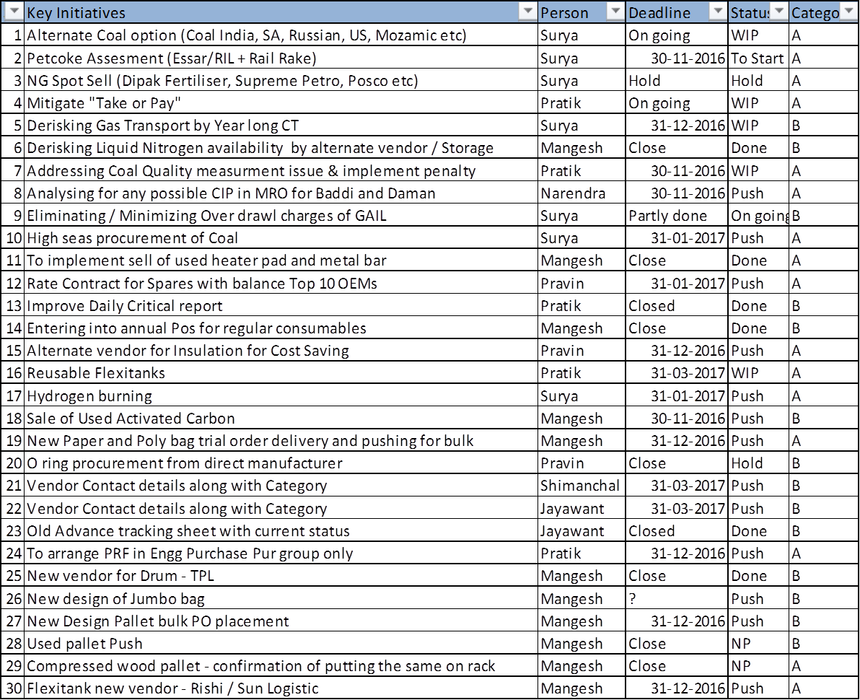
Partial list of Initiatives to be implemented

Slide 13
Best Practices
Fixing Rate Contract for most consuming Material and Service Category in put the same in system (Catalogue buying as available in ARIBA)
Based on Inventory level auto PO generation and transmission to vendor for rate contracted items
Formal system based approval of vendor selection based on QCS and justification before PO generation
Master Data Management System for Material, Services and Vendor

Slide 14
Support required from Management
1) Immediate:
Two additional buyer required permanently
(If very high value Project comes up particularly like Jammu project will required additional resources temporary)
Renaming of Department
2) Long term:
Investing in SRM (Supplier Relation Management) tools like ARIBA with Catalogue buying system etc.
Automation of manual process like Pre-PO vendor selection and price approval, new vendor approval, advance payment approval
To go for best practices

Slide 15
Thanks…!

